Slide 1
United States Department of Agriculture
Rural Development
Indiana

Slide 2

USDA Rural Development
Committed to helping improve the economy and quality of life in all of rural America
Through our programs and services, rural Americans can benefit from the same services enjoyed by people in suburban and urban areas while retaining the advantages of small town living.

Slide 3
USDA Rural Development
Business
Community Programs
Housing

Slide 4
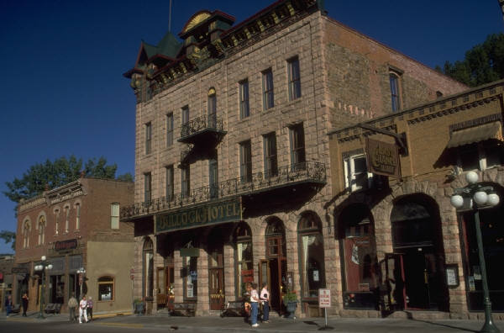
USDA Rural Development
Business Programs
F. Dean Edwards
Program Director
317-290-3100 Extension 427 dean.edwards@in.usda.gov

Slide 5
USDA Rural Development
Business Programs
Business & Industry (B&I) Guaranteed Loans
Rural Business Enterprise Grants (RBEG)
Rural Business Opportunity Grants (RBOG)
Rural Economic Development Loans/Grants (REDLG)
Rural Intermediary Relending Program (IRP)
Rural Energy for America Program (REAP)
Rural Cooperative Development Grants
Value Added Producers Grant

Slide 6
USDA Rural Development
Business Programs
Business & Industry (B&I) Guaranteed Loans
Lender Makes Loan
Comes To Rural Development For Guarantee
Most Banks Are Eligible - State or Federal Chartered
Most Types Of Businesses Are Eligible
Percentage of guarantee is 80% - loans less than $5 million

Slide 7
USDA Rural Development
Business Programs
Rural Business Enterprise Grants (RBEG)
Designed for non-profit organizations and public bodies
Grant funds used to set up Revolving Loan Funds (RLFs)
To purchase machinery and equipment
For technical assistance (i.e. feasibility studies and/or
market research)

Slide 8
USDA Rural Development
Business Programs
Rural Business Opportunity Grants (RBOG)
Designed for non-profits, public bodies or co-ops
To pay costs of providing rural economic planning
Technical assistance for rural businesses
Training for rural entrepreneurs or economic
development officials

Slide 9
USDA Rural Development
Business Programs
Rural Economic Development Loans/Grants (REDLG)
Grants to Current RUS Electric Borrower
Creates Revolving Loan Funds
Maximum grant amount: $300,000
Applicants compete Nationwide

Slide 10
USDA Rural Development
Business Programs
Rural Intermediary Relending Program (IRP)
Designed for non-profit organizations and public bodies
Maximum loan amount: $750,000
Terms: 1%, 30 years
Reloan to ultimate recipients (UR)
Intermediary establishes rates/terms to UR

Slide 11
USDA Rural Development
Business Programs
Rural Energy/Energy Efficiency
Ag producers and rural small businesses
Areas outside municipal boundaries
Renewable energy and energy efficiency
Max grant amount: $500,000 and $250,000 respectively – 25%
Maximum loan amount: $10 million – 50% total project cost
Equipment, construction or improvements, energy audits

Slide 12
USDA Rural Development
Business Programs
Rural Cooperative Development Grant
To establish and operate centers for co-op development
Non-profit and accredited institutions of higher education
Areas outside municipal boundaries
To improve startup, expansion, operation – mutually-owned businesses
Max grant amount: $225,000
Local/regional food systems, renewable energy generation, use of broadband, access to capital

Slide 13
USDA Rural Development
Business Programs
Value Added Producer Grants
Private for profit agri-business owners
Areas outside municipal boundaries
Activities related to adding value to raw commodity
Planning activities or working capital
Max planning grant amount: $100,000
Max working capital amount: $300,000

Slide 14
USDA Rural Development
Business Programs
F. Dean Edwards
Program Director
317-290-3100 Extension 427 dean.edwards@in.usda.gov

Slide 15
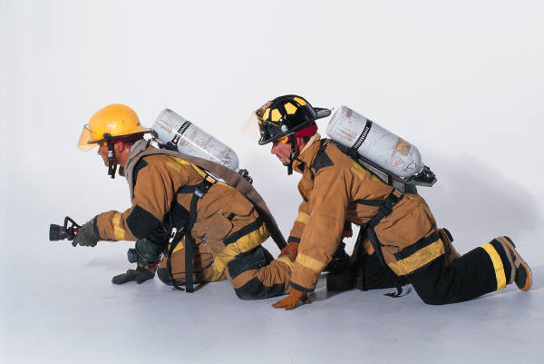
USDA Rural Development
Community Programs
Gregg Delp
Program Director
317-290-3100 Extension 431
gregg.delp@in.usda.gov

Slide 16
USDA Rural Development
Community Programs
Community Facilities
Water and Environmental Programs
Electric and Telecommunication Programs

Slide 17
USDA Rural Development
Community Programs
Community Facilities
Program Objective:
Construct or improve essential community facilities providing essential services in rural areas.
To public bodies and non-profit organizations using three funding sources:
Guaranteed Loans
Direct Loans
Grants

Slide 18
USDA Rural Development
Community Programs
Community Health Care
Hospital
Critical Access Hospital
Dental Clinic
Nursing Home
Assisted Living Facility
Physicians Clinic
Rehabilitation Center
Psychiatric Hospital
Outpatient Clinic

Slide 19
USDA Rural Development
Community Programs
Cultural & Educational
All Purpose Buildings
Colleges
Educational Camp for Physically & Mentally Impaired
Library
Museum
Outdoor Theatre
Public School
School Maintenance & Equipment Service Center
Vocational School

Slide 20
First Responders
Fire, Rescue, & Public Safety
USDA Rural Development
Community Programs
Civil Defense Building
Communications Center
Fire Department Building
Fire Trucks
Jail
Turn Out Gear
Mobile Communications Center
Multi-Service Fire/Rescue Building
Equipment Building
Jaws of Life

Slide 21
Community Support Buildings & Improvements
USDA Rural Development
Community Programs
Adult Dare Care Center
Child Day Care Center
City Hall
Community Health Department
County Office Building
Community Center
County Courthouse/Annex
Data Processing Center
Food Preparation Center
Food Storage and Distribution Center
Home for Troubled Youth
Public Maintenance Building

Slide 22
Transportation
USDA Rural Development
Community Programs
Airport Hanger
Airport
Bridge
Municipal & County Garage
Offstreet Parking
Sidewalks
Street Improvements
Rural Transportation
Railroad
Town Bus
Service/Equipment
Special Transportation Equipment

Slide 23
Other Eligible Submissions
USDA Rural Development
Community Programs
Fairgrounds
Animal Shelter
Levee/dike
Sustaining energy for school – wind, solar
Special Services Building
Sprinkler System
Telemedicine / Distance Learning

Slide 24
USDA Rural Development
Community Programs
Gregg Delp
Program Director
317-290-3100 Extension 431
gregg.delp@in.usda.gov

Slide 25
USDA Rural Development
Rochelle Owen, AICP
State Environmental Coordinator
317-290-3100 Extension 407
rochelle.owen@in.usda.gov

Slide 26
USDA Rural Development
AREA I: COLUMBIA CITY
Area Office
1919 East Business Park 30
Columbia City, IN 46725
(260) 244-6266 Ext. 4
AREA V
COVINGTON
Area Office
2378 West US 136, Suite 3
Covington, IN 47932
(765) 793-3651 Ext. 4
LaPorte Office
100 Legacy Plaza West
LaPorte, IN 46350
(219) 324-6303 Ext. 4
Plymouth Office
2903 Gary Drive
Plymouth, IN 46563
(574) 936-2024 Ext. 4
Lafayette Area V Sub-Office
1812 Troxel Dr. Suite C-1
Lafayette, IN 47909
(765) 474-9992 Ext. 4
Decatur Office
975 South 11th
Decatur, IN 46733
(260) 728-2141 Ext. 4
Albion Office
104 East Park Drive
Albion, IN 46701
(260) 636-7682 Ext. 4
AREA III
BLOOMFIELD
Area Office
104 County Road 70 East, Suite C
Bloomfield, IN 47424
(812) 384-4634 Ext. 4
AREA IV
MUNCIE Area Office
3641 N. Briarwood Lane
Muncie, IN 47304
(765) 747-5531 Ext. 4
Bedford Office
1919 Steven Avenue
Bedford, IN 47421
(812) 279-6521 Ext. 4
Bloomington Office
1931 Liberty
Bloomington, IN 47403
(812) 334-4318 Ext. 4
Jasper Office
1484 Executive Boulevard
Jasper, IN 47546
(812) 482-1171 Ext. 4
AREA II
NORTH VERNON
Area Office
2600 Highway 7 North
North Vernon, IN 47265
(812) 346-3411 Ext. 4
Boonville Office
1124 South 8th Street
Boonville, IN 47601
(812) 897-2840 Ext. 4
Indiana State Office
5927 Lakeside Boulevard
Indianapolis, IN 46278
(317) 290-3100
(317) 290-3343 TDD

