Slide 1
TAB Services and E-Tools
Sabine E. Martin, Ph.D., P.G.
Center for Hazardous Substance Research
Kansas State University
September 2010

Slide 2
Technical Assistance to Brownfield (TAB) Communities
A national program
Funded by EPA headquarters via grants to 4 different entities
Free to communities
K-State assists communities in EPA Regions 5 and 7

Slide 3
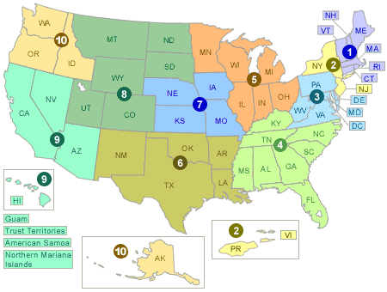
EPA Regions

Slide 4
TAB Assistance to Communities
Tailored to specific community needs
Typically coordinated through the city, tribal or non-profit brownfields project manager
May include:
Help identifying funding sources for revitalization projects
Review of EPA and other grant applications
Help finding a consulting firm
Review of project plans, technical reports
Assistance with community outreach/involvement
Educational workshops and redevelopment visioning
Other assistance, as needed and agreed upon
Communities accepted on a ‘first come’ basis
Depends on staff/funding availability

Slide 5
Successful Community Involvement
=
Information/Education + Dialogue
Informed Community participating in the decision-making process
Sustainable Revitalization

Slide 6
Community Involvement Tools
Fact Sheets, Citizen Briefs
clear
concise
in layman’s terms
basic information
provide contact info and additional resources
Note: NOT a stand-alone tool

Slide 7
KSU TAB Citizen Briefs
http://www.engg.ksu.edu/CHSR/outreach/resources/

Slide 8
Workshops/Training Sessions
Tailored to the information needs of the community
Relaxed atmosphere
Time for networking
Variety of presenters
Hands-on segments
Very effective !

Slide 11
Workshops
Open participation
Adequate meeting facility (size, handicapped accessible, audio/visual, etc.)
Well chosen meeting time and duration
Sensitivity toward minorities (translation)
Local “champion”
Marketing
Conference calls
Refreshments

Slide 12
Redevelopment Planning

Slide 13
Visioning

Slide 14
Visioning

Slide 15
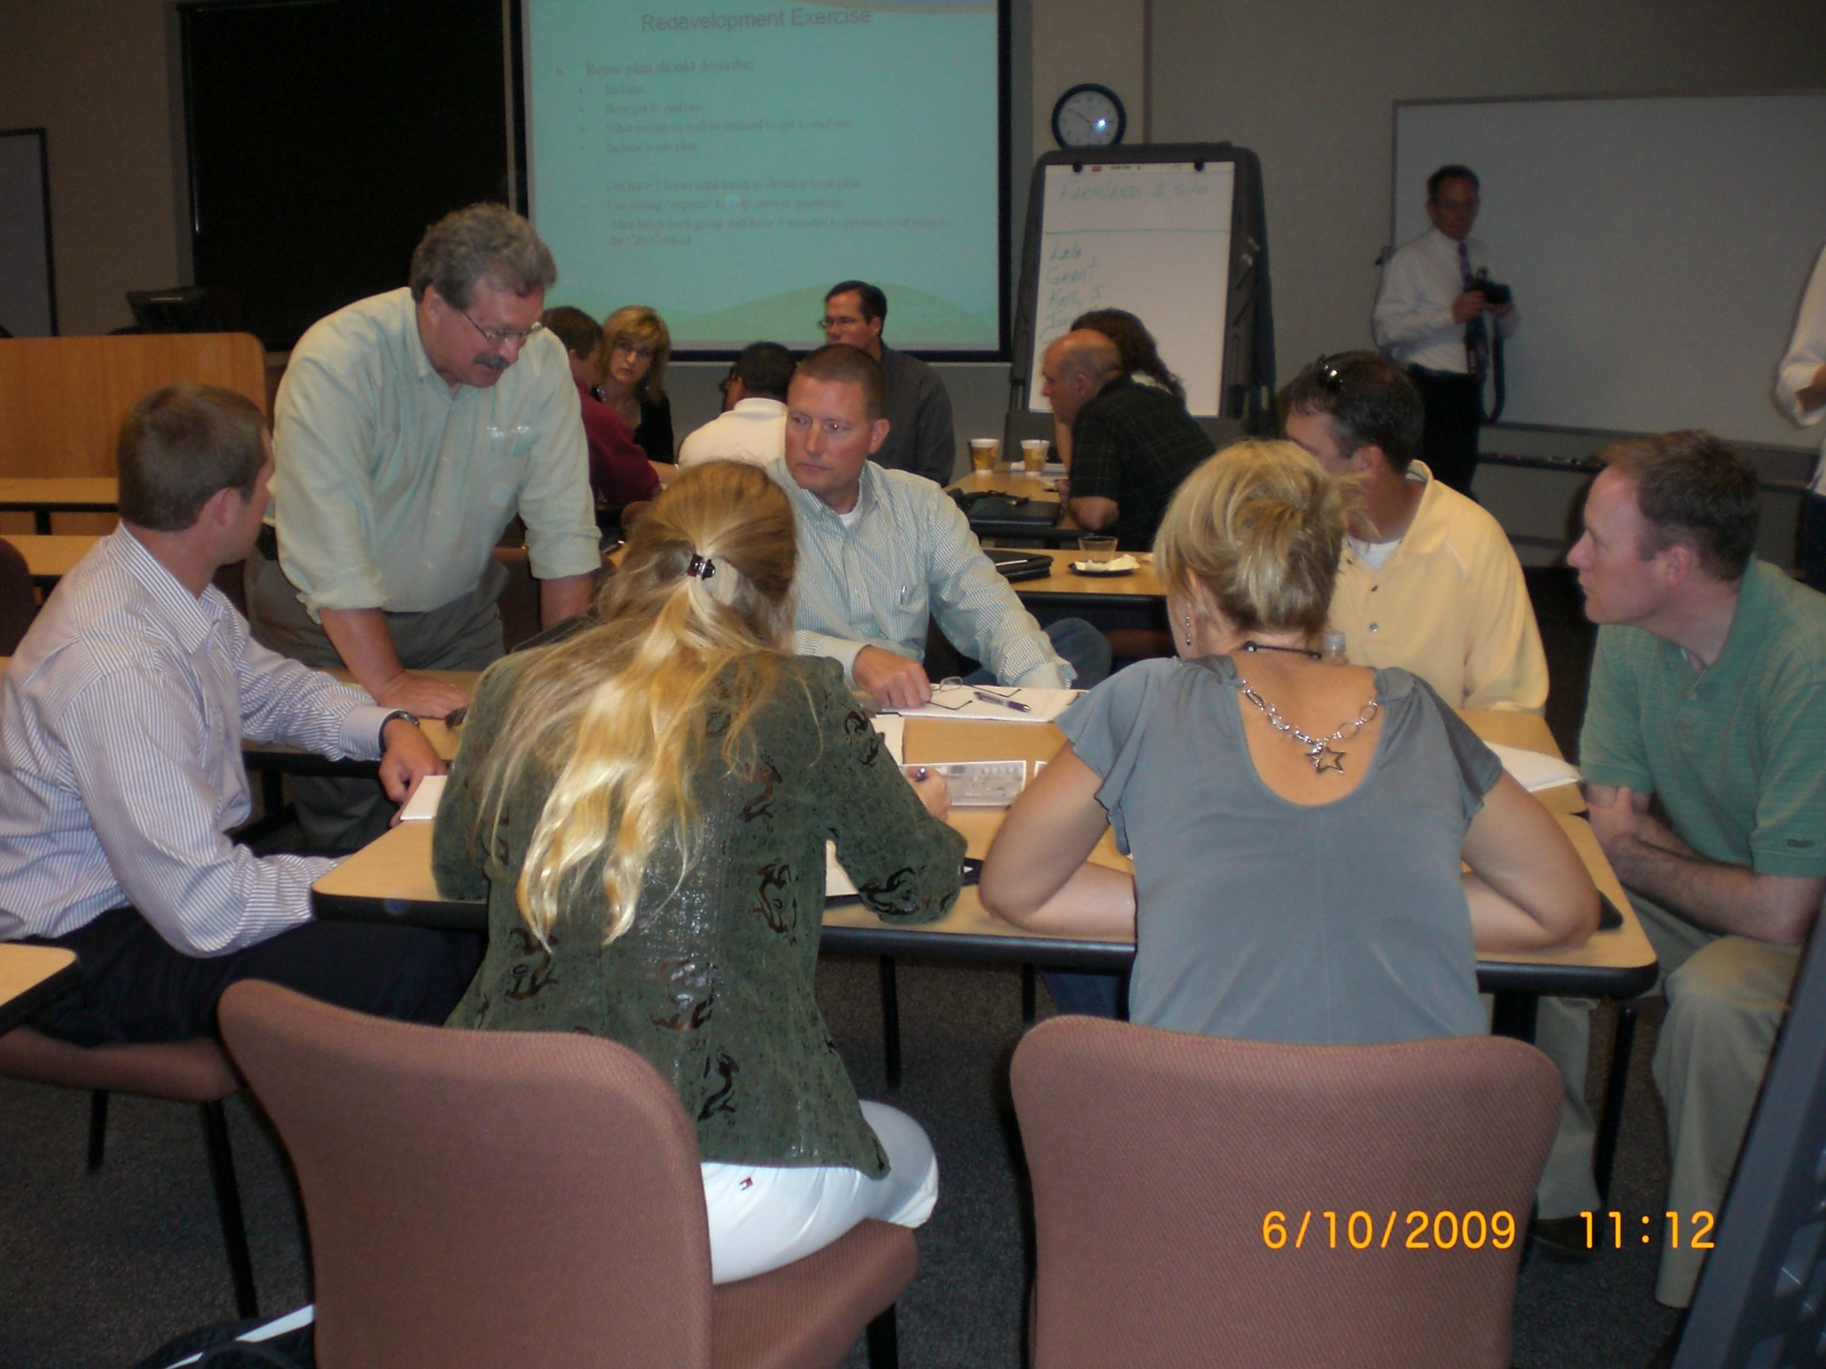

Slide 16
Visioning

Slide 17
Visioning

Slide 18
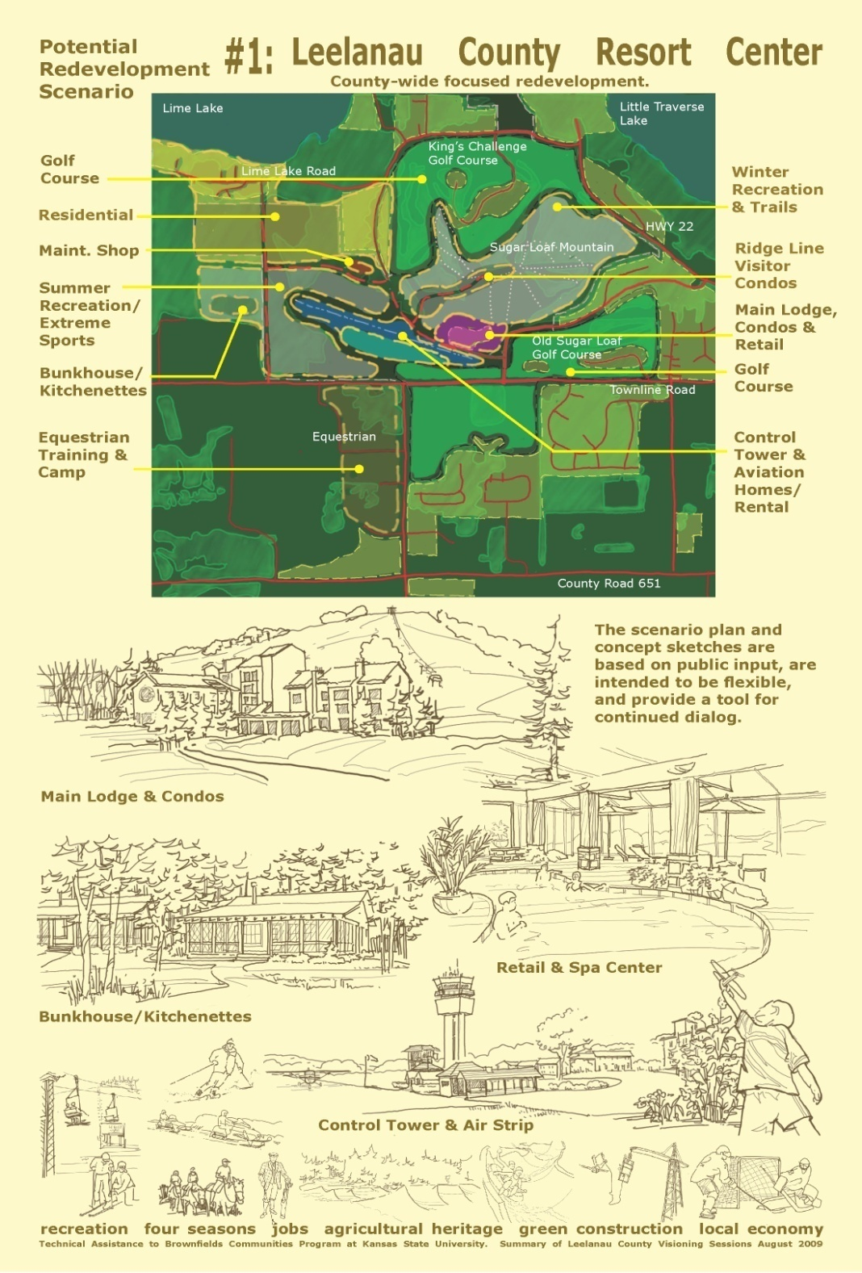

Slide 19
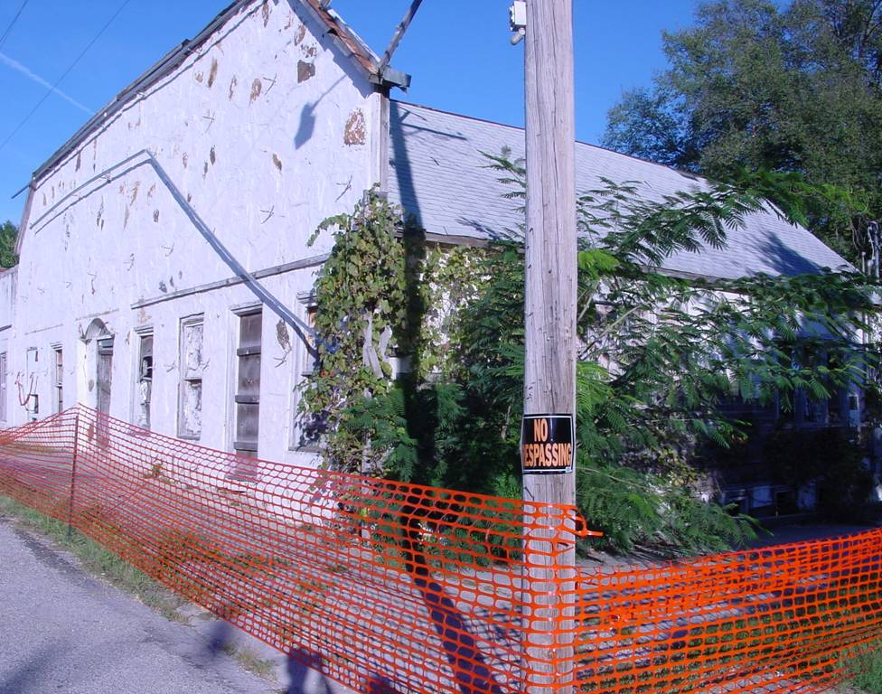

Slide 20
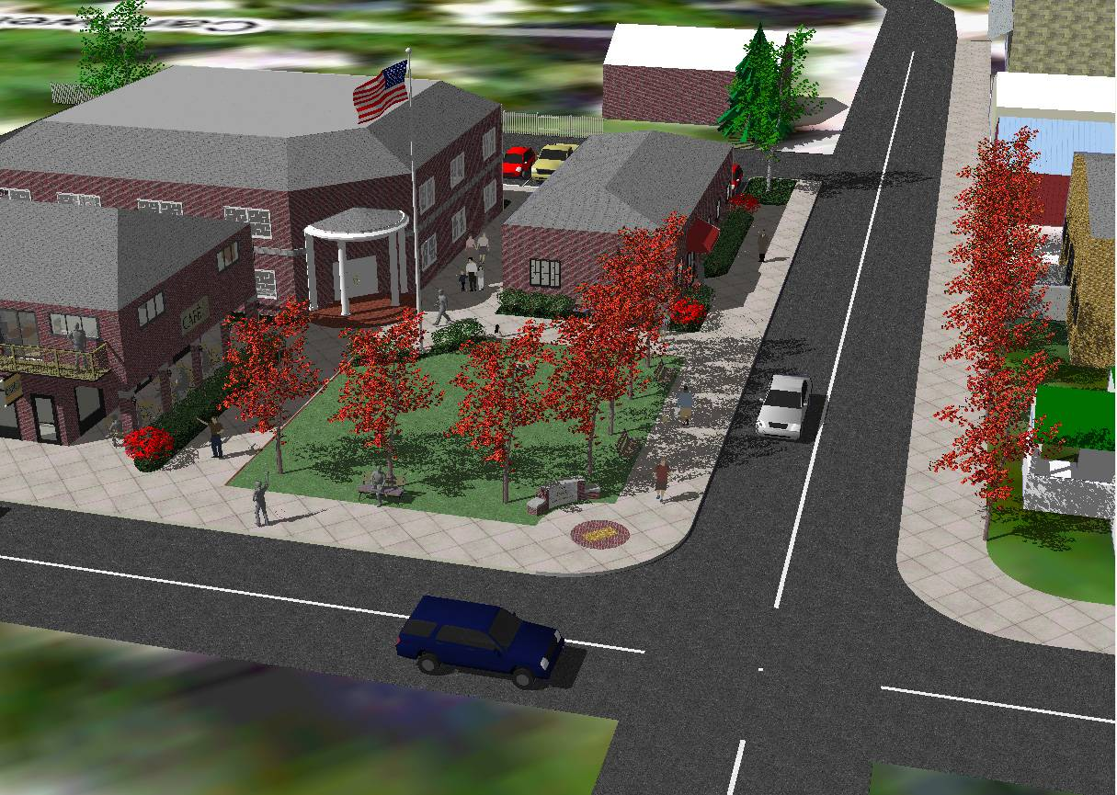

Slide 21
Technical Presentations
Community Meetings

Slide 22
If you feed them, they will come

Slide 23
Special Projects Web - based software: TAB-BIT www.tab-bit.org

Slide 24
TAB-BIT Brownfields Inventory Tool
Released January 29, 2010
Free, web-based and desk-top version
Desk-top version to be released later this year

Slide 25
Background
Prototype developed by EPA Region 8
Intended to help Response Grant, and other brownfields grant recipients with survey & inventory, public record, oversight & enforcement, assessment and cleanup, and administrative reporting requirements
Tool became obsolete due to MSWindows upgrades

Slide 26
BIT Features
Password protected
Multiple users possible, if permission is granted, or “read only” feature
Database
Import/export function
Search function

Slide 27
What can TAB-BIT do?
Data Management:
Brownfields related data
Other environmental data
Track funding
Upload documents or enter data directly
Site information
Redevelopment data

Slide 28
What can TAB-BIT do? Cont.
Data Management:
Program admin. data
Enforcement documentation
Complaints

Slide 29
What can TAB-BIT do? Cont.
Report Generation:
Property Profile Form (e-submit to ACRES)
Quarterly report form (outline)
Forms for enforcement, complaints, ICs, inspection/oversight, public record reports, etc.
Customized reports
Maps

Slide 30
Special Projects Web - based software: TAB EZ www.tabez.org

Slide 31
WHY TAB EZ?
Levels playing field for small/ rural communities, disadvantaged cities and towns and not-for-profits
Tool is time and place independent: flexibility critical to community resources that are stretched to capacity

Slide 32
Features and Benefits to Users
User friendly and can be accessed anytime at the user’s own pace
Integrates Brownfield education with online support: definitions, regulatory citations and pertinent federal/state web links
Helpful Hints for every criteria to be addressed

Slide 33
What TAB EZ CAN and Can NOT do
TAB EZ can:
provide a framework for the community’s proposal
provides strategies and links to reduce time in writing the proposal
TAB EZ cannot:
write a specific and compelling proposal for you
It’s your proposal!

Slide 34
TAB EZ is NOT a substitute
for reading the grant
guidelines!!!

Slide 35
TAB Contacts
Dr. Sabine Martin (Program Director)
785-532-6519 smartin1@k-state.edu
Beth Grigsby
317-579-4069 beth.grigsby@atcassociates.com
Web site: http://www.engg.ksu.edu/chsr/outreach

