Slide 1
Indiana Brownfields Program
Incentives: Financial, Legal, & Technical Assistance
Michele Oertel
317-234-0235
Brownfields Resources and Partners
TAB/BSU Workshop
Indianapolis
September 2, 2010

Slide 2
Presentation Overview
What’s the bad news? – obstacles (or opportunities?)
What’s the good news? – incentives (for opportunities!)
Who needs financial, legal/liability, and/or technical
assistance?
How can the Indiana Brownfields Program help?
What do you really need to remember?
What are your next steps?

Slide 3
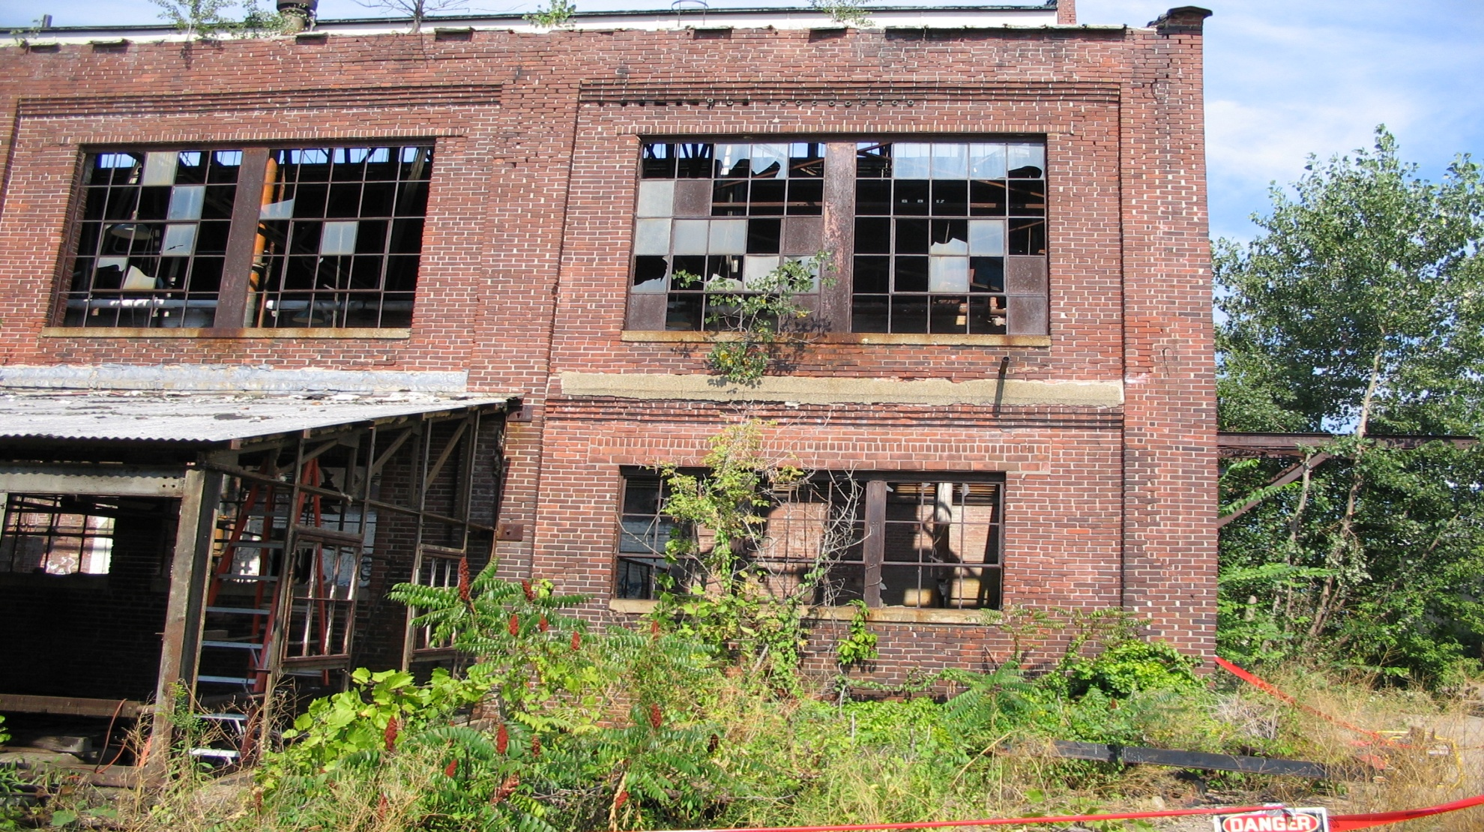
Obstacle or Opportunity?

Slide 4

Issues with Brownfields
Science
● Environmental contamination factor
● Private environmental consultant & IDEM opinions on
technical aspects
Law
● Liability fears
Real Estate
● Property reuse & transfers
● Brownfields vs. Greenfields
Politics
● Competing priorities of local governments
Socio-economics
● Tax base in blighted areas
● Jobs
Art
● Understanding & coordination of multi-disciplines
● Creativity

Slide 5
What are Obstacles to
Brownfield Redevelopment?
Real or potential environmental contamination
Assessment / Cleanup costs
Liability issues for the lender, prospective purchaser, and third parties
Socio-economic issues
Economic development climate
Viability of re-use plans for the site

Slide 6
More Potential Obstacles to
Redevelopment?
Unknowns – risks, ownership, access
Lack of awareness
Lack of planning
Lack of community support
Lack of resources
Lack of partnerships (among local gov’t,
developers, community groups, etc.)

Slide 7
Who Can Help?
WE…can help you help yourselves!
YOU…can help redevelop brownfields!
● Identify potential partners to help you.
● Identify blighted priority properties.
● Provide input for proposed brownfield redevelopment
projects.
● Promote brownfield sites when planning new parks;
recreation, youth, and senior citizen centers;
businesses; municipal buildings; and schools.
● Support businesses that have redeveloped
brownfields or plan to occupy brownfields.

Slide 8
Stakeholders/Partners
Local Government – Public
State and Federal Government
Agencies – Public
Local/State Interest Groups - Private &
Public
Local Business Organizations - Private
& Public

Slide 9
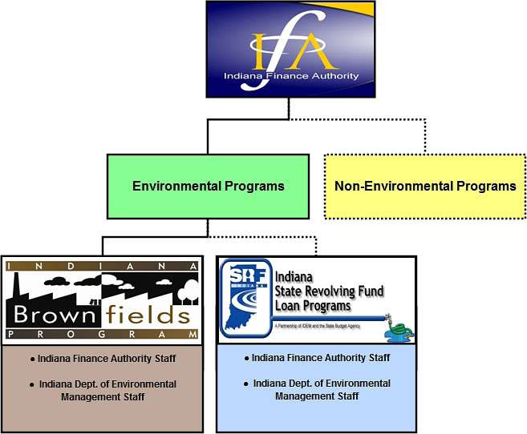
Indiana Brownfields Program
Lends a Hand
Helps communities by
providing:
  Educational Assistance
  Financial Assistance
  Legal Assistance
  Technical Assistance
Serves as a liaison with U.S.
EPA for financial assistance
Coordinates with IDEM’s
Voluntary Remediation
Program
  Certificates of Completion
  Covenants Not to Sue
Coordinates with other related
IDEM programs

Slide 10
When You Want/Need $…
Indiana Brownfields Program - loan funding throughout the year
  Revolving Loan Fund (RLF) Incentive (federally funded)
  Automotive Sector Brownfields Assessment Initiative
  Supplemental Environmental Projects
  State Revolving Loan Fund coordination
  Future funding via U.S. EPA
  Federal Matching Grants - suspended
  Stipulated Assessment & Remediation Grants - suspended
  Low-interest Loans - suspended
  Trails and Parks Initiative (federally funded) – ending

Slide 11
When You Want/Need Liability & Technical Assistance…
Indiana Brownfields Program – letters throughout the year via request form
  Comment Letters
  Environmental liability interpretation
letters, including BFPP language
- Comfort Letters
- Site Status Letters
  Environmental technical oversight

Slide 12
Liability Interpretation Letters
Comfort Letter:
  Issued to a party that qualifies for an applicable
exemption to liability found in Indiana law or IDEM policy, but is not a legal release from liability
  Explains the applicable liability exemption or
IDEM’s exercise of enforcement discretion under
an applicable IDEM policy

Slide 13
Liability Interpretation Letters
Site Status Letter:
  Issued to a party that can demonstrate that current levels
of contaminants of concern substantially meet current
cleanup criteria as established by IDEM under the Risk
Integrated System of Closure (RISC)
  Does not address the potential liability of the party
requesting the letter
  States that based on a technical analysis of information
submitted to IDEM pertaining to site conditions, IDEM
concludes that current site conditions do not present a
threat to human health or the environment and that IDEM
does not plan to take or require a response action at the
brownfield site

Slide 14

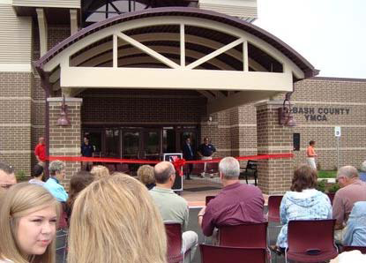
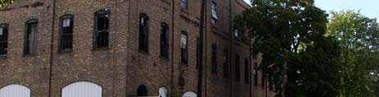
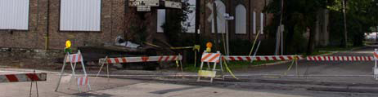
Teamwork leads to Success!
Wabash: Former Bront building demolished to make way for
new YMCA facility with Skate Park across the street

Slide 15
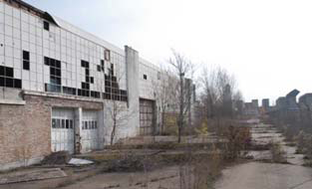
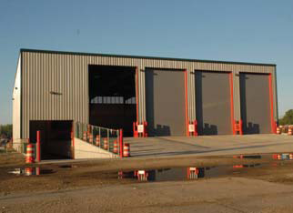
Teamwork leads to Success!
South Bend: Former Studebaker Plant 8 deconstructed to make
way for Green Tech Transfer and Recycling Station

Slide 16
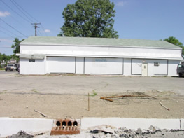
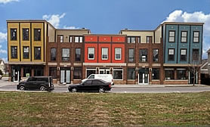
Teamwork leads to Success!
Indianapolis: Former Gas Stations redeveloped into vibrant
Live-Work Residences

Slide 17
Important Points to Remember
Brownfields: not just obstacles or challenges – but opportunities!
Brownfield redevelopment balances economic development with
environmental protection.
Brownfield projects are driven by local leaders.
Success breeds success – talk to other stakeholders – don’t reinvent the wheel.
3 Ps: planning (long-term), public participation, and partnerships are keys to success!!
Brownfield projects may warrant state and/or federal assistance.
Indiana Brownfields Program offers tools to address environmental issues to facilitate brownfield redevelopment.
Next steps: Determine needs and ask for appropriate assistance….

Slide 18
Contact Information
Jim McGoff, Director of Env. Programs, IFA 317- 234-2916
jmcgoff@ifa.in.gov
Meredith Gramelspacher, Asst. Dir. & General Counsel 317- 233-1430
mgramels@ifa.in.gov
Sue Overstreet, Administrative Assistant, General Questions 317- 234-4293
soverstreet@ifa.in.gov
Michele Oertel, Federal Funding & Community Relations 317- 234-0235
moertel@ifa.in.gov
Sara Westrick Corbin, Financial Incentives 317- 234-1688
swestrick@ifa.in.gov
Kevin Davis, Technical Matters 317- 233-2415
kdavis@ifa.in.gov
Check out the Indiana Brownfields Program web site at
www.brownfields.in.gov
Environmental Stewardship. Economic Development.

