Slide 1
Environmental Protection Agency (EPA) Brownfield Grant writers’ Tool
A walk-through
Prepared by the Center for Business and Economic Research Ball State University | August 2010
Prepared by the Center for Business and Economic Research Ball State University | August 2010

Slide 2
Introduction
Purpose of the tool and users
Variable List
Sample Screenshots of the variables
Tax Increment Financing: TIF IN-A-BOX
Future Variables
Access the tool

Slide 3
Purpose
To assist grant authors with accurate and relevant data about the demographic, economic, and health factors pertaining to the community in question.
Users:
Brownfield Grant writers
Economic Developers
Community Volunteers/Organizers/Leaders
Government Officials

Slide 4
Variables
Demographics:
Population and Growth
Population Density and Housing units Density
Population by Age and Gender
Education Attainment
High School Graduation Rates
Households
Poverty
Free and Reduced Lunches
Disabled Population
Public Assistance

Slide 5
Variables (contd.)
Economy
Percent share of Total Establishments
Employment Growth
Employment Trend
Unemployment Rate
Personal and Household Income
Income Inequality
Federal Spending

Slide 6
Variables (contd.)
Health
Natality /Mortality
Birth rates – By age group
Birth Measures
Fertility Rates
Death Rate – By gender, By cause
Infant Mortality
Premature Death
Average Life Expectancy
Years of Potential Life lost before age 75
Morbidity
Self-rated poor health
Average Unhealthy Days per month
Disease / Cancer
All Cancer and Lung Cancer – Incidence and Death Rates
Lung Diseases

Slide 7
Sample Graphics

Slide 8
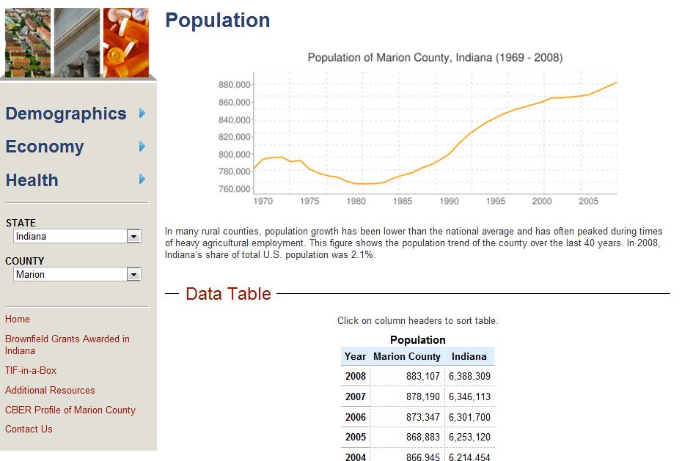

Slide 9
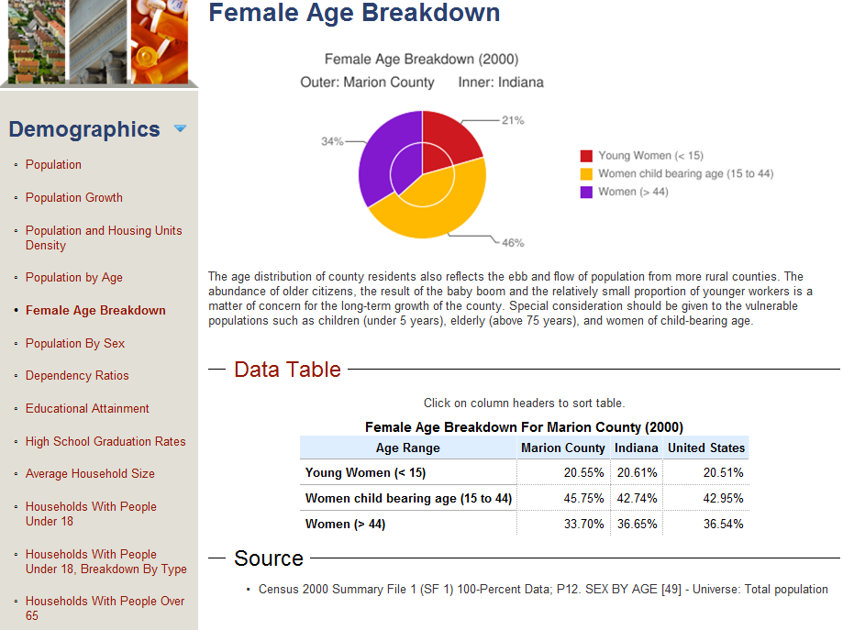

Slide 10
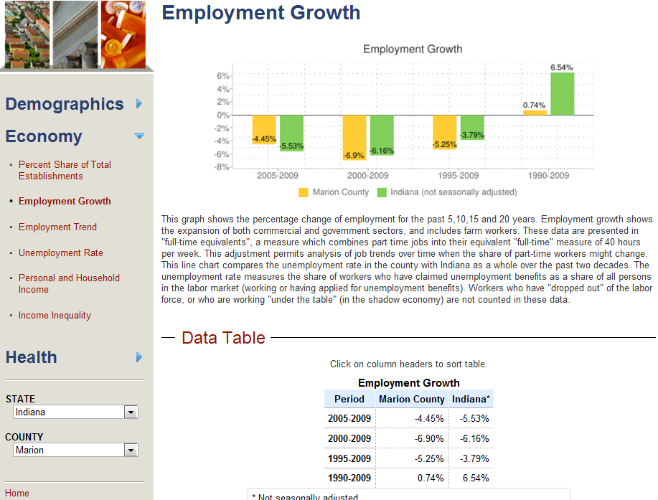

Slide 11
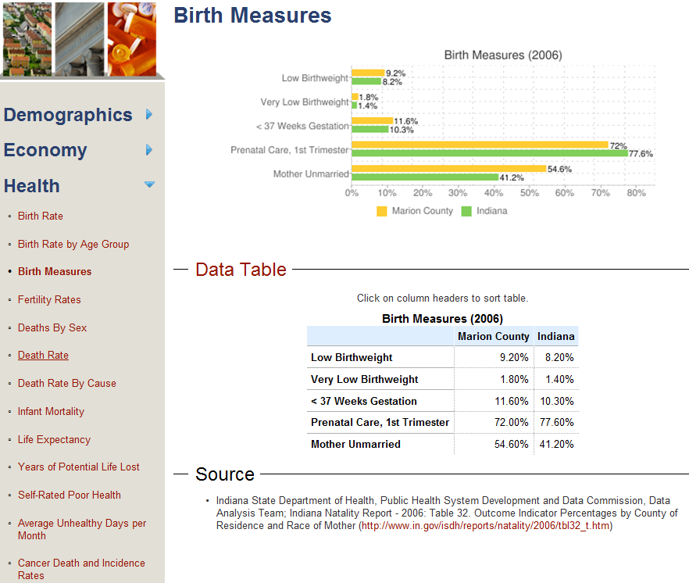

Slide 12
Features
Tables can be sorted – ascending and descending
Copy the graphics right clicking the mouse and select “copy”
Copy Tables and paste in “excel” or “word” without changing the format

Slide 13
TIF IN-A-BOX
Tax Increment Financing (TIF)
Tool used by local governments to allocate changes to local taxes caused by new business development for a specific purpose.
In a typical setting, the growth of property taxes associated with a new business will be applied to a purpose that has significant impact on the community.
Examples of these are installation of water or sewer infrastructure, construction or expansion of roadways, or remediation of a brownfield.

Slide 14
TIF-in-a-box (contd.)
Contains:
Basic materials on TIF
Studies by Bartsch and Wells (2003), and Paull (2008)
Enabling legislation contained in IC 36-7-14 which deals with TIFs and uses
Economic Impact Calculator
A tool for estimating the economic and fiscal effects of new business development. To use the Economic Impact Calculator, enter company information into the form to the left.

Slide 15
Economic Impact Calculator
Example:
County: Marion
Industry: Health Care and Social Assistance
Input Method: Number of Employees = 50

Slide 16
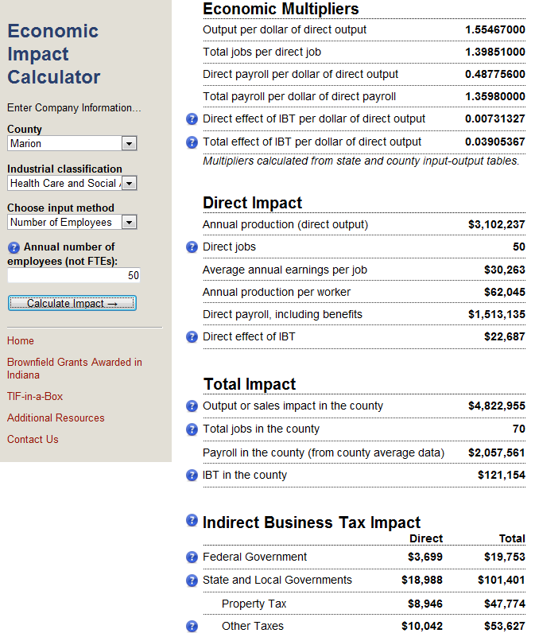

Slide 17
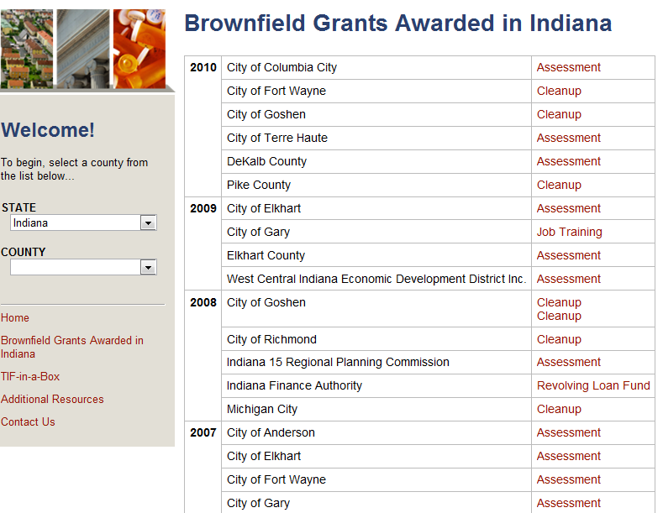

Slide 18
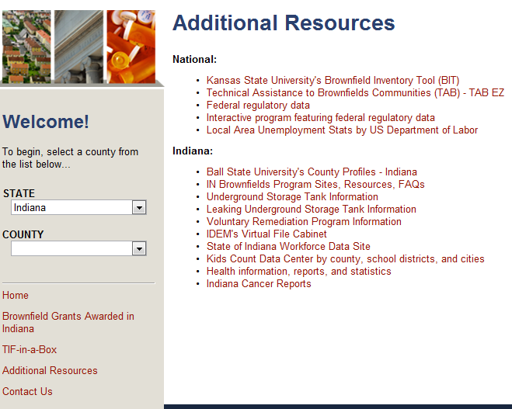

Slide 19
Additional Variables in Future
Health
Releases to environment
Hazard Score
Vehicle Mileage and ADT
Risk Index (Cancer, Respiratory and Neurological)
Hospitalization rate
% of diabetic and chronically ill Medicare enrollees
Unhealthy days due to ozone and fine particulate matter

Slide 20
How to access this tool?
Visit www.epa.cberdata.org
(or)
Go to www.bsu.edu/cber
Click on “Data Center”
Select “EPA Brownfield Grant Writers’ Tool”

