Slide 1

The “Dirt” on Brownfield Redevelopment
Building Better Communities
Brownfield Resources and Partners Workshop
Chris Harrell – Brownfield Redevelopment Coordinator
    City of Indianapolis
    Department of Metropolitan Development
    Community Economic Development Division
    charrell@indy.gov
Presented at Offices Ball State University CAP Center
50 South Meridian St. – Indianapolis, IN 09/02/2010 9:30AM

Slide 2
Brownfield Breakfast in Brief
  Basic Dirt on Brownfields – Boring DEFINITIONS
    Section 101 of CERCLA 1980 (42 USC 9601) as amended
    (39)(A) In General – The Term “brownfield site” means real property, the expansion, redevelopment, or reuse of which may be complicated by the presence or potential presence of a hazardous substance, pollutant or contaminant (subject to exceptions as always)
    Indiana Code
    IC 13-11-2-19.3 – “Brownfield” means a parcel of real estate: (1) that: (A) is abandoned or inactive; OR
    (2) on which expansion, redevelopment, or reuse is complicated; because of the presence or potential presence of a hazardous substance, a contaminant, petroleum, or a petroleum product that poses a risk to human health and the environment.

Slide 3
Brownfield Breakfast in Brief
  Basic Dirt on Brownfields
    Local Redevelopment Examples
    Trends Nationwide / Locally
      How is Indianapolis driving trends nationally?!
      Area Wide Strategies & Corridor Strategies (Non-Profit/Quasi DA)
      Empirical Data Approach – Brownfield Inventory Project
      Linking Sustainability and Economic Development
        Smart Growth Redevelopment District
        Sustainable Communities Pilot Designation (HUD/DOT/EPA – 02.05.2010)_
      Commercial/Industrial Land Banking Entities
      Alternative Uses of Property in Weak Market Areas
    Insurance Cost Recovery

Slide 4
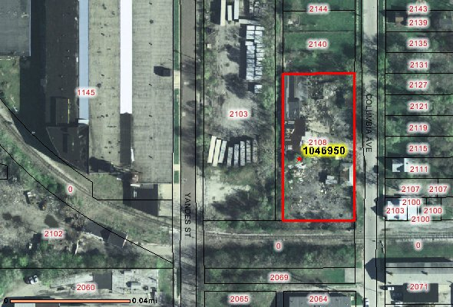
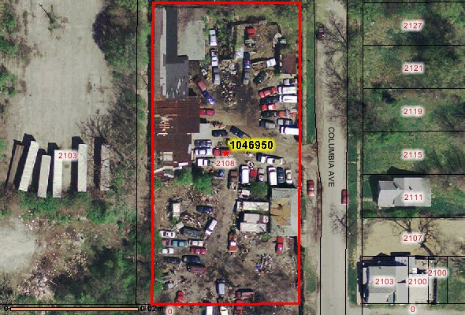
Local Project Examples
2108/2110 Columbia Avenue (Near Monon)
  Abandoned Junkyard

Slide 5
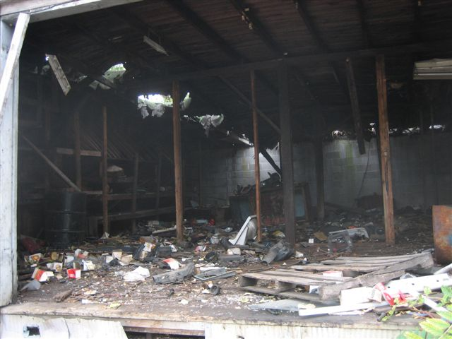
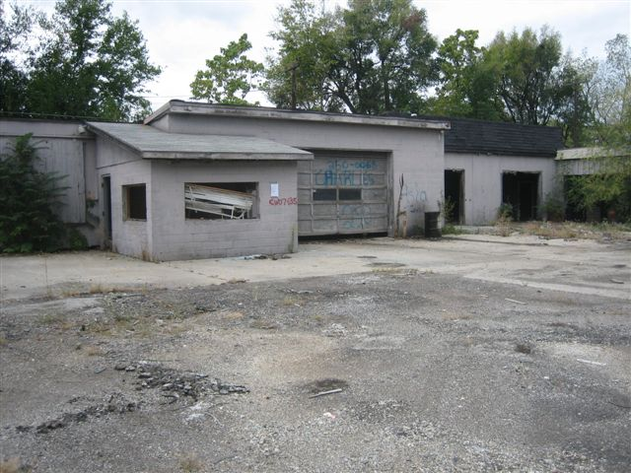
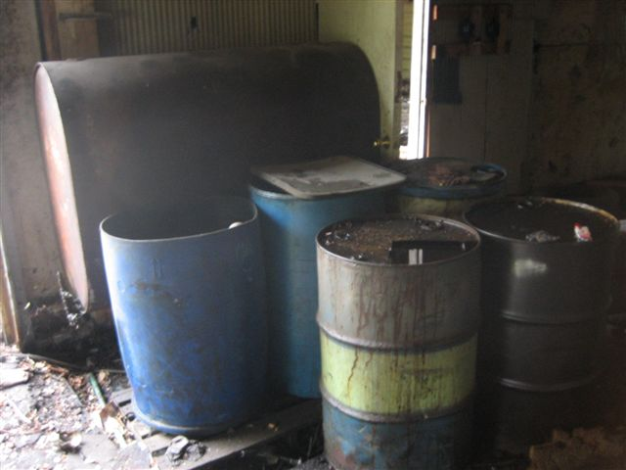
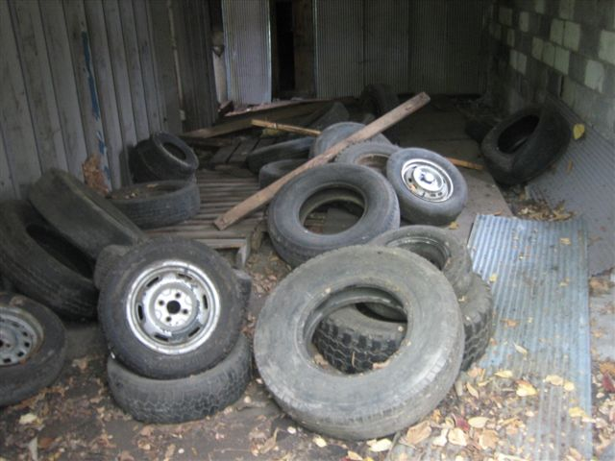
Local Project Examples
2108/2110 Columbia Avenue (Near Monon)
  Abandoned Junkyard

Slide 6
Local Project Examples
2108/2110 Columbia Avenue (Near Monon)
  Abandoned Junkyard
    MCHHCorp removed junk cars
    Site Acquisition Assistance
      Assist Developer with demonstrating condition of site and value diminished as such
      Developer Removes Drums ($5,000)
      Costs Subtracted from Sale Price
      Demolition by City / Costs to be Refunded to Unsafe Building Fund
        $22,325
    DMD Brownfield Redevelopment Program Applies $60,000 SAG
    Phase I ESA, Phase II ESA – identification of soil cover & NFA Issued!

Slide 7
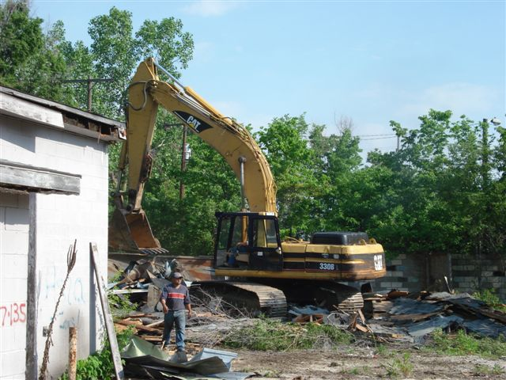
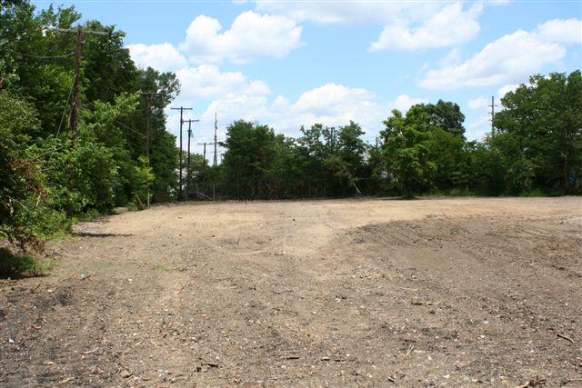
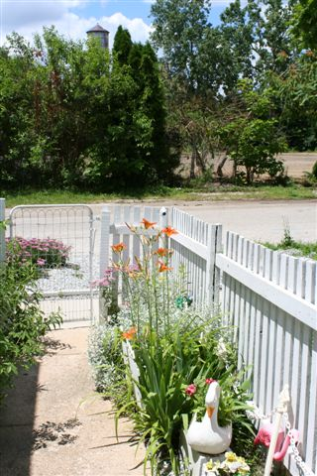
Local Project Examples
2108/2110 Columbia Avenue (Near Monon)
  Abandoned Junkyard Now!
  Prepared for Redevelopment for Developer

Slide 8
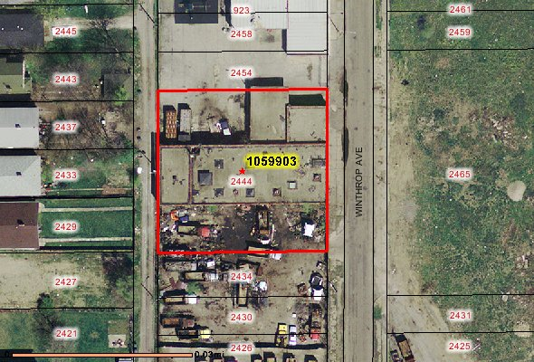
Local Project Examples
2444 N. Winthrop Avenue
  (Former Colonial Bakery Maintenance Garage)
    Abandoned for 30 years

Slide 9
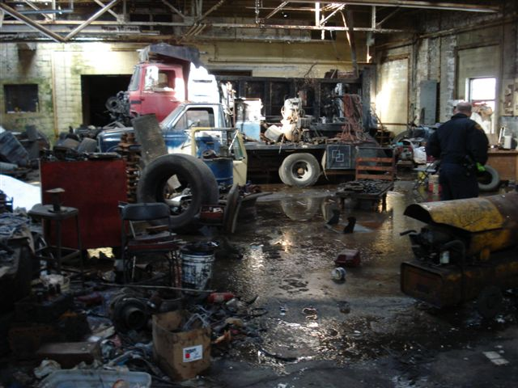
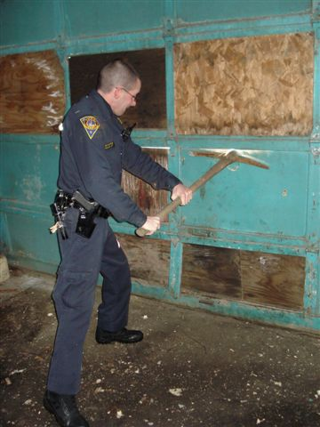
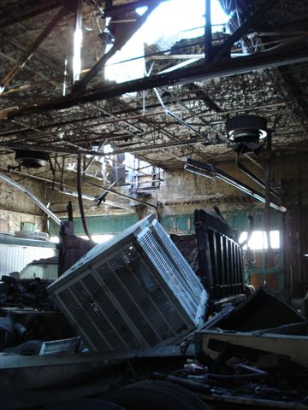
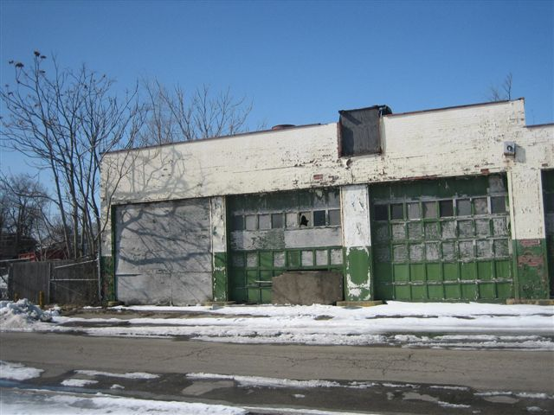
Local Project Examples
2444 N. Winthrop Avenue
  (Former Colonial Bakery Maintenance Garage)

Slide 10
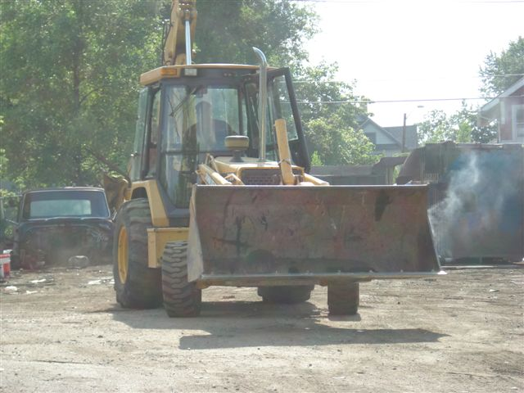
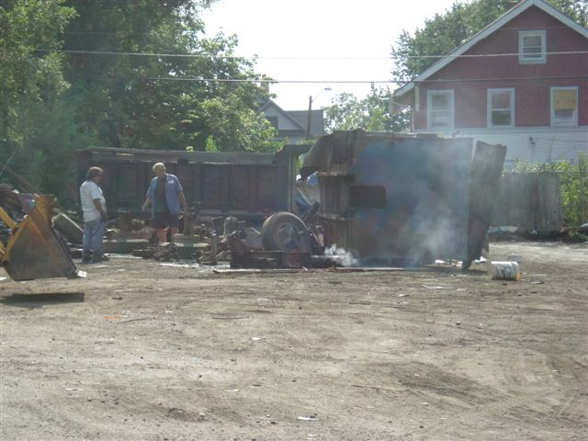
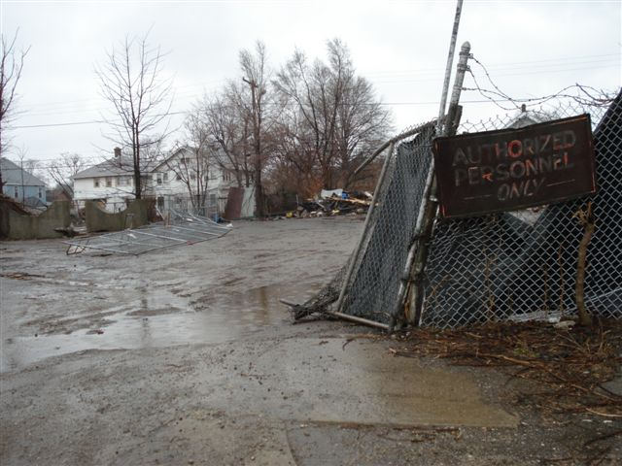
Local Project Examples
2444 N. Winthrop Avenue
  (Former Colonial Bakery Maintenance Garage)

Slide 11
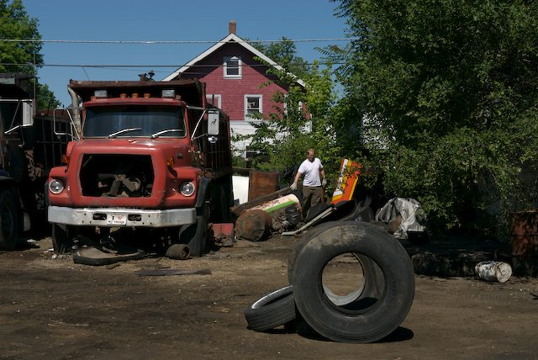
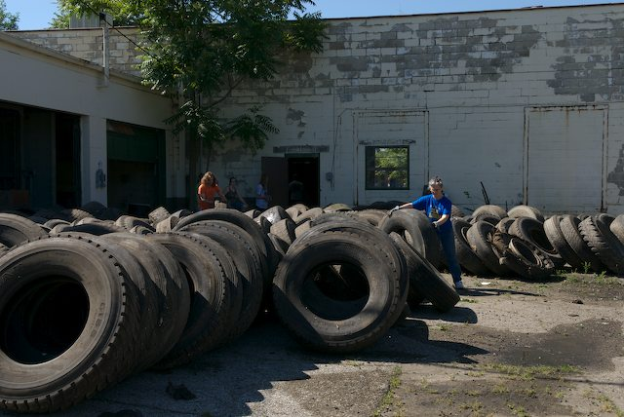
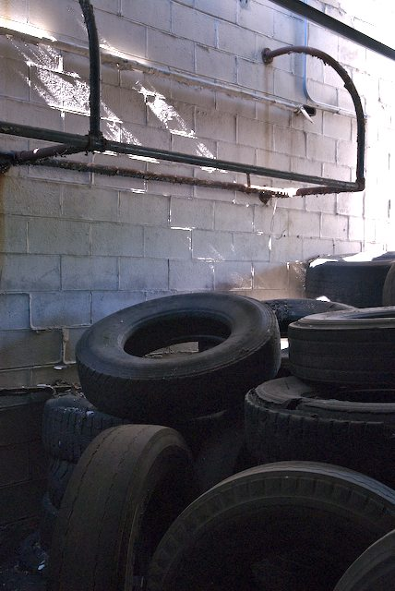
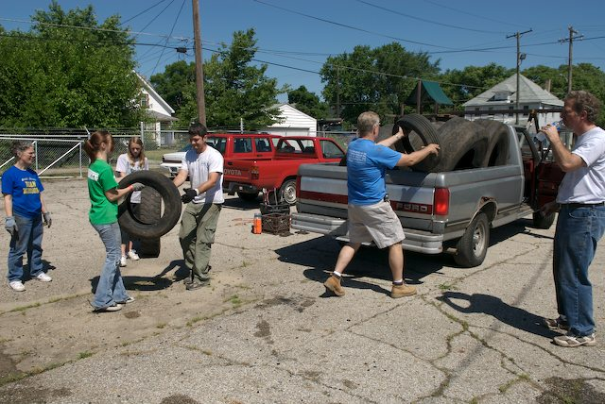
Local Project Examples
2444 N. Winthrop Avenue
  (Former Colonial Bakery Maintenance Garage)

Slide 12
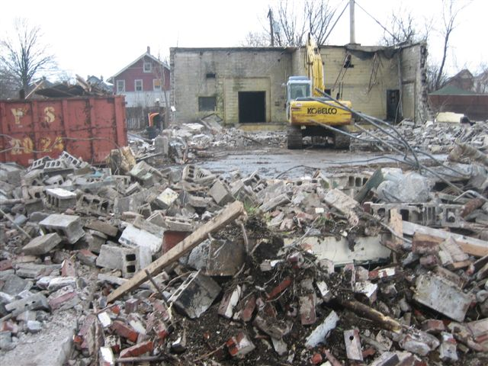
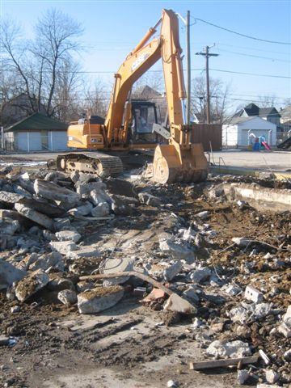
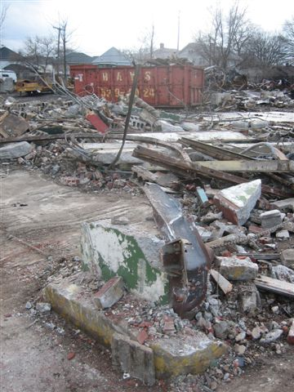
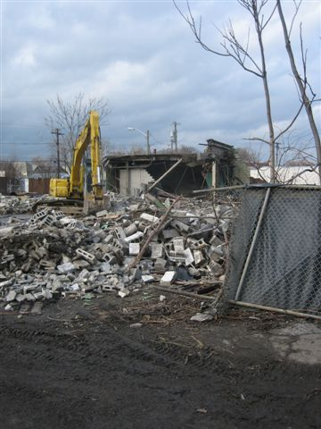
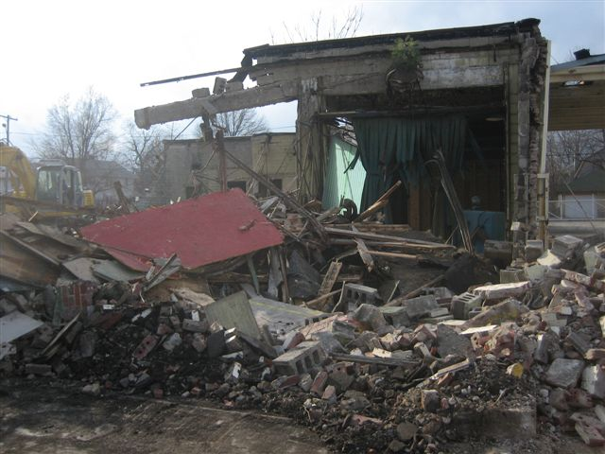
Local Project Examples
2444 N. Winthrop Avenue
  (Former Colonial Bakery Maintenance Garage)

Slide 13
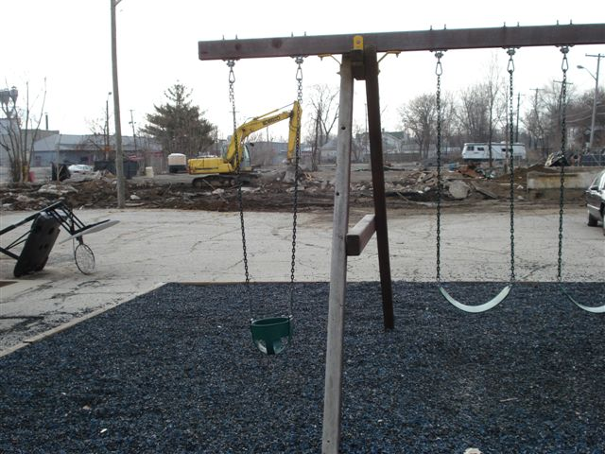
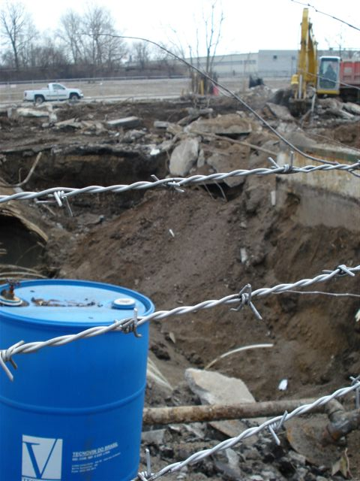
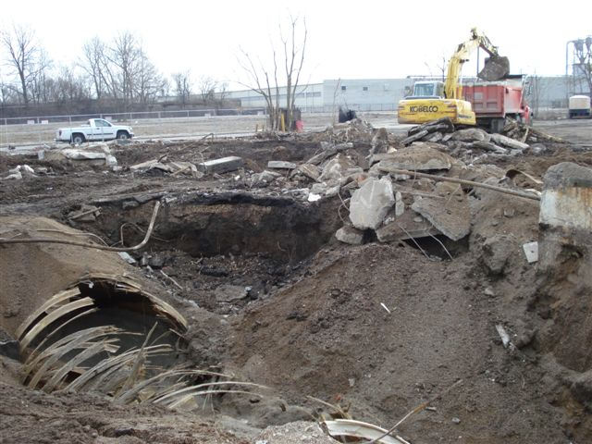
Local Project Examples
2444 N. Winthrop Avenue
  (Former Colonial Bakery Maintenance Garage)

Slide 14
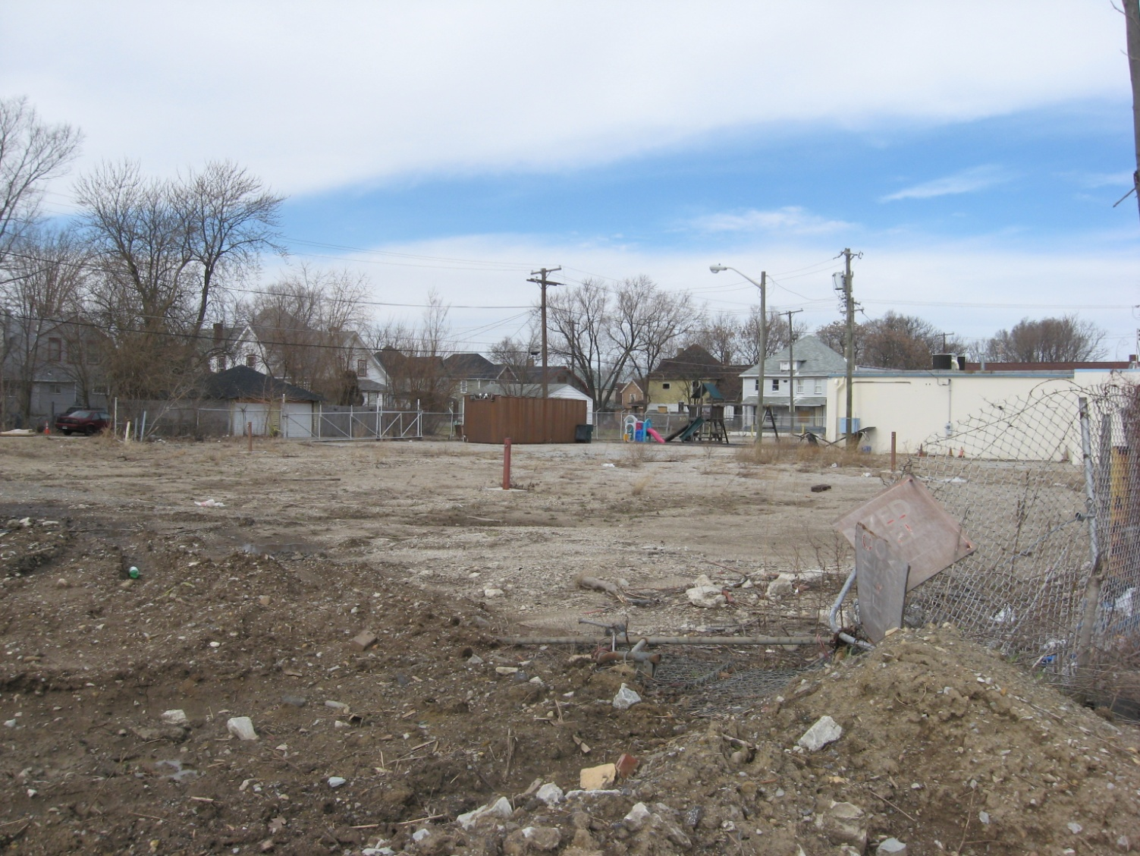
Local Project Examples
2444 N. Winthrop Avenue
  (Former Colonial Bakery Maintenance Garage)

Slide 15
City of Indianapolis County-Wide Brownfield Site Inventory Project
Overview –
  How it began (Area Wide Phase I Survey)
Project Update
Recent Project Benefits
Benefits Already Realized
Proposed Next Steps

Slide 16
City of Indianapolis County-Wide Brownfield Site Inventory Project
  How many brownfields do we have in Marion Co.?

Slide 17
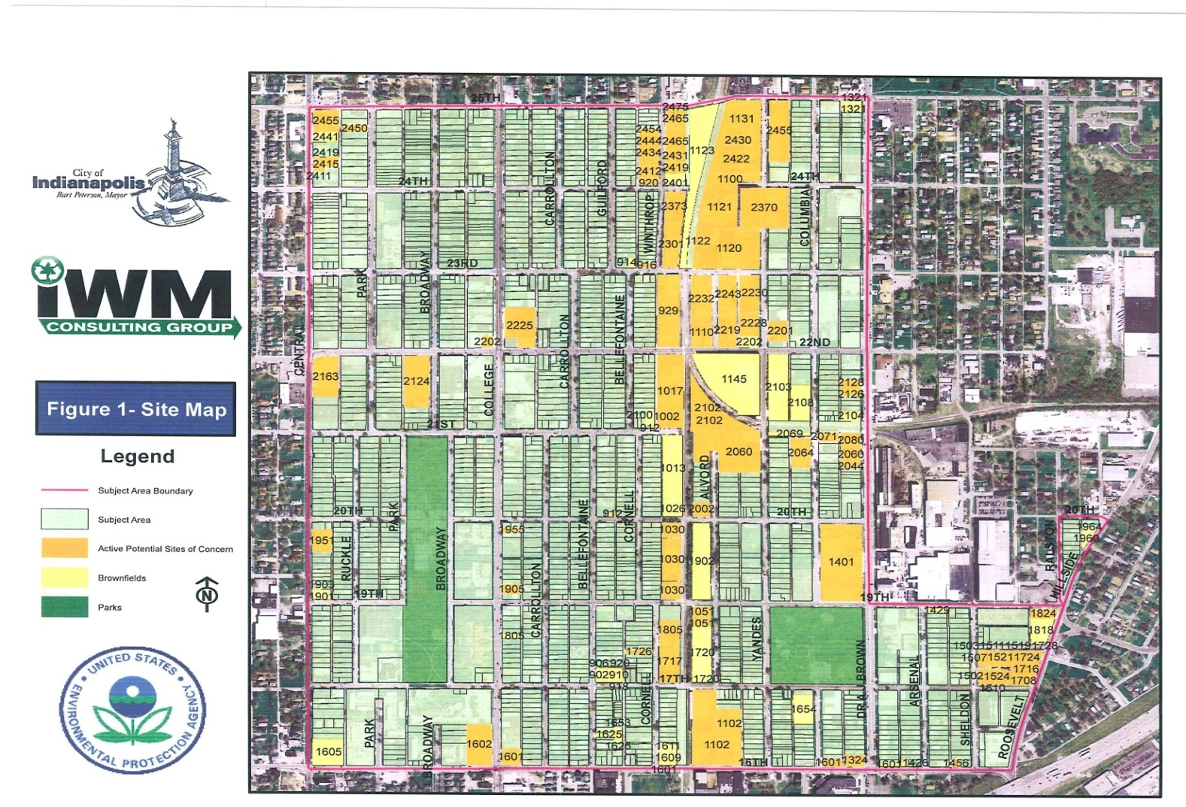
City of Indianapolis County-Wide Brownfield Site Inventory Project

Slide 18
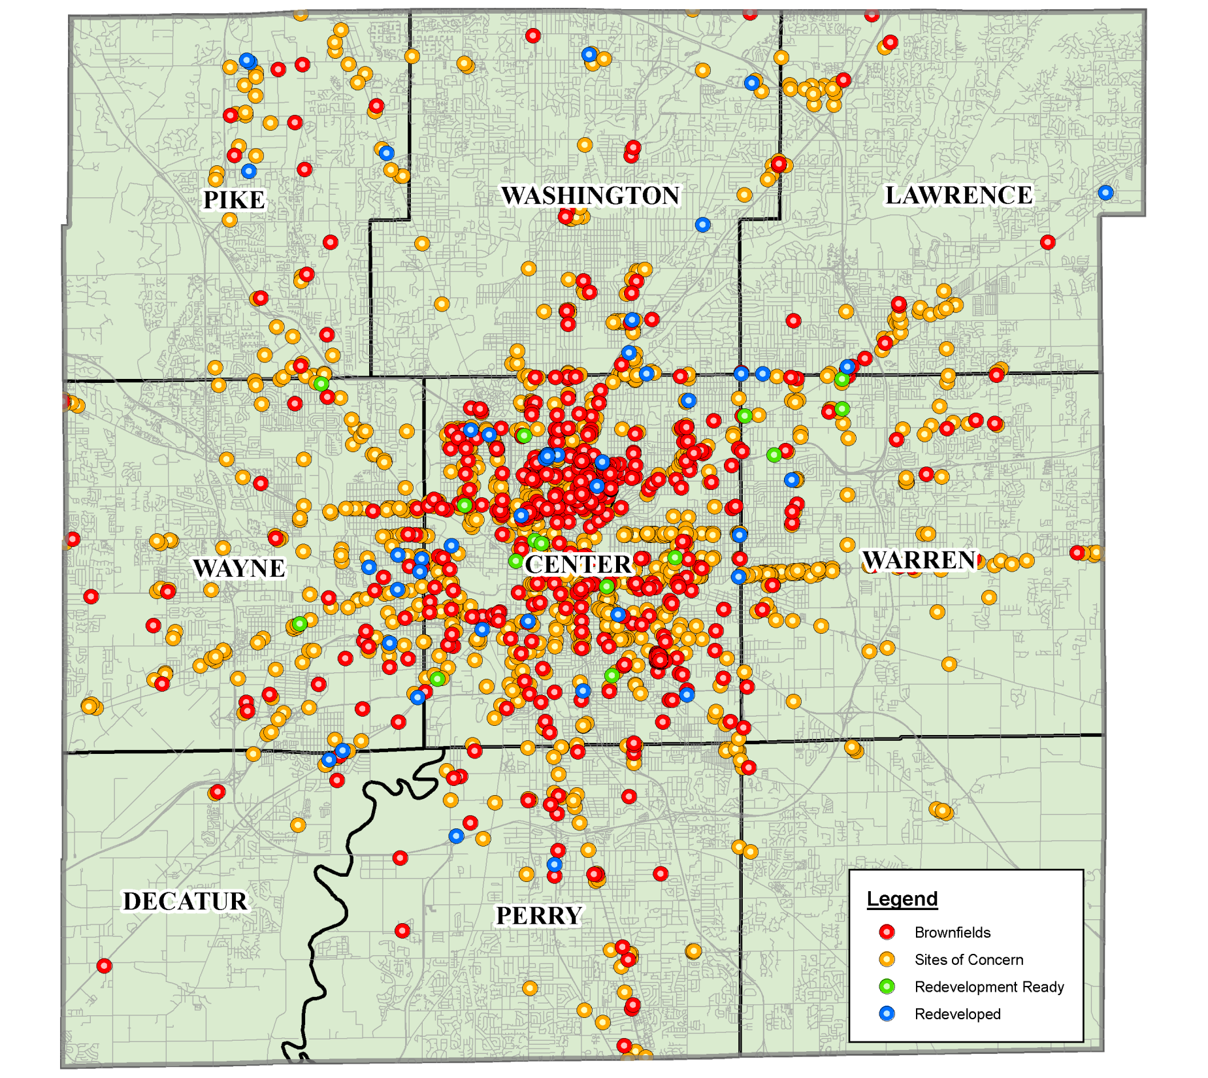
Brownfield Inventory-Site Identification
Marion County, In
Site Inventory Site Status
Notes:
Site Status" was determined using the following criteria:
I. CLASSIFY STATUS AS "BROWNFIELD WHEN:
1. Vacancy <50% in use per Windshield Survey, or
2. Vacant per Windshield Survey, or
3. USPS Vacant and in FRS Database, or
4. Status defined in recent inventory reports as:
a. Brownfield
b. Vacant
II. CLASSIFY STATUS AS "SITE OF CONCERN" WHEN:
1. USPS Vacant and Not in FRS Database
2. Vacancy = In-Use as per Windshield survey
3. Status defined in recent inventory reports as:
a. Active Potential Site of Concern
b. Site of Concern
c. Inactive Potential Site of Concern
18

Slide 19
Overview
What?
  Outcome of MDC Res. 09-E01 02/04/2009
  Totally Grant funded Brownfield Inventory Project (EPA and HUD CDBG) available to public on WEB
  Examination of 353,000 Parcels in Marion County
  Examine all previous data
    2004 Center Township SPEA Capstone
    2007 Phase I ESA Area Survey
    Irvington DC & NNDC Inventories
  Generate NEW DATA
EPA Brownfields Grantee Reporting Requirements
Section 128(a) of Small Business Liability Relief and Brownfields Revitalization Act: State and Tribal grant recipients are required to take reasonable steps to develop and/or maintain a system or process that can provided an reasonable estimate of brownfield sites
EPA 510-R-09-002

Slide 20
Overview
Why?
Goal: Empirical data to support and guide efforts including:
Identifying sites that are “Redevelopment Ready”
  Assisting with marketing of sites and removing stigma
Prioritizing sites for grant funding purposes/identifying conditions that avail each site to particular funding mechanisms
Presenting the case to EPA and IFA Brownfields Program
  Meeting EPA requirements
Tracking progress
  Success Measurement
  Rate of new challenges developing
Increasing awareness and public information/education
Promoting infill redevelopment/achieving sustainability goals and efforts of SustainIndy

Slide 21
Overview
How?
Others: some good
Pennsylvania also grants up to $50,000 to cities and development authorities that carryout brownfields inventories and list these properties in the states PaSiteFinder, a web-based brownfield inventory system. Localities and development authorities receive a $1,000 credit for each site listed (Bartsch et al., 2001; DEP, 2000)
Elkhart County, INDIANA (inspiration with Ground Water Management)
MOST: IGNORE the Issue, or don’t take comprehensive approach, leaving development ready sites languishing because lack of data

Slide 22
Overview
How?
We: Recognize that
DATA is king.
  DATA is good.
  DATA develops
    Ideas / Plans
    Which develop Properties
    Which benefit neighborhoods
    Which develops Tax Base & City

Slide 23
Overview
How?
We: First Consulted with Office of Corporation Counsel to address potential liability considerations.
Rumored State of Texas “takings” case just that… a rumor.
Recognized the benefits of malleable database outweigh falsehoods and rumors!
Recognize that you cannot manage that which you cannot Measure. 2 steps / 1 step or ???
Competitively Bid – 10 Respondents

Slide 24
Project Update
Marion County Site Inventory
  Desktop Study
  USPS Database Integration
  Community Development Corporation Input
  Windshield Survey
  Site Status Evaluation
1960 City Directory Mapping Pilot Project
Historical Sanborn Fire Insurance Mapping
Web-Based GIS Application Development
Document Management System

Slide 25
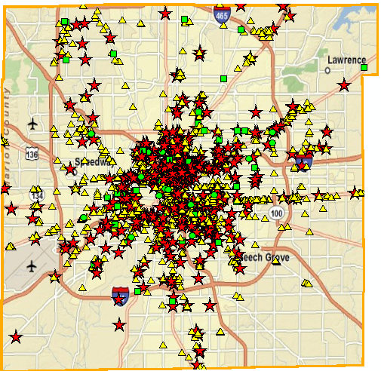
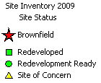
Site Inventory-Site Status Evaluation
  Evaluated Site Inventory for Brownfield Status
Summary
Brownfield: 519
Redeveloped: 49
Redevelopment Ready: 16
Site of Concern: 1098
Marion County, In
Site Inventory Site Status
Notes:
Site Status" was determined using the following criteria:
I. CLASSIFY STATUS AS "BROWNFIELD WHEN:
1. Vacancy <50% in use per Windshield Survey, or
2. Vacant per Windshield Survey, or
3. USPS Vacant and in FRS Database, or
4. Status defined in recent inventory reports as:
a. Brownfield
b. Vacant
II. CLASSIFY STATUS AS "SITE OF CONCERN" WHEN:
1. USPS Vacant and Not in FRS Database
2. Vacancy = In-Use as per Windshield survey
3. Status defined in recent inventory reports as:
a. Active Potential Site of Concern
b. Site of Concern
c. Inactive Potential Site of Concern
25

Slide 26
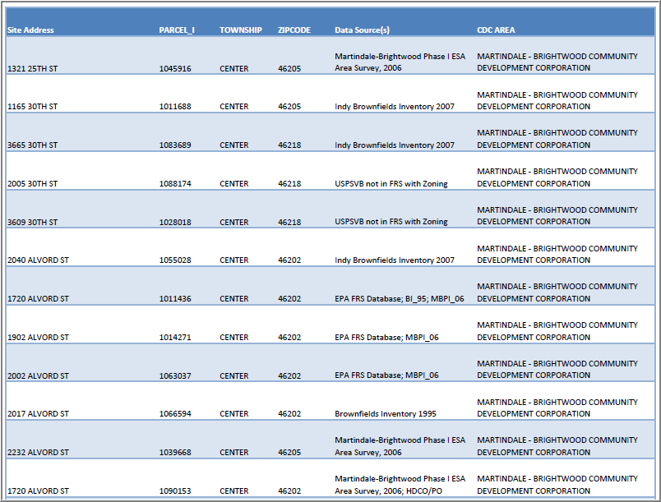
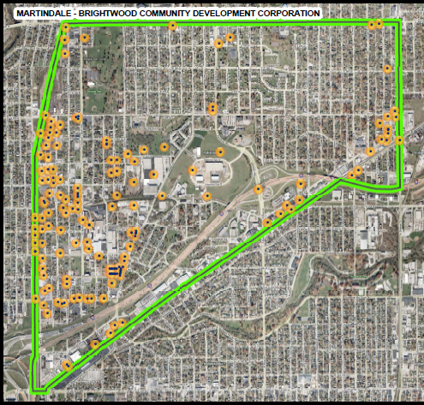
Site Inventory-Community Development Corporation Input
  Provided opportunity for input from Community Development Corporations
Martindale-Brightwood
CDC Site Inventory Report
Martindale-Brightwood
CDC Site Inventory Map
Notes:
Met with ?? CDCs, present our project, discussed goals, provided each a map and list of sites currently in the inventory and then asked them to provide input or known sites that did not make our list.
26

Slide 27
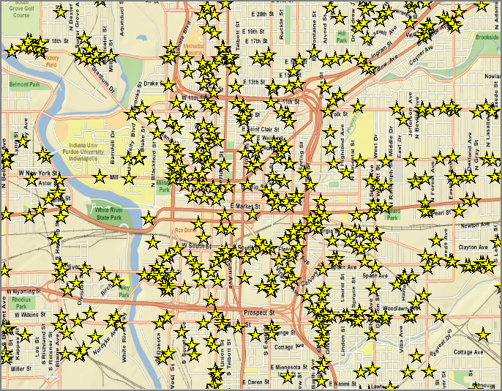
1960 City Directory Pilot Project
  Performed Data Gap Analysis using 1960 City Directory listings to evaluate potential sites not identified in existing databases using business with a high likelihood of historic Hazardous Substance or Petroleum use
Summary
Total businesses mapped: 1,105
Businesses found in existing site inventory:178
Therefore an additional 927 sites could be at minimum defined as a “Site of Concern”
Location of 1960 City Directory Sites
Notes:
27

Slide 28
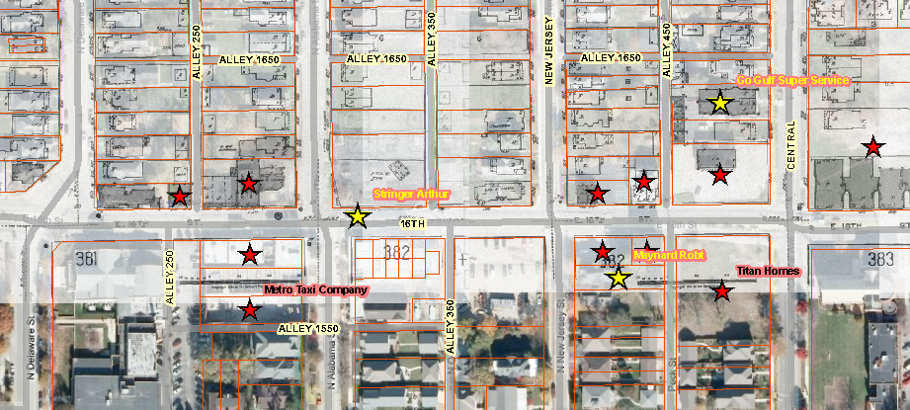
East 16th Street (Meridian Street to Sheldon Street) Corridor

Slide 29
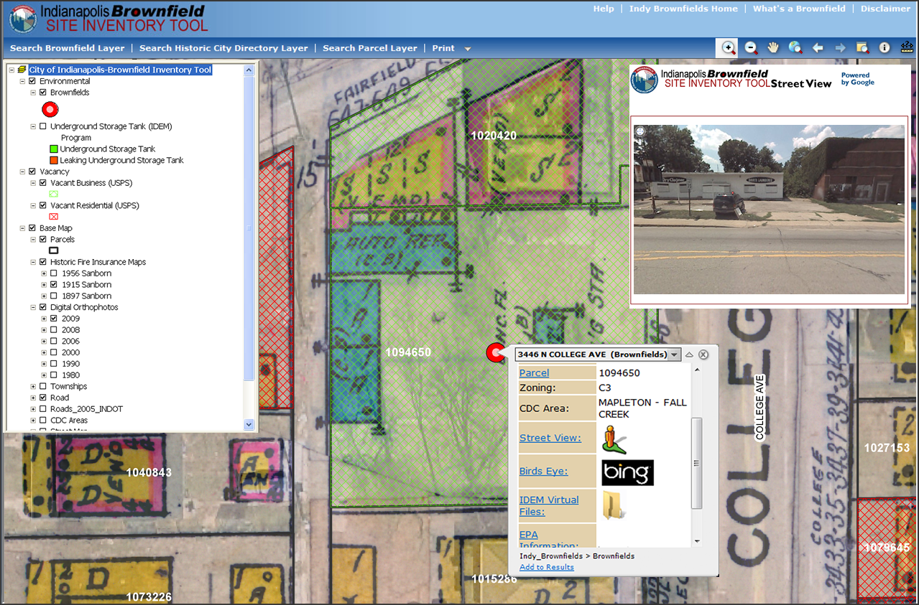
Sneak Peek into the future of Brownfield Redevelopment!

Slide 30
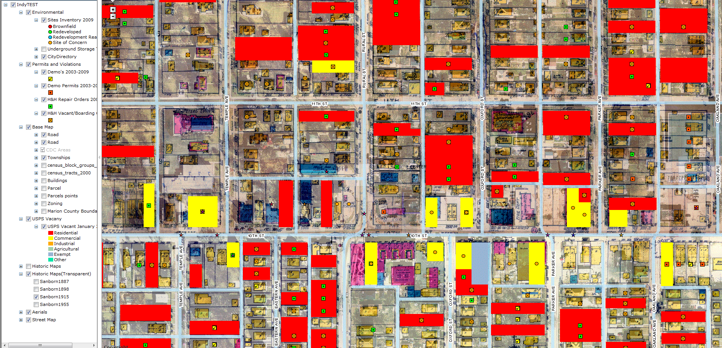
Sneak Peek at Inventory Screen Shot

Slide 31

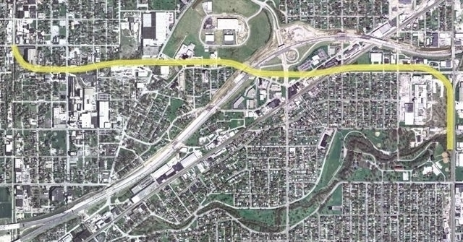
Smart Growth Redevelopment District
Originally: Greenway Expansion

Slide 32

Smart Growth Redevelopment District
  Born June 24, 2008 at CIRTA Public Meeting
    How to Get BEYOND BROWNFIELDS?
    10 Tenants of Smart Growth

Slide 33
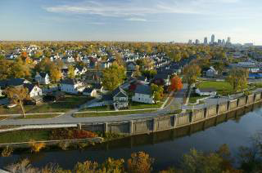
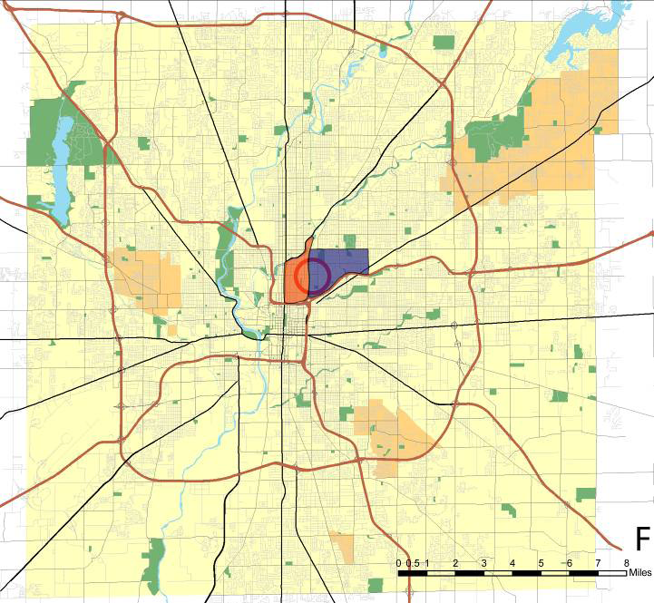
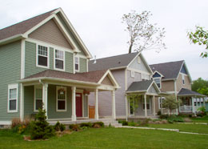
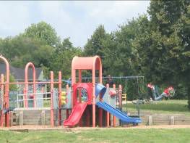
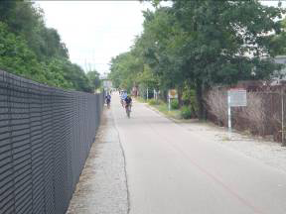
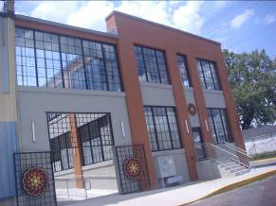
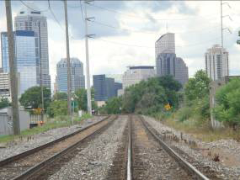
Smart Growth Redevelopment District

Slide 34
Smart Growth Redevelopment District

Slide 35
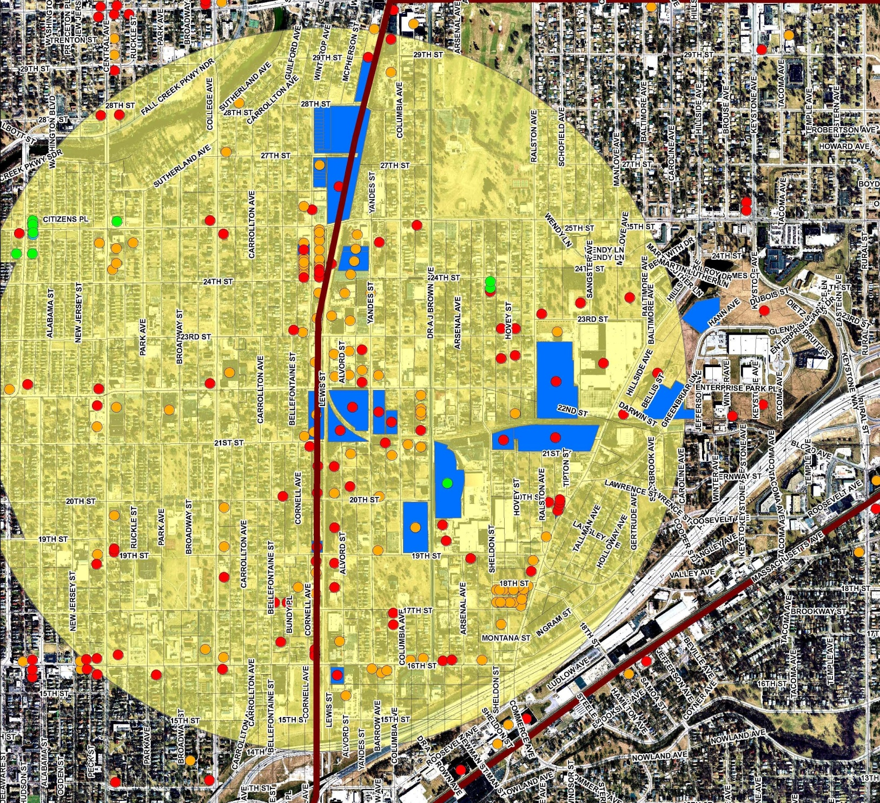
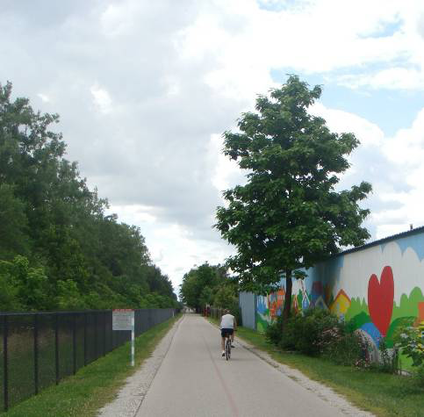
Smart Growth Redevelopment District

Slide 36

Smart Growth Redevelopment District

Slide 37

Smart Growth Redevelopment District

Slide 38

Smart Growth Redevelopment District

Slide 39

Smart Growth Redevelopment District

Slide 40

Smart Growth Redevelopment District

Slide 41

Smart Growth Redevelopment District

Slide 42
Smart Growth Redevelopment District
Restoring a Block
Before & After
© 2009, NRDC

Slide 43




Smart Growth Redevelopment District
Increase Density Increase Walkability
Increase Transit Options
Increase Livability
Increase Sustainability

Slide 44


Smart Growth Redevelopment District
  AIA SDAT Grant / Citizens Energy
    October 29- 31, 2009 Community Workshop
    EPA A.A. Stanislaus Attends
    Assistance Pledged

Slide 45
Sustainable Communities Pilot Designation
  February 5, 2010 – Announcement (one of 5 nationally)
    What does it mean?
HUD/DOT / US EPA interagency cooperative agreement signed March 18, 2009
Feb. 5, 2010 Indy receives “Pilot” Designation
The technical assistance provided through these sustainable community pilots will serve as a model for future partnerships between EPA, HUD and DOT to address blight and sustainable redevelopment throughout the nation.

Slide 46
Preparing Brownfields For Green Reuse |Produce
  Urban Farming Inquiries Exploding for Brownfield Sites and Urban Infill Lots (Mayor Noted this Recently!)
    Concern over soil condition – Brownfield Lots & Infill Residential lots – Brownfield Inventory Helps
      Site Specific Context In Indy (Examine
    Safe Soils Issue is Key – Establishing Interdisciplinary Effort to Create Country’s First Standardized Protocols
      US EPA
      ATSDR
      IDEM / IFA Brownfields Program
      Marion County Health & Hospital Corp.
      IUPUI – Medical School Research Community
      City of Indianapolis Brownfield Redevelopment Program
    BrownLots2GreenPlots Plan for vacant parcels

Slide 47
Preparing Brownfields For Green Reuse / Produce
Site Specific Projects In Indy Context
  The Project School – Edible Schoolyard Safe Soils Project
    Neighborhood Brownfield Initiative 2009
    Indy $20,000 / $10,000 LISC
  Monon Acres – Proposed Urban Farm Reuse of abandoned Rail Yard Maintenance Facility
  1960/1964 Former Smith’s Diesel Service Site and illegal dumping site
    Felege Hiywot Center: Youth Urban Farming Non Profit
    Expansion lots nearby

Slide 48
Preparing Brownfields For Green Reuse / Produce
Site Specific Projects In Indy Context (cont.)
  6000 E. 46th Street – Devington Farm Proposal
  2868 N. Olney Street – Urban Infill Lot Example
  NOT A FARM, but…Phytoremediation Pilot Project similar concerns at Keystone Enterprise Park
    How to relate to urban orchards, updake, and retention in wood / leaves?
    Disposal
    Fruit uptake?

Slide 49
Preparing Brownfields For Green Reuse / Produce
  The Project School – Edible Schoolyard Safe Soils Project
    Neighborhood Brownfield Initiative 2009
    Indy $20,000 / $10,000 LISC

Slide 50



Preparing Brownfields For Green Reuse | Produce
  Neighborhood Brownfield Initiative ($50,000)
    The Project School – Edible Schoolyard / Playgrounds

Slide 51

Preparing Brownfields For Green Business
  Neighborhood Brownfield Initiative ($50,000)
    The Project School – Edible Schoolyard / Playgrounds

Slide 52

Preparing Brownfields For Green Reuse | Produce
  Neighborhood Brownfield Initiative ($50,000)
    The Project School – Edible Schoolyard / Playgrounds

Slide 53




Preparing Brownfields For Green Reuse |Produce
  Neighborhood Brownfield Initiative ($50,000)
    The Project School – Edible Schoolyard / Playgrounds

Slide 54





Preparing Brownfields For Green Reuse |Produce

Slide 55
Preparing Brownfields For Green Reuse / Produce
  Former Monon Rail Yard and Maintenance Facility
    15 Acre Urban Farm Possibility
    Prior promises of Tiger Woods First Tee Youth Golf Facility have built expectations
      No budget to fulfill expectations
    How to mix recreational reuse with Urban Farming and Farmer’s Market, Compost Zone, Urban Allotments?

Slide 56


Preparing Brownfields For Green Reuse | Produce

Slide 57




Preparing Brownfields For Green Reuse |Produce

Slide 58

Preparing Brownfields For Green Business

Slide 59


Preparing Brownfields For Green Business

Slide 60

Felege Hiywot Center & Expansion Lots
1960/ 1964 Hillside Avenue
2 Blocks from FHC http://fhcenter.org/

Slide 61


Preparing Brownfields For Green Business
  First Brownfield Bicycle Tour! May 14, 2009
    IUPUI Campus Compact & Peace Institute – University students & Environmental Leadership Retreat
    Highlights the Felege Hiywot Center – Youth Urban Farming

Slide 62



Preparing Brownfields For Green Reuse
  Highlights the Felege Hiywot Center – Youth Urban Farming Training

Slide 63


Preparing Brownfields For Green Business
– EPA CARE Grant | EPA TBA Grant
  Martindale Brightwood Environmental Justice Collaborative (MBEJC) & Improving Kids’ Environment (IKE) – EPA CARE GRANT $98,000
    Additional $50,000 EPA Targeted Brownfield Assessment Grant
      1960/1964 Hillside Avenue Former Smith’s Diesel Service Station

Slide 64




Preparing Brownfields For Green Business
– EPA CARE Grant
      1960/1964 Hillside Avenue Former Smith’s Diesel Service Station – Felege Hiywot Center Urban Farming Youth Education

Slide 65
Preparing Brownfields For Green Reuse
  6000 E. 46th Street Devington Urban Farm Proposed Site

Slide 66

Preparing Brownfields For Green Reuse – Planting the Seed

Slide 67

Preparing Brownfields For Green Reuse – Planting the Seed
Devington Green Earth Golden Character 8.0 Acre Site 2010
Back to the FUTURE
Devingtion Community Development Corporation Applies for $28,000 HUD CDBG funds for 2010.
Unknown to Brownfield Program
Break down the silos
Ensure Safe Soils Conditions as questions not yet asked.

Slide 68

Preparing Brownfields For Green Reuse – Planting the Seed
Devington Green Earth Golden Character Site
1937 Aerial Photo
Undeveloped Farm Land

Slide 69

Preparing Brownfields For Green Reuse – Planting the Seed
Devington Green Earth Golden Character Site
1941 Aerial Photo
Undeveloped Farm Land

Slide 70

Preparing Brownfields For Green Reuse – Planting the Seed
Devington Green Earth Golden Character Site
1956 Aerial Photo
Undeveloped Farm Land

Slide 71

Preparing Brownfields For Green Reuse – Planting the Seed
Devington Green Earth Golden Character Site
2007 Aerial Photo
Farm Land Displaced with
Development, but subject site remains undeveloped
High School to North of site, and Devington strip mall to the left.

Slide 72

Preparing Brownfields For Green Reuse – Planting the Seed
Devington Green Earth Golden Character Site
1962 Aerial Photo
Farm Land Displaced with
Development
High School to North of site, and Devington strip mall to the left.

Slide 73


Devington Green Earth Golden Character Site Aerial Photos through time: Note Development & Parking

Slide 74
Preparing Brownfields For Green Reuse / Produce
  2868 North Olney Street -
    Urban Infill Lot Request
    Lillian Rucker’s Dream
      Site soil tested for lead impacts
    Discovered it was more than she bargained for!
      Confronting abandoned house next door
      Youth violence wrecks her sign

Slide 75
Preparing Brownfields For Green Reuse – Planting the Seed
Urban Infill Lots & Community Gardens 2886 North Olney Street | Seeds of Hope Garden
- We HOPE this garden will make a positive impact on our community.
- We HOPE this garden will provide fresh produce for those identified as “ friends of the garden.”
- We HOPE members of the community will be inspired to maintain the beauty that is the “Seeds of Hope”.
- We HOPE that the seeds planted in this garden will also take root in each neighbor’s heart and cause a revitalization of the Martindale-Brightwood area.
- We HOPE this garden will inspire other communities to share in the beautification of our great city of Indianapolis.

Slide 76



Preparing Brownfields For Green Reuse – Planting the Seed
Seeds of Hope Site

Slide 77

Legacy of Abandoned Plating Facilities &
Prior Industrial Activity
  IDNR Urban Forestry Grant / HUD CDBG Phytoremediation Pilot Project – Keystone Enterprise Park
    53 Hybrid Poplar Trees Planted Nov. 2007
    GW Monitoring

Slide 78


Preparing Brownfields For Green Business
  IDNR Urban Forestry Grant / HUD CDBG Phytoremediation Pilot Project – Keystone Enterprise Park

Slide 79


Preparing Brownfields For Green Reuse
  IDNR Urban Forestry Grant / HUD CDBG Phytoremediation Pilot Project – Keystone Enterprise Park

Slide 80
Preparing Brownfields For Green Reuse
  Brown Lots 2 Green PlotsSM – One Potential Solution to help with onslaught of 22,000 tax delinquent vacant/abandoned parcels
    Urban Farming / Gardening Reuse
    Faith Based Groups, Neighborhood Associations, CSAs, etc. petition City DMD for a 7 Year Land Use License
    Pre-determined “buy out” clause with cost for CSA, Faith Based group, neighborhood based entity for acquisition at close of 7 year land use license.
    Remove out of control carrying costs of mowing, illegal dumping, etc. for the city, while encouraging sightly and productive reuse by community based groups.

Slide 81



Thank you for your time and thoughts!

