Slide 1

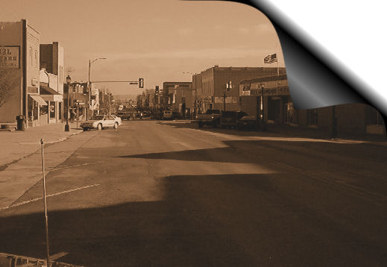

Technical Assistance to
Brownfields Communities (TAB)
Navigating the Challenges of Coalition Grants
Redevelopment Resources for Blighted Properties Workshop
Kankakee-Iroquois
Regional Planning Commission
August 18, 2010
Monon, IN

Slide 2
In keeping ‘green’ and paperless …
There is no handout. Please take away more in concepts and ideas than notes.
An electronic copy of this presentation will be e-mailed to you upon request.
Please e-mail:
Dave Koch / Terracon
dekoch@terracon.com

Slide 3
Coalition
Grantee
?
?
n. a combination; union; an alliance between entities, during which they cooperate in joint action, each in their own self interest.
EPA Brownfields; A coalition is a group of three or more eligible entities that submits one grant proposal under the name of one of the coalition participants who will be the grant recipient. Coalition members may not have the same jurisdiction (i.e., different departments within the same county government) unless they are separate legal entities (i.e., a city and a redevelopment agency).
Some observations on challenges
and solutions from the trenches …

Slide 4
Why Coalition approach?
Same reason a need for Regional Commission, the ‘multiplier’ effect of numbers
Individually, any one community may not;
  Have staff or resources to seek and manage the federal funds
  Have enough Brownfield sites to warrant a grant application
  Be able to demonstrate sufficient need to
  be competitive
  Be able to plug into other resources that will strengthen application and increase results

Slide 5
Brownfields are Opportunity
“Opportunity is missed by most people because it is dressed in overalls and looks like work.”
Thomas Alva Edison

Slide 6
5 Challenges of Coalitions
Picking The Right Partners
Picking Target Areas
Overcoming Geography
Overcoming Inertia
Dilution of Communication

Slide 7
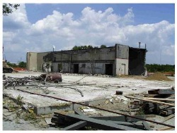
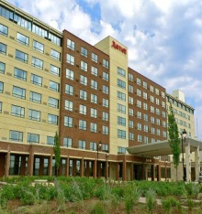
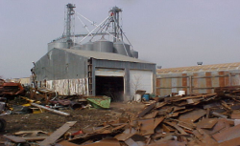
Picking Partners
Don’t form an assessment coalition simply on the basis of existing relationships
  Don’t try to ‘make fit’ partners of past projects or relationships without true Brownfield need
  Some successful economic development partners of the past can detract from coalition and weaken the balance of demographics and joint demonstration of need necessary at application
The strong primary grantee often has 3 traits;
  Strong, well established management structure across the geographic boundary of the coalition
  Ability and experience to manage federal funding through partnerships
  Ability to serve as an unbiased third party directing force in managing assessment and equitable deliveries to partners

Slide 8
Picking Partners
Navigating the Pitfalls
All partners are not equal
  In need, resources, commitment and even sincerity
Partners must believe they have Brownfield issues affecting their community
  Surprising how many express interest because they only see ‘another pot of federal money’
  Others are surprised once they ‘join up’ that Brownfields can mean blight and see it as a stigma on their community
Each should have a Brownfields champion, better yet two
  Often not the lead representative, doers over managers
  Person who has time to respond quickly to coalition requests, attend working meetings and events
  Person who has the support of ‘their boss’ to give these
  on a regular basis as a reasonably high priority

Slide 9
Picking Partners
Navigating the Pitfalls
Brownfields
  Brownfield funding is not a silver bullet that will
  solve all economic development issues
    In some rare instances it has become Pandora’s Box
The successfully funded coalition will reach out and engage the region, communities and stakeholders in a process that educates and helps participants self-evaluate the appropriateness and need for Brownfields assessment and the benefits it may or may not bring
So too, should a coalition during its formation
    Engage potential partners in understanding what Brownfields are and are not
    Educate them as to the limits of Brownfields funding, what it can and cannot do
    Demonstrate by example what has been done by other coalitions, both the good and the negative aspects of participation

Slide 10
Partners Must Understand Grant’s Role
Idled
Discovery
Assessment
Corrective Action
Reconstructed
Red Zone
RECs
Identified
Perceived Property Value ($)
Developer and other capital-source interest in the property.
Brownfields Grant $
RECs: ASTM E1527-05 Recognized Environmental Conditions produce a stigma that affects property value whether impairment is real or not.
Notes:
Koch

Slide 11
Partners Must Understand Grant Process & Timing
Preparation Phase
EPA Debrief
Original
Application
Contact
Partnerships
Draft Using
Old Guidelines
Guidelines
Released
Update/ ‘Tune’
Application
State Letter
Of Support
Contractor
Prequalification
September /
October
Last 30 Days
Competition Phase
Final
Application
Get EPA
Support Letter
Application
To Local EPA
EPA Region
Threshold
Scoring
EPA HQ
Receives All
Scoring/
Ranking Groups
Nationwide
EPA Compiles
Scores
October
November
January - February
February - April
EPA/Grantee Contract Phase
Contractor
Competition
Grant
Award Notice
Brownfields
SF424
Final
Coalition
MOAs
Primary
Cooperative
Agreement
Work Plan
(Administrative)
Grant
Money
Implement
Agreement
April – May
June - July
July - August
October 1
Unless Pre-Award
* MOAs: Memorandum of Agreements between Coalition partners with primary grant recipient MWGRC

Slide 12
Partners Must Understand Basics of Programmatic Processes & Timing
EPA Quality
Plans
QMP
(Revised)
QAPP
To EPA
EPA Approves
QAPP
Phase II
Workplan
to EPA
EPA Approves
Phase II
Workplan
Up to 90 Days
20 to 30 Days
ACRES
New 2007
Property Profile Form
STOP
Eligibility/Screening/
Prioritize Sites
Inventory
EPA Site
Approval
Phase I
Access
Phase I
ESA and AAI
Phase II
Access
STOP
State Liable
& Viable
STOP
Outreach
STOP
Phase II
Assessment
Field QC &
Audits
QA Lab Data
PARC
Phase II ESA
Report
Cost-to-
Remedy
Analysis
Reports to
Client & EPA
Cleanup
Planning

Slide 13
Picking Target Areas
Seems to be commonly one of the most difficult things for coalitions to get their heads around in the early stages of grant application
  Partially due EPA guidance that assessments must be coalition-wide and need not provide property-specific details, but then ask for very detailed specifics of need and demographics
  Common area of conflict in debrief comments
Target Areas are your demonstrations of need for Brownfield funding
  They will represent your project, although they physically can be much smaller segments than the overall coalition
  They will provide 80-90% of your documentation statistics; demographics, financial impacts, etc.
  They should have a common element that comes across as a Brownfields-related issue of health or financial distress
    Automotive Alley
    Smelter Waste Region
    I-75 Relocation Corridor
    Blue Creek Watershed
    Southside Neighborhood

Slide 14
Economic Development Projects
That Have ‘Hit The Wall’
Concept
Business Model
Capital
Financing
Market Feasibility
Evaluate
Risk
Deal
Fails
Construction Risks
Environmental
Phase I / II ESA
real or perceived
Notes:
Koch

Slide 15
Practical Definitions
Brownfields are real estate deals with an environmental “twist” that complicates, but does not prevent, redevelopment of the property. The property may not be contaminated.
Brownfields are properties caught between “clean” and “nasty” Superfund.
  “Clean enough” not to be public hazards
  Perceived as too “dirty” for investors’ comfort
In view of the current economy, Brownfields are also identified as Green & Sustainable

Slide 16
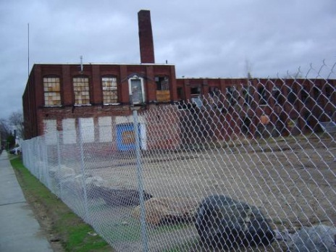
Picking Target Areas
Navigating the Pitfalls
Coalition target areas, to be meaningful, must conduct some preliminary research prior to application and establish the common element
  Canvass the local public through coalition partners to gain insights
  Engage public health and economic development departments
  Engage state environmental regulator perceptions and databases
Do a preliminary inventory to test that target areas do indeed have common issues and are Brownfields
  A list of sites generated by a database search is not enough
    Many, many listed sites are ineligible
    Brownfields by definition are those that fall between “clean” and enforcement
    Many listed sites are actually owners conducting their business properly (i.e., small quantity hazardous waste generators)
  Apply the EPA eligibility rules , even though community- / coalition-wide
  This is not the detailed inventory and prioritization that will occur with
  funding later

Slide 17
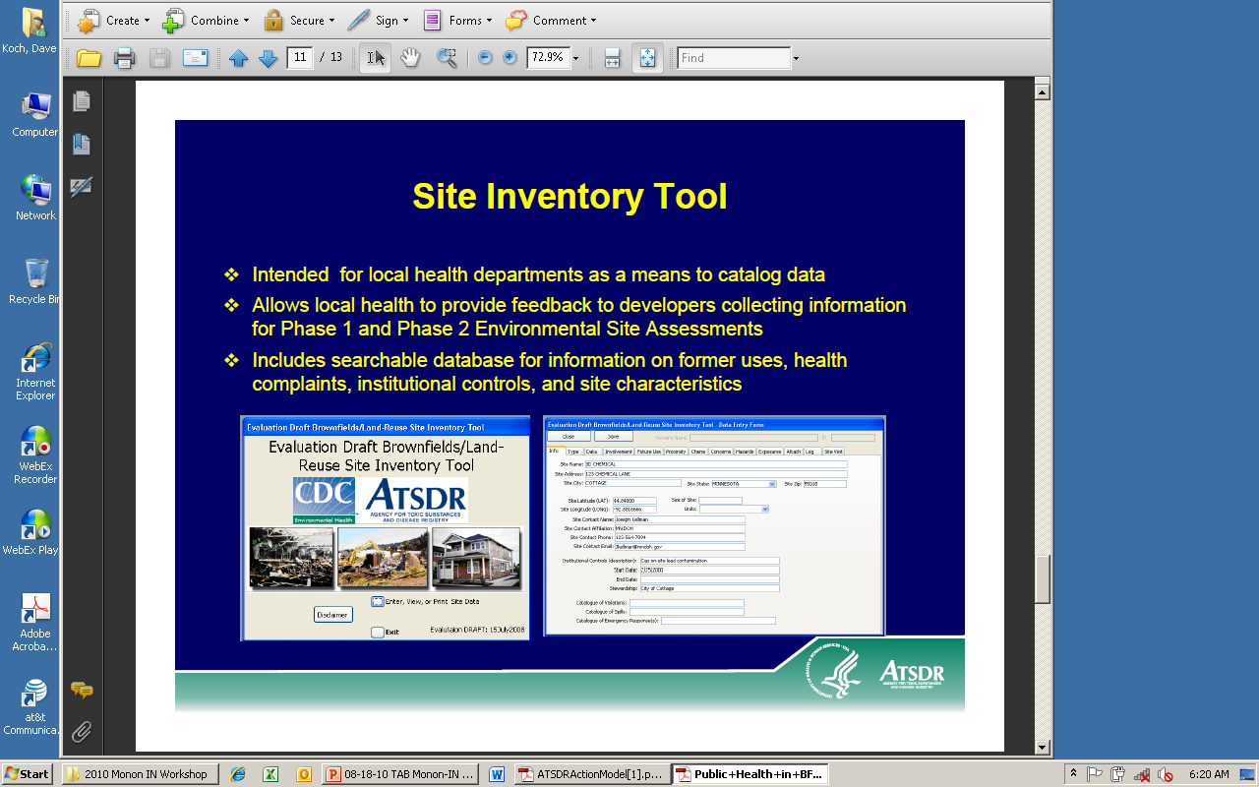
Picking Target Areas
Navigating the Pitfalls
The inventory should be compiled by the partner(s) geographically enclosing the Target Area
There are a number of good tools for developing a preliminary inventory, many of them capable of expanding into the working inventory of the coalition assessment grant
  BIT (Brownfield’s Inventory Tool) by TAB
  ATSDR’s Reuse Site Inventory Tool
  As simple as custom spreadsheets

Slide 18
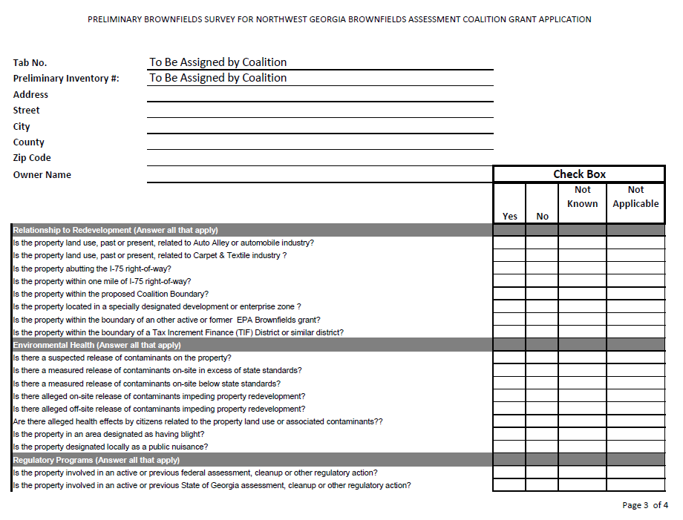
Inventory Has Two Different Functions,
Always Tailored to Coalition Needs
Now;
Demonstrate needs and target area for grant application
After Award;
Determine eligibility, rank/score properties and prioritize to needs of coalition

Slide 19
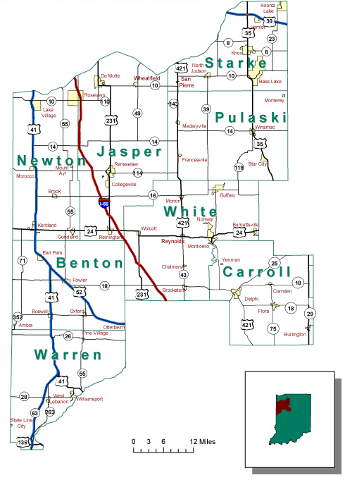
Overcoming Geography
Regional Planning Commissions have a better feel for the challenges confronting Brownfields assessment coalition applicants
They face the same thing in their extended organizational, multi-partner organizations every day
  Overlap and interaction of multiple administrative, political & financial spheres of influence
  Balancing very location-specific opportunity for reinvestment for equity of benefit to partners vs equity of return to the region

Slide 20
Overcoming Geography
Navigating the Pitfalls
With coalition partners and stakeholders spread out over hundreds or thousands of square miles, scheduled communication between partners becomes a necessity to be effective
These working sessions can take a number of forms to fit your geography
  Bi-weekly conference calls
  Face-to-face meetings, often coinciding with community outreach events
  WebEx, Windows Meeting or other similar online
    Convenience of your own work personal computer
    Adds visual presentations and materials sharing
    Removes need and expense to travel

Slide 21
Overcoming Geography
Navigating the Pitfalls
Too much talk, not enough action, can easily eat up a 3 year coalition assessment grant
Partners should set the ground rules for performance and active participation
The directing coalition committee, task force or other should not be overly large
  Too many cooks in the kitchen doesn’t spoil the soup, but it takes forever to do the dishes afterward
  Champions should meet more frequently and report back to coalition partners for input

Slide 22
Use Community-Based Organizations
Community Service and Action
Community service and action CBOs focus on improving the general physical characteristics of a community. Although particular programs may be quite specific, these organizations tend to view their programs not merely as ends in themselves, but rather to see such progrms within a broader community perspective. The CBOs categorized here differ from other problem-oriented CBOs in being more multipurpose. Descriptive Examples: Civic Service Groups, Community Development Groups, Neighborhood-Improvement Groups, Community Protection Groups, etc.
Health
Health CBOs focus on preserving and enhancing the physical and/or mental health of a community including treatment of health problems, aftercare, and rehabilitation. Descriptive Examples: Health Education, Hospitals/Health Treatment Facilities, Crisis and Suicide Hotlines, Nursing Homes, Public Health Support Services, Rehabilitative Medical Services, Emergency Assistance, Hospices, Residential/Custodial Care, Community Health Care, Drug and Alcohol Abuse Treatment and Prevention Groups, etc.
Educational
Educational CBOs have as their primary goal the education or increasing learning and knowledge of community residents. These groups are either directly involved or contribute to the educational process. Descriptive Examples: School-Based Educational Programs, School-Related Tutoring Programs, School-Based At-Risk Youth Programs, Community-Serving School-Based Groups, General Adult Education, Workplace-Related Programs, Adult Continuing Education, Literacy Educational Services, Preschool and Nursery Programs, etc.
Personal-Growth, Self-Development, Self-Improvement
Personal-Growth CBOs aim primarily to build character, personality, and skills in individuals primarily through self-help and experiential learning as opposed to formal education. Descriptive Examples: Youth Development Programs, Adult Development Programs, Future Farmers, Adult/Child Matching Programs, Boys/Girls Clubs, CYO, Scouting Organizations, YMCA/YWCA, etc.
Social Welfare
Social Welfare CBOs are oriented primarily toward providing for the general welfare of some category of community resident facing serious social problems due to their social situation. Their focus and the prime legitimatization of their activity is not the community as a whole, but rather, service to particular categories of persons seen as having special needs, problems, or requirements. Descriptive Examples: Marriage and Family Problems Groups, Friendship/Relations Groups, Crime and Delinquency, Employment Assistance (e.g. Job Development/Training), Vocational Rehabilitation, Volunteer Recruitment, Screening Referral and Advocacy Groups, Consulting and Technical Assistance Groups, Homeless Shelters/Temporary Housing, Housing Support Services, Women's and Children's Shelters, Children/Youth Support Services, etc.
Self-Help Disadvantaged and Minority
Self-help disadvantaged and minority CBOs have as their focus the betterment of the poor, women, or other such traditionally disadvantaged
groups. These CBOs are generally oriented toward improving the quality of common welfare and quality of life of their target populations
through changing society's perceptions and treatment of disadvantaged people. Descriptive Examples: Senior Citizens Programs,
Programs for Persons with Physical and Cognitive Disabilities, MHMR Programs, etc.

Slide 23
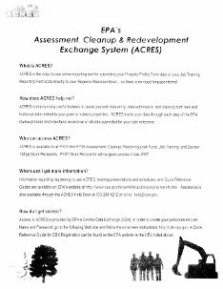
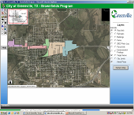
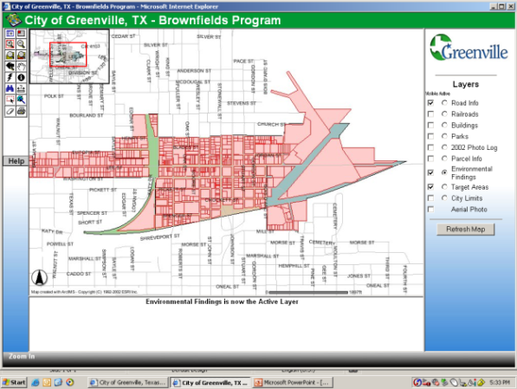




Communication
Bi-weekly E-status as e-mail to primary stakeholders and regulators organized by task
  Answers that surprise question by public, media, supervisors or politicians … “What’s happening?”
Quarterly reporting in Assessment, Cleanup & Redevelopment Exchange System (ACRES)
Electronic Data Management
  No “piles of files”
  Use the “low end of high tech” for online, cost-effective data management and sharing
  Updating support for GIS system
Notes:
23
Scott
We understand that this Task is that of the ETRA Project Manager, we also know that the PM cannot do a good job of it unless the consultant readily provides both updated status and readily accessible documents.

Slide 24
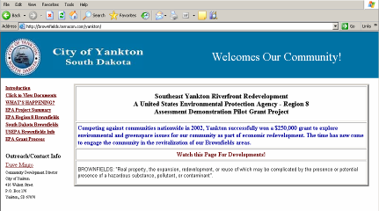
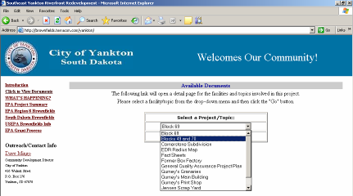
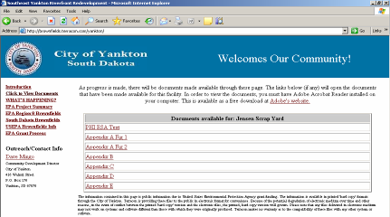
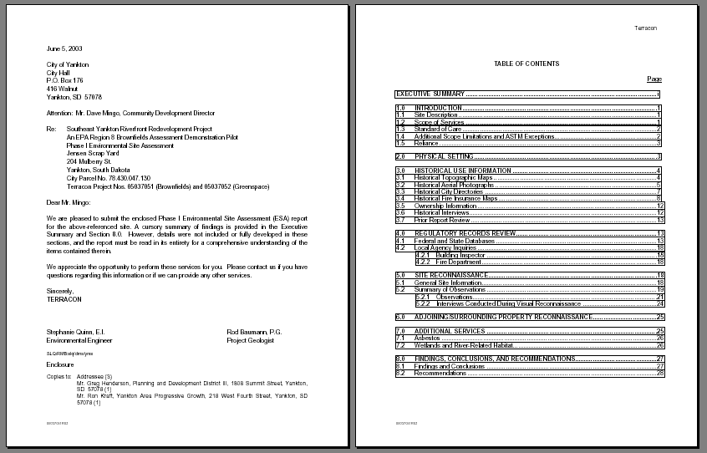
Internet- or intranet-based.
Point-and-click navigation.
Linkable to GIS, CADD and other documents with viewers made resident on system.

Slide 25
Thank You
Notes:
Scott

