Slide 1

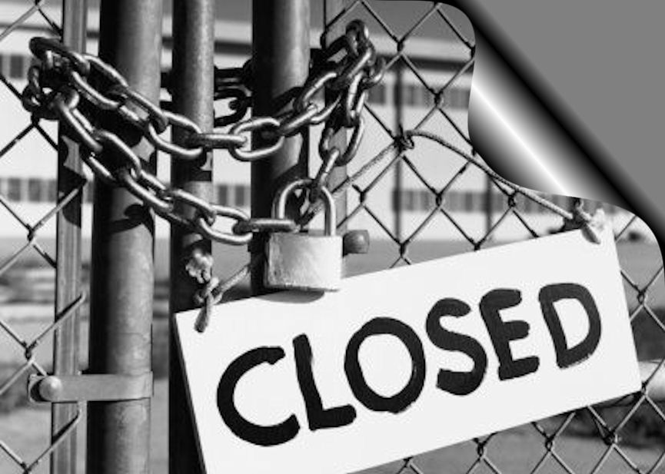

Tried, True and Unexpected Funding for Brownfields Redevelopment
Garden City, Kansas March 30, 2011

Slide 2

Today …
Examples of (non-EPA) federal program tools/tax incentives that can be put together in a brownfield effort – and what they can do
Low cost/no cost strategies with important $$ impacts
Emerging local financing strategy innovations that communities are exploring that can be linked to brownfield efforts
Examples of diverse resources in action…

Slide 3

Public Tools Promoting
Brownfield Reuse
To provide resources directly
  Grants; forgivable loans
But also to…
Reduce lender’s risk
  loan guarantees; companion loans
Reduce borrower’s costs
  interest-rate reductions/subsidies; due diligence assistance
Improve the borrower’s financial situation
  re-payment grace periods; tax abatements and incentives; technical assistance help
Provide comfort to lenders or investors
  performance data, risk management/corroboration

Slide 4
Every Aspect of the
Brownfield Reuse Process…
brownfield reuse/redevelopment planning
site acquisition
environmental assessment
removal or remediation of contamination
installation of institutional controls
site clearance, demolition, and debris removal
rehabilitation of buildings
construction of infrastructure, related improvements that enhance contaminated property value

Slide 5
Non-EPA Funding Used to Finance Brownfield Reuse
Loans
  EDA capital for local revolving loan funds
  HUD funds for locally determined CDBG loans and “floats”
  EPA capitalized revolving loan funds
  SBA’s microloans
  SBA’s Section 504 development company debentures
  EPA capitalized clean water revolving loan funds (priorities set/ programs run by each state)
  HUD’s Section 108 loan guarantees
  SBA’s Section 7(a) and Low-Doc programs
  USDA business, intermediary, development loans
Grants
  HUD’s Brownfield Economic Development Initiative (BEDI)
  HUD’s Community Development Block Grants (for projects locally determined)
  EPA assessment, cleanup grants
  EDA public works and economic adjustment
  DOT (various system construction, preservation, rehabilitation programs)
  Army Corps of Engineers (cost-shared services)
  USDA community facility, business and industry grants
Equity capital
  SBA Small Business Investment Cos.
Tax incentives and tax-exempt financing
  Targeted expensing of cleanup costs
  Historic rehabilitation tax credits
  Low-income housing tax credits
  Industrial development bonds
  Energy efficiency construction credits
Tax-advantaged zones
  HUD/USDA Empowerment Zones
  HUD/USDA Enterprise Communities

Slide 6
Assessment Grants
Authorized Brownfield Funding
Cleanup Revolving Loan Fund Grants
$200 Million*
Communities
Direct Cleanup Grants
Job Training Grants
*25% Must Be Used For Petroleum
Brownfield Targeted Assessments
By EPA Regional Contractors
$50 Million
States & Tribes*
State & Tribal Response and Voluntary Cleanup Programs (Including 128a Assessments)
New: EPA Area-Wide Planning & Renewable
Energy Feasibility Grants
Notes:
128a Assessments are the CERCLA reference for funding in the Act. These are done by state agencies through state contractors. Terracon is a contractor in KS, NE, SD, and MN.

Slide 7
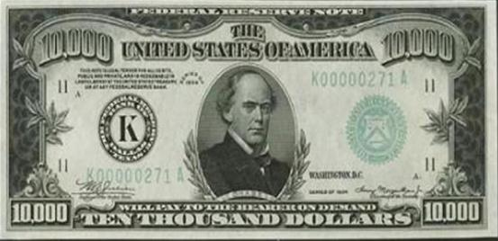
Commonly used (non-EPA) federal resources… especially in smaller communities
HUD – CDBG
EDA – public works, economic dislocation
DOT – enhancement, construction, system rehab/modernization
USDA – rural development/community facilities loans and grants
Tax code incentives – for housing, cleanup, structural rehabilitation

Slide 8
HUD Supported
Entitlement and State/Small Cities CDBG Programs
    Cities over 50,000 people get annual formula allocations
    Each state gets an annual funding allocation from HUD to meet small cities’ (less than 50,000 population) community development needs
    CDBG funds must meet one of HUD’s 3 broadly defined program objectives:
      addressing the needs of low- and moderate-income people (at least 51% of funds)
      addressing slums and blight
      meeting an urgent community need

Slide 9
CDBG Eligible Activities
Linking to Brownfield Needs
Demolition and removal
Rehabilitation of public and private buildings
Planning
Construction or reconstruction of infrastructure, neighborhood centers, recreation/public works facilities
Can include coping with contamination as part of site preparation or infrastructure development
Can be lent to private companies in some circumstances
For the state/small cities program –
  Each state sets it own project funding priorities, defines its own program requirements, within these objectives and activities

Slide 10

Indiana
State/Small Cities CDBG
$ 31.3 million in FY 2009 – making
the fit to brownfields:
Community Focus Funds
  Eligible projects include – infrastructure, downtown revitalization, historic preservation, community centers
Micro-enterprise assistance
  Goal is long-term community development – why not focus on businesses on brownfield sites?
Planning
  Facilitate projects such as downtown revitalization and community facilities – why not target to brownfield activities?

Slide 11
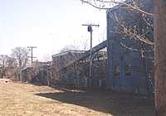
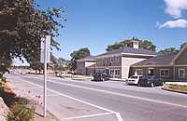
CDBG:
Marsh Island Carry – Old Town, ME
Abandoned 3-acre Lily-Tulip paper plate manufacturing site on Penobscot River. Converted into waterfront park, 2 commercial buildings
Key funding included $400,000 state/small cities CDBG grant for infrastructure around commercial buildings
Other funding included:
  $24,500 from the National Trails Recreation Act for trails, walkways, and river stabilization
  $8,000 from ME Forest Service for trees
  Leverage: 4 new businesses, 30 jobs, $18,000 in property tax revenues, open space

Slide 12
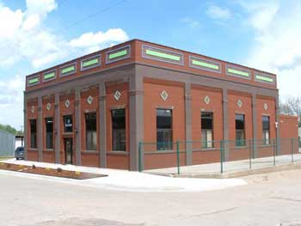
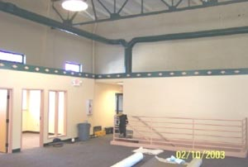
CDBG:
Small Business Incubator, Walthill, NE
HCCDC Business Center Building Renovation
Renovated and modernized former 4,000 SF former electric power plant site, built in 1910, abandoned 20+ years
Project Cost $430,000.00
Financing included –
  $105,000 in state small/
  cities CDBG
  $150,000 local sources

Slide 13
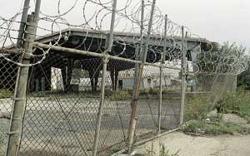
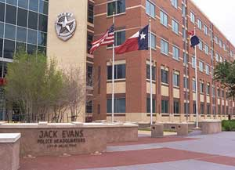
HUD/CDBG
Jack Evans Police Station, Dallas TX
Small, isolated brownfield site used to meet critical public service need
Jack Evans police station, on 3.2 acre former gas station/ dry cleaner site
$150,000 in CDBG used for site preparation, including cleanup and demolition
Construction funded with G.O. bonds

Slide 14

Economic Development Administration
Key EDA related programs and initiatives include:
  Public works grants finance industrial development site and infrastructure preparation
  Economic dislocation program capitalizes RLFs for distressed areas
  Rural planning to support revitalization, through EDDs
  Key EDA eligibility factor – high relative unemployment rate

Slide 15
EDA
EDA typically puts 50% + of its resources into small/mid-sized towns and rural areas
Since 2001, ~$250 million invested in ~250 brownfield projects
  $50 million in rural areas
  55% in public works
  9% in planning
  25% in economic adjustment

Slide 16
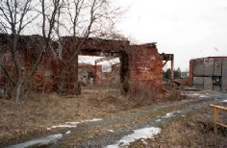
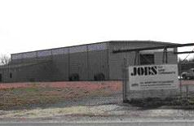
EDA/Public Works
Plainview Steel, Plainview- AR
Lumber/pressure treating facility, shut down in 1986 after quarter-century of operations; declared superfund site in 1999. Cleaned, redeveloped as specialty steel plant.
$763,000 in EDA public works funding supported site preparation, construction, infrastructure upgrading as part of $1.1 million financing package
Today – 25 new jobs, significant tax revenues for community

Slide 17
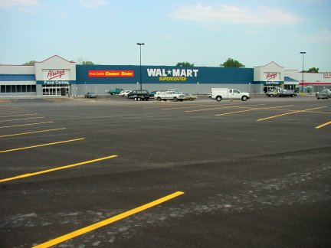
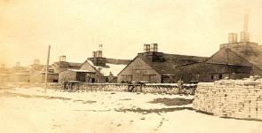
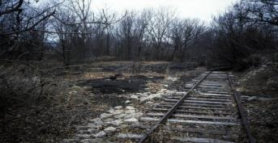
EDA/Planning
Cimarron Center, Sand Springs, OK
Former zinc smelter, abandoned rail spur in small Oklahoma town
Challenge was structuring a cleanup plan that made the site competitive with nearby greenfield for big-box retail
Financing included EDA planning resources, local TIF
Leverage -- Cimarron Center, with Wal-Mart Supercenter as anchor, has created 350 new jobs, added $3.5 million in annual city sales tax revenues

Slide 18

USDA
Rural Development Programs
USDA rural development funds must meet broadly defined program objectives -- 4 key programs can do this within a brownfields context:
Community facility loans and grants – for a range of development and community benefit projects
Business and industry loans – to public or private organizations, for activities such as industrial park site development/rehabilitation or access ways
Intermediary re-lending program – intermediaries such as local governments are loaned money to re-lend to companies, in order to finance business facilities
Rural development grants (RBEGs/RBOGs) – given to provide operating capital and finance emerging private business and industry

Slide 19
USDA-RD Funds
Supporting Brownfield Redevelopment
Eligible activities can include:
  Planning for redevelopment or revitalization – for businesses and community facilities (which could include brownfield projects)
  Site clearance/preparation, including demolition – key brownfield reuse/redevelopment activities
  Rehabilitation/improvement of sites or structures – which might need to include removal or remediation of contamination as part of project
  Construction of real estate improvements
  Installation of amenities to enhance development

Slide 20
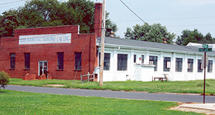
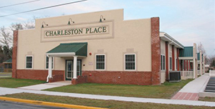
USDA
Charleston Place, Seaford, DE
Abandoned sewing factory, built in 1920s
Developed by non-profit Better Homes of Seaford
$600,000 USDA rural development loan, plus DE Housing Authority and private bank participation
Ribbon cutting 1/9/06; fully occupied by March

Slide 21


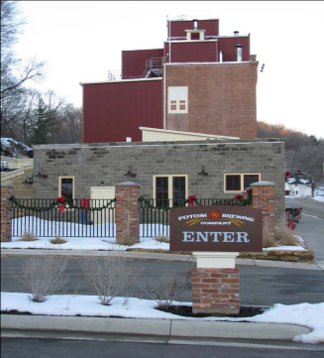
USDA
Potosi Brewery, Potosi, WI
Brewery built 1852 in Potosi (700), abandoned 1972. Asbestos, lead paint, other contaminants
$3.3 million B&I guaranteed loan key to securing additional $4.2 million in financing
Transformed Potosi’s main street; community involvement key
Result: Refurbished as micro-brewery, brewing museum and library, opened June 2008
50 new jobs, 4 new beers

Slide 22

Transportation Programs
Must work thru state MPOs, local transportation agencies
In March 2009, DOT re-affirmed its brownfield policy
  Transportation funding can be used for cleanup at sites integral to transportation system development/upgrades
DOT highway/transit construction programs can support related revitalization by:
  helping upgrade existing facilities
  offer transportation amenities that improve access to – and marketability of – sites
  fund facilities and structures that serve as part of the remedial solution

Slide 23

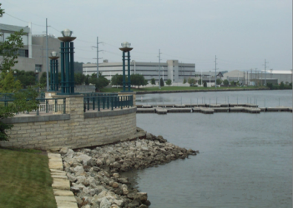
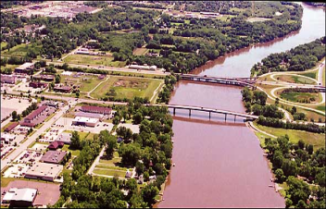
DOT
Arterial Road Installation, Moline, IL
largely abandoned riverfront, former industrial/warehousing uses
converted to residential and marina/mixed use complex and commercial space
$3.2 million in state and federal funding included DOT funds for road grid and enhancements

Slide 24
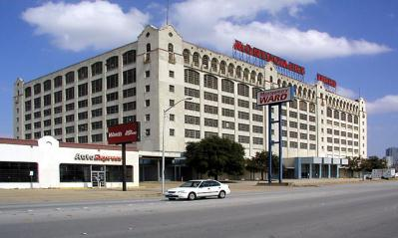
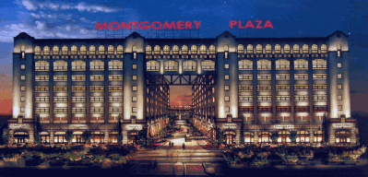
DOT
Old Montgomery Ward Distribution Center,
Fort Worth, TX
Historic “white elephant” on a 45-acre site adjoining CBD
DOT Congestion Mitigation and Air Quality Improvement for road and sidewalk infrastructure
Other financing tools used
  Historic rehab tax credits
  State tax abatements, fee waivers
Today -- DOT mixed use commercial/ retail/office complex, CBD extension

Slide 25

Federal Tax Incentives
3 with particular relevance to smaller cities and smaller sites –
  Rehabilitation tax credits
  Low income housing tax credits
  Brownfield cleanup expensing

Slide 26
Tax Incentives in Brownfields
Increase project’s internal rate of return
Ease borrower’s cash flow by freeing up cash ordinarily needed for tax payment
Some credits can be sold for cash, or syndicated to attract additional investment
Not subject to competitive public grant process – you qualify, you win!

Slide 27
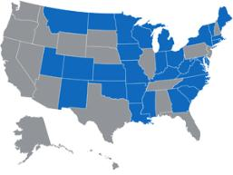
Rehabilitation Tax Credits
Historic Preservation Credit in Kansas
  Online Economic Impact of Historic Rehabilitation Tax Credits in Kansas
Taken the year renovated building, in service
20% credit for work done on historic structures, with rehab work certified by state
10% credit for work on “non-historic” structures build before 1936; no certification required
In 2008; 1,231 projects, $1.12 billion credits
  leveraged $5.64 billion in private investment
  led to nearly 68,000 jobs
  17,051 housing units, 5,200 affordable

Slide 28
Rehabilitation Tax Credits caveats and “fine print”
Rehabilitation costs must be “substantial” – i.e., exceed minimum of $5,000 or the building’s adjusted basis
Property must be “income-producing” – multi-family rental housing can claim the 20% credit, but not the 10% credit
Rehab work must conform to state historic preservation standards – which can deter integration of “green” technologies
Credit is recaptured on a sliding scale (20% annually) if owner disposes of the building within five years of completing renovation

Slide 29
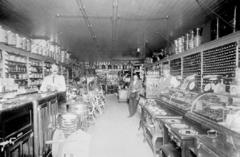
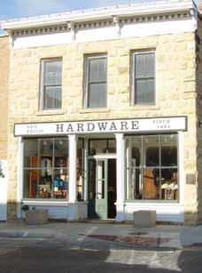

Philip Hardware Store
Hays, Ellis County, Kansas
Originally 1874 Hardware Store
New Use: Retail/Residential
Total Project Costs: $424,932
  Qualified Project Costs $304,480
  State Historic Tax Credits $76,119
  Federal Historic Tax Credits $60,896
Incentives Used:
  State and Federal Historic Tax Credits
  Property Tax Abatement
  Heritage Trust Fund Grant

Slide 30
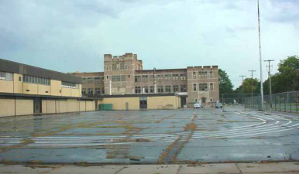
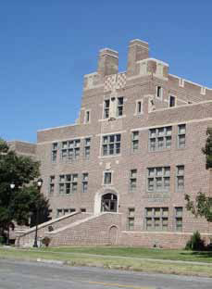
Roosevelt-Lincoln Jr. High School
Salina, Kansas
Current Name: Pioneer President’s Place
Construction date: 1915-1925
New Use: Low-Income Senior Housing
Total Project Costs: $8,639,603
  State Historic Tax Credits: $2,042,886
  Housing Units: 61 (Rents start at $275/month.)
Incentives:
  State and Federal Historic Tax Credits
  Low Income Tax Credits
  Property Tax Rebate for 10 years

Slide 31
Low-Income Housing Tax Credits
Can encourage capital investment in affordable housing/target investment to certain areas – vacant properties, brownfields, infill locations, other priority sites
  States get annual population-based allocation for distribution to communities and non-profits – approx. $1.75 per capita
Investors can get 9% annual credit for 10 years for qualified new construction/rehabilitation costs (i.e. 90% of total) for projects not financed with federal subsidy
  Federal subsidy limits credit to 4%
Credits can be used for new construction, rehabilitation, or acquisition and rehabilitation

Slide 32
Low-Income Housing Tax Credits
“fine print” and caveats
Wrinkles…
  Loss of tax incentive value on secondary market – from about 95 cents/$ to about 65 cents/$ now
  “Green” priority for credit allocations within states
Credits support a wide range of housing types/situations
  Urban, suburban, rural projects
  Housing for families, special needs tenants, elderly
$3.85 billion in credits issued in fiscal year 2008, supporting 1/3 of all new construction in that year
Impacted by Recession like everything else

Slide 33
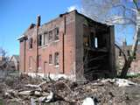
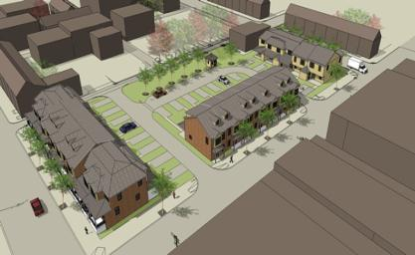
Mifflin Mills, Lebanon, PA
PA’s first affordable “rent-to-own” townhouse community
Former vacant, blighted city block near downtown
Energy efficient construction, designed to blend into existing residential neighborhood
20 units, completed Nov. 2009
$1.5 million in low-income housing tax credits key part of financing package needed to attract investors to rent-to-own project structure

Slide 34
Brownfield Cleanup Expensing Tax Incentive
Deduction pegged to cleanup costs, which allows new owners to recover cleanup costs in the year incurred; only incentive targeted to private site owners
Can include:
  Site assessment, cleanup, monitoring costs
  Costs related to install/monitor institutional controls
  State VCP fees and associated costs
  Removal of demolition debris
No long term authorization in place; most recently extended until 12/31/09 (retroactive to 1/1/08)
  Petroleum sites made eligible in 2007 extension

Slide 35
Brownfield Cleanup Expensing caveats and “fine print”
“Stealth incentive” – less than 2 dozen projects annually
Little understanding of what it is, what it does, how it works
  On the part of Treasury (no regs/guidance), developers, transaction support professionals, state agencies who certify
Process not well articulated at state level
Authorized in “fits and starts”
  Makes long-term, larger projects hard to plan
Subject to recapture on transfer
  Vague Treasury interpretation deters use

Slide 36
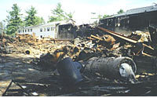
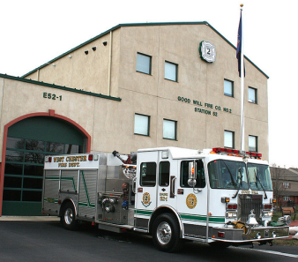
Alliance Environmental
Goodwill Fire Department, West Chester, PA
8.5 acre former pharmaceutical property and dump site in economically distressed area
Cleaned and redeveloped by Alliance Environmental
Now, location of Good Will Business Park: 100,000 sq. ft. of retail, public service facilities including fire department and district court
Incentive provided Alliance with nearly $800,000 in tax relief

Slide 37
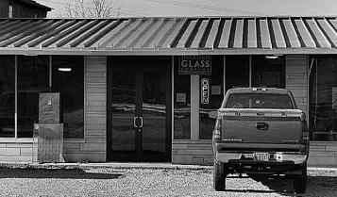
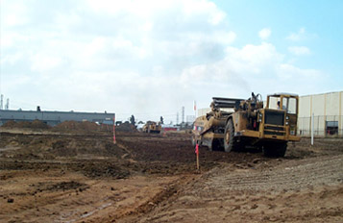
T.R. Thickston Glass Company Bloomington, IN
Former recycling center with foundry waste
Project spearheaded by environmental consulting firm familiar with tax incentive
Incentive saved about $80,000 in tax liability, used to support cash flow until redevelopment occurred
Result -- Site leased by T.R. Thickston Glass Company; created 3 jobs

Slide 38
“Low-Cost/No-Cost”
Brownfield Redevelopment Tools
Tools that enhance redevelopment financing – with little or no additional cash outlay
Institutional controls
  Can reduce site preparation, cleanup costs
Innovative remedial technologies
  Can lead to big reductions in cleanup costs
Cost saving technical assistance and project support
  Can save time, money, other development costs

Slide 39
Common Local Financing Tools
Putting a Brownfields “Spin” on the Local Tried-and-True … Making them Work for Site Cleanup and Reuse
    Tax increment financing/TIF-style financing
    Tax abatements
    Tax forgiveness
    Special service areas or taxing districts
    Revolving loan funds (RLFs)
    Property transfers

Slide 40
Local Initiatives
TAX INCREMENT FINANCING
Uses the anticipated growth in property taxes generated by a development to finance it; most common local financing tool supporting brownfield cleanup and reuse

Slide 41
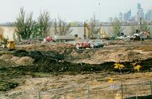
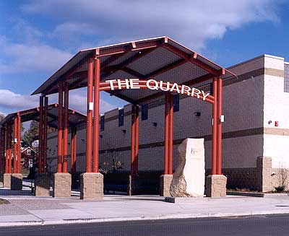
Johnson Street Quarry Minneapolis, MN
Johnson Street Quarry was a blighted, under-utilized property
A local developer wanted to build a 420,000 SF shopping mall
After extensive community involvement, as well as strong public/private cooperation, several major national retailers located in the retail center, including Target, Pet Smart, and Rainbow Foods
TIF was key to financing site preparation
Redevelopment of this property has spurred redevelopment in the surrounding area, created over 2,000 new jobs (much above original estimates) and increased property and sales tax revenues in excess of $3 million a year.

Slide 42
Local Initiatives
TAX ABATEMENTS
Reductions or forgiveness from tax liabilities, granted for a specific period of time (typically 5, 10, or 20 years); helps project cash flow
Fading with Recession stresses on counties and communities
  “can’t afford to give anything away’

Slide 43
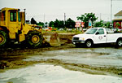
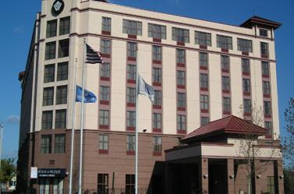
Urban Renewal District
Chelsea, MA
Blighted 10-acre outdoor storage yard for junk cars and equipment.
Developer purchased 2 acres for $1.2 million to construct a $17 million, 180-room, full-service hotel
10-year property tax abatement key incentive, used to offset site cleanup and preparation costs
Hotel now employs 100 workers, generates approximately $400,000 in sales and income tax revenue annually – even with the abatement in place.

Slide 44
Local Initiatives
TAX FORGIVENESS
Authorizes local governments to forgive back taxes on delinquent properties
In a brownfield context, these new tax forgiveness programs typically:
  Are linked to new owners or prospective purchasers
  Require agreement to clean up and reuse site
  Require purchaser to enter state VCP

Slide 45
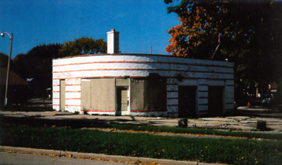
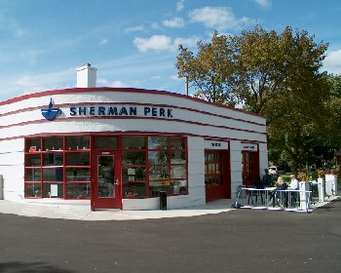
Sherman Perk, Milwaukee, WI
Abandoned gas station, closed since 1989
Issues of financing/addressing cost of petroleum contamination; 9 years tax delinquency
Financing included state forgiveness of back taxes linked to VCP participation, rehabilitation tax credits
Result -- reuse of historically significant building as successful neighborhood retail anchor
Notes:
Site – abandoned gas station, closed 10 years
Site – abandoned gas station, closed 10 years

Slide 46
Local Initiatives
SPECIAL SERVICE AREAS OR TAXING DISTRICTS
Cities can use a “special service area” designation to raise cash for activities, facilities, or bond servicing needed by the target area.
Property owners agree to the special levy or fee, based on its use in their area to finance maintenance or improvements.
Property owners may “self-impose” fees as part of a redevelopment agreement.

Slide 47
Local Initiatives
LOCALLY CAPITALIZED REVOLVING LOAN FUNDS (RLFs)
A growing number of communities are establishing their own RLFs targeted to redevelopment and brownfield-related projects; similar to state or federal RLFs, but they write the rules.
They use a wide variety of sources for capitalization – general revenue appropriations, bank contributions, philanthropic donations, fees or fines, repayments from CDBG projects, etc.

Slide 48
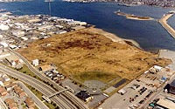
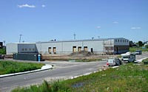
Waterfront Development
New Bedford, MA
Locally capitalized RLF used to pay for Phase I site assessments at sites served with environmental tax lien
Capitalization sources include local contributions, proceeds from property sales as liens are redeemed

Slide 49
Local Initiatives
PROPERTY TRANSFERS with intent
Site is transferred to new owner or user for a nominal fee, typically $1, in exchange for an agreement to clean up and reuse the property

Slide 50
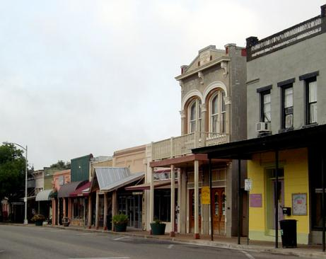
What about small communities?
Any community, even the smallest rural area, can face brownfield issues that may impede local development efforts.
The question here is … how can they identify and leverage $$$ to achieve brownfield success?
Can they do it?

Slide 51

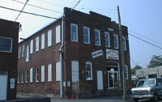
Yes, they can !!!
- Population does not measure success
- Making do with what is available
- Strength & success in combination
Small Town Bob
does brownfields!!

Slide 52
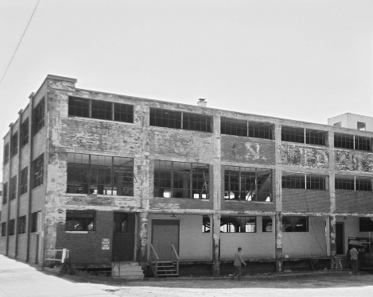
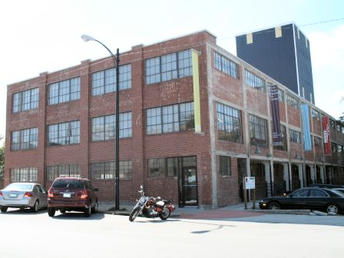
Abandoned Structures & Stream Restoration In Redevelopment Corridors
Brownfield Funding
  EPA Assessment Pilot, $200,000
  EPA Assessment, $200,000
  EPA Assessment, $300,000
  EPA Targeted Assessment, ~$40,000
  EPA Targeted Assessment Funding, $60,000
  2nd EPA Targeted Assessment Funding, $70,000
  EPA Assessment, $200,000
  EPA Assessment, $200,000
  Revolving Loan Fund, $1MIL
  EPA Cleanup Grant,
  $200,000
Notes:
Koch

Slide 53
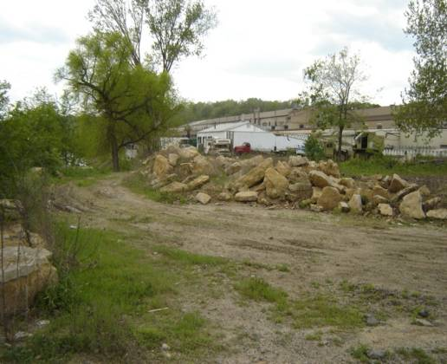
Small Railroad Properties
& Quality of Life
Atchison, KS
Brownfield Funding
  128a Assessments (3), ~$40,000
  EPA Assessment
  Grant, $200,000
Notes:
Atchison Kansas
Utilized Kansas state programs for 3 Phase I and II assessments – spurred intereted and won subsequent EPA assessment grant.

Slide 54

Find Every Dollar, Leverage It
Federal DOT Congressional Earmark - through KDOT | 1,000,000.00
KDOT Transportation Enhancement Program | 604,821.00
Economic Development Administration | 409,100.00
Kansas Dept. of Wildlife and Parks | 300,000.00
HUD EDI Special Project Congressional Earmark | 281,657.00
EPA Brownfields Assessment | 200,000.00
Kansas Water Office | 50,000.00
Total Federal and State Agencies | 2,845,578.00

Slide 55
Breakdown by Source of Funding | Dollar | Percent
Federal and State Agencies | 2,845,578.00 | 68.4%
Private Foundations | 532,500.00 | 12.8%
Private Citizens | 447,130.00 | 10.7%
City of Atchison | 192,322.00 | 4.6%
Private Businesses | 143,328.00 | 3.4%
Total Injection | 4,160,858.00 | 100.0%

Slide 56
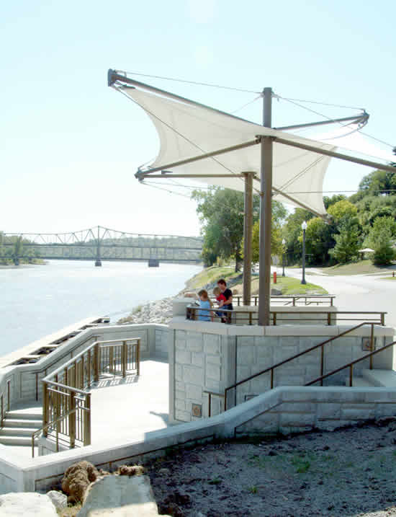
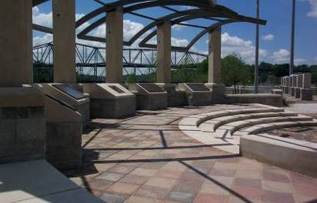
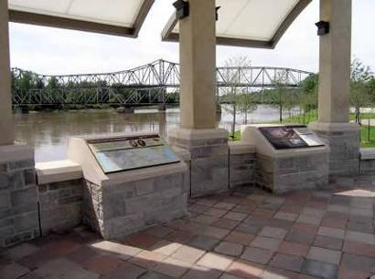
Notes:
Breakdown of Federal and State Agencies
Federal DOT Congressional Earmark - through KDOT 1,000,000.00
KDOT Transportation Enhancement Program 604,821.00
Economic Development Administration 409,100.00
Kansas Dept. of Wildlife and Parks 300,000.00
HUD EDI Special Project Congressional Earmark 281,657.00
EPA Brownfields Assessment 200,000.00
KDHE BTAs (3) 40,000.00
Kansas Water Office 50,000.00
Total Federal and State Agencies $2.8 MIL

Slide 57
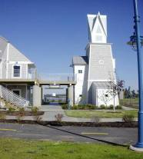
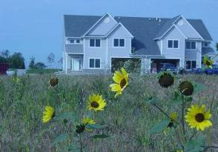
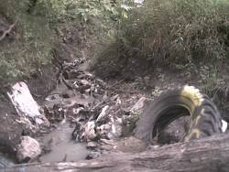






Former Riverfront Landfills
Population ~20,000
Brownfield Funding
  EPA Pilot Assessment, $200,000
  EPA Supplemental Pilot, $150,000
  State Program Grant, $120,000
  ~$600,000 Corps of Engineers Public Assistance to States
  Transportation Infrastructure~ $400,000
  TIF financing and incentives through City

Slide 58




Small Cities
Population Doesn’t Measure Success
Population 9,000 in 1999
Brownfield Funding
  EPA Assessment Pilot, $200,000
  EPA Supplemental, $100,000
  EPA Supplemental, $100,000
  EPA BCRLF, $1MIL
  $1.3MIL Corps of Engineers Public Assistance to States
  $900,000 Insurance Archaeology
  $80,000 PRP Archaeology
  $497,000 Economic Development Grant
  EPA Assessment,
  $375,000
  EPA Assessment,
  $380,000
  EPA Assessment,
  $387,000
  EPA Assessment,
  $364,000

Slide 59
Investment & Programs
Coralville Marriott Hotel and Conference Center: $70,000,000
Parking ramp and lot: $9,400,000
Demolition: $1,200,000
Wetlands mitigation: $1,440,000
Infrastructure improvements: $6,377,300
  $16MIL Green Streetscape Grant
  Supported by EPA Grants
River Bend commercial/residential development: $12,000,000
Land Acquisition: $30,000,000
Total: Over $140,000,000
956 new jobs to date

Slide 60


$ Resource Conservation:
Project-wide Reuse & Recycling
Complete buildings
Concrete and asphalt
Recycled 80,000 cubic yards

Slide 61



No Cost Savings Too Small: Wet ‘n’ Muddy Day

Slide 62






Slide 63


It’s not all fun & games …
3

Slide 64

But Brownfields is About Survival

Slide 65


Yes, they can!! Rosalia, WA –
Locally driven public-private partnerships can stimulate innovative site financing in small communities
1923 vintage Texaco gas station, in
downtown Rosalia, WA (pop. 600)
Abandoned 21 years; UST issues
Site as focus of “heritage tourism”
main street revitalization strategy
Converted to “gateway” retail,
craft/farmers market, visitor center
for nearby Steptoe Nat’l Battlefield,
national forest
Public financing sources include:
$33,000 USTfields pilot grant
$54,000 WA Dept of Ecology grant
$45,000 Whitman County
“community development ’08” grant

Slide 66


Rosalia Partners
Partner donations include:
Development grant sharing from
surrounding counties
Rosalia Lions Club
Rosalia “Gifted Grannies”
Retired Texaco Executives Assn.
Pro bono legal, remedial services
Utility incentive rates
Community sweat equity
First-ever partnership with a state
Dept. of Corrections

Slide 67
Question & Answer
Close with a favorite, Jewell, KS …

