Slide 1
Community Resources for Brownfields Redevelopment Tried, True, & Unexpected Funding Sources to Promote Site Redevelopment in Indiana
Charlie Bartsch
Senior Fellow/Vice President, ICF International
Osgood, IN
May 6, 2010
www.icfi.com

Slide 2
What this discussion will cover…
Range of (non-EPA) federal program tools/tax incentives that can be put together in a brownfield effort – and what they can do
Low cost/no cost strategies with important $$ impacts
Emerging local financing strategy innovations that communities are exploring that can be linked to brownfield efforts
Examples of diverse resources in action…

Slide 3
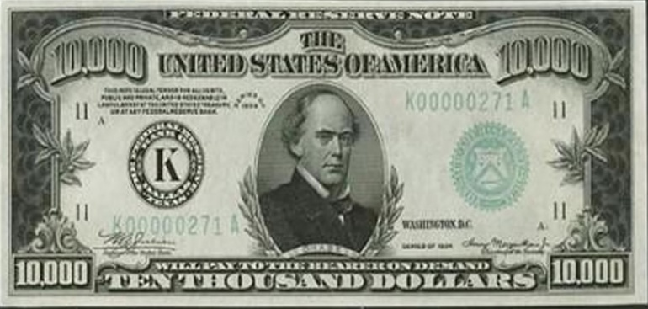
Public Tools Are Being Used in a Variety of Ways to Promote Brownfield Reuse
To provide resources directly
Grants; forgivable loans
But also to…
Reduce lender’s risk
loan guarantees; companion loans
Reduce borrower’s costs
interest-rate reductions/subsidies; due diligence assistance
Improve the borrower’s financial situation
re-payment grace periods; tax abatements and incentives; technical assistance help
Provide comfort to lenders or investors
performance data, risk management/corroboration

Slide 4
Putting it all together today: promoting brownfield reuse – the Pink Floyd strategy
Money, it’s a crime. Share it fairly but don’t take a slice of my pie.
It’s all about leveraging and partnerships….
Creatively using development and environmental procedures and funding to meet the range of site redevelopment needs, attract
attract private financing for –
Animals, 1977 – 1st ever brownfield album cover!

Slide 5
…Every Aspect of the Brownfield Reuse Process…
brownfield reuse/redevelopment planning
site acquisition
environmental assessment
removal or remediation of contamination
installation of institutional controls
site clearance, demolition, and debris removal
rehabilitation of buildings
construction of infrastructure, related improvements that enhance contaminated property value

Slide 6
Financing Programs: A Federal “Laundry List”
What’s Been Used to Help Finance Brownfield Reuse?
Loans
EDA capital for local revolving loan funds
HUD funds for locally determined CDBG loans and “floats”
EPA capitalized revolving loan funds
SBA’s microloans
SBA’s Section 504 development company debentures
EPA capitalized clean water revolving loan funds (priorities set/ programs run by each state)
HUD’s Section 108 loan guarantees
SBA’s Section 7(a) and Low-Doc programs
USDA business, intermediary, development loans
Grants
HUD’s Brownfield Economic Development Initiative (BEDI)
HUD’s Community Development Block Grants (for projects locally determined)
EPA assessment, cleanup grants
EDA public works and economic adjustment
Grants (continued)
DOT (various system construction,
preservation, rehabilitation programs)
Army Corps of Engineers (cost-shared
services)
USDA community facility, business and
industry grants
Equity capital
SBA Small Business Investment Cos.
Tax incentives and tax-exempt financing
Targeted expensing of cleanup costs
Historic rehabilitation tax credits
Low-income housing tax credits
Industrial development bonds
Energy efficiency construction credits
Tax-advantaged zones
HUD/USDA Empowerment Zones
HUD/USDA Enterprise Communities

Slide 7
Most commonly used (non-EPA) federal resources…especially in smaller communities
HUD – CDBG
EDA – public works, economic dislocation
DOT – enhancement, construction, system rehab/modernization
USDA – rural development/community facilities loans and grants
Tax code incentives – for housing, cleanup, structural rehabilitation

Slide 8
HUD Supported Entitlement and State/Small Cities CDBG Programs
Cities over 50,000 people get annual formula allocations
Each state gets an annual funding allocation from HUD to meet small cities’ (less than 50,000 population) community development needs
CDBG funds must meet one of HUD’s 3 broadly defined program objectives:
addressing the needs of low- and moderate-income people (at least 51% of funds)
addressing slums and blight
meeting an urgent community need

Slide 9
CDBG Eligible Activities – With Links to Brownfield Needs -- Include:
Demolition and removal
Rehabilitation of public and private buildings
Planning
Construction or reconstruction of infrastructure, neighborhood centers, recreation/public works facilities
Can include coping with contamination as part of site preparation or infrastructure development
Can be lent to private companies in some circumstances
For the state/small cities program –
Each state sets it own project funding priorities, defines its own program requirements, within these objectives and activities

Slide 10
Indiana State/Small Cities CDBG
$ 31.3 million in FY 2009 – making
the fit to brownfields:
Community Focus Funds
Eligible projects include – infrastructure, downtown revitalization, historic preservation, community centers
Micro-enterprise assistance
Goal is long-term community development – why not focus on businesses on brownfield sites?
Planning
Facilitate projects such as downtown revitalization and communitiy facilities – why not target to brownfield activities?

Slide 11
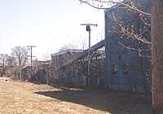
CDBG: Marsh Island Carry – Old Town, ME
Abandoned 3-acre Lily-Tulip paper plate manufacturing site on Penobscot River
Converted into waterfront park, 2 commercial buildings
Key funding included $400,000 state/small cities CDBG grant for infrastructure around commercial buildings
Other funding included:
$24,500 from the National Trails Recreation Act for trails, walkways, and river stabilization
$8,000 from ME Forest Service for trees
Leverage: 4 new businesses, 30 jobs, $18,000 in property tax revenues, open space

Slide 12
CDBG -- Small Business Incubator, Walthill, NE
Small business incubator in Walthill (population 909)
Renovated and modernized former 4,000 sq. ft. electric power plant site, built in 1910, abandoned 20+ years
Financing included –
$105,000 in state small/ cities CDBG
$150,000 local sources

Slide 13
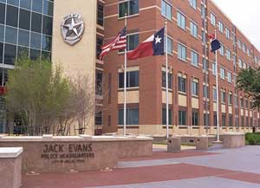
HUD/CDBG -- Jack Evans Police Station, Dallas TX
Small, isolated brownfield site used to meet critical public service need
Jack Evans police station, on 3.2 acre former gas station/ dry cleaner site
$150,000 in CDBG used for site preparation, including cleanup and demolition
Construction funded with G.O. bonds

Slide 14
Economic Development Administration
Key EDA programs and initiatives include:
Public works grants finance industrial development site and infrastructure preparation
Economic dislocation program capitalizes RLFs for distressed areas
Rural planning to support revitalization, through EDDs
Key EDA eligibility factor – high relative unemployment rate

Slide 15
Economic Development Administration
EDA typically puts 50% + of its resources into small/mid-sized towns and rural areas
EDA’s brownfields track record --
Since 2001, $225 million invested in 210
brownfield projects
$50 million in rural areas
55% in public works
9% in planning
25% in economic adjustment

Slide 16
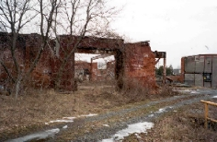
EDA/public works -- Plainview Steel – Plainview AR
Lumber/pressure treating facility, shut down in 1986 after quarter-century of operations; declared superfund site in 1999
Cleaned, redeveloped as specialty steel plant
$763,000 in EDA public works funding supported site preparation, construction, infrastructure upgrading as part of $1.1 million financing package
Today – 25 new jobs, significant tax revenues for community

Slide 17
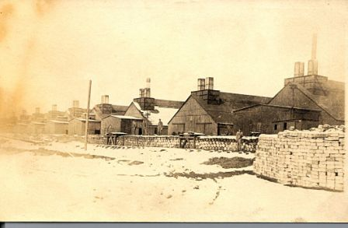
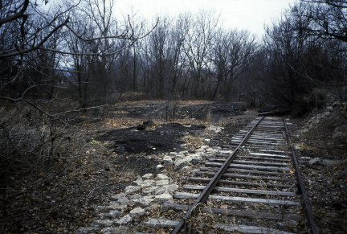
EDA/planning -- Cimarron Center – Sand Springs, OK
Former zinc smelter, abandoned rail spur in small Oklahoma town
Challenge was structuring a cleanup plan that made the site economically competitive with nearby greenfield for big-box retail
Financing included EDA planning resources, local TIF
Leverage -- Cimarron Center, with Wal-Mart Supercenter as anchor, has created 350 new jobs, added $3.5 million in annual city sales tax revenues

Slide 18
USDA Rural Development Programs
USDA rural development funds must meet broadly defined program objectives -- 4 key programs can do this within a brownfields context:
Community facility loans and grants – for a range of development and community benefit projects
Business and industry loans – to public or private organizations, for activities such as industrial park site development/rehabilitation or access ways
Intermediary re-lending program – intermediaries such as local governments are loaned money to re-lend to companies, in order to finance business facilities
Rural development grants (RBEGs/RBOGs) – given to provide operating capital and finance emerging private business and industry

Slide 19
How Can USDA Rural Development Funds Be Used For Activities that Also Support Brownfield Redevelopment ?
Eligible activities often can include: :
Planning for redevelopment or revitalization – for businesses and community facilities (which could include brownfield projects)
Site clearance/preparation, including demolition – key brownfield reuse/redevelopment activities
Rehabilitation/improvement of sites or structures – which might need to include removal or remediation of contamination as part of project
Construction of real estate improvements
Installation of amenities to enhance development

Slide 20
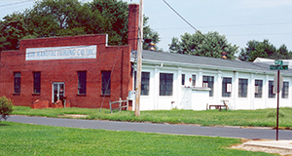
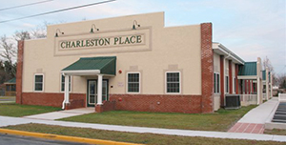
USDA: Charleston Place – Seaford, DE
Abandoned sewing factory, built in 1920s
Developed by non-profit Better Homes of Seaford
$600,000 USDA rural development loan, plus DE Housing Authority and private bank participation
Ribbon cutting 1/9/06; fully occupied by March

Slide 21
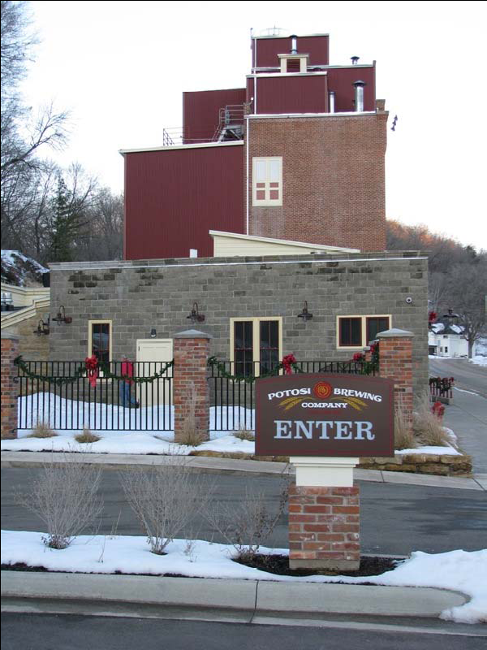
USDA: Potosi Brewery, Potosi, WI
Brewery built 1852 in Potosi (pop. 700), abandoned 1972
Asbestos, lead paint, other
contaminants
$3.3 million B&I guaranteed loan key to securing additional $4.2 million in financing
Transformed Potosi’s main street; community involvement key
Result: Refurbished as micro-brewery, brewing museum and library, opened June 2008
50 new jobs, 4 new beers

Slide 22
Transportation Programs
Must work thru state MPOs, local transportation agencies
In March 2009, DOT re-affirmed its brownfield policy
Transportation funding can be used for cleanup at sites integral to transportation system development/upgrades
DOT highway/transit construction programs can support related revitalization by:
(1) helping upgrade existing facilities
(2) offer transportation amenities that improve access to – and marketability of – sites
(3) fund facilities and structures that serve as part of the remedial solution

Slide 23
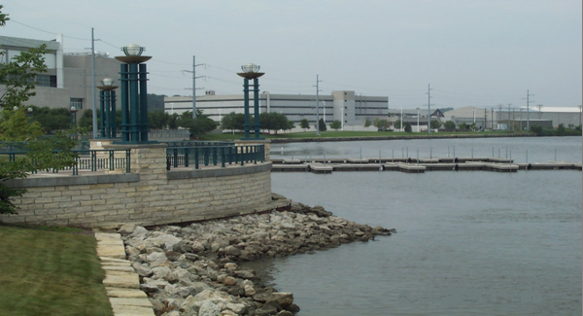
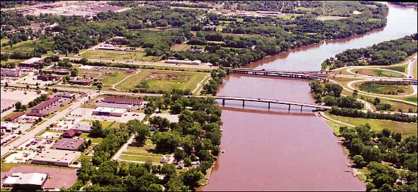
DOT: arterial road grid installation -- Moline, IL
largely abandoned riverfront, former industrial/warehousing uses
converted to residential and marina/mixed use complex and commercial space
$3.2 million in state and federal funding included DOT funds for road grid and enhancements

Slide 24
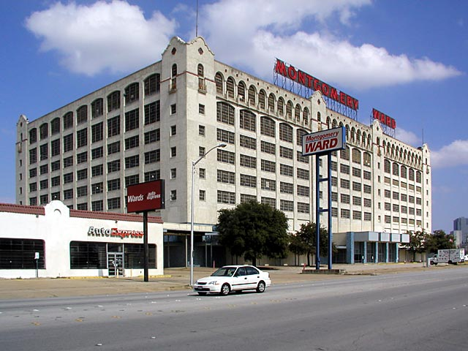
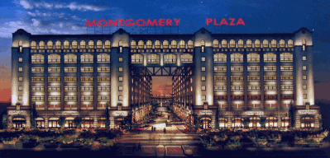
DOT: infrastructure enhancements, old Montgomery Ward distribution center– Fort Worth, TX
Historic “white elephant” on a 45-acre site adjoining CBD
DOT (CMAQ) for road and sidewalk infrastructure
Other financing tools used
Historic rehab tax credits
State tax abatements, fee waivers
Today -- DOT mixed use commercial/ retail/office complex, CBD extension

Slide 25
Federal tax incentives that can be linked to brownfield redevelopment – at little or no cost to the community or project….
3 with particular relevance to smaller cities and smaller sites –
Rehabilitation tax credits
Low income housing tax credits
Brownfield cleanup expensing

Slide 26
Advantages of Using Tax Incentives in Brownfield Projects
Increase project’s internal rate of return
Ease borrower’s cash flow by freeing up cash ordinarily needed for tax payments
Some credits can be sold for cash, or syndicated to attract additional investment
Not subject to competitive public grant process – you qualify, you win!

Slide 27
Rehabilitation Tax Credits
Taken the year renovated building is put into service
20% credit for work done on historic structures, with rehab work certified by state
10% credit for work on “non-historic” structures build before 1936; no certification required
In 2008 – 1,231 projects, $1.12 billion in credits
leveraged $5.64 billion in private investment
led to nearly 68,000 jobs
resulted in 17,051 housing units – 5,200 affordable

Slide 28
Rehabilitation Tax Credits – caveats and “fine print”
Rehabilitation costs must be “substantial” – i.e., exceed minimum of $5,000 or the building’s adjusted basis
Property must be “income-producing” – multi-family rental housing can claim the 20% credit, but not the 10% credit
Rehab work must conform to state historic preservation standards – which can deter integration of “green” technologies
Credit is recaptured on a sliding scale (20% annually) if owner disposes of the building within five years of completing renovation

Slide 29
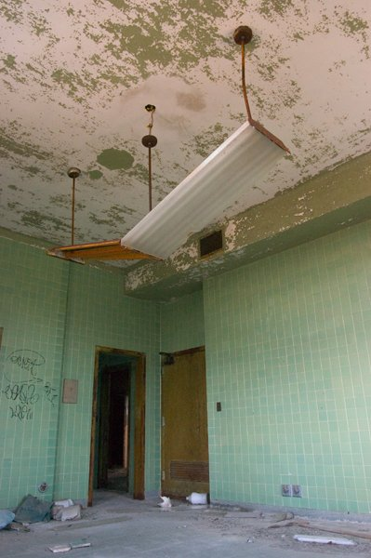
Old Northampton Fire Station -- Northampton, MA
Old Northampton Fire Station, built in 1872, shut down in 1999
13,000 sq. ft. building redeveloped into downtown office space, café, small scale retail
Adjoining property, used by the fire department for maintenance activities, being redeveloped into a residential and studio space
Total project costs -- $1.6 million
Cash flow impacts of rehab tax credits a key part of the economic viability of this project

Slide 30
Thames Street Landing – Bristol, RI
$8.3 million mixed-use redevelopment, including housing, hotel, and offices at a vacant downtown site
200-year history – buildings included original Bank of Bristol (1797), Taylor Store (1798) and DeWolf Warehouse (1818); industrial uses started in 1861
Developed in phases; banks unwilling to provide follow-on financing until 1st phase generated a positive cash flow
Rehab tax credits key to generating positive cash flow, attracting additional private capital
Today, project is cornerstone for historic revitalization of Bristol waterfront

Slide 31
Low-Income Housing Tax Credits
Can encourage capital investment in affordable housing/target investment to certain areas – vacant properties, brownfields, infill locations, other priority sites
States get annual population-based allocation for distribution to communities and non-profits – approx. $1.75 per capita
Investors can get 9% annual credit for 10 years for qualified new construction/rehabilitation costs (i.e. 90% of total) for projects not financed with federal subsidy
Federal subsidy limits credit to 4%
Credits can be used for new construction, rehabilitation, or acquisition and rehabilitation

Slide 32
Low-Income Housing Tax Credits – fine print and caveats
New wrinkles…
Loss of tax incentive value on secondary market – from about 95 cents/$ to about 65 cents/$ now – impacts syndication value
“Green” priority for credit allocations within states
Credits support a wide range of housing types/situations
Urban, suburban, rural projects
Housing for families, special needs tenants, elderly
$3.85 billion in credits issued in fiscal year 2008, supporting 1/3 of all new construction that year
Indiana has received $159 million from 1987-2005, supporting 33,300 units

Slide 33
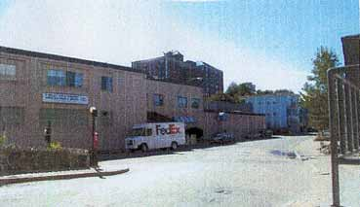
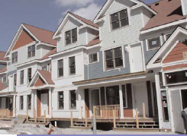
Brian J. Honan Apartments – Allston, MA
Allston-Brighton CDC saw an opportunity to develop former Legal Seafoods fish processing plant into affordable housing
Low-income housing tax credits key parts of financing incentive package needed to attract capital, convince funders that the project would work
Result – affordable units in a sustainable development: green energy, pedestrian access to groceries, shops, transit

Slide 34
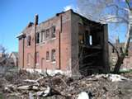
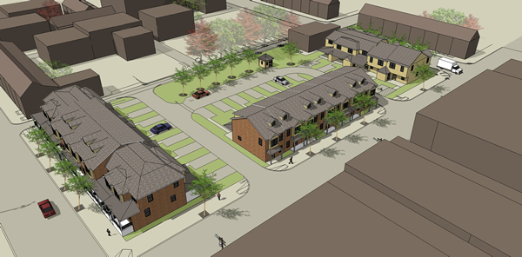
Mifflin Mills – Lebanon, PA
PA’s first affordable “rent-to-own” townhouse community
Former vacant, blighted city block near downtown
Energy efficient construction, designed to blend into existing residential neighborhood
20 units, completed Nov. 2009
$1.5 million in low-income housing tax credits key part of financing package needed to attract investors to rent-to-own project structure

Slide 35
Brownfield Cleanup Expensing Tax Incentive
Deduction pegged to cleanup costs, which allows new owners to recover cleanup costs in the year incurred; only incentive targeted to private site owners
Can include:
Site assessment, cleanup, monitoring costs
Costs related to install/monitor institutional controls
State VCP fees and associated costs
Removal of demolition debris
No long term authorization in place; most recently extended until 12/31/09 (retroactive to 1/1/08)
Petroleum sites made eligible in 2007 extension

Slide 36
Brownfield Cleanup Expensing Tax Incentive – caveats and fine print
“Stealth incentive” – less than 2 dozen projects annually
Little understanding of what it is, what it does, how it works
On the part of Treasury (no regs/guidance), developers, transaction support professionals, state agencies who certify
Process not well articulated at state level
Authorized in “fits and starts”
Makes long-term, larger projects hard to plan
Subject to recapture on transfer
Vague Treasury interpretation deters use

Slide 37
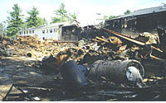
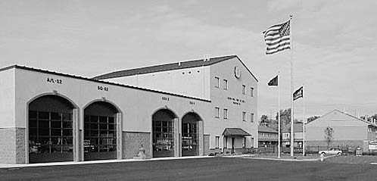
Alliance Environmental/Goodwill Fire Department – West Chester, PA
8.5 acre former pharmaceutical property and dump site in economically distressed area
Cleaned and redeveloped by Alliance Environmental
Now, location of Good Will Business Park: 100,000 sq. ft. of retail, public service facilities including fire department and district court
Incentive provided Alliance with nearly $800,000 in tax relief

Slide 38
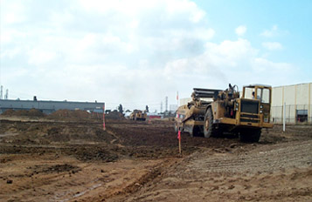
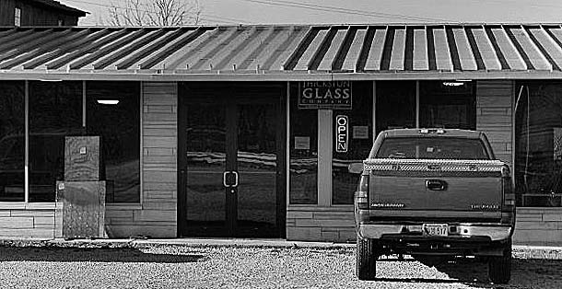
T.R. Thickston Glass Company, Bloomington, IN
Former recycling center with foundry waste
Project spearheaded by environmental consulting firm familiar with tax incentive
Incentive saved about $80,000 in tax liability, used to support cash flow until redevelopment occurred
Result -- Site leased by T.R. Thickston Glass Company; created 3 jobs

Slide 39
“Low-Cost/No-Cost” Brownfield Redevelopment Tools
Tools that enhance redevelopment financing – with little or no additional cash outlay
Institutional controls
Can reduce site preparation, cleanup costs
Innovative remedial technologies
Can lead to big reductions in cleanup costs
Cost saving technical assistance and project support
Can save time, money, other development costs

Slide 40
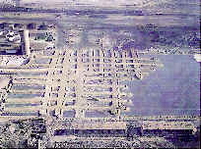
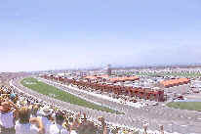
California Speedway – Fontana, CA
Institutional controls
Speedway on a portion of 23-acre former Kaiser Steel Mill site (from 1942 to 1983) in rural CA
Raceway and interior facilities used as an environmental cap, saving nearly $500,000 in cleanup costs, reducing redevelopment time
In 2008, Speedway generated $12.5 million in economic activity, $2.5 million in new tax revenues, 1200 new jobs.

Slide 41
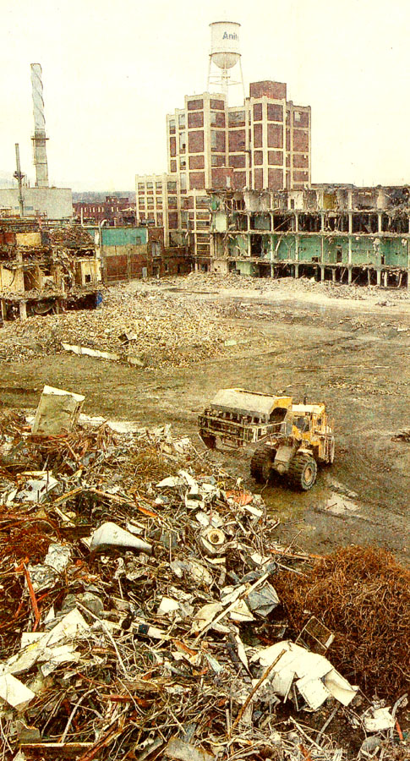
Downtown retail, Williamsport, PA
Innovative cleanup technologies
former airplane engine factory, abandoned nearly 50 years, with groundwater contamination that proved too costly to treat by conventional means
state and local governments worked with developer to identify innovative cleanup technology – molasses injection -- that would work within standards of VCP
Now…retail complex and parking facility

Slide 42
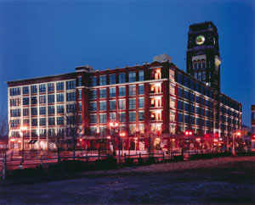
Victor Building – Camden, NJ
Cost saving t.a. and project support
Abandoned former RCA Victor Building on Camden’s waterfront, with pervasive PCBs
Site intended for residential re-use; challenge was keeping $7 million cleanup manageable
NJDEP provided t.a. to developer – on remedial and monitoring applications, ICs, entombment of residual PCBs – strategies that allowed cleanup and redevelopment to go forward concurrently, with big cost savings
Now… $60 million private investment in 341 units, 1st market rate housing built in Camden in 40 years, landmark “Nipper Tower” saved

Slide 43
Common Local Financing Tools
Putting a Brownfields “Spin” on the Local Tried-and-True – Making them Work for Site Cleanup and Reuse
Tax increment financing/TIF-style financing
Tax abatements
Tax forgiveness
Special service areas or taxing districts
Revolving loan funds (RLFs)
Property transfers

Slide 44
Local Initiatives
TAX INCREMENT FINANCING
Uses the anticipated growth in property taxes generated by a development to finance it; most common local financing tool supporting brownfield cleanup and reuse

Slide 45
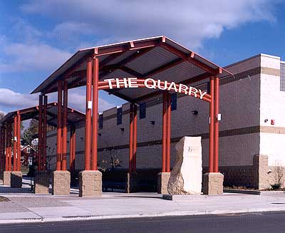
Johnson Street Quarry – Minneapolis, MN
Johnson Street Quarry was a blighted, under-utilized property
A local developer wanted to build a 420,000-sq. ft shopping mall
After extensive community involvement, as well as strong public/private cooperation, several major national retailers located in the retail center, including Target, Pet Smart, and Rainbow Foods
TIF was key to financing site preparation
Redevelopment of this property has spurred redevelopment in the surrounding area, created over 2,000 new jobs (much above original estimates) and increased property and sales tax revenues in excess of $3 million a year.

Slide 46
Local Initiatives
TAX ABATEMENTS
Reductions or forgiveness from tax liabilities, granted for a specific period of time (typically 5, 10, or 20 years); helps project cash flow

Slide 47
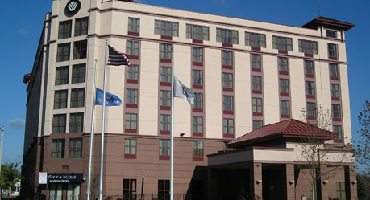
Everett Ave. Urban Renewal District – Chelsea, MA
Blighted 10-acre outdoor storage yard for junk cars and equipment.
Developer purchased 2 acres for $1.2 million to construct a $17 million, 180-room, full-service hotel
10-year property tax abatement key incentive, used to offset site cleanup and preparation costs
Hotel now employs 100 workers, generates approximately $400,000 in sales and income tax revenue annually – even with the abatement in place.

Slide 48
Local Initiatives
TAX FORGIVENESS
Authorizes local governments to forgive back taxes on delinquent properties
In a brownfield context, these new tax forgiveness programs typically:
Are linked to new owners or prospective purchasers
Require agreement to clean up and reuse site
Require purchaser to enter state VCP

Slide 49
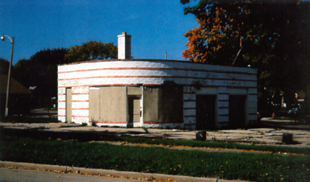
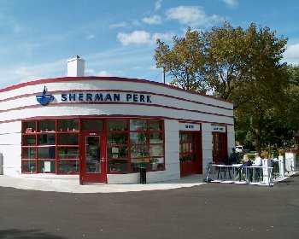
Sherman Perk -- Milwaukee, WI
Abandoned gas station, closed since 1989
Issues of financing/addressing cost of petroleum contamination; 9 years tax delinquency
Financing included state forgiveness of back taxes linked to VCP participation, rehabilitation tax credits
Result -- reuse of historically significant building as successful neighborhood retail anchor
After
Notes:
Site – abandoned gas station, closed 10 years
Site – abandoned gas station, closed 10 years

Slide 50
Local Initiatives
SPECIAL SERVICE AREAS OR
TAXING DISTRICTS
Cities can use a “special service area” designation to raise cash for activities, facilities, or bond servicing needed by the target area.
Property owners agree to the special levy or fee, based on its use in their area to finance maintenance or improvements.
Property owners may “self-impose” fees as part of a redevelopment agreement.

Slide 51
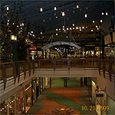
Jersey Gardens Metro Mall – Elizabeth, NJ
166-acre former garbage dump, across the street from Ikea Center – Elizabeth’s first big brownfield success
$320 million investment – 1.5 million square feet of retail space, resulting in 5,200 jobs and $4.2 million annual tax revenue increase
Bonds being paid off through franchise fees levied within a “landfill reclamation district” established for this project, paid by mall tenants as part of their rent

Slide 52
Local Initiatives
LOCALLY CAPITALIZED
REVOLVING LOAN FUNDS (RLFs)
A growing number of communities are establishing their own RLFs targeted to redevelopment and brownfield-related projects; similar to state or federal RLFs, but they write the rules.
They use a wide variety of sources for capitalization – general revenue appropriations, bank contributions, philanthropic donations, fees or fines, repayments from CDBG projects, etc.

Slide 53
Waterfront Development – New Bedford, MA
Locally capitalized RLF used to pay for Phase I site assessments at sites served with environmental tax lien
Capitalization sources include local contributions, proceeds from property sales as liens are redeemed

Slide 54
Local Initiatives
PROPERTY TRANSFERS
Site is transferred to new owner or user for a nominal fee, typically $1, in exchange for an agreement to clean up and reuse the property

Slide 55
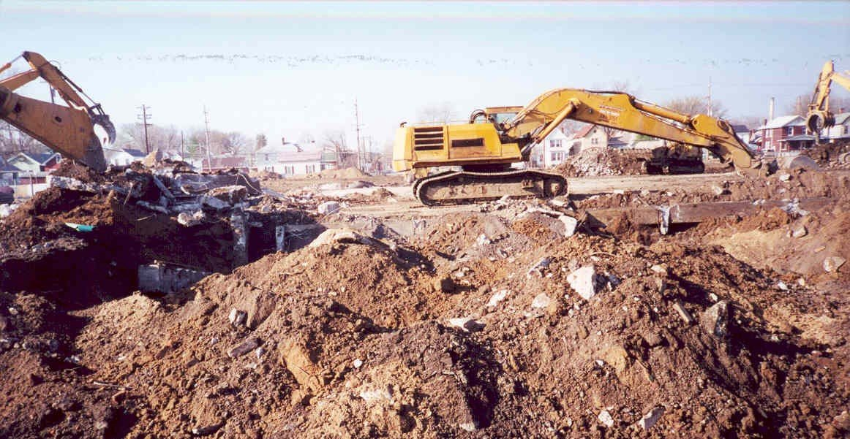
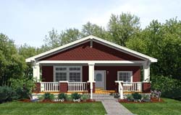
Mills of Carthage – Cincinnati, OH
Abandoned industrial property was transferred to new owner for $1, in exchange for an agreement to take
site through Ohio VCP, clean it up, and reuse it
First new housing in Carthage neighborhood in 40 years
Completely sold out

Slide 56
So, to wrap-up….when it comes to brownfield reuse --
Any community, even the smallest rural crossroads, will face brownfield issues that may impede local development efforts.
The question will be -- how can they
identify and leverage $$$ to achieve
brownfield success?
Can they do it?

Slide 57
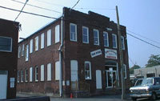
Yes, they can !!!
Bob does brownfields!!

Slide 58
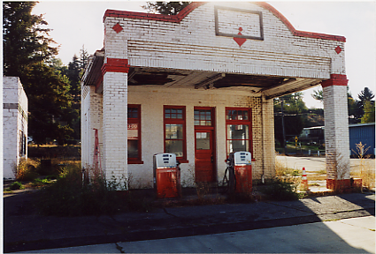
Yes, they can!! Rosalia, WA – Locally driven public-private partnerships can stimulate innovative site financing in small communities
1923 vintage Texaco gas station, in
downtown Rosalia, WA (pop. 600)
Abandoned 21 years; UST issues
Site as focus of “heritage tourism”
main street revitalization strategy
Converted to “gateway” retail,
craft/farmers market, visitor center
for nearby Steptoe Nat’l Battlefield,
national forest
Public financing sources include:
$33,000 USTfields pilot grant
$54,000 WA Dept of Ecology grant
$45,000 Whitman County
“community development ’08” grant

Slide 59
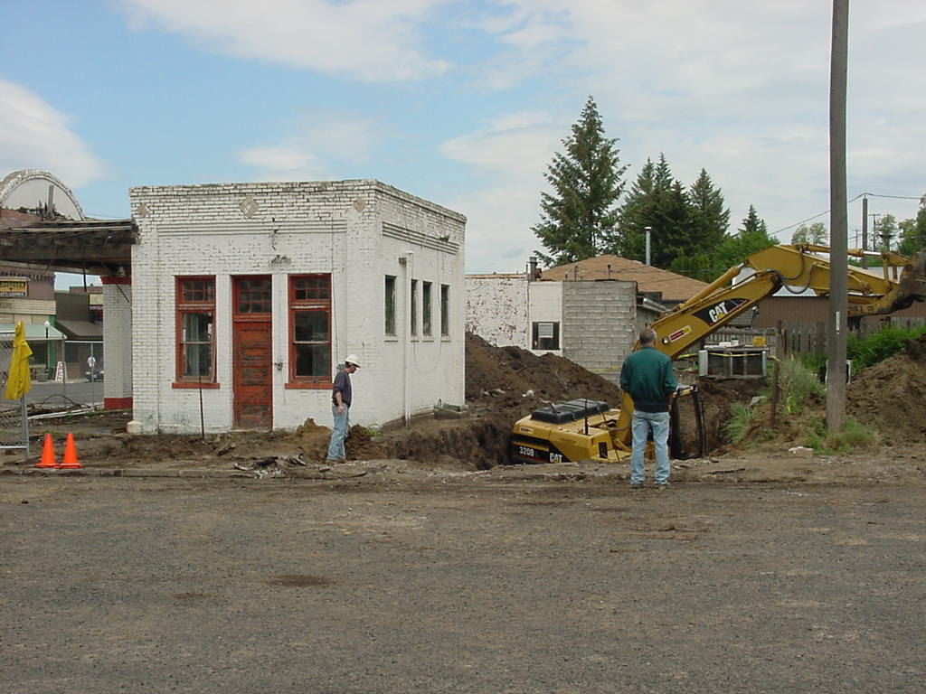
Yes, they can!! Rosalia, WA – Locally driven public-private partnerships can stimulate innovative site financing in small communities
Partner donations include:
Development grant sharing from
surrounding counties
Rosalia Lions Club
Rosalia “Gifted Grannies”
Retired Texaco Executives Assn.
Pro bono legal, remedial services
Utility incentive rates
Community sweat equity
First-ever partnership with a state
Dept. of Corrections

Slide 60
Charlie’s contact information
For further information………..
For additional examples and information….
cbartsch@icfi.com
www.icfi.com

