Slide 1
BROWNFIELDS… HOW TO IDENTIFY, INVENTORY, AND PRIORITIZE
Prepared for…
Community Resources for Brownfields
Redevelopment Workshops
MAY 2010
Prepared by…Beth A. Grigsby, LPG ATC Associates, Inc. beth.grigsby@atcassociates.com
Notes:
NAVIGATION & PRESENTATION EDITING TIPS: (Print this Notes Page)
This overview presentation has been created to give the presenter the greatest opportunity for message customization on-the-fly. Present only as much information as relevant for your target audience. Encourage interaction at every opportunity.
Slide 1-5 These slides demonstrate grasp of your understanding of issues impacting their organizations. Also, you’re underscoring the issues in play when needed action is delayed or avoided.
Slide 6 Use this slide as a facilitation mechanism. Stop. Interact.
Slide 7 Primary Navigation Screen – Click on any relevant links based on your discussion in slide #6. Make your presentation as short or long as needed. Click on the SUMMARY link (located throughout the presentation) to go to the final closing slides.
Slides 8-11 Construction Engineering, Testing & Inspection Section
Slides 12-15 Business Operations Section
Slides 16-19 Facility Management Section
Slides 20-23 Expansion & Renovation Section
Slides 24-27 Real Estate Purchase, Finance & Sale Section
Slides 28-32 Summary Slides
EDITING TIPS -
Replace text wherever desired but try to avoid adding more lines of text or causing existing text to wrap to a second line.
Add slides where necessary. The easiest way is to simply select INSERT-DUPLICATE from the slide you want to emulate and edit/delete the text in that duplicate slide as needed.
The slide #7 hyperlinks will always go to the same target page – even if their slide number has changed because of inserted slides
Try to follow existing formatting. (Single lines of text. Sentence-type capitalization for body text. Labels/title initial cap each word)
When inserting other images – Use only quality imagery.

Slide 2
Brownfield Redevelopment What’s all the Hype?
EXPANSION, REUSE, OR REDEVELOPMENT OF
BROWNFIELD SITES:
Increase (RENEWS) property value and local tax base
Reduce the need to develop greenfields
Uses existing infrastructure (cost savings)
Mitigates public health and safety concerns
Improves the community image

Slide 3
What is a Brownfield?
“…..real property, the expansion, redevelopment, or
reuse of which may be complicated by the presence
or potential presence of a hazardous substance, pollutant or contamination.” (US EPA)
States vary in definitions
Most contain low to moderate levels of contamination
Can address asbestos, lead paint, meth lab contaminants and mine-scarred lands
Notes:
By law the definition expanded to included land contaminated by petroleum or petroleum products, land contaminated by controlled substances (meth-labs) and mine-scarred land.

Slide 4
THE COMMUNITY DEFINES ITS BROWNFIELDS
EPA provides the guidance, but it is the community that identifies a property as a Brownfield
Abandoned property
Active but Underutilized
Real estate turnover complicated by real or perceived contamination
Property use Blighted –significantly conflicts with a master plan

Slide 5
BROWNFIELD PROGRAM DOES NOT…
BENEFIT POTENTIALLY RESPONSIBLE PARTIES
BROWNFIELD RESOURCES CANNOT BE USED TO BENEFIT THE POLLUTER!!

Slide 6
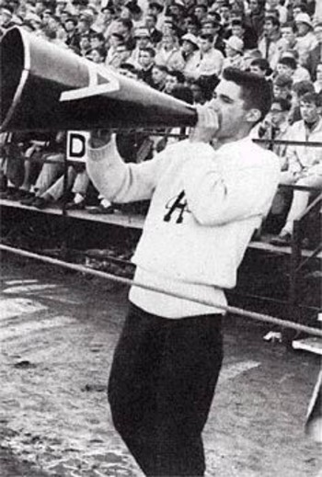
LET’S GET STARTED : FIRST STEP---DESIGNATE THE LOCAL CHAMPION
COUPLE OF EXAMPLES:
MAYOR
PLANNING DEPARTMENT
REGIONAL PLANNING COMMISSION
LOCAL ECONOMIC DEVELOPMENT ORG.
COUNTY COMMISSIONERS
TOWN MANAGER
LOCAL CHAMPIONS ARE AS DIVERSE AS THE COMMUNITIES THAT REDEVELOP BROWNFIELDS

Slide 7
HOW TO GET STARTED?
REVIEW THE COMMUNITY’S PLAN FOR TARGETED AREA…WHAT’S THE BIG PICTURE?
IDENTIFY SUSPECTED AREAS
IDENTIFY STAKEHOLDERS

Slide 8
Identification
Tour targeted areas-identify sites
Go to local library or County Seat to:
review Topographic maps, local and State maps
Review historical Fire Insurance maps
Review historical plat maps
Notes:
State and local maps State and local maps offer a broad spectrum of information, such as zoning codes, master plans, topography, water table levels, and aquifer locations.
These maps can help you examine several brownfields issues, such as remediation and site reuse options. Contact your local and/or State planning departments for more information on these maps.
Discuss the historical uses with owner/neighbors
Review state/local maps
Review old Fire Insurance maps (Sanborns)
Check with Health Department, Police and Fire departments Building and zoning records
Interview community elders
Check State Department of Environmental Quality records
Check EPA web site – www.epa.gov
Check with local planners

Slide 9
USING MAPS TO IDENTIFY BROWNFIELDS
Notes:
Impaired soil, water, or air conditions from historical use
Land uses:
Waste storage/ disposal
Manufacturing/ industrial
Transportation/ rail
Petroleum
Mining
Agribusiness
Improvements
Underground/ aboveground storage tanks
Process areas/ machinery
Asbestos
Lead-based paint
Polychlorinated biphenyls (PCBs)
Fill materials

Slide 10
Identification
Meet with local and state agency representatives:
Local and State Health Departments: Complaints, spills, violations
Local Police and Fire Departments: Fire runs, drug busts, nuisance, complaints
Local Planning Officials
Notes:
State and local maps State and local maps offer a broad spectrum of information, such as zoning codes, master plans, topography, water table levels, and aquifer locations.
These maps can help you examine several brownfields issues, such as remediation and site reuse options. Contact your local and/or State planning departments for more information on these maps.
Discuss the historical uses with owner/neighbors
Review state/local maps
Review old Fire Insurance maps (Sanborns)
Check with Health Department, Police and Fire departments Building and zoning records
Check State Department of Environmental Quality records
Check EPA web site – www.epa.gov
Check with local planners

Slide 11
Utilize Resources on-line
Where you live...Search your Environment by Zip code
http://www.epa.gov/epahome/commsearch.htm
Other Program information and Support
http://www.epa.gov/brownfields
http://www.epa.gov/compliance/environmentaljustice/index.html
http://www.epa.gov/smartgrowth
http:///www.smarte.org

Slide 12
More On-line resources: State Websites
Virtual File Cabinet
http://www.in.gov/idem/4101.htm
Select Virtual File Cabinet
Search by County, City, Town, Zip code
For Brownfield Program Resources and Support
http://www.brownfields.in.gov

Slide 13
What are you looking for?
Abandoned property
Active but Underutilized…Salvage yard next to the Greenway
Real estate turnover complicated by real or perceived contamination
Property Blighted –significantly conflicts with a Master plan or Revitalization Plan
Property Blighted and located at the gateways to your community

Slide 14
Make Your List….
IDENTIFY SUSPECTED AREAS (FORMER INDUSTRIAL, FORMER DRY CLEANERS, OLD GAS STATIONS
CONSIDER PROPERTIES TIED TO OTHER PROJECTS (TRANSPORTATION, DISASTER RECOVERY, NEIGHBORHOOD STABILIZATION)
CONSIDER TAX DELINQUENT PROPERTIES
CONSIDER FORMER SCHOOL PROPERTIES, HOSPITALS, PROPERTIES THAT ARE GATEWAYS TO THE COMMUNITY

Slide 15
The inventory can be detailed…

Slide 16
An effective Inventory can also be simple…
Old English Furniture on Main
Pete’s Gas Station at SWC Green & Walnut
Marcy’s Dry Cleaners on Washington
Old School in Mercy Neighborhood
Old Dump on River

Slide 17
INVITE COMMUNITY STAKEHOLDERS TO HELP IDENTIFY
Bring stakeholders to the table
local neighborhood groups
church groups
local planners
developers
economic development interests
private corporations

Slide 18
Communities Select Their Criteria for Prioritization
CRITERIA EXAMPLES:
Eligible for EPA or State funding
Located in the TIF district or Revitalization Zone
Environmental Impacts—Quality of Life Issues
Blight eliminations-Quality of Life Issues
Development Potential for New Jobs
Control of Property: can you get access?
Visibility of the Site to the Community
Physical site characteristics: acreage, visibility, etc.
Notes:
Start with the list obtained from a brainstorming session (stakeholders)-here are suggestions:
Location: Core area, impact on neighborhood, remove blight, redevelopment potential, surrounding land use
Marketability:
Zoning: Current zoning and potential zoning change to one of the 6 categories
Master plan
Extent of contamination
Health risks – potential and known
children and family: impact of redevelopment
Utilities/infrastructure/telecommunication: includes accessibility to roads/airport
physical site characteristics: size, buildings, visibility
Ownership: private v. public
Current use
Historical Building or area
Financing available/funding available
Community acceptance

Slide 19
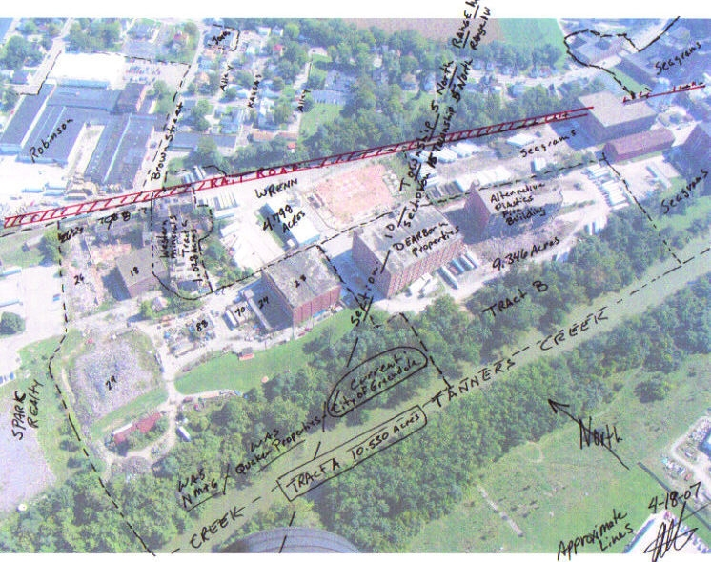
WHAT’S THE BIG PICTURE?

Slide 20
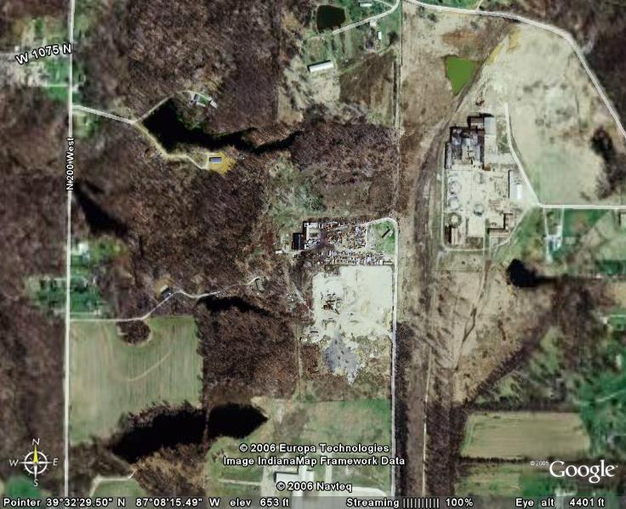
WHAT IS THE FUTURE PLAN?

Slide 21
BROWNFIELD? GREENWAYS, TRAILS
REAL PROPERTY?
POTENTIAL FOR CONTAMINATION?
REUSE?
LOGICAL
STAKEHOLDERS?

Slide 22
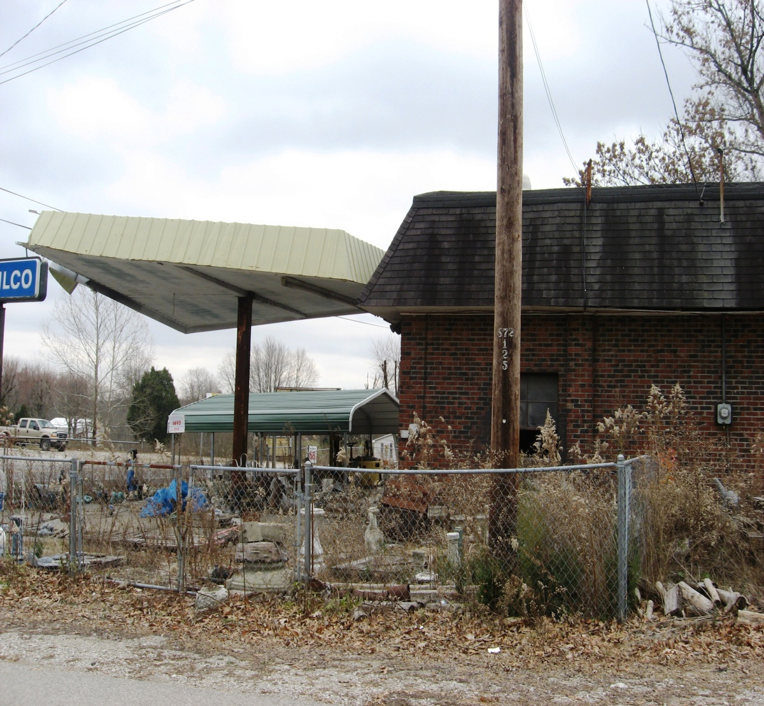
REAL PROPERTY, POTENTIAL FOR CONTAMINATION
EXPANSION,
REUSE
REDEVELOPMENT
PLAN???

Slide 23
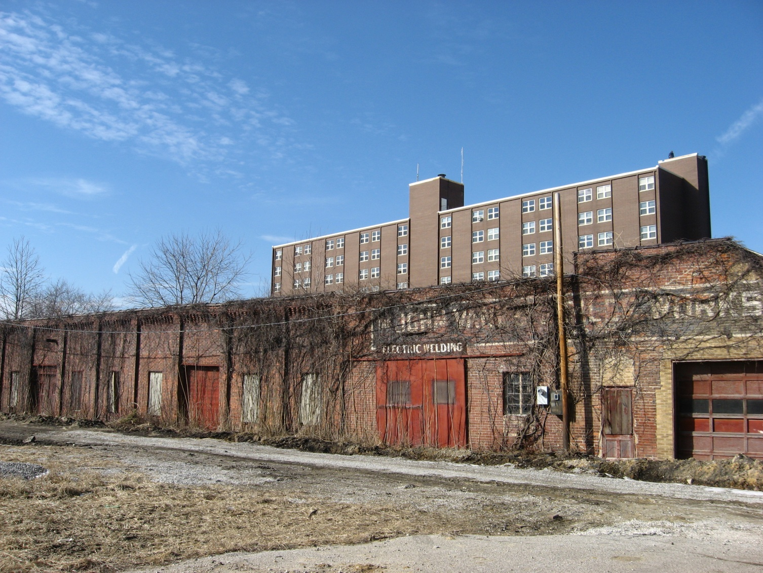
ABANDONED BUILDING NEXT TO COMMUNITY HOUSING PROJECT
POTENTIAL FOR
CONTAMINATION
REAL PROPERTY?
REUSE?
STAKEHOLDERS?

Slide 24
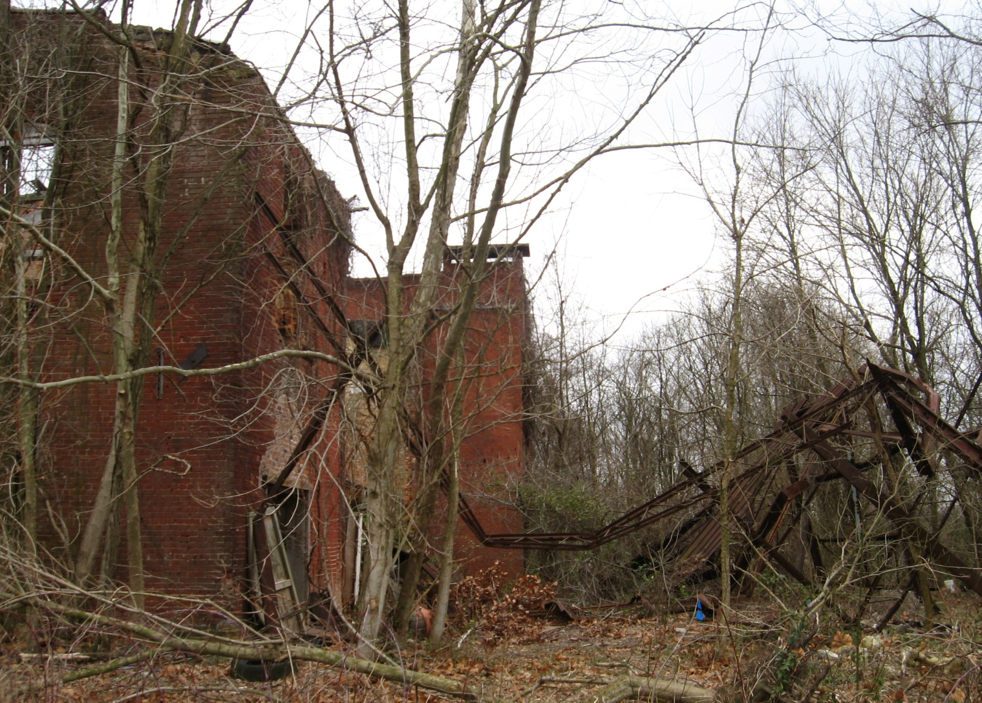
OLD SCHOOL
REAL PROPERTY
POTENTIAL FOR
CONTAMINATION
REUSE PLAN?

Slide 25
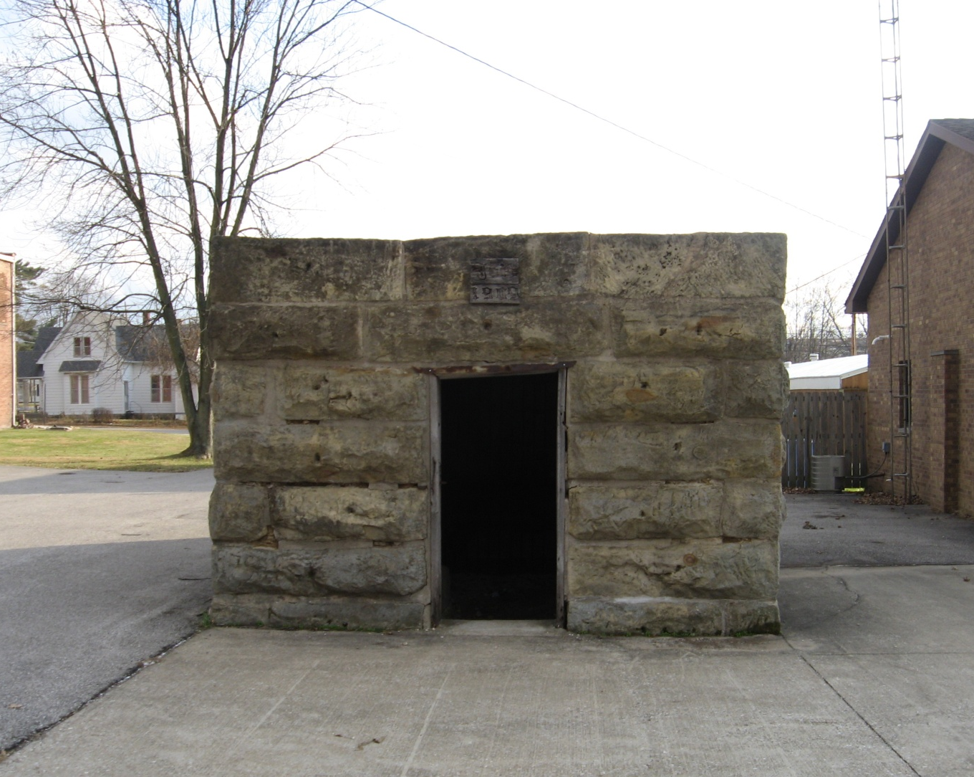
HISTORIC CITY JAIL—BROWNFIELD???
REAL PROPERTY
REUSE PLAN
POTENTIAL FOR CONTAMINATION

Slide 26
OLD SULLIVAN GRADE SCHOOL—BROWNFIELD??
REAL PROPERTY
POTENTIAL CONTAMINATION
REUSE PLAN?

Slide 27
MAIN STREET BUILDINGS—BROWNFIELD?
REAL PROPERTY
POTENTIAL FOR CONTAMINATION
REUSE PLAN

Slide 28
OLD COUNTY HOSPITAL—BROWNFIELD?
REAL PROPERTY
CONTAMINATION?
REUSE PLAN

Slide 29
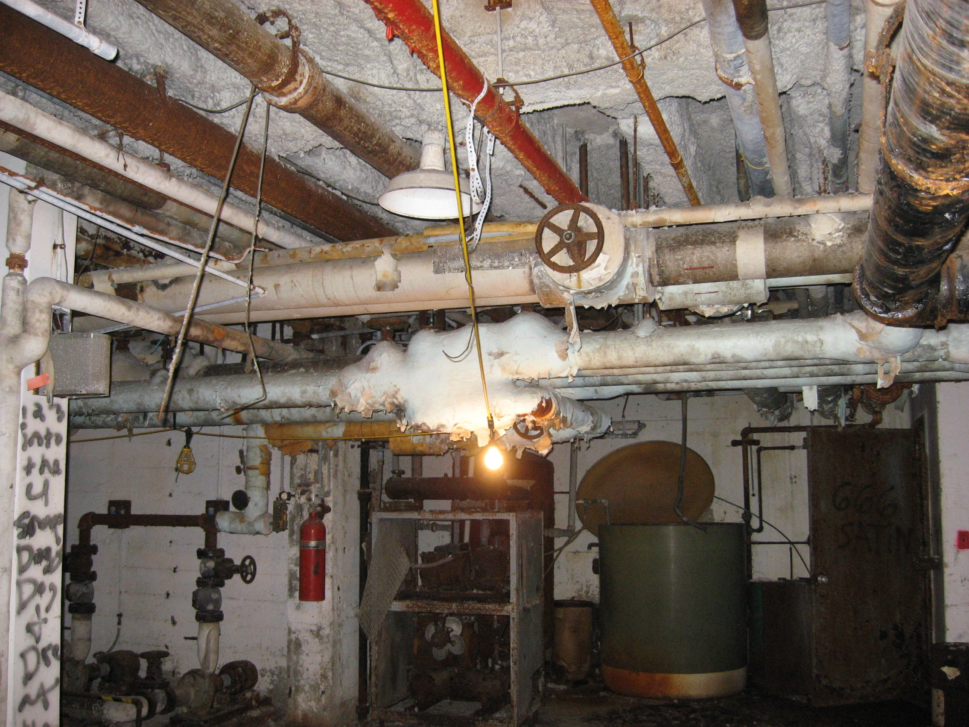
ASBESTOS

Slide 30
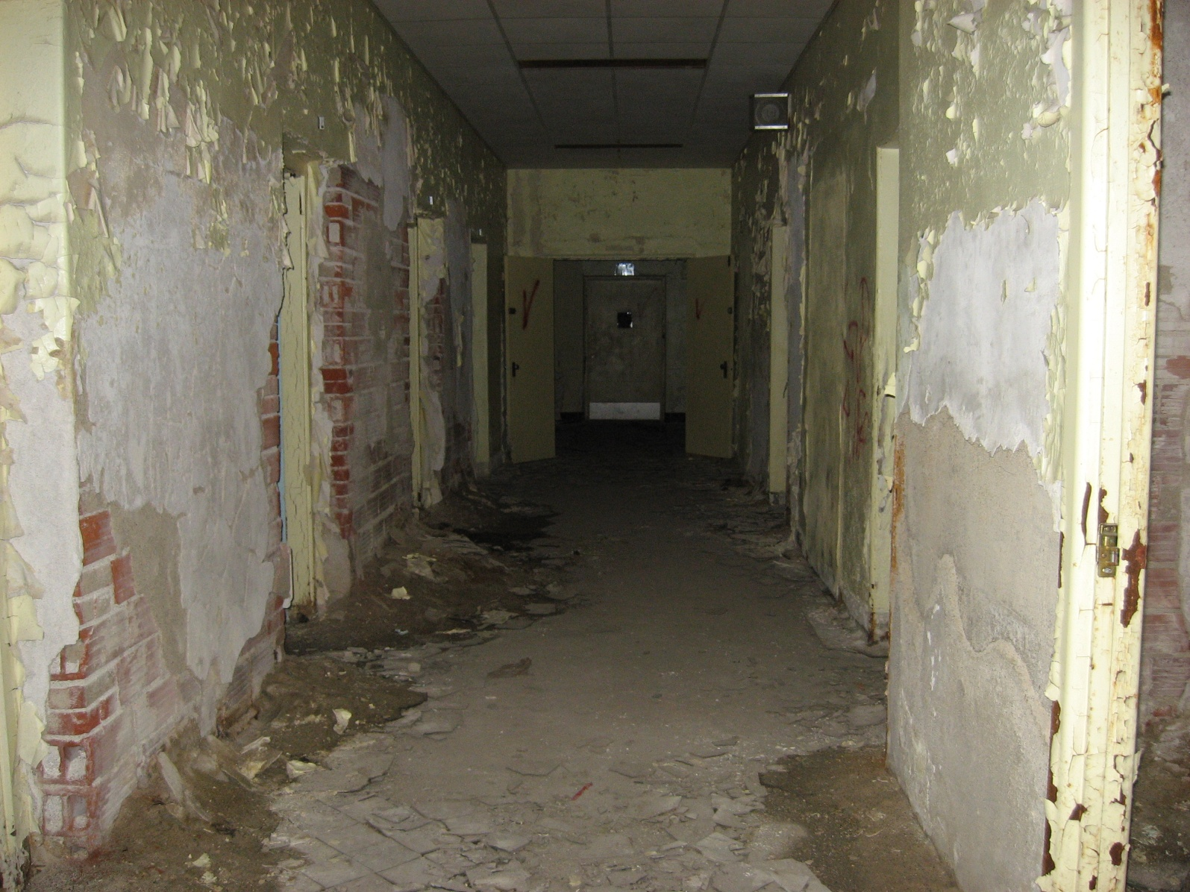
LEAD PAINT….

Slide 31
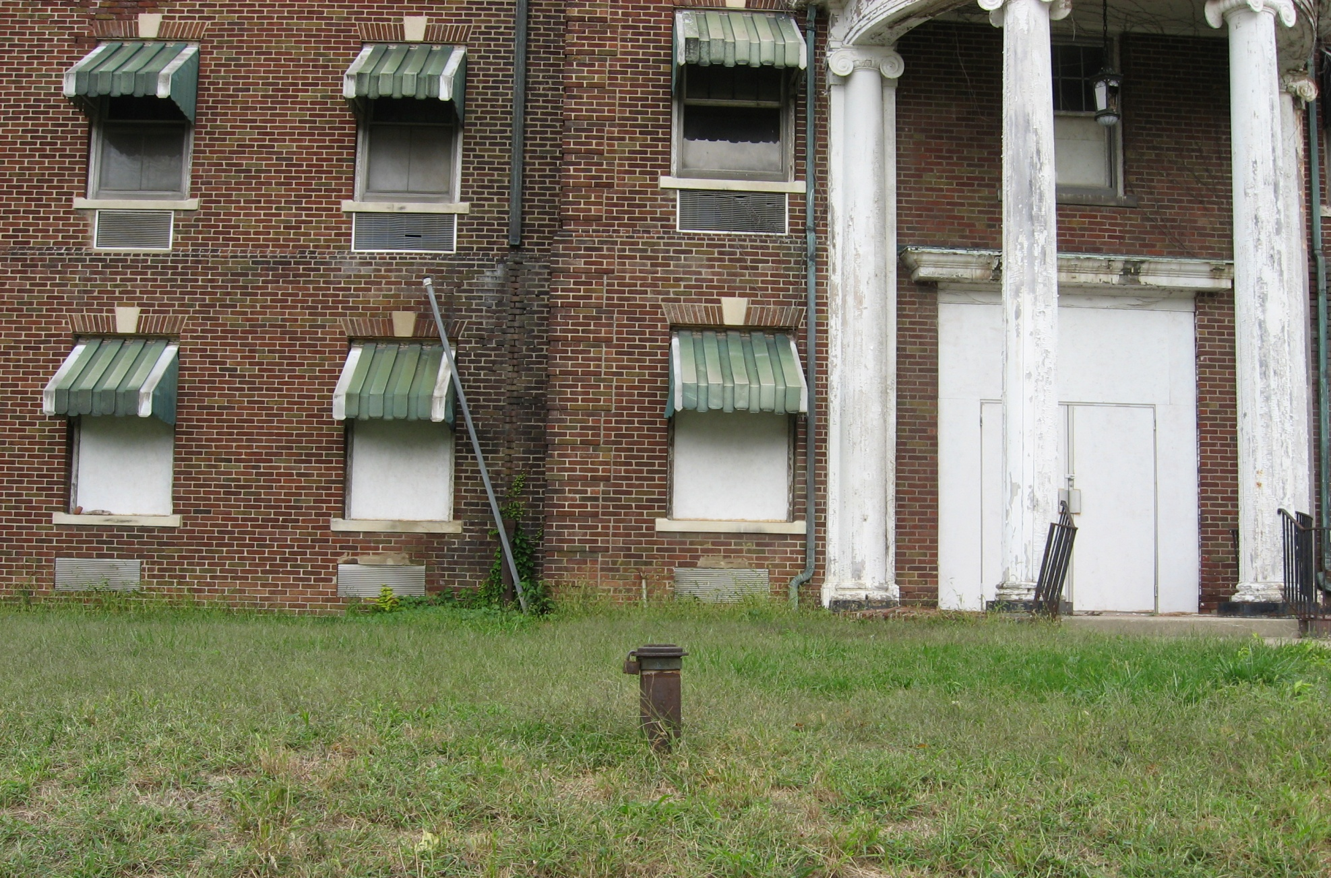
UNDERGROUND STORAGE TANK

Slide 32
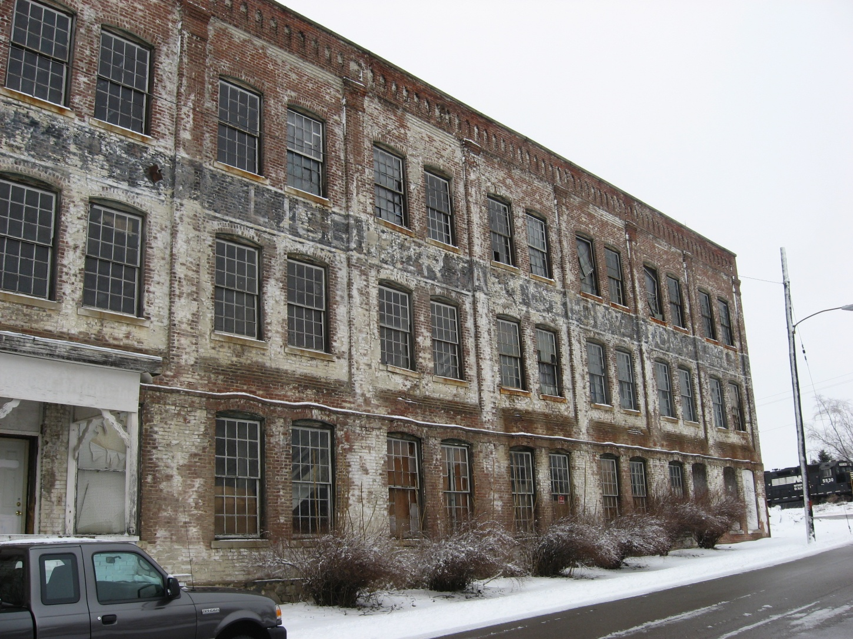
POTENTIAL FOR CONTAMINATION

Slide 33
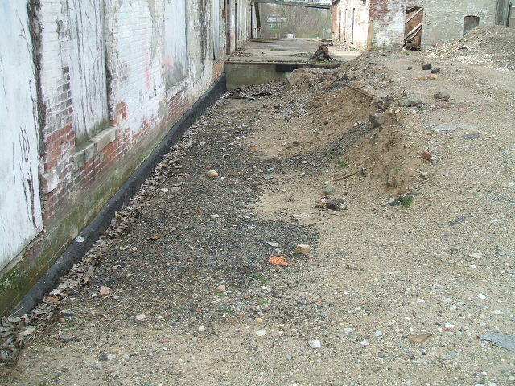
STAINED SOILS

Slide 34
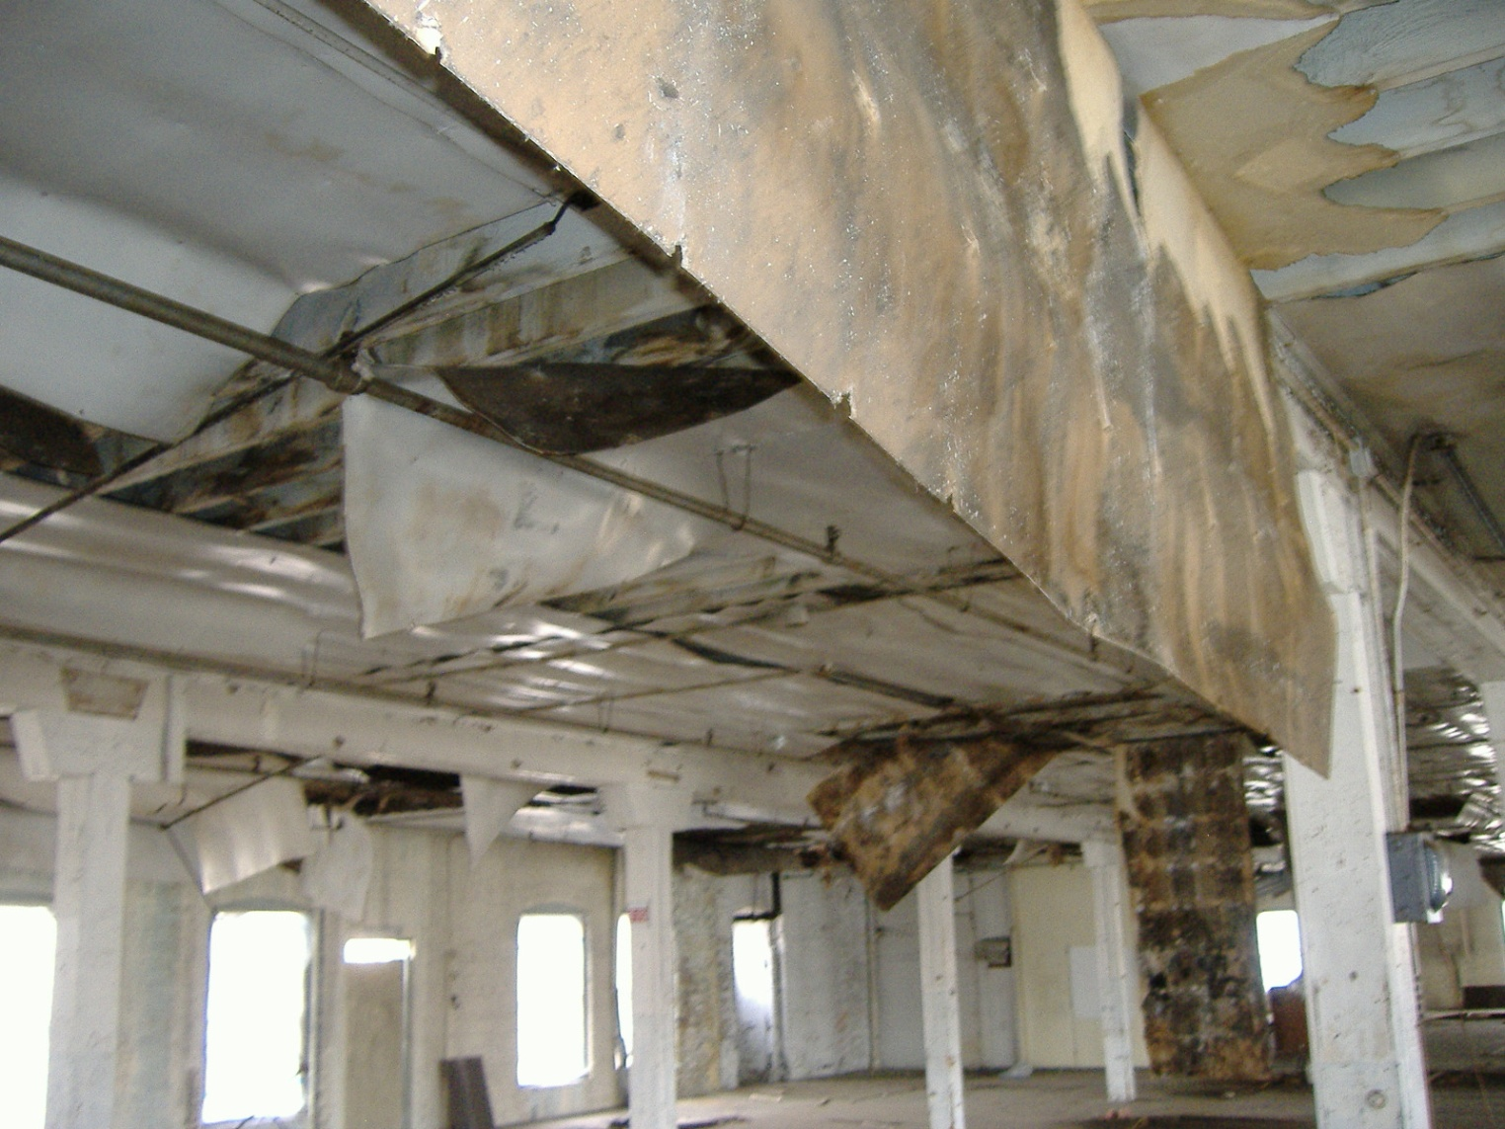
POTENTIAL FOR CONTAMINATION?

Slide 35
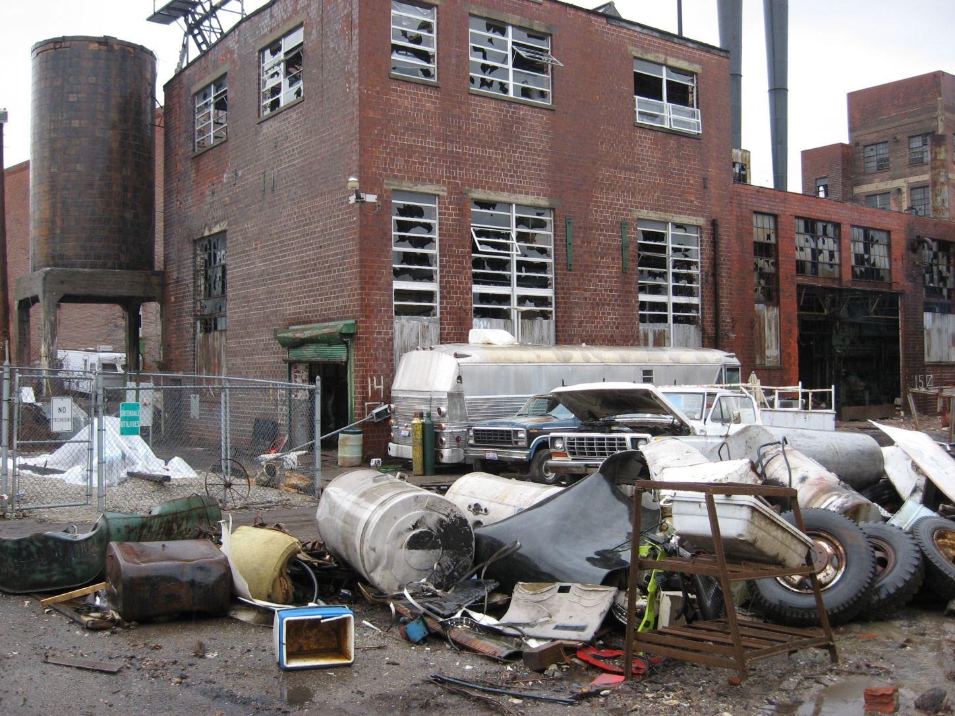
POTENTIAL FOR CONTAMINATION

Slide 36
BROWNFIELDS REDEVELOPMENT…NOT ALWAYS EASY
CROSSING TURF
LINES
UPSIDE DOWN
DEALS
LIABILITY ISSUES
CONFUSING

Slide 37
CHALLENGES FOR RURAL COMMUNITIES
Rural geography with abundant green space, inaccessibility
Rural demographics – sparse population, out migration, poverty
Limited and inconsistent resources – capital and technical expertise
Inadequate infrastructure
Local community resources
Public perception, misinformation and fear

Slide 38
OVERCOMING RURAL CHALLENGES
Local champion
Community involvement at every step
Pursue several different funding sources and leverage
Educate community leaders through local media, site visits, forums, planning sessions
Present best practices from nearby redevelopments
Use regional, state and national development organizations
Take risks and be innovative, flexible and have a redevelopment vision

Slide 39
PRESENTED BY:
BETH A. GRIGSBY, LPG
BROWNFIELD PROGRAM MANAGER
ATC ASSOCIATES, INC
beth.grigsby@atcassociates.com
1-800-488-2054
1-317-439-7871

