Slide 1
Brownfields Redevelopment Steps and Resources
Blase A. Leven
Technical Assistance to Brownfields (TAB) Program
Kansas State University
March 31, 2011

Slide 2
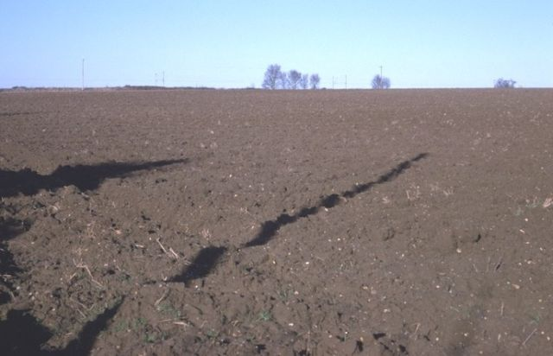
Undeveloped Farm Ground

Slide 3
Grain Storage Facilities/Coops

Slide 4
Environmental Due Diligence
Required for all property purchases, and most major improvements and expansions
Any time financial assets involved:
Loans
Federal or State government
Shareholders
Just like other types of due diligence performed when assets sold/purchased

Slide 5
Often it is the PERCEPTION of contamination that keeps properties from being redeveloped, not the actual presence of contamination.
Once the “stigma” is gone, properties can be returned to productive use.

Slide 6
What is a Brownfield?
“…real property, the expansion, redevelopment, or reuse of which may be complicated by the presence or potential presence of a hazardous substance, pollutant, or contaminant.”*
Practical implication: Brownfields are everywhere!
*(Public Law 107-118 (H.R. 2869) - “Small Business Liability Relief and Brownfields Revitalization Act”, signed into law January 11, 2002).

Slide 7
Brownfields Law & Incentives
Helps address the environmental issues for property transactions & expansions
Liability protection
For prospective purchaser, contiguous landowners, and others
Perform Phase I environmental assessment before purchase and cooperate in addressing environmental issues
Funding for
Assessment
Cleanup
Redevelopment (primarily non-EPA sources)
For eligible sites and entities

Slide 8
BF Process
Identify Brownfields & Redevelopment Goals
Investigate – Phase I/II site assessments (environmental due diligence)
Clean-up, if necessary
Redevelop

Slide 9
Identify Brownfields
Make a list of potential sites
Are environmental unknowns a barrier to redevelopment?
Is current owner viable/liable for ongoing state or federal environmental actions?

Slide 10
Identify Brownfields (Continued)
Record information about suitability for redevelopment
Zoning and compatibility with surrounding land uses
Existing infrastructure
Increase local tax base
Improve community image
Mitigate blight
Mitigate public health and safety concerns
Reduce the need to develop greenfields

Slide 11
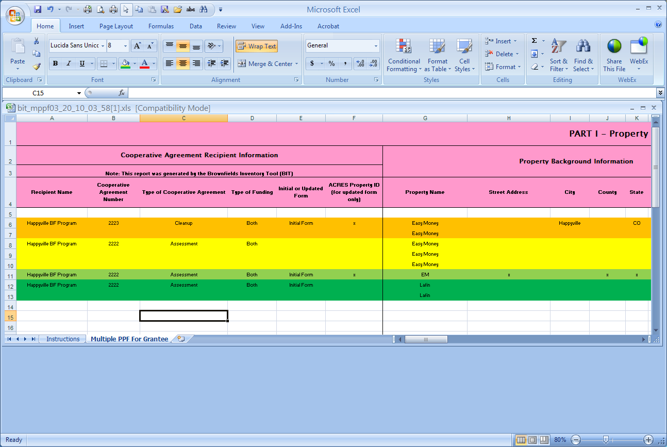
Identify Brownfields (Continued)
Use excel spreadsheet list your potential brownfields

Slide 12
Identify Brownfields (Continued) Free Database www.tab-bit.org

Slide 13
BF Process
Identify Brownfields & Redevelopment Goals
Investigate – Phase I/II site assessments (environmental due diligence – performed by contractors)
Clean-up, if necessary
Redevelopment

Slide 14
Investigate
Perform Phase I/II Environmental Site Assessments (ESAs)
to identify environmental risks before purchase
evaluate whether environmental risks are worth accepting / correcting in a case where contamination is discovered
avoid responsibility for cleanup under CERCLA as an “innocent landowner”

Slide 15
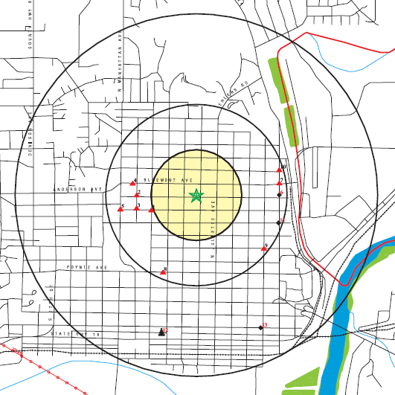
Phase I ESA
Identifies potential or known recognized environmental conditions
Involves:
Records review
Site reconnaissance
Interviews
Report

Slide 16
Phase II ESA
Evaluates known or potential conditions
Tailored to site-specific situation
Limited sampling and laboratory analysis to confirm or rule out concerns
Extensive sampling and analysis to define nature and extent of contamination
Recommendations regarding cleanup

Slide 18
Contaminants are rarely distributed evenly
Neither horizontally, nor vertically
Assessment estimates between available sample points
>500 ppm
100 - 500 ppm
10
0
100
1010
0
500
150
500
1500
1600
“Clean”
<100 ppm
90
0
1000
40
410
110
40
0
100
0
70
30
0
200
200
0
0
90
10
60
0
30
10
30
10
150
10
70
30
90
70
20
60
70
20
90
20
0
90
70
50
20
60
70
20
0
10
30
0
150
10
“Cleaned Up”
to 0 ppm
0
70
30
0
0
0
0
0
0
0

Slide 19
Site Assessment Protocols
All Appropriate Inquiries final rule (40 CFR 312)
American Society for Testing and Materials (ASTM) Standards
Phase I Environmental Assessment (ASTM 1527-05)
Phase II ESA (E1903-97, 2002)
2002 Brownfields Redevelopment Act & Superfund Liability
Clarified appropriate inquiry for Innocent Landowners and extended exemptions to:
Bonafide Prospective Purchasers
Contiguous landowners
Household, small business, and non-profit generators of municipal solid wastes at NPL sites

Slide 20
BF Process
Identify Brownfields & Redevelopment Goals
Investigate – Phase I/II site assessments
Clean-up, if necessary (contracted)
Redevelopment

Slide 21
Brownfields Cleanup
Low to moderate levels of contamination
Risk-based cleanups to standards for future use and/or resource protection
Industrial
Commercial
Residential
Prevent contaminant exposures to receptors
Treatment, removal, containment
Land use controls (if residual contaminants remain)
Soil and Soil to Groundwater
Surface Water
Groundwater

Slide 22
Brownfields Cleanup
Phyto Treatment - before
Time available?
Yes - treatment during interim use?
No - Integrate construction and final site elements with remedies
Fence at boundary
Stabilization & Hydraulic Control - after
Notes:
contaminant levels
total and leachable metals
residual organic compounds
size and configuration
all of treatment area before
select areas after
thickness = rooting depth
land use & installation:
site controls required before and maybe after
deep planting method for trees
commercial or recreational use

Slide 23
BF Process
Identify Brownfields & Redevelopment Goals
Investigate – Phase I/II site assessments
Clean-up, if necessary
Redevelopment

Slide 24
Redevelopment
Gather resources and partners needed to redevelop
According to:
Master plans and community input
To address various needs and opportunities
Economic
Transportation and infrastructure
Quality of Life
Other
Smart growth & livable community principles for sustainable communities
http://www.epa.gov/smartgrowth/basic_info.htm

Slide 25
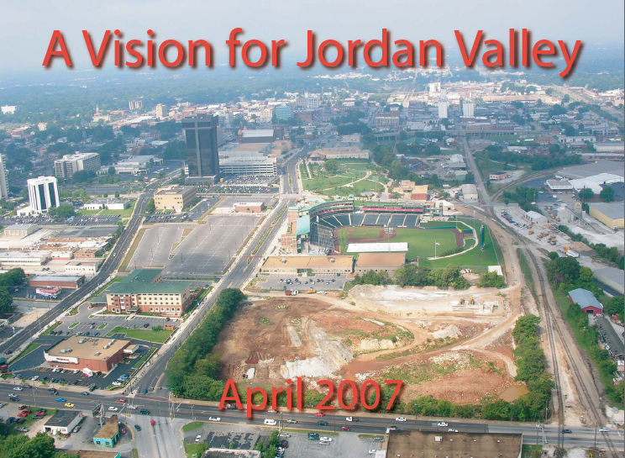
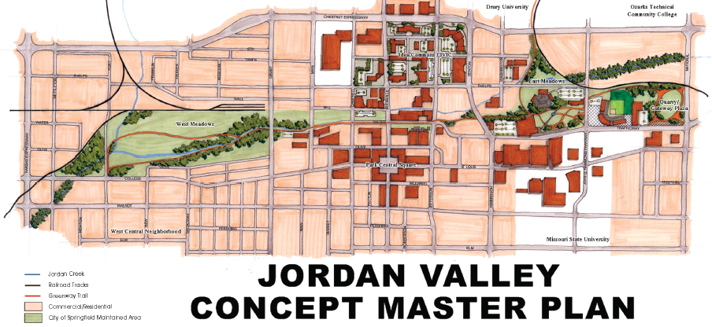
Importance of Redevelopment Planning Process
Vision development
Stakeholder coordination
Eligibility for incentives
Long-term Implementation
City of Springfield, MO Missouri

Slide 26
So How Does this Get Paid For?

Slide 27
Local, State, and Federal Funds
Phase I / II Site Assessments
Free TBAs (Targeted Brownfields Assessments) by KDHE & EPA
EPA Assessment Grants
Including for Coalitions
Cleanup, if necessary
State Trust Funds, EPA Cleanup Grants
Redevelopment (Construction, etc.)
EDA, USDA, DOT, HUD, etc.

Slide 28
State Contact:
Ryan Weiser
785-296-5519
rweiser@kdheks.gov
State Brownfields Site
http://www.kdheks.gov/brownfields/index.html

Slide 30
EPA Assessment, Cleanup & Revolving Loan Grants - Who can apply?
General Purpose Unit of Local Government
Land Clearance Authority or other quasi-governmental entity
Government Entity Created by State Legislature
Regional Council or group of General Purpose Units of Local
Redevelopment Agency established by the state
States and Tribes
Non-profits (for Cleanup)

Slide 31
EPA Assessment Applicant Options
An applicant applying for an assessment grant can do the following combinations:
Up to 3 grant proposals (2 community-wide not to exceed $400k and 1 site-specific not to exceed $350k).
OR
1 grant as part of a coalition not to exceed $1 M if not applying for individual assessment funds.
Community Wide | Site Specific | Coalitions
Up to $200,000 for hazardous substances and $200,000 for petroleum addressing the same community. | Up to $200,000 for petroleum or hazardous substances (comingled) | Up to $1 million per coalition. Coalition Members can NOT apply for individual assessment funding.
 | May request a waiver for up to $350,000 | Requires 3 or more eligible entities; must assess at least 5 sites; members not eligible for other EPA assessment grants
Maximum Combined Amount $400,000 | Maximum Amount $350,000 | Maximum Amount $1 million
Three year grant period
Notes:
Requires 3 or more eligible entities
Must assess a minimum of 5 sites
Coalition members are not eligible to apply for individual, community-wide or, site-specific assessment grants in the year they apply as part of a coalition

Slide 32
EPA Cleanup Grant Program
Up to $200K per site for three year grant period
Must have:
FEE SIMPLE TITLE
ASTM E1903-97 Phase II or equivalent
Note Section VI.F Programmatic Requirements
Community Relations Plan
Administrative Record and public notice of it
Analysis of Brownfields Cleanup Alternatives (ABCA)
Public Notice of ABCA and written responses to comments received

Slide 33
Revolving Loan & Job Training Grants
Up to $1M for revolving loan fund (RLF) program over 5 year period
Assessment
Cleanup
20% cost share required
at least 60% is for loans, rest can be for grants
Authorizes grants of up to $200K for job training to eligible entitles over 2 year period

Slide 34
Ranking Criteria
4 Ranking Criteria Sections for ARC applicants:
Community need
Project description and feasibility of success
Community engagement and partnerships
Project benefits
Total possible points for each grant type is 100
Bottom line: must demonstrate compelling need, plans & relationships, and capacity to do the work

Slide 35
Get Advice as you Go
Technical Assistance to Brownfields (TAB)
KDHE
USDA
Consultants

Slide 36
Technical Assistance to Brownfield (TAB) Communities
A national program
Funded by EPA headquarters via grants to 4 different entities
Free to communities
K-State assists communities in EPA Regions 5 and 7

Slide 37
TAB Assistance to Communities
Tailored to specific community needs
Typically coordinated through the city, tribal or non-profit brownfields project manager
May include:
Help identifying funding sources for revitalization projects
Review of EPA and other grant applications
Help finding a consulting firm
Review of project plans, technical reports
Assistance with community outreach/involvement
Visioning
Other assistance, as needed and agreed upon
Communities accepted on a ‘first come’ basis
Depends on staff/funding availability

Slide 38
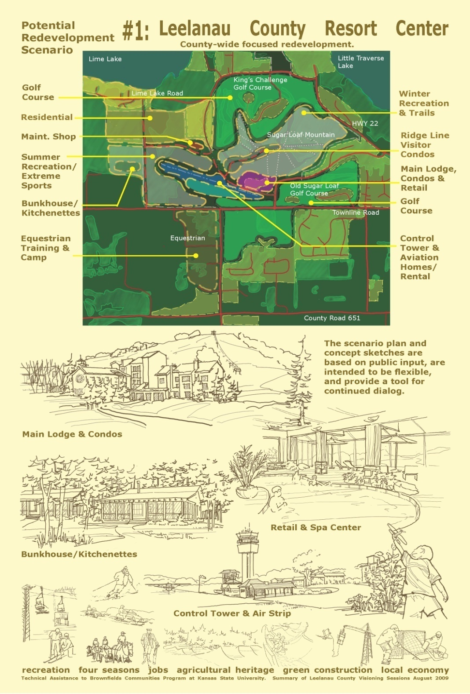
Redevelopment Planning

Slide 39
Community Involvement
Redevelopment Planning
Technical Presentations
Clear, concise

Slide 40
Technical Presentations
Community Meetings

Slide 41
Getting Our Help
Contact us
We’ll set up a meeting to discuss assistance needs
Review needs and TAB capability
Agree on a course of action
Get started

Slide 42
TAB Contacts
Dr. Sabine Martin (Program Coordinator)
1-800-798-7796 785-532-6519 smartin1@k-state.edu
Blase Leven
785-532-6519 baleven@ksu.edu
Terrie Boguski
913-780-3328
tboguski@ksu.edu
Web site: http://www.engg.ksu.edu/chsr/outreach
No Question is Too Big or Small – Just Call - We’ll Help or Find Someone Who Can!

