Slide 1

Brownfields Workshop
OVERVIEW BROWNFIELDS
GRANT PROCESS
AUGUST, 2013
REGION 6 BROWNFIELDS

Slide 2
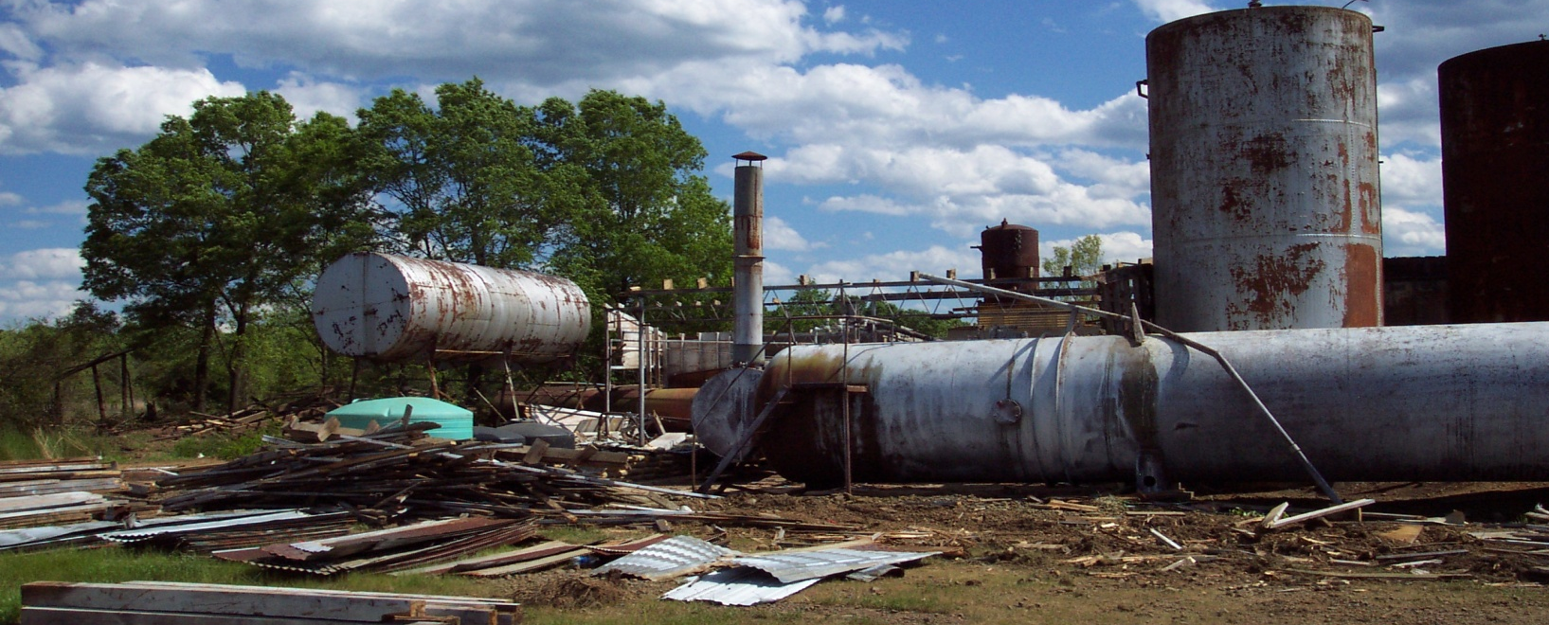
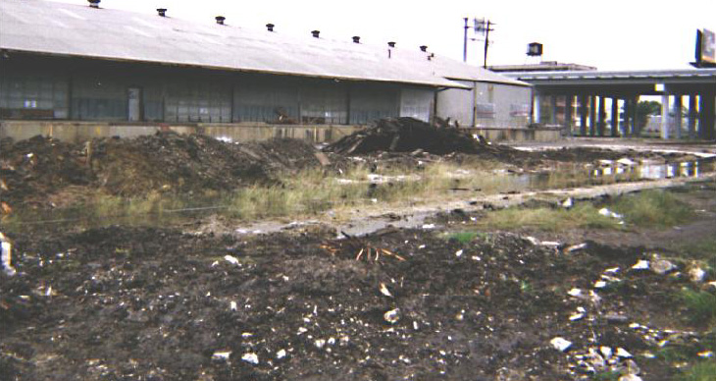
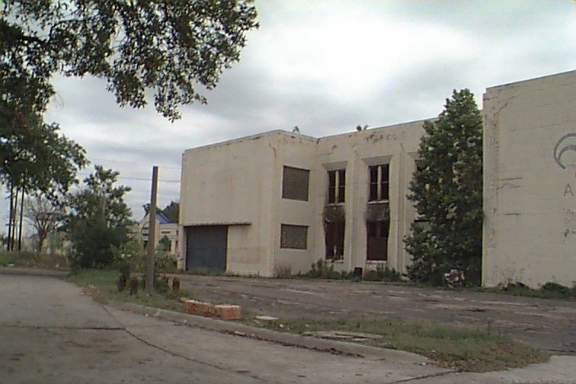
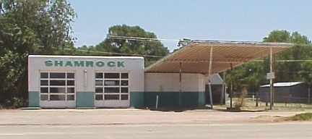
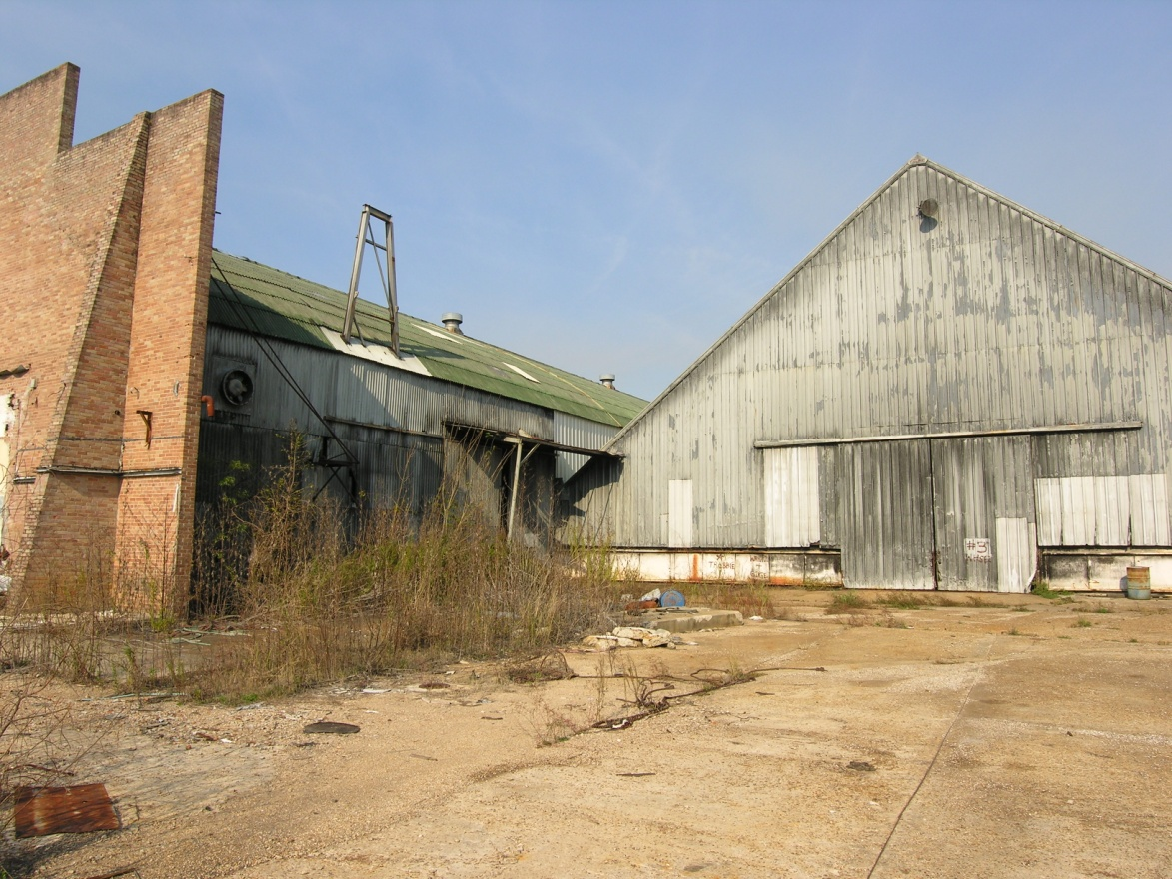
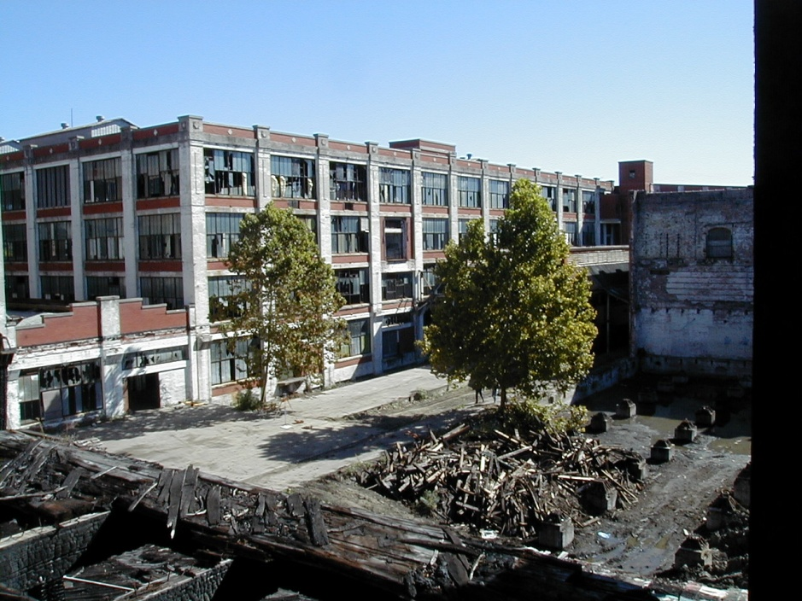
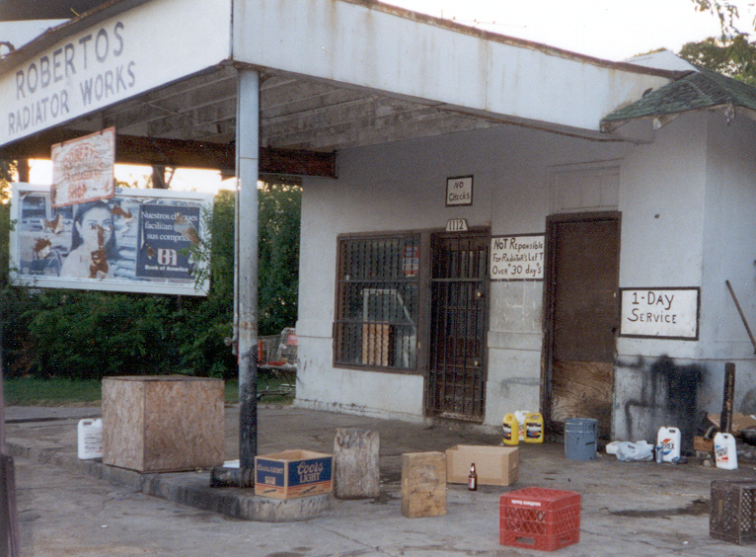
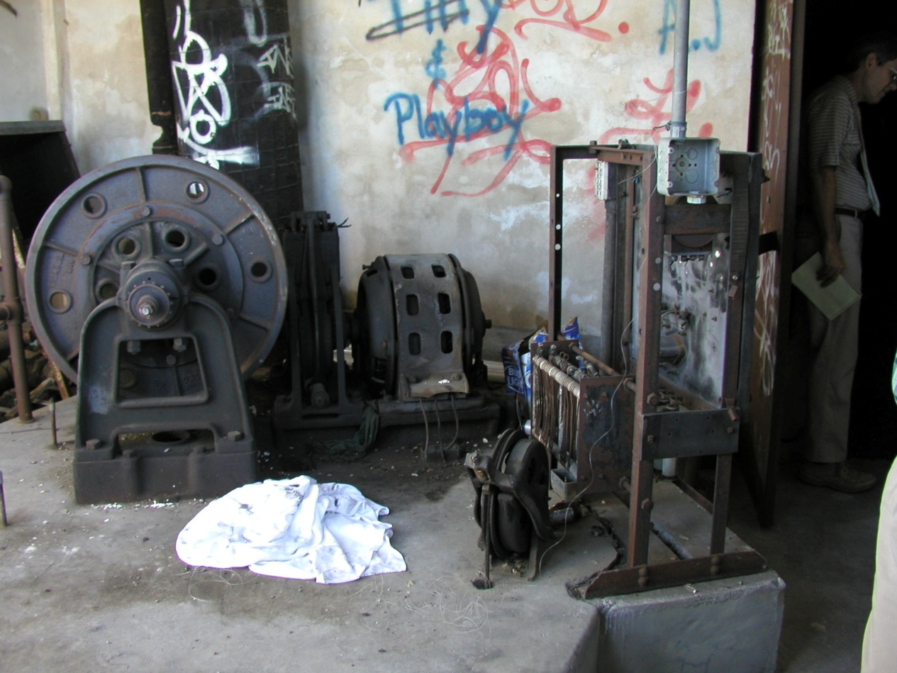
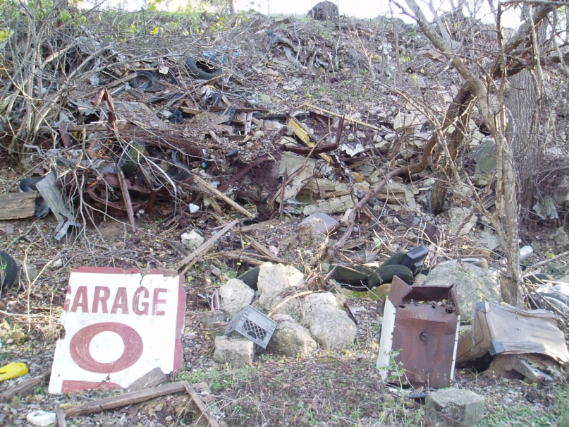
What are Brownfields?
1

Slide 3
Elements of
Brownfields Revitalization
2
Local Stakeholders
Determine Reuse Vision and Goals
Conduct
Environmental
Assessments
Leverage Funding Resources
Clean up and Revitalize
Identify
Brownfields
Prioritize
Brownfields
EPA Assessment Grants
EPA RLF and/or
Cleanup
Grants

Slide 4


Slide 5
Brownfields Assistance Opportunities Funding
4
Assessment Grants
Cleanup Grants
Revolving Loan Fund Grants
Area-wide Planning
Job Training Grants
Multi-purpose Grants

Slide 6
ASSESSMENT GRANTS – NO MATCH!
$200K, $350K, $600K
USES:
Inventory of BF Sites
Community Engagement
Phase I Environmental Site
Assessments
(ESAs) [All Appropriate Inquiry]
Phase II ESAs (Sampling)
Cleanup Planning
Analysis of Brownfields Cleanup
Alternatives (ABCA)
COMMUNITY-WIDE
Hazardous &/or Petroleum
SITE-SPECIFIC
Hazardous &/or Petroleum
Waiver/Justification to Exceed $200K Limit:
  Size of Site (30+ acres)
  Complexity of
  Contamination
  Owner
  Uncooperative
COALITION
Hazardous &/or Petroleum
  Commitment Letters
  Coalition Members
  ALL COALITIONS
  MEMBERS MUST
  BE ELIGIBLE

Slide 7
CLEANUP GRANTS – 20% MATCH
$200K + 20% MATCH
Non-Profits – Eligible Applicant
Must Own Property
Must Not Be Operator
Must Qualify as
  HAZARDOUS
  Bona Fide Prospective Purchaser
  OR
  PETROLEUM
  Eligibility Determination – State
Phase I ESA Completed
Phase II ESA Completed
Analysis of Brownfields Cleanup
Alternatives (ABCA) - Drafted
Public Participation on Grant
Proposal
  Community Notice (Document!)
  Community Meeting (Document!)
  Community Comments on Grant Proposal (Document!)
USES:
Cleanup Activities
Finalize ABCA
Public Participation on ABCA
State Voluntary Cleanup
Program Fees
Quality Assurance Project Plan
(QAPP)
Qualified Environmental
Professional (Your
advocate/technical advisor)
Confirmatory Sampling
(CONFIRM CLEANUP MEETS
STATE CLEANUP STANDARDS)
Community Engagement
Activities

Slide 8
REVOLVING LOAN FUND GRANTS - 20 % MATCH
$1M
USES:
Loans for Cleanup Activities
  Analysis of Brownfields Cleanup Alternatives (ABCA)
  Cleanup Planning
  State VCP Fees
Subgrants for Cleanup (eligible
entities)
Qualified Environmental
Professionals For Loan &/Or
Subgrant Recipients
Community Engagement
Activities
Fund Manager
Activities to Administer Loan
APPLICABLE TO ALL RLF APPLICANTS: TWO Legal Opinions
  Access to Secure Site
  Administer Loans
COMMUNITY-WIDE
Hazardous &/or Petroleum
COALITION
Hazardous &/or Petroleum
  Commitment Letters
  Coalition Members
  ALL COALITIONS
  MEMBERS MUST BE ELIGIBLE

Slide 9
ENVIRONMENTAL WORKFORCE DEVELOPMENT & JOB TRAINING GRANTS – NO MATCH!
$200K
USES:
Develop Curriculum
Market/Recruit Students
Conduct Training
Supplies for Students/Trainers
Graduation Activities
Job Placements
Student Screening – Physical, Medical,
Education
Track Measures – Students Graduated,
Students Placed in Job, Student Job
Retention
IDENTIFY TARGET MARKET
  Funds Limited to Training
  No Stipends for Child Care, Transportation, Living Expenses
  Identify Workforce Needs in Area

Slide 10
AREA-WIDE PLANNING GRANTS – NO MATCH!
$200K
USES:
Advance Ongoing Local Planning
Community Meetings, Charettes
Community Engagement –
Website, Newsletters, Social
Media
Proposed Plan to Revitalize
Target Area Brownfields Sites
Identify Next Steps
Identify Resources – Local,
Regional, State, Federal
Host Federal Partners Meeting(s)
Inventory Brownfields Sites
NEIGHBORHOOD/REGIONAL APPROACH
  Not Allowed to Conduct ESAs
  Identify Community Needs Assessments

Slide 11
MULTI-PURPOSE GRANTS – NO MATCH!
$550K
USES:
Assessments:
Phase I ESA
Phase II ESAs
Cleanup Plans
ABCA
Community Engagement
Cleanups:
State VCP Fees
Qualified Environmental
Professional
Cleanup Activities
Confirmatory Sampling AFTER
Cleanup
Community Engagement
COMBO – ASSESSMENT & CLEANUP
  Up to $350K Assessment (Waiver/Justification)
  Up to $200K Cleanup
  Non-Profits – NOT ELIGIBLE
  Must Be Past EPA Brownfields Grant Recipient
  Must NOT be Liable for Past Contamination under Superfund and/or Petroleum – Underground Tanks Reguatlion

Slide 12


Slide 13
Assessment, Revolving Loan Fund, Cleanup (ARC) – Brownfields Grants Schedule
General ARC Grant Schedule
  Guidelines posted mid-late August
  Proposals due 60 days from date of posted guidelines
  Selections announced following May
  Grants awarded following October

Slide 14
Overview ARC Grant Review Process
THRESHOLD CRITERIA
  Pass/Fail
RANKING CRITERIA
  Accrue Points
    Assessment 200 Points
    Revolving Loan Fund 100 Points
    Cleanup 100 Points

Slide 15

Overview ARC Grant Review Process
Proposal Process Step 1:
Pass/Fail Threshold Criteria
  Evaluated by your EPA Region
  Clarification by your EPA Region to Determine Eligibility after Submittal
  If Applicant and/or Brownfields Site Does Not Meet Threshold Criteria, Application Will Not Be Scored/Ranked

Slide 16

Overview ARC Grant Review Process
Proposal Process Step 2:
Receive Ranking Criteria Score
  Evaluated by a National Panel
    Reviewers are from SOMEWHERE ELSE
    Scores Based on PROPOSAL
  REMEMBER . . . Scores!
    Assessment 200 Points
    Revolving Loan Fund 100 Points
    Cleanup 100 Points

Slide 17
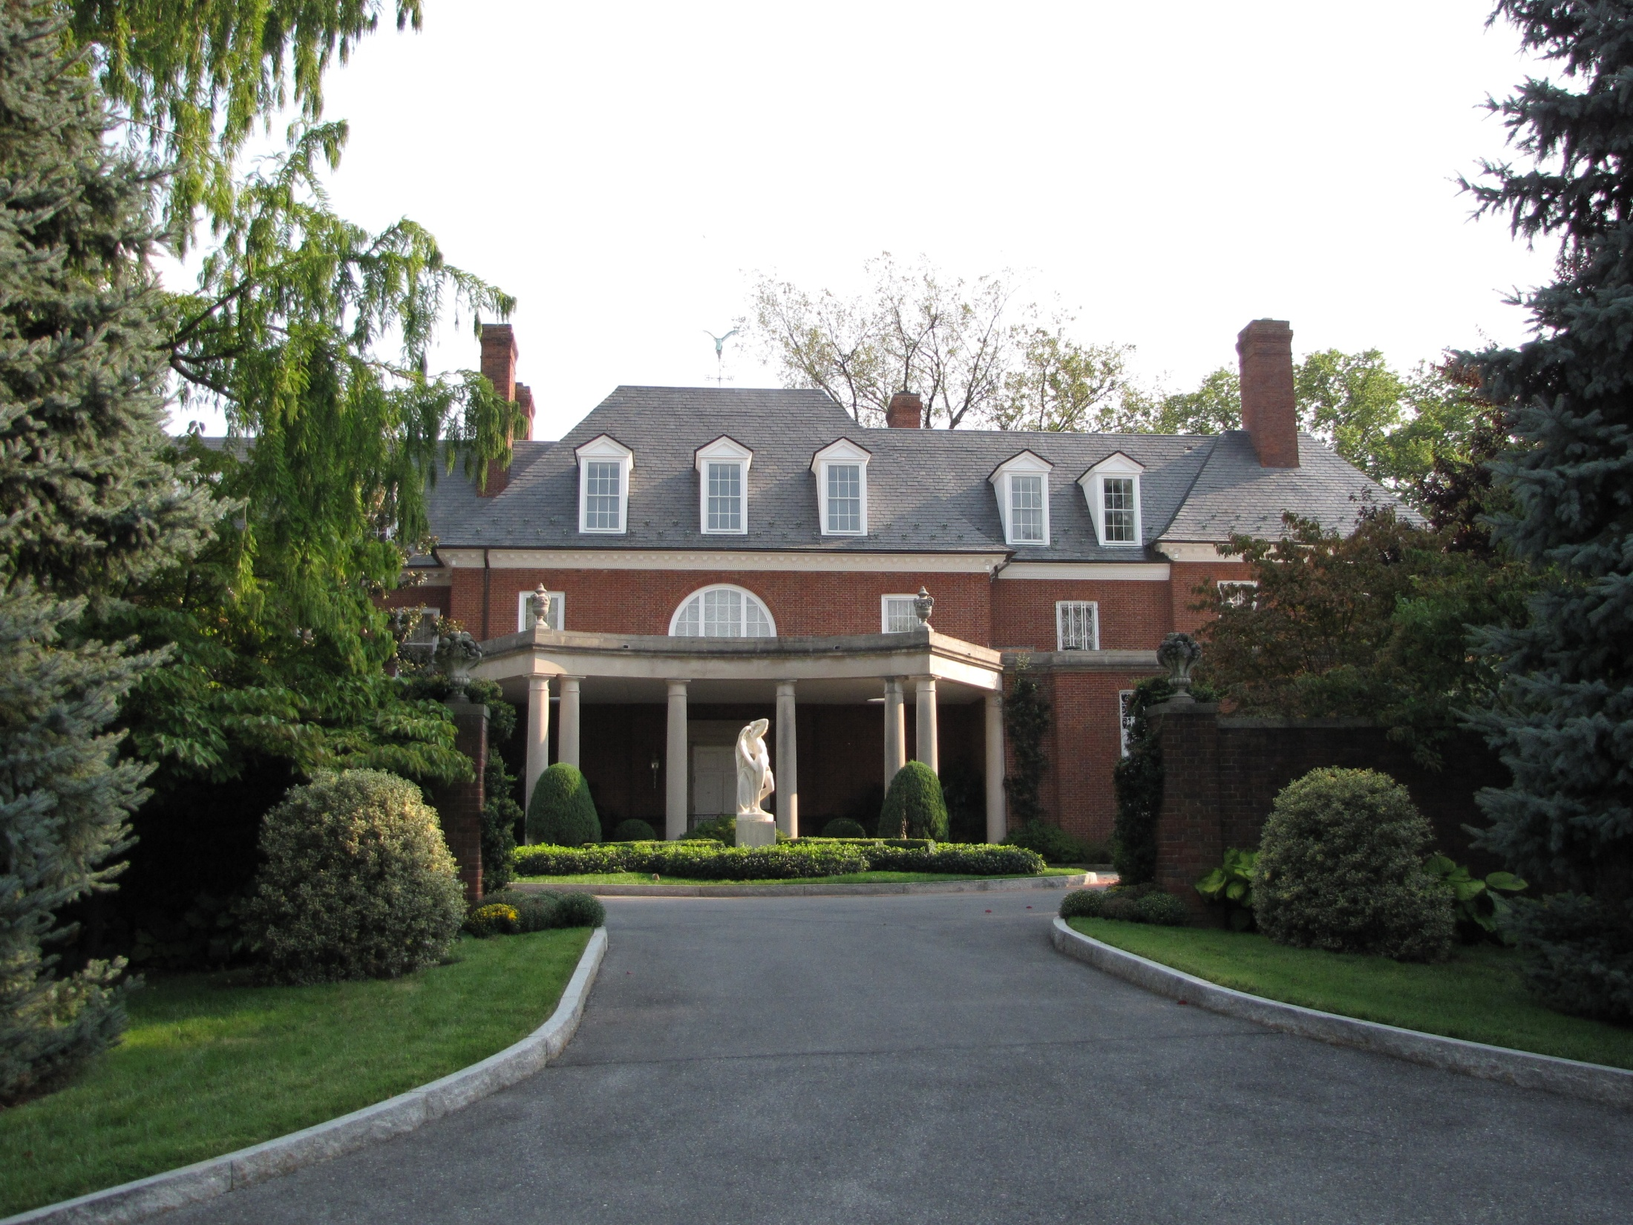

Slide 18

RANKING CRITERIA
POINTS!!!
ASSESSMENT – 200 Points
RLF – 100 Points
CLEANUP – 100 Points

Slide 19

COMMUNITY NEED
Environmental Issues include:
# of BF Sites, Size of BF Sites
Health Concerns
Social Concerns
Disproportionate Impact to
Community from BF sites
SENSITIVE POPULATIONS:
  Children?
  Women of Child-Bearing
  Age?
  Seniors?
  Minorities?
    African American %?
    Latino %?
    Asian American %?
    Native American %?
ASSESSMENT – 40 Points
RLF – 15 Points
CLEANUP – 15 Points
18
Notes:
ENVIRONMENTAL – CONTAMINANTS? Soils, groundwater, exposure pathways dermal, ingestion, airborne
HEALTH – Asthma, Lead Blood Poisoning?
SOCIAL - – Lack of Affordable Housing, Parks, Retail, Services

Slide 20
PROJECT DESCRIPTION &
FEASIBILITY OF SUCCESS
Budge Table
Budget Narrative
Outputs
Outcomes
$ &/or Resources
Leveraged – Assessment
Gaps, Cleanup,
Redevelopment
Does Budget Table Match
Narrative?
Leveraged Resources
Letters Attached?
ASSESSMENT
# Phase I ESAs
# Phase II ESAs
# Cleanup Plans
Prioritization for Phase I and II ESAS
RLF
Sustainability of RLF
Loan Administration Subgrants?
Target Market
CLEANUP
Reuse????
Cleanup Plan
VCP vs Non VCP?
ASSESSMENT – 100 Points
RLF – 55 Points
CLEANUP – 55 Points
19
Notes:
Outputs - # of Assessments, Quarterly Reports, ACRES Reporting
Outcomes - # of Cleanups, Increased Tax Base, # Jobs Created?

Slide 21
PROGRAMMATIC CAPABILITY
Include Details – Key Staff
Involved in Project
Demonstrate Understanding-
Competitive Bid Process
(40 CFR Parts 30 or 31),
As Appropriate
Confirm No Adverse Audit
Findings OR No Audit
If Adverse Audit Findings –
Explain How Findings Are
Addressed
IF PAST RECIPIENT – PROVIDE
PAST ACCOMPLISHMENTS!
ASSESSMENT – 40 Points
RLF – 20 Points
CLEANUP – 20 Points
20
Notes:
ENVIRONMENTAL – CONTAMINANTS? Soils, groundwater, exposure pathways dermal, ingestion, airborne
HEALTH – Asthma, Lead Blood Poisoning?
SOCIAL - – Lack of Affordable Housing, Parks, Retail, Services

Slide 22
COMMUNITY ENGAGEMENT
Engage Community HOW?
  Community Meetings
  Web
  Newsletters
  Social Media
Language Needs
Accommodated?
Partnerships Local, State,
Federal
  Health Dept.
  State Environmental
  Agency
  HUD, DOT, EPA?
Key Community Based Orgs.
  Proposal – List NAME, ROLE
  & CONTRIBUTION of Key
  CBO’s to Brownfields
  Project
  Support Letters – ROLE &
  CONTRIBUTION to
  Brownfields Project
ASSESSMENT – 30 Points
RLF – 15 Points
CLEANUP – 15 Points
21

Slide 23
PROJECT BENEFITS
BENEFITS - SENSITIVE
POPULATIONS:
  Improved Environment?
  Improved Health?
  Improved Social?
Redevelopment - Equitable
Development or Livability?
Economic Gain $, Jobs
Greenspace or Non-Profit
Sustainable Practices! Livability
Principles! Green Building,
Green Cleanup, Green
Contracting!!
ASSESSMENT – 30 Points
RLF – 15 Points
CLEANUP – 15 Points
22

Slide 24


Slide 25

THRESHOLD CRITERIA
Pass – Entry
Fail – No Entry

Slide 26
THRESHOLD CRITERIA:
Eligible Applicants
25
Non-Profits
States
Redevelopment Agencies
Private
Owners/
Developers
Potentially
Liable
Parties
Regional
COGs
Cities
Local
Governments

Slide 27

THRESHOLD CRITERIA: Site Eligibility –
Site Specific Assessment OR Cleanup Grants
26
Illegal Drug Labs
Lead Based Paint
Hazardous Substances
Pollutants
Asbestos
Contaminants
Petroleum Products
Mine-Scarred Lands
Excluded Facilities
  listed/proposed on the National Priorities List
  subject CERCLA order or decree
  subject to the control of the federal government

Slide 28
THRESHOLD CRITERIA: ALL ARC PROPOSALS State Acknowledgment Letter
CURRENT Acknowledgement Letter from State or Tribal Environmental Authority – TCEQ &/or RRC
Can Cover Multiple Brownfields Proposals
Call or email Christine and/or Aimee at:
  Christine Whitney, TCEQ:
  512.239.0843
christine.whitney@tceq.texas.gov
Kelly Wilson, RRC:
512.475.0730
    Kelly.Wilson@rrc.state.tx.us

Slide 29
THRESHOLD CRITERIA: Property Owner Eligible – Site Specific Assessment OR Cleanup Grants
  HAZARDOUS:
  Applicant Can Not Be Potentially Liable (CERCLA)
  EPA Determines CERCLA Liability
IF Brownfield Contaminants are asbestos and/or lead-based paint – CERCLA may not apply . . .
PETROLEUM:
State Petroleum Eligibility Determination Letter (Attachment)
FOR MORE INFORMATION CONTACT:
  Karen Peycke, EPA Christine Whitney
  214.665.7273 512.239.0843
  peycke.karen@epa.gov christine.whitney@tceq.texas.gov
Notes:
CERCLA – COMPREHENSIVE ENVIRONMENTAL RESPONSE, COMPENSATION, AND LIABILITY - SUPERFUND

Slide 30
THRESHOLD CRITERIA: RLF & CLEANUP
20% MATCH
RLF
Two Legal Opinions
  Authority to Access Property
  Authority to Administer Loans
CLEANUP
Phase I ESA
Phase II ESA
ABCA (Draft – Minimally)
Public Notice, Public Meeting, Public Comments
Cleanup Authority and Oversight Structure
Notes:
Cleanup Authority and Oversight Structure
Enroll In State Voluntary Cleanup Program
Applicant’s Ability To Oversee Cleanup
Plan To Access Relevant Property IF APPLICABLE

Slide 31
THRESHOLD CRITERIA: COALITION GRANTS
Three or more coalition members
  All separate legal entities
  All eligible applicants
Include in proposal:
  Documentation that all members are eligible entities
  Coalition members’ letters agreeing to be part of coalition
FOR MORE INFORMATION CONTACT:
  Karen Peycke, EPA
  214.665.7273
  peycke.karen@epa.gov

Slide 32


Slide 33
Overview ARC Grant Proposal
PROPOSAL CHECKLIST
ASSESSMENT
Site Specific:
$350K Justification Waiver
Property-Specific Determination IF Applicable
Property Owner Eligibility IF
Applicable
Petroleum Eligibility Determination
IF applicable
Coalitions:
Letters of Commitment
Document Coalition Member
Eligibility
CLEANUP
Analysis of Brownfields Cleanup
Alternatives (ABCA) DRAFT
Documentation of Community
Notice/Meeting/Comments
Owner Eligibility
Petroleum Eligibility Determination
IF applicable
Property- Specific Determination IF
Applicable
Cost Share Waiver IF Applicable
Transmittal Letter (2 Page Limit)
Narrative Proposal – Ranking Responses (15 Page Limit)
Attachment(s)
  Threshold Responses
  Non-profit for Cleanup ONLY – Document Status
  Acknowledgement Letter State Environmental
  Authority
  Leveraged Resource Letters
  Key Community Based Organization Letters
  Special Considerations Checklist
RLF
Letter – Two Legal Opinions:
  Access Site – Emergency
  Administer RLF Loans
Letters of Coalition Members
Commitment IF Applicable

Slide 34
Overview ARC Grant Proposal
SPECIAL CONSIDERATIONS CHECKLIST
Community Population
< 10,000
Federally Recognized Indian
Tribe
Assisting Tribe or Territory?
Mine-Scarred Brownfields?
Controlled-Substances
Brownfields?
Impact from Natural Disaster
(Hurricane Ike?)
Plant Closures Or Other
Economic Disruptions?
HUD/DOT/EPA Core Partner
Brownfields Area-Wide Planning
Grant Recipient
Green Remediation?
Phase II ESA ONLY?

Slide 35

General Lessons Learned
The Narrative Tells Your Story –
Tie All the Criteria Together
Remember, Reviewers Know
Nothing About Your Community
Highlight Your Redevelopment
and/or Sustainability
Opportunities Realized
with Grant
Any Previous and Ongoing
Master Planning Efforts?
Include in Narrative!
Any Economic &/Or
Sustainability Initiatives?
Include in Narrative!
“Special Considerations”?
Include in the Narrative!
Respect Page Limits!
Acronyms – NOT HELPFUL!
Maps, Graphics – After 20
Copies – How Does It Look?
FOLLOW OUTLINE FORMAT
PRESENTED IN PROPOSAL
GUIDELINES
Use Proposal Checklist
READ THE CURRENT PROPOSAL
GUIDELINES!

Slide 36
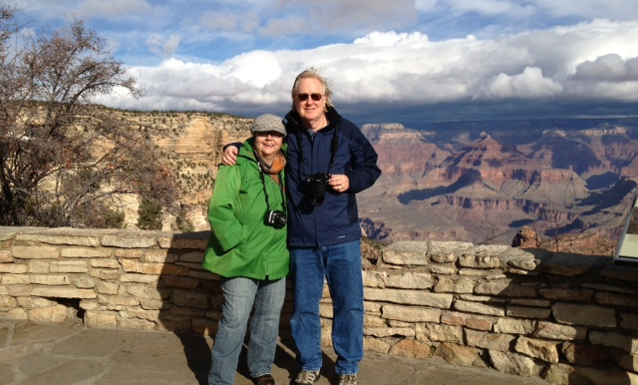
WWW.EPA.GOV/BROWNFIELDS
THANK YOU!
KAREN PEYCKE 214.665.7273 peycke.karen@epa.gov
MARY KEMP 214.665.8358 kemp.mary@epa.gov

