Slide 1
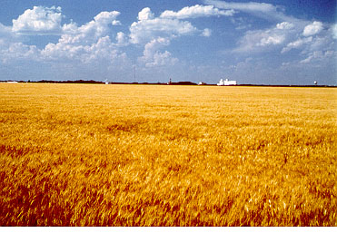
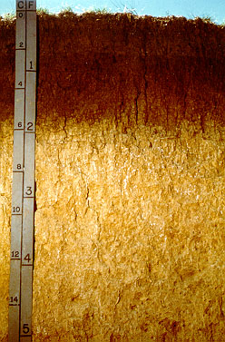

Greenhouse Gases:
Soil Science, Terrestrial Sequestration, and Agricultural Offsets
Charles W. Rice
University Distinguished Professor
Soil Microbiologist
Department of Agronomy
K-State Research and Extension

Slide 2
IPCC Fourth Assessment Report, Working Group III, 2007

Slide 3
Mitigation

Slide 4
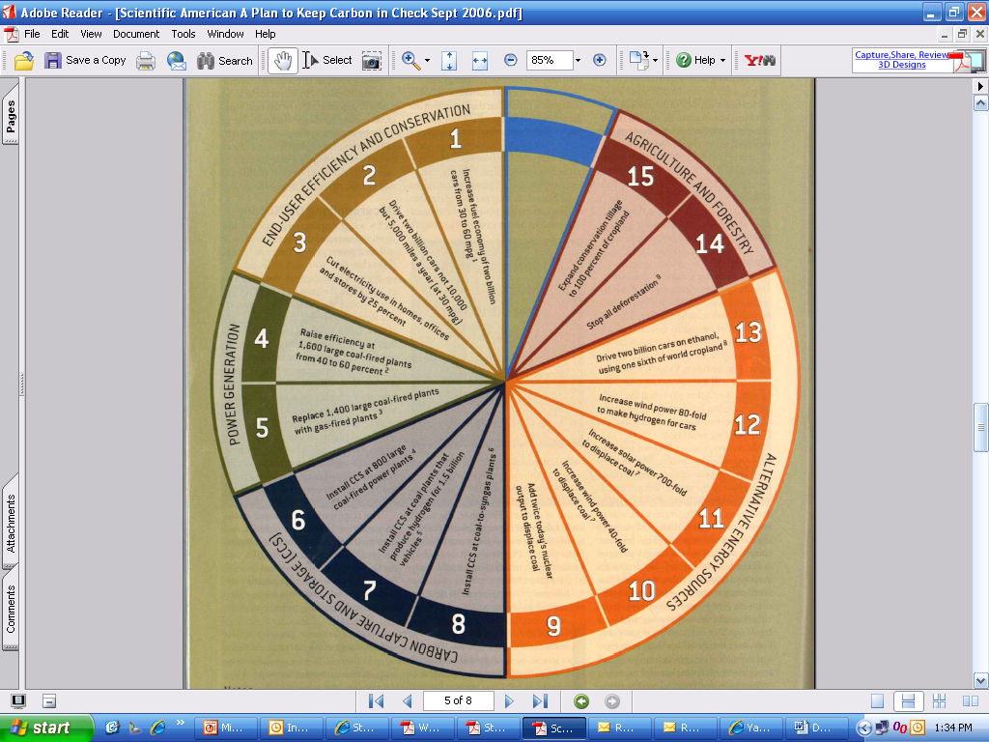
7 wedges needed to reach stabilize carbon emissions
Source: Socolow & Pacala; Sci. Am., Sept. 2006
Notes:
4

Slide 5
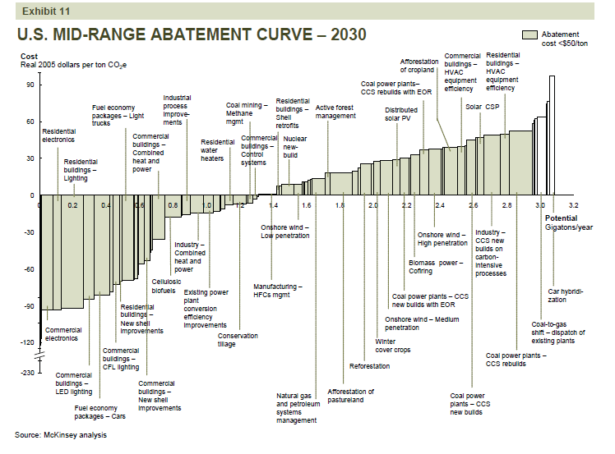

Slide 6

Global economic mitigation potential for
different sectors at different carbon prices
IPCC, 2007

Slide 7
Agriculture
A large proportion of the mitigation potential of agriculture (excluding bioenergy) arises from soil C sequestration, which has strong synergies with sustainable agriculture and generally reduces vulnerability to climate change.
Agricultural practices collectively can make a significant contribution at low cost
  By increasing soil carbon sinks,
  By reducing GHG emissions,
  By contributing biomass feedstocks for energy use
IPCC Fourth Assessment Report, Working Group III, 2007

Slide 8
Global mitigation potential in agriculture
N₂O
CH₄
CO₂
Global biophysical mitigation potential (Mt CO₂ seq. yr⁻¹)
Global biophysical mitigation potential (Mt CO₂ seq. yr⁻¹)
Grazing land Management
Livestock
Setaside LUC & Agroforestry
Restoration of Degraded Lands
Manure Management
Rice Management
Bioenergy Crops (Soils Component)
Water Management
Restoration of Cultivated Organic Soils
Cropland Management
Smith et al. (2008)

Slide 9

Climate
Soils
Management
Sunlight
CO₂
Harvestable Yield
Soil Microbial Activity
Soil Organic Matter (C)

Slide 10
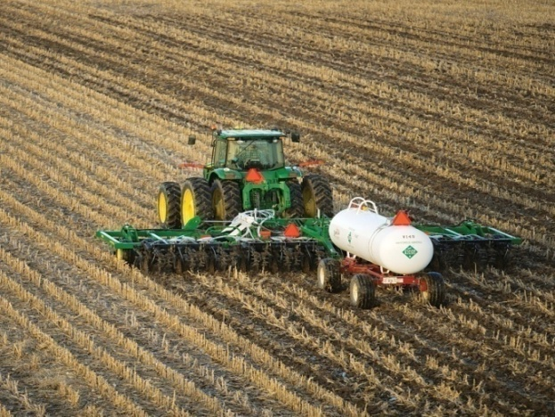
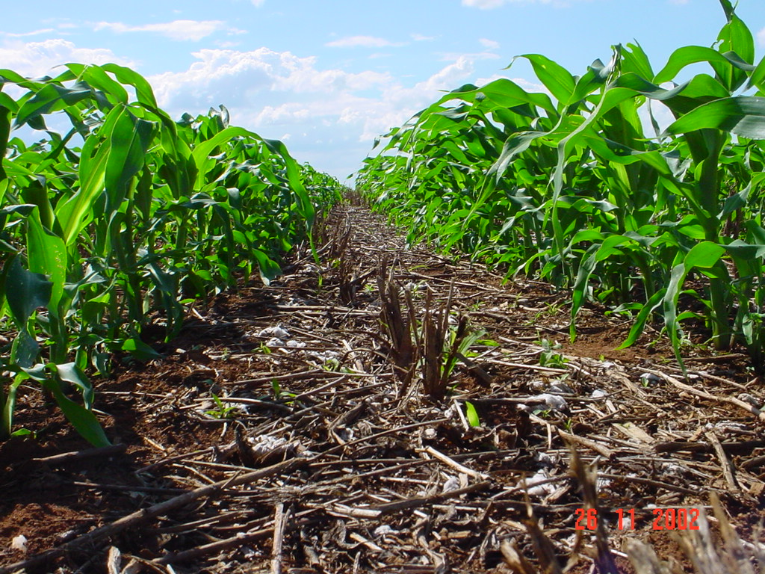
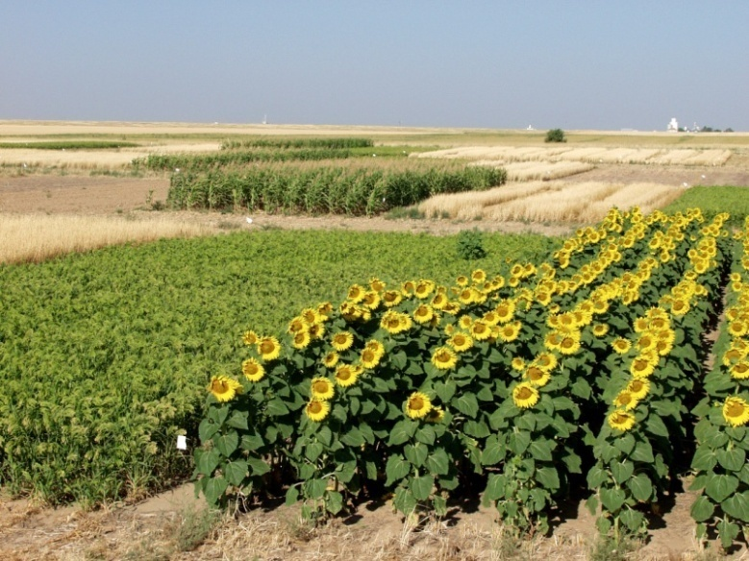
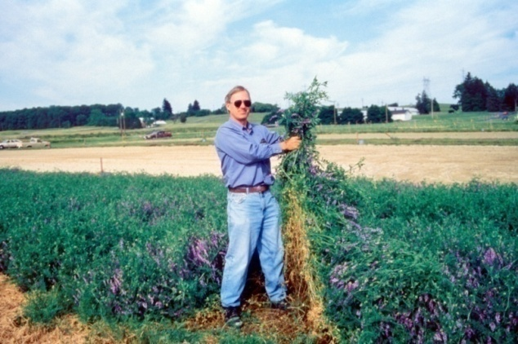
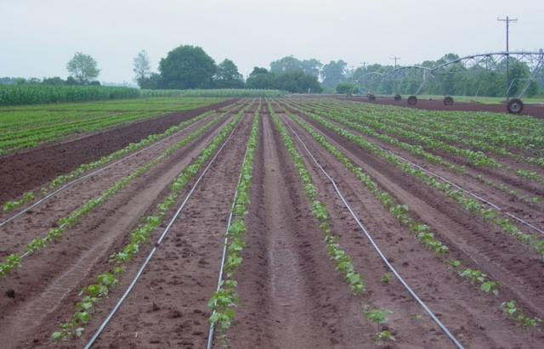
Many opportunities for GHG mitigation!
Cropland
  Reduced tillage
  Rotations
    Reduced bare fallow
    Increased intensity
  Cover crops
  Fertility management
    Nitrogen use efficiency
  Water management
    Irrigation management
Reduced Tillage
Fertilizer Management
Diversifying rotations
Smart irrigation technologies
Hairy Vetch as a cover crop
Notes:
Dr. Rice, I don’t really have a good picture of crop rotations for increasing cropping intensity. Maybe you do?
Here are some examples of these activities such as croplands, rice paddies and agroforestry. In general, the various practices under each activity can be defined with some precision and the general impact of the practice can on soil organic carbon can be quantified as well. But from a global and from site specific perspectives we need to improve our understanding of the impacts of these practices or the interactive effects of these practices on soil carbon stocks under a variety of climate-soil combinations. Take for example reduced tillage and its impact of erosion rates and soil carbon dynamics. In general, we know the answer how the system is going to behave but the intensity of the responses might be site specific.

Slide 11
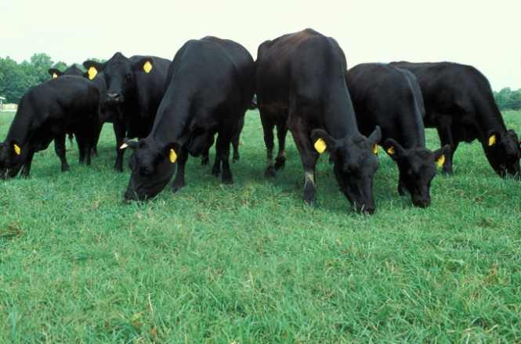
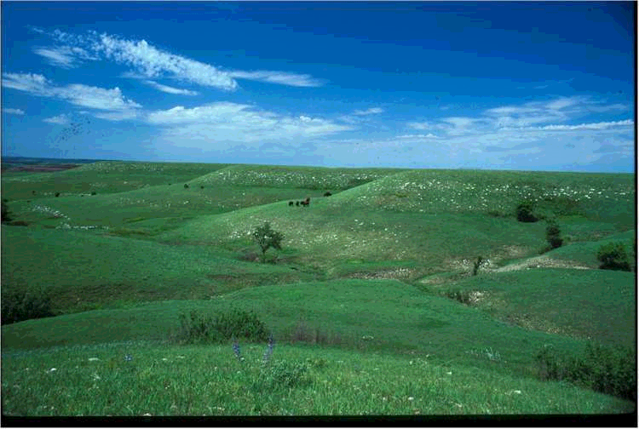
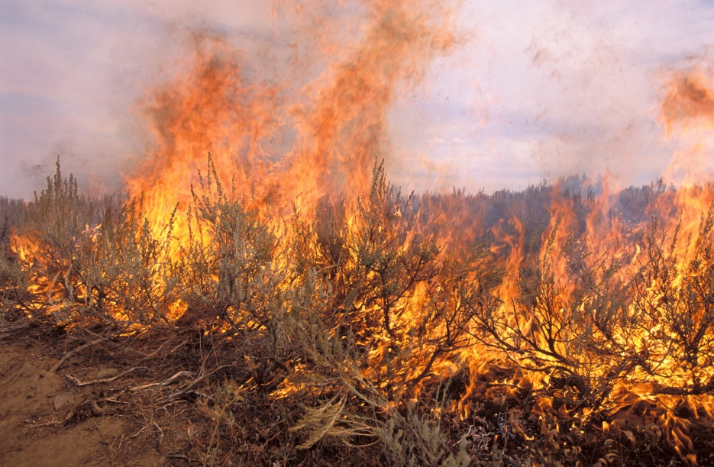
Many opportunities for GHG mitigation!
Grasslands
  Grazing management
  Fire management
  Fertilization
Managed Grazing
Controlled Burning
Notes:
Here are some examples of these activities such as croplands, rice paddies and agroforestry. In general, the various practices under each activity can be defined with some precision and the general impact of the practice can on soil organic carbon can be quantified as well. But from a global and from site specific perspectives we need to improve our understanding of the impacts of these practices or the interactive effects of these practices on soil carbon stocks under a variety of climate-soil combinations. Take for example reduced tillage and its impact of erosion rates and soil carbon dynamics. In general, we know the answer how the system is going to behave but the intensity of the responses might be site specific.

Slide 12
Conservation of Soil Carbon
H₂O
Organic C
Temperature
Microbial composition and activity
O₂
Plant
characteristics
Substrate
quality
Management
Clay
Hierarchy of importance
Biological
factors
Physical Protection
Disturbance
Organics
Mineralogy
Chemical
Clay
CO₂
Notes:
The amount of C soils can sequester is dependent on several factors. First is the amount of C. Once that C enters the soil that of primary importance is microbial activity. Second is physical protection and finally chemical. I would like to illustrate a couple of examples. C inputs

Slide 13
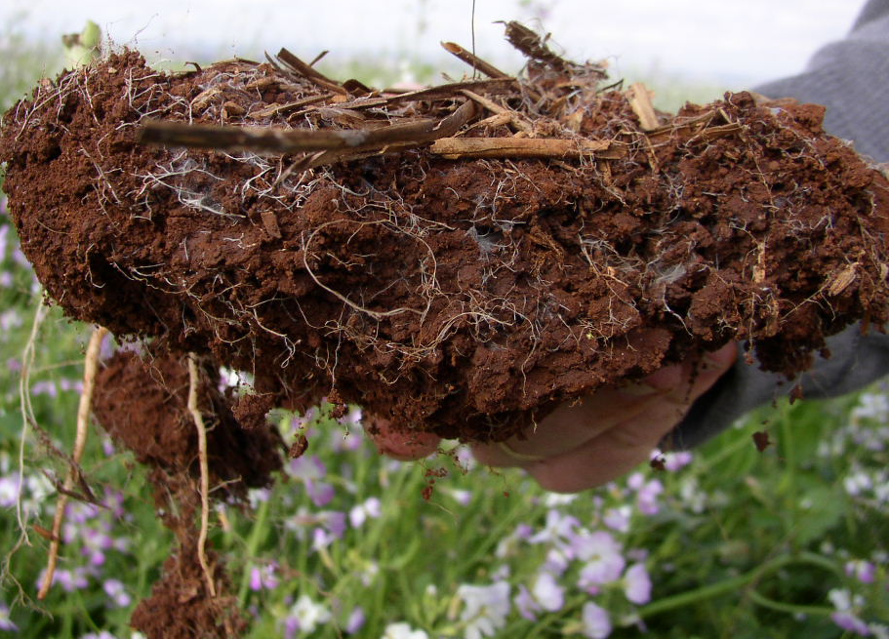
No-till promotes fungal activity
5 cm
Fonte: Juca Sá

Slide 14
Soil Aggregation
60
a
a
Restored prairie
No-tillage Sorghum
Tillage Sorghum
50
b
40
a*
g aggregate 100 g⁻¹ soil
b
30
b
20
ab
a
b
10
0
<53
53-250
250-2000
>2000
Microaggregates
Macroaggregates
Aggregate Size Class
White and Rice, 2007

Slide 16
How long? How deep?
How much?
Cultivation
New
Management
Soil C content

Slide 19
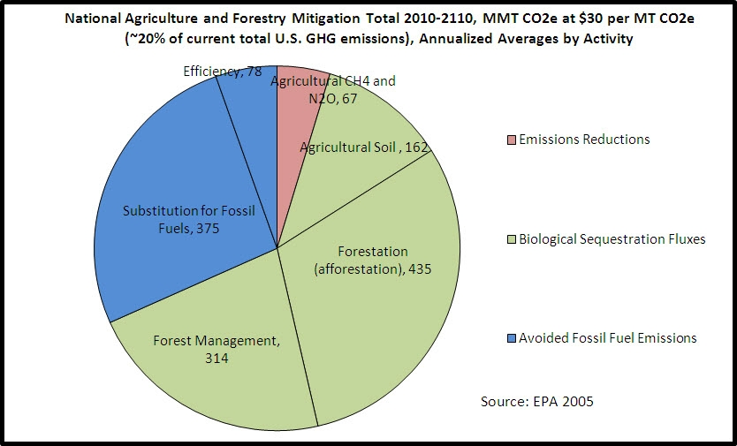
Ag and forestry have the potential to offset 10 - 25 percent of total annual U.S. GHG emissions

Slide 20
Gaseous Emissions
Environmental Services
Microbial
Activity
Soil
Structure
Soil
Biodiversity
Water
Erosion
&
Availability
Soil
Organic
Carbon
Nutrient
Cycling
Plant Growth
Yield
Sustainability

Slide 21
Reduction Opportunities
Sequestration
  Conservation tillage and crop rotations
  Cover crops
  Grazing practices
  Forestation, reforestation, forest management
Avoided emissions
  Biofuel production
  Thermal bio-power and bio-heat
  Renewable electrical power
Emission reductions
  Manure management
  Fertilizer practices N2O
Notes:
21

Slide 22
Types of Agricultural & Forestry GHG Offset Transactions
Outright Sale
  Direct GHG emissions reductions –
    N₂O, CH₄, CO₂
  Soil/Biomass Carbon – permanent commitment
Term-Limited Lease
  Soil carbon storage
  Biomass storage

Slide 23
Offsets Are Critical for Cap & Trade
Induces Change in Uncapped Sectors
Reduces Program Costs
Produces Large Volumes Earlier
Fills the Timing Gap; Bridges to the New Energy Future
Notes:
23

Slide 24
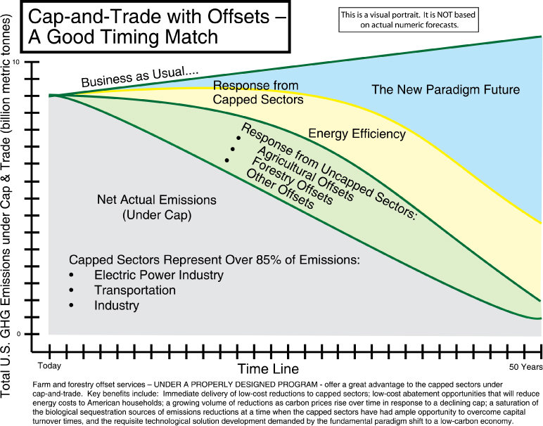
Notes:
24

Slide 25
Examples of feasibility and pilot projects on soil carbon sequestration
Region | Land Use | Land management change
Saskatchewan, Canada | Cropland | Direct seeding / cropping intensification
Pacific Northwest, USA | Cropland | Direct seeding / cropping intensification
Midwest Iowa, Kansas | Cropland Grass planting | No-till New grass plantings
Oaxaca, Mexico | Crop / natural fallow secondary forest | Fruit tree intercrops with annual crops / Conservation tillage
Pampas, Argentina | Cropland | Direct seeding
Kazakhstan | Cropland | Agriculture to grassland
Izaurralde (2004), Rice

Slide 26
Carbon as a Revenue Crop

Slide 27
Primary Challenges
Costs
  Changes in operating practices
  Tracking and selling offsets
  Increased input cost (esp. fuel and fertilizer)
Getting the correct enabling policy in place
Development of viable markets
Informing ag and forest sectors of opportunities, challenges, alternatives and consequences
Shaping our own destiny

Slide 28
Measurement, Monitoring and Verification
Detecting soil C changes
  Difficult on short time scales
  Amount of change small compared to total C
Methods for detecting and projecting soil C changes (Post et al. 2001)
  Direct methods
    Field measurements
  Indirect methods
    Accounting
      Stratified accounting
      Remote sensing
      Models
Post et al. (2001)

Slide 29
Primary Challenges
Costs
  Changes in operating practices
  Tracking and selling offsets
  Increased input cost (esp. fuel and fertilizer)
Getting the correct enabling policy in place
Development of viable markets
Informing ag and forest sectors of opportunities, challenges, alternatives and consequences
Shaping our own destiny

Slide 30
Production Costs
Iowa State
  Roughly a 1.5% increase for corn and soybean farmers by 2020
University of Missouri (FAPRI)
  Dryland corn 3.2% increase by 2020
  Irrigated corn 3.5% increase by 2020
  Soybeans 1.6% by 2020

Slide 31
Primary Challenges
Costs
  Changes in operating practices
  Tracking and selling offsets
  Increased input cost (esp. fuel and fertilizer)
Getting the correct enabling policy in place
Development of viable markets
Informing ag and forest sectors of opportunities, challenges, alternatives and consequences
Shaping our own destiny

Slide 32
Policy
State and Regional Policy
  California
  Northeast Region
  34 State Climate Action Registry (Kansas included)
  Western Governors Association
  Midwest Governors Association
National Policy
  Farm Bill
    Many programs tie to offsets
      CSP, EQIP
  Voluntary Registry
  Climate Change Legislation (will ag be included)
    Cap and Trade
    Carbon Tax
International
  Kyoto (EU has a trading platform)
  Partnerships

Slide 33
Waxman-Markey Bill
Sets a cap on GHG emissions
  17% reduction by 2020
  83% reduction by 2050
Allows 2 billion tons of offsets
  Split equally between domestic and international sources
Allocates ~86% of allowances
  Rural Cooperatives get a portion

Slide 34
Peterson Amendments
Makes USDA responsible for managing the agricultural offset program
Further specifies how the offset program will operate
Provides protection for "early actors"
Incorporates a list of practices that will be eligible for inclusion in the offset program
Commodity Futures Trading Commission regulates the trading of derivatives for emission allowances, offset credits and renewable electricity credits

Slide 35
Conclusions: Mitigation
Agriculture has a significant role to play in climate mitigation
Agriculture is cost competitive with mitigation options in other sectors
Bio-energy crops and improved energy efficiency in agriculture can contribute to further climate mitigation
Agricultural mitigation should be part of a portfolio of mitigation measures to reduce emissions / increase sinks while new, low carbon energy technologies are developed.

Slide 36
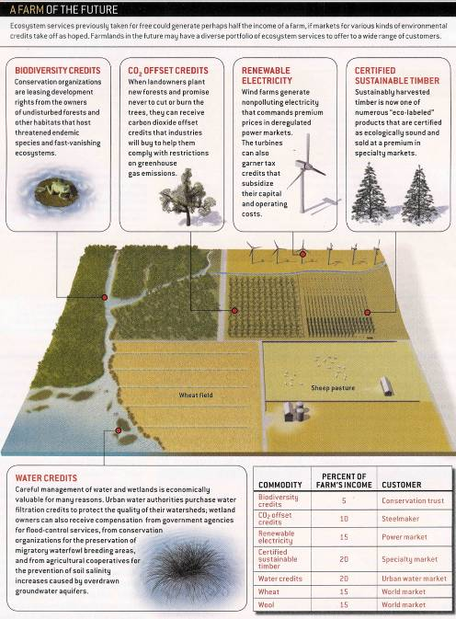
Scientific American’s
Vision of the Future Farm
Scientific American, 2005

Slide 37

Chuck Rice
Phone: 785-532-7217
Cell: 785-587-7215 cwrice@ksu.edu
Website
  www.soilcarboncenter.k-state.edu/
K-State Research and Extension
Notes:
www.conservationinformation.org/powerpoint/rice_oct29.ppt

