Slide 1
Carbon Sequestration Policy, Business Development, and Regulatory Issues
KSU Winter Intersession 2010
Michael E. Moore
VP CCS Business Development and External Affairs
Blue Source, LLC
Executive Director
North American Carbon Capture Storage Association
January 7, 2010

Slide 2
Session 4b – Carbon Sequestration Policy, Business Development, and Regulatory Issues
Start 1:50-2:40 Thursday
40 minutes 10 QA

Slide 3
Policy and Regulatory

Slide 4
H.R. 2454, The American Clean Energy and Security Act of 2009
Provide substantial support for early movers in carbon capture and storage
Bonus allowance for early movers could be as high as $100/ton
Recognizes the use of geologic sequestration (Section 813)
Primary sequestration mediums are saline formations , depleted oil and gas fields and deep coal seams (June 5th Committee Report)
EPA sets up Task force to study legal framework within six months of enactment and due within 18 months to Congress of enactment could be interpreted as also including BAU Class II EOR wells.
EPA tasked with establishing itself (1 yr report to Congress), the geologic sequestration regulations (2 yrs), Safe Drinking Water regulations (3 yrs) and requirements for geologic sequestration both subsurface and atmospheric reporting (4 yrs)
Using Enhanced hydrocarbon recovery results in reduced bonus allowance values at the EPA Administrator’s discretion
17% reduction of 2005 CO₂ levels by 2020

Slide 5
Interesting Finding on Oil In WM but not in Boxer-Kerry
SEC. 127. OPEN FUEL STANDARD.
17 (a) FINDINGS.— “The Congress finds that—(1) the status of oil as a strategic commodity, which derives from its domination of the transportation sector, presents a clear and present danger to the United States”;
Final version language on page 120. Language found on page 117 of June 19th HR 2454 this language also found on page 115 of the “Amendment in the Nature of a Substitute” 946 page version of HR 2454 not in the May 21, 932 page version but also on page 33 in the Committee report June 5th.
Note: “Clear and present danger” was used by Ronald Reagan in Policy Memorandum No.3 “Foreign Policy and National Security” to convey his feelings about the threat from Russia and its nuclear weapons. Fall of 1979 while running for President. Effectively set the stage for the “Star Wars” initiative

Slide 6
Senate’s “American Clean Energy Leadership Act of 2009” S. 1462
Accelerate the introduction of new clean energy technologies in the United States, creating new jobs and helping businesses grow through clean energy project financing, a renewable electricity standard, and a robust and secure national electricity transmission highway
Increase energy efficiency in buildings, major equipment, and appliances, saving consumers and businesses billions of dollars on their energy bills
Enhance America’s energy independence by increasing clean energy supplies and energy security, including new access to over 20 trillion cubic feet of clean natural gas resources
Strengthen America as the world leader in energy innovation, by doubling our national investment in energy research and technology
Build a new energy workforce for the future
Protect consumers by making energy markets more transparent and fair, and by providing new tools to fight market manipulation;
Tackle future energy and climate challenges with smarter, more integrated planning.
20% reduction of 2005 CO₂ levels by 2020
Promoting the development of domestic sources of oil and natural gas
Demonstrating the large-scale geologic storage of industrial sources of carbon dioxide;

Slide 7
Senator Cantwell’s “CLEAR Cap and Refund Act”
Unlike the Waxman Markey bill, this legislation envisions: 100% auction of "carbon shares"; reduced trading with trading limited to energy producers; a price collar $7-12 with escalator; no offsets; emission cap limited to only CO₂ (not other GHGs); and program run by DOE. A "carbon share" is the right to sell or otherwise place into commerce in the United States 1 ton of fossil carbon. Thus, unlike the "allowance" approach of Waxman Markey, which focuses on industrial emissions, the Cantwell bill addresses carbon when it is introduced upstream in fossil fuels (and fossil fuel products) in commerce at the wellhead, mine mouth, or point of entry.
For CCS purposes, the bill grants operators of CCS facilities surplus "carbon shares" in a quantity that corresponds to the quantity of fossil carbon permanently sequestered. (A similar incentive is provided for the beneficial reuse of CO₂.) The "carbon shares" could be used by the facility or sold in the market. Background materials accompanying the draft legislation describe these bonus "carbon shares" as a "strong, positive incentive for fossil fuel power plants to reduce their net carbon dioxide emissions through permanent sequestration ....”
75% of auction revenues go back to public
The bill does not define "sequestration" and is silent on issues such as permitting and long-term stewardship.

Slide 8
Senator’s Kerry, Lieberman & Graham Compromise Bill
Cap and Trade
Expanded offshore leasing for oil and gas production
More carbon capture & storage and “clean coal” support
More loans and incentives for nuclear power
17% CO₂ emissions cut by 2020

Slide 9
Federal CCS Funding Opportunities U.S. Department of Energy-National Energy Technology Laboratory Recovery Act: Carbon Capture and Sequestration from Industrial Sources and Innovative Concepts for Beneficial CO2 Use Funding Opportunity Number: DE-FOA-0000015 Announcement Type: Initial CFDA Number: 81.089 Fossil Energy Research and Development. Announcement June 8, 2009 application due August 7, 2009
$1,321,765,000.00 Available
Carbon Capture Storage from Industrial Sources-can be with/from steel, aluminum, cement, manufacturing, muni-waste, petcoke fuel source. Exclusions on power plants with energy output over 50% and fuel is over 55% coal. Efficiency in capture technology min 10% CO₂ content with 75% capture of emitted CO₂ stream storage, 1 million tons/year in CO2-EOR-EGR, basalt, stacked and ECBM, required site characterizations and MVA as program components
Phase I: concept and planning. Seven months. 10-12 awards, $500K to $3 million. DOE 80% cost share
Phase II: Design, Construction and Operations. 60 months. 4-6 awards must be in Phase I to qualify. $50 to $400 million award size. DOE targets 50% but cannot exceed 80% cost share.
No min-max on awards and qualifications open-financial ability in Phase II. Applications in by August 7, 2009

Slide 10
EPA
UIC Codes/Geologic Sequestration Well Protocols- Docket ID No. EPA-HQ-OW-2008- 0390- Proposed rule: 40 CFR Parts 144 and 146 Federal Requirements Under the Underground Injection Control (UIC) Program for Carbon Dioxide (CO2) Geologic Sequestration (GS) Wells
EPA proposes adding Class VI, MSG proposes Class IIb and Class VII
Public comment period ended December 24, 2008
Expect out sometime end 2010 or early 2011
http://www.epa.gov/fedrgstr/EPA-WATER/2008/July/Day-25/w16626.htm
Mandatory GHG Reporting- Docket ID No. EPA-HQ-OAR-2008-0508 FY2008 Consolidated Appropriations Act (H.R. 2764; Public Law 110–161), EPA has proposed a rule that requires mandatory reporting of greenhouse gas (GHG) emissions from large sources(>25,000tns) in the United States.
Public comment period ended June 9, 2009
In effect Jan 1, 2010, first reporting due 2011
Industry data collection under the draft rule would begin in January 2010, with the first reports due to EPA in March 2011.
http://www.epa.gov/climatechange/emissions/ghgrulemaking.html
Endangerment Finding-issued under Section 202(a)(1) of the Clean Air Act, OMB approved Dec. 7
Given that similar endangerment findings serve as the bases for other programs under the Clean Air Act, it is anticipated that, unless Congress acts, EPA will also begin to regulate GHGs from stationary sources and set ambient air quality. The endangerment determination may include an assessment of current and future risks rather than being limited to proof of actual harm.
EPA cannot control how a federal court would rule in the event of a citizen’s suit to force regulation of all sources that emit GHGs in excess of the statutory thresholds.
On May 12, EPA Administrator Lisa Jackson told the U.S. Senate Environment and Public Works committee: "It is true that if the endangerment finding is finalized, EPA would have the authority to regulate green-house-gas emissions and...we would be judicious, we would be deliberative, we would follow the science, we would follow the law."

Slide 11
EPA
Endangerment finding gives the EPA authority to regulate greenhouse gasses/CO₂ under the Clean Air Act
Fuel switching may be triggered pushing coal gasification (IGCC) over to natural gas for gas turbine generation
EPA pushes Kentucky regulators in determining permit applications from the Cash Creek IGCC plant in Kentucky to consider if natural gas would not be “BACT” or best available control technology for generating electricity at this project

Slide 12
Two Markets for Same Molecule
Commodity CO₂ for use in enhanced oil recovery (EOR) in the US where available (~89 bln bbls)
Alternative commodity uses developing
Stored CO₂ for compliance and resulting tradable offsets or credits
Carbon Capture Storage (CCS) could readily utilize values from both markets

Slide 13
Commodity CO₂ Markets and Infrastructure for CO₂-EOR-Sequestration

Slide 14
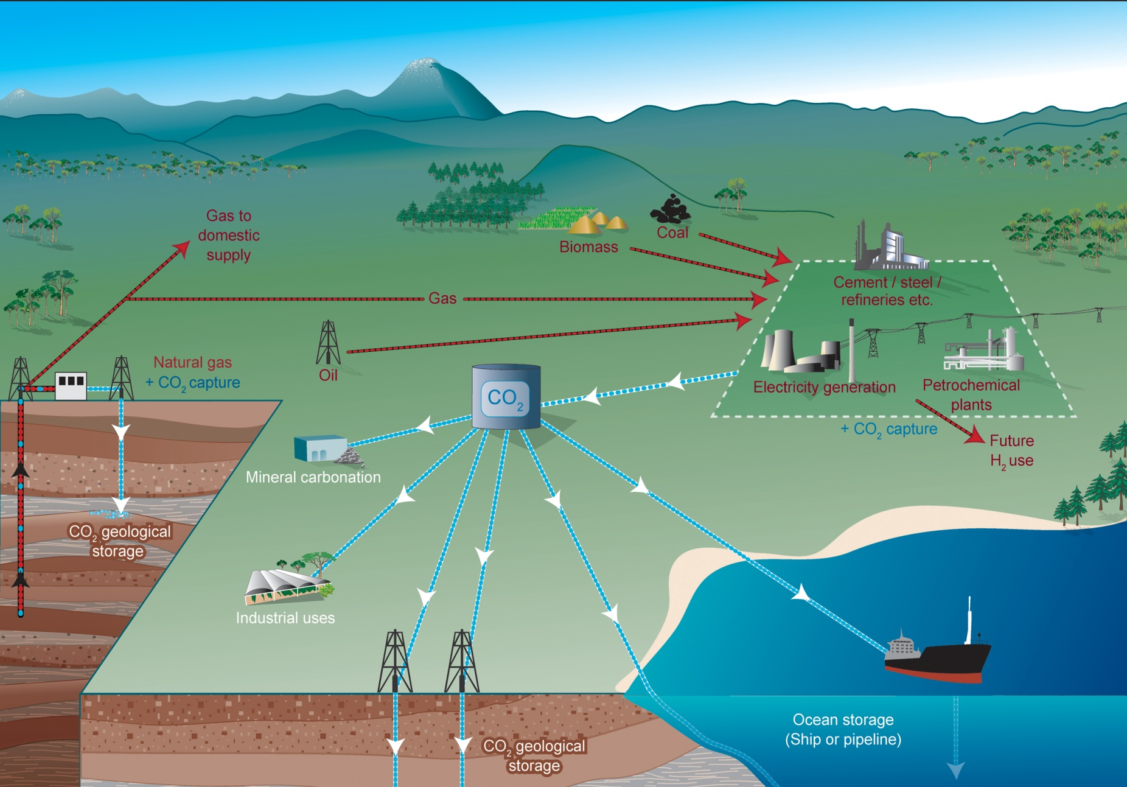
Geologic Sequestration http://www.co2crc.com.au/images/imagelibrary/gen_diag/spm1_media.jpg http://www.netl.doe.gov/technologies/carbon_seq/core_rd/storage.html

Slide 15
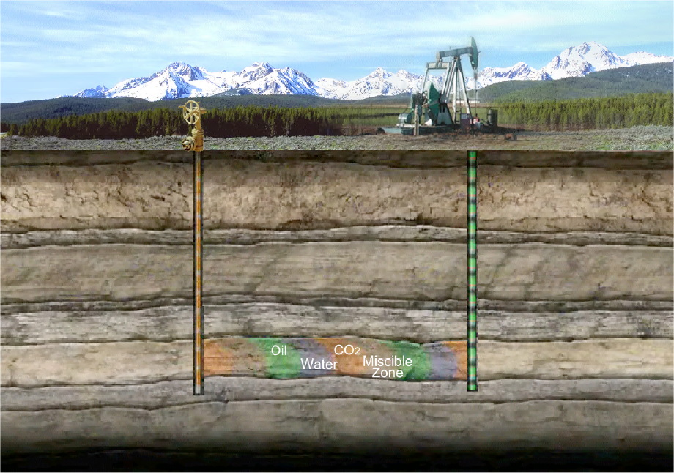
CO₂-Enhanced Oil Recovery (EOR)
Graphic courtesy of USDOE National Energy Technology Laboratory

Slide 16
DOE-ARI US Oil Basin Assessments

Slide 17
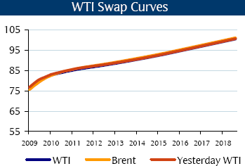
Recent US Commodity CO₂ Assessment WTI Curve: November 13, Barclays Daily Commodity Report
10 year mid WTI/Brent Oil price ~$88./bbl. Value of CO₂ created by oil price.
Permian Basin rule of thumb: 1000 cubic ft of CO₂ is valued as 2.0% of bbl of oil value delivered to well head ~34.14/tn ~1.76/mcf
Note: This is an implied value the crude oil quality, field characteristics, CO₂ utilization/bbl and distance to/from markets will influence ultimate commodity CO₂ value/price
Example: Kansas crude oil basket runs ~ $5 to 10.00/bbl discount to WTI

Slide 18
CO₂ Pricing Considerations-EOR
Quality of produced crude oil
Local transportation/storage costs/access
Regional oil market demand/pricing
Local/distant refinery requirements
Competitive alternatives-Canadian syncrude avails in midwest markets
Utilization factor
Operators margins
Up front cost considerations-discount on first years-premium on back years

Slide 19
Commodity CO₂ Valuation Issues
Quality i.e. too much H₂S could change permitting, oversight and public acceptance
Regional volumes-too much/not enough
Funding-cost per barrel produced too high
Recognition of concurrent oil production and storage
Who holds ultimate carbon compliance responsibility

Slide 20
Current CO₂ Pipeline Network

Slide 21
Expected CO₂ Supplies and Opportunity

Slide 22
480,000 Miles of Natural Gas and HL Pipelines

Slide 23
INGAA High EOR CO₂ Pipelines CARBON SEQUESTRATION & STORAGE: DEVELOPING A TRANSPORTATIONINFRASTRUCTURE Prepared for The INGAA Foundation, Inc. by:ICF International Feb 2009

Slide 24
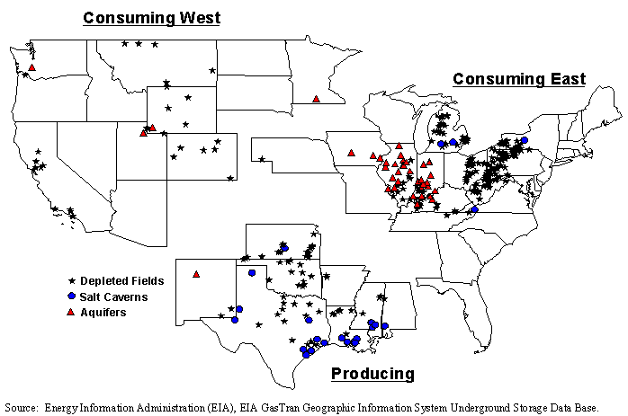
~400 Lower 48 Gas Storage Facilities

Slide 25
States with Geologic Storage Legislation and Regulation
Texas
Wyoming
Kansas
New Mexico
Oklahoma
Montana
Pennsylvania
Indiana
Kentucky
New York
Washington
Louisiana
Michigan
Mississippi
North Dakota
South Dakota
West Virginia
Illinois

Slide 26
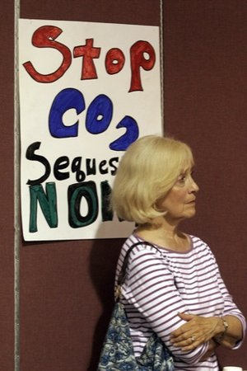
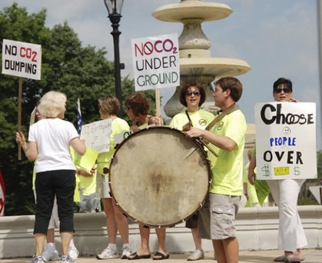
Public Acceptance is Crucial http://sites.google.com/site/noco2wasteindarke/

Slide 27
Carbon Markets Global Credits and Offsets

Slide 28
CFTC’s Commissioner Chilton http://www.cftc.gov/newsroom/MediaAdvisory/2009/mediaadvisory061109.html
Commissioner Bart Chilton of the Commodity Futures Trading Commission (CFTC) told an audience here that Green CAT Markets (cap and trade) that are currently trading on a voluntary basis in Chicago and New York could become the largest of all commodity markets.
“Globally, these environmental markets have already grown on average 329 percent per year since 2002”, Chilton said.
With the passage of legislation, such as H.R. 2454 introduced by Representatives Henry Waxman (D-CA) and Edward Markey (D-MA), Chilton estimates "Green CAT Markets could become $2 trillion endeavors in five years.“

Slide 29
Carbon Markets http://carbon.newenergyfinance.com/?gclid=CJ2dyNOqjJ4CFQ4hDQodUDx6pw
EU Emissions Trading Scheme (EUAs)
Kyoto Protocol and its successor (CERs, ERUs, AAUs)
North America (RGGI allowances, prospective federal allowances, Canadian allowances)
Australia (CPRS allowances)
Voluntary Market (VCS, GS CER, CAR, ACR, CCX, WCI, MGGA, EPA Climate Leaders)

Slide 30
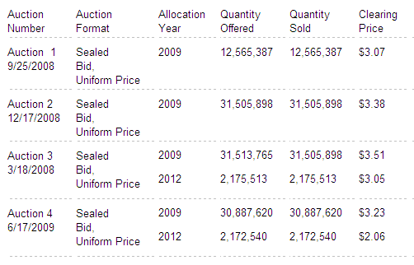
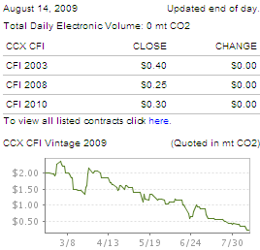
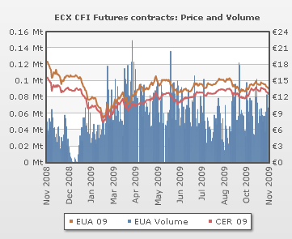
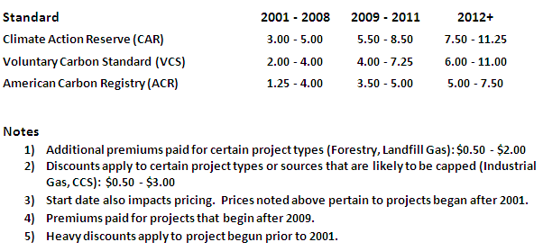
Carbon Market Assessment
RGGI Auction Results
http://www.rggi.org/co2-auctions/results
Chicago Climate Exchange
http://www.chicagoclimatex.com/
US Voluntary Market:
European Climate Exchange

Slide 31
Carbon Market Values & Volumes Source: http://www.commodities-now.com/news/environmental-markets/938-global-carbon-market-shrinks-in-q3.html
2009 Global carbon market value ~$122 bln
2008 Global carbon market value ~$119 bln
2007 Global carbon market value ~$ 65 bln
2009 global carbon volume ~7.588 bln tonnes
2009 volumes increased 103% over 2008

Slide 32
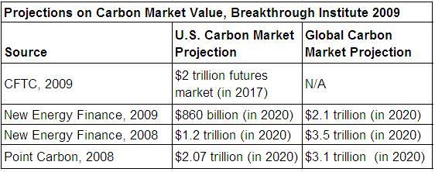
Estimated Size of Global Carbon Markets

Slide 33
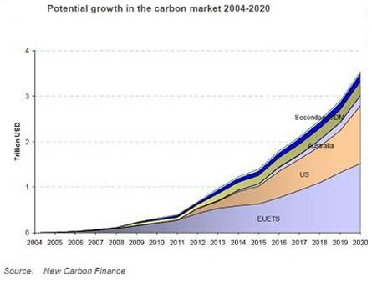
Expected Size of Global Carbon Market

Slide 34
Expected Global Carbon Price by 2020

Slide 35
Expected CO₂ Price End of First Yr US Cap & Trade Compliance

Slide 36
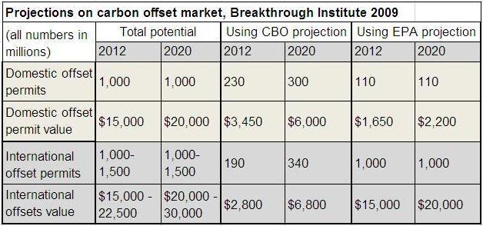
Potential Size of Offsets per HR 2454 Source: http://www.thebreakthrough.org/blog/Projection_Offset_Market_Breakthrough_2009.JPG

Slide 37
Issues of Confidence in Carbon Markets
The recent announcements of “carousel” fraud in the European Union’s $90 billion emissions trading scheme has prompted the European Commission to propose a temporary solution later this month to stop tax fraud in the European carbon emissions market, reports Reuters.
However, experts are warning that a patchwork of unilateral actions by member states like the UK and France to prevent carousel fraud in spot trading of EU carbon permits could push the suspected activity into neighboring states, according to Reuters.

Slide 38
Contact Information
Michael E. Moore
VP External Affairs and Business Development CCS
Blue Source LLC
Executive Director
North American Carbon Capture Storage Association
WWW.NACCSA.Org
VP and Founding member Board of Directors
Texas Carbon Capture Storage Association
WWW.TXCCSA.Org
mmoore@bluesource.com
Tel: 281-668-8475
www.bluesource.com

