Slide 1
Voluntary Greenhouse Gas Reduction Programs
Kansas State University Sustainability Seminar
January 7, 2010
Tom Gross, Chief
Monitoring and Planning Section
Bureau of Air
www.kdheks.gov

Slide 2
Overview
Local (Mayors Climate Protection Agreement)
State (KEEP)
Regional (RGGI, WCI, MGA)
International (Copenhagen)

Slide 3
Mayors Climate Protection Agreement
U.S. Conference of Mayors
Initiative launched on February 16, 2005
To advance the goals of the Kyoto Protocol
1016 signatories as of December.
12 Kansas cities have signed.
Commitments:
Urge federal and state governments to meet 7% GHG reductions below 1990 levels by 2012.
Urge Congress to pass bipartisan GHG reduction legislation.
Strive to meet or exceed Kyoto Protocol targets for GHG reductions

Slide 4
Kansas Energy and Environmental Policy Advisory Group (KEEP)
Created by Governor’s Executive Order.
Four meetings held to date.
GHG emission inventory complete.
GHG reduction strategies narrowed to 49.
Quantification of emission reductions and cost pending.
Future uncertain due to funding

Slide 5
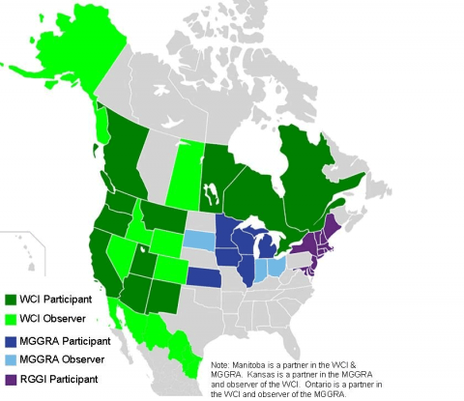
Regional GHG Programs
Source: www.wri.org

Slide 6
Regional Greenhouse Gas Initiative (RGGI)
First market-based effort in the U.S. to reduce GHG emissions.
10 Northeastern and Mid-Atlantic States.
Capped power sector CO₂ emissions to reduce 10% by 2018.
Auction proceeds support low-carbon-intensity solutions, energy efficiency and renewable energy.
Expanding to include low carbon fuel standard

Slide 7
Western Climate Initiative (WCI)
Agreement signed February, 2007
7 western states and 4 Canadian provinces
Multi-sector cap and trade design.
Cap and trade start date set for January 1, 2012.
Fuels sector in 2nd compliance period.
Initial emissions threshold at 25,000 MT/yr CO₂e.
Includes CO₂, CH₄, SF₆, N₂O, HFCs, PFCs.
Point of Regulation varies by sector.

Slide 8
MGA Energy Summit 2007
Energy Security and Climate Stewardship Platform
Endorsed by ten governors and one Canadian premier.
Initiatives:
Carbon Management Infrastructure - Kansas did not sign.
Midwestern Bioproduct Procurement Program
Regional Electricity Transmission
Renewable Fuels Corridors and Coordinated Signage
Bioenergy Permitting
Regional Low-Carbon Energy Transmission Infrastructure
Regional low-carbon fuels policy
Greenhouse Gas (GHG) Reduction Accord

Slide 9
Midwestern Greenhouse Gas Reduction Accord (MGGRA)
Establish GHG reduction targets and time frames.
Develop market-based and multi-sector cap-and-trade mechanism.
Establish system to enable tracking, management, and crediting of GHG emissions.
Develop and implement other strategies to achieve targets:
Low-carbon fuel standard (LCFS).
Regional incentives.
Funding mechanisms.

Slide 10
MGA Accord Approach
Program starts 2012.
Targets:
18% below 2005 levels by 2020 (additional 2% reduction to reserve pool).
80% below 2005 levels by 2050.
Scope:
Electricity combustion, including imports.
Industrial combustion and process emissions.
Transportation fuels.
Residential, commercial, and industrial (RCI) fuels.

Slide 11
MGA Accord Approach
Point of regulation:
Electricity and industrial sources at point of emissions.
Transportation and RCI fuels at the point where the fuels enter the participating jurisdiction.
Threshold for coverage:
25,000 MT/yr emissions.
3-year rolling average; once-in, always in.
Electric generators with nameplate capacity < 25 MW are exempt.

Slide 12
MGA Accord Approach
Recommendation for distributing allowances:
~33% auction; 67% sold for fee.
Transition to 100% beginning in 4th compliance period.
Offsets:
May be used to cover up to 20% of each entity’s compliance obligation.
Offsets from region, plus states & provinces with MOU.

Slide 13
MGA Accord Approach
Reporting:
Commence in 2011.
Reporting threshold: 20,000 MT/year.
Cost containment:
Compliance period is 3 years.
Banking allowed.
Borrowing allowed 2 years into next compliance period.
Next steps:
Influence the federal cap and trade discussion.
Modeling of macroeconomic impacts prior to final design recommendations.
Model Rule development – final stages.

Slide 14
MGA Low Carbon Fuel Standard Timeline
November 2007: MGA Summit, announcement of platform.
Spring 2008: appointment of LCFS advisory group.
January 2009: consensus on recommendations.
March 2009: adoption by MGA steering committee.
March 2009 – present: planning, preparation, fundraising, and outreach.

Slide 15
MGA LCFS Objectives
Create framework and incentives for low carbon fuels in Midwest.
Decrease the GHG intensity of transportation fuels.
Take advantage of agricultural and industrial strengths to benefit regional economy
Complement other policies focused on improving transportation efficiency and reducing GHG emissions in the region.

Slide 17
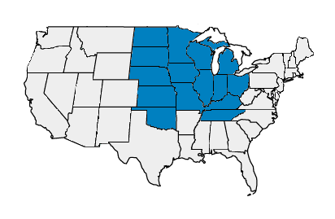
Petroleum Administration For Defense Districts (PADD) II: Midwest

Slide 18
Dane McFarlane, Great Plains Institute
Source: EIA, 2009
http://tonto.eia.doe.gov/dnav/pet/pet_move_impcp_a2_r20_ep00_ip0_mbbl_a.htm

Slide 21
MGA LCFS Highlights
2005 baseline; 10% reduction within 10 years.
Scope: liquid and non-liquid ground transportation fuels.
Develop mechanisms for commercialization of “very low carbon” fuels, 50% lower GHG intensity than baseline.
Advisory group recommends=
methodology; default values; point of regulation; compliance; penalties; interaction with other programs.
Firms offer Life cycle analysis values based on site-specific analysis
Auditing by state regulators or 3rd party

Slide 22
LCFS Model Rule Development
Timeline
January 4: Skeleton draft model rule.
April 5: First model rule draft delivered to entire advisory group.
May 3: Near final model rule draft complete for 3rd in-person meeting.
May 17-24: 3rd in-person meeting.
June 7: Final model rule draft complete.

Slide 23
LCFS Model Rule Outline
Applicability
Fuels (Types)
Gasoline; Reformulated Gasoline; Diesel Fuel; Electricity; CNG or LNG; Biogas CNG or LNG; Hydrogen; Hydrogen Fuel Blend; 10% Ethanol Fuel Blend; Biomass-based Diesel Fuel Blend; Denatured Fuel Ethanol (E100); Neat Biomass-based Diesel (B100); Any Other Liquid or Non-Liquid Fuel.
Credit for Fuels Presumed to Comply
Fuels presumed to comply: Electricity; Hydrogen; Hydrogen Blends; Fossil CNG from North American Sources; Biogas CNG; Biogas LNG.

Slide 24
LCFS Model Rule Outline
Applicability (cont’d)
Exemptions for Specific Fuels
Exemptions for Specific Applications
Exemption for Small Producers and Importers
Definitions
Carbon Intensity Requirements for Transportation Fuels
Requirements for Regulated Parties

Slide 25
LCFS Model Rule Outline
Calculation of Credit Balance
Reporting Requirements
Annual Compliance Report
Rounding, Significant Digits
Recordkeeping
Compliance
Calculation of Credits and Deficits
Credit Acquisition, Banking, and Trading
Determination of Carbon Intensity

Slide 26
International Efforts
United Nations Framework Convention on Climate Change (UNFCCC)
March 21, 1994
Sets overall framework for intergovernmental efforts
Ratified by 192 countries.
Kyoto Protocol
5% reduction against 1990 levels in GHG emissions over five years, 2008 – 2012.
Binding targets for 37 countries.
Ratified by 184 parties of the UNFCCC.
Mechanisms: Emissions Trading; Clean Development Mechanism; Joint Implementation.

Slide 27
International Efforts
Copenhagen
December 7-18, 2009
Copenhagen Accord
Aspirational goal of limiting global temperature increase to 2ºC.
Process for countries to enter specific mitigation pledges by January 31, 2010.
Broad terms for reporting and verification of countries’ actions.
Collective commitment by developed countries for $30 billion in “new and additional” resources in 2010-2012 to help developing countries.
Goal of mobilizing $100 billion per year in public and private finance by 2020 to address developing countries’ needs.
November 2010 in Mexico City.

Slide 28
Contact Information
Tom Gross, Chief
Air Monitoring and Planning Section
Bureau of Air
Kansas Department of Health & Environment
Curtis State Office Building
1000 SW Jackson, Suite 310
Topeka, Kansas 66612
www.kdheks.gov
voice 785.296.1692
fax 785.296.7455
tgross@kdheks.gov
Notes:
28

