Slide 1
GREENHOUSE GAS (GHG) INVENTORY METHODS
Terrie Boguski
Harmony Environmental, LLC
Kansas State University
January 2010

Slide 2
What are Greenhouse Gases?
Gases that allow sunlight to enter the atmosphere freely. When sunlight strikes the Earth’s surface, some of it is re-radiated back towards space as infrared radiation (heat). Greenhouse gases absorb this infrared radiation and trap its heat in the atmosphere.
If it were not for naturally occurring greenhouse gases, the Earth would be too cold to support life as we know it.

Slide 3
Greenhouse Gases of Concern
Carbon dioxide (CO2)
Methane (CH4)
Nitrous oxide (N2O)
Industrial Gases:
Hydrofluorocarbons (HFCs)
Perfluorocarbons (PFCs)
Sulfur hexafluoride (SF₆)

Slide 4
Sources of Greenhouse Gases
United States GHG Inventory
81% - carbon dioxide from combustion of petroleum, coal, and natural gas
10% - methane from landfills, coal mines, oil and natural gas operations, and agriculture
5% - nitrous oxide from use of nitrogen fertilizers, burning fossil fuels, and certain industrial and waste management processes
2% - hydrofluorocarbons (HFCs), perfluorocarbons (PFCs), and sulfur hexafluoride (SF₆) released as byproducts of industrial processes and through leakage

Slide 5
WHY GHG Inventory?
New EPA regulations requires reporting by certain entities
Some states require reporting by certain entities
Voluntary reduction of GHG emissions
Business advantage or corporate policy

Slide 6
GHG Inventory – the Process
Simple Concept; Complex Execution
Decide which Standard or Protocol to follow
Set Boundaries
Collect Data
Perform Calculations
Report Results

Slide 7
1. Standards and Protocols
GHG Protocol (WRI/WBCSD)
Corporate Accounting and Reporting Standard
Project Protocol
Product Life Cycle Accounting and Reporting Standard (draft)
Scope 3 Accounting and Reporting Standards (draft)
ISO 14064 (three standards)
Organizational
Projects
Validation and Verification
EPA Climate Leaders Greenhouse Gas (GHG) Inventory Guidance
IPCC National Greenhouse Gas Inventories Programme
Climate Registry Reporting Protocols
Notes:
WRI - World Resources Instititute
WBCSD – World Business Council for Sustainable Development
EPA – United States Environmental Protection Agency

Slide 8
1. Standards and Protocols
KSU GHG Inventory
American College & University Presidents Climate Commitment (ACUPCC) Reporting Instructions
GHG Protocol Corporate Accounting and Reporting Standard
Climate Registry Reporting Protocols
Notes:
WRI - World Resources Instititute
WBCSD – World Business Council for Sustainable Development
EPA – United States Environmental Protection Agency

Slide 9
2. Set Boundaries
Organizational Boundaries
Choose a consolidation methodology to account for partial ownership, operating licenses, leases, joint ventures, partnerships
Equity Share Approach
Account for GHG emissions according to share of economic interest
Operational Control Approach
Account for GHG emissions for operations under operational control
Financial Control Approach
Account for GHG emissions for operations under financial control

Slide 10
2. Set Boundaries
Operational Boundaries
Scope 1: Direct GHG emissions
Emissions from combustion in owned or controlled boilers, furnaces, vehicles, etc.
Emissions from chemical production in owned or controlled process equipment (example: lime from calcium carbonate)
Scope 2: Indirect GHG emissions from purchased electricity (also, purchased steam or heat, such as from heated water)
Scope 3: Other indirect GHG emissions
Travel, commuting, suppliers operations, customers activities

Slide 11
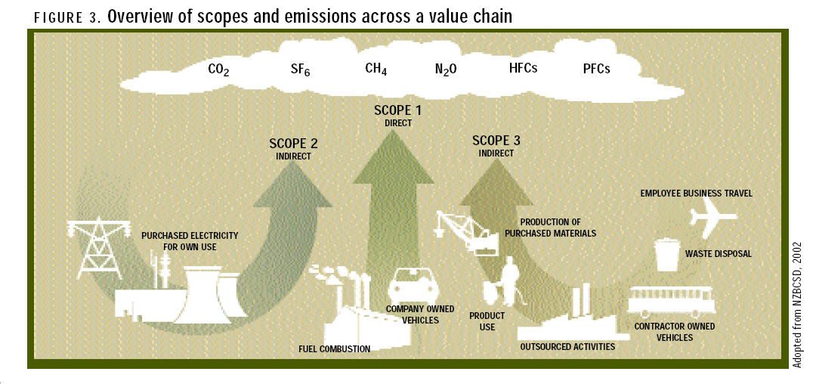
2. Set Boundaries
Source: The Greenhouse Gas Protocol: A Corporate Accounting and Reporting Standard (revised edition)

Slide 12
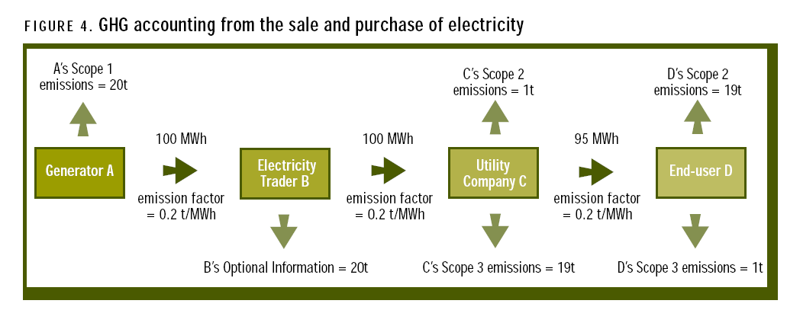
Why Scopes 1, 2, 3?
Prevents double counting when adding GHG emissions from different inventories
Example: Electricity sales and purchases
Source: The Greenhouse Gas Protocol: A Corporate Accounting and Reporting Standard (revised edition)

Slide 13
2. Set Boundaries
Temporal Boundaries
12-month period is standard practice
Fiscal year is acceptable
Calendar year is required by Climate Registry

Slide 14
3. Collect Data
Scope 1 Sources
Stationary combustion
Boilers, furnaces, heaters, burners, flares, etc.
Fuel purchase records - natural gas, fuel oil, coal
Mobile combustion
Trucks, buses, cars, airplanes, boats, ships, barges, etc.
Fuel purchase records or annual vehicle mileage and type of fuel
Process emissions
Catalytic cracking of petroleum, calcination step in cement manufacture, etc.
Measured or calculated annual emissions; Requires knowledge of process
Fugitive emissions
Equipment leaks, coal piles, onsite wastewater treatment, onsite landfills, etc.
Typically estimated based on knowledge of the source of emissions

Slide 15
3. Collect Data
Scope 2 Sources
Purchased electricity, steam, heating, cooling
Utility bills
Scope 3 Sources
Air travel
Employee commuting
Solid waste (incineration or decomposition offsite)
Emissions from upstream or downstream of owned or controlled operations (purchased raw materials; use of products sold)

Slide 16
4. Calculations
Goal – calculate total GHG emissions in units of carbon dioxide-equivalents (CO₂-e) for the processes and activities within the chosen boundaries
CO₂-e is the measure of the global warming potential (GWP) of a gas compared to carbon dioxide. For example, methane has a GWP of 21. The CO₂-e measure for 1 kilogram of methane is 21 kg CO₂-e.

Slide 17
4. Calculations
Choose a Calculation Tool
Clean Air-Cool Planet Campus Carbon Calculator
GHG Protocol Initiative Sector Tool Set
EPA Climate Leaders Tools for Developing an Inventory and Tracking and Reporting Emissions
Proprietary Databases and Models

Slide 18
4. Calculations
Direct measure of GHG emissions by concentration and flow rate (most accurate; most uncommon)
Mass balance or stoichiometric basis specific to the facility or process (more common)
Application of documented emission coefficients (most common)
Fuel use is multiplied by published emission factors such as the EPA AP-42 emission factors
Example: 100 lbs coal x 2.86 lbs CO₂ per lb coal burned = 286 lbs CO₂

Slide 19
4. Calculations
Choose a Source of Emission Coefficients
Emission coefficients are used to calculate the amount of GHG gases produced
Fuel combustion x emission coefficient = quantity of GHG emitted
Industrial processes and fugitive emissions; activity level x emission coefficient = quantity of GHG emitted

Slide 20
4. Calculations
Sources for emissions coefficients
Clean Air-Cool Planet Campus Carbon Calculator contains emission coefficients
The Greenhouse Gas Protocol Initiative Calculation Tools (http://www.ghgprotocol.org/)
EPA AP-42 emission factors (http://www.epa.gov/ttn/chief/ap42/)
Department of Energy – Energy Information Administration (http://www.eia.doe.gov/)

Slide 21
4. Calculations
Convert all GHG emissions to the units of CO2-e and sum for a final total
Results are typically reported in metric units (required by UNFCCC and Kyoto Protocol)

Slide 22
4. Calculations
IPCC Global Warming Potentials (GWPs)
The ratio of radiative forcing (degree of warming the atmosphere) for one unit of a specific GHG compared to one unit of carbon dioxide (CO2).
Three choices
SAR – IPCC Second Assessment Report
Required by United Nations Framework Convention on Climate Change (UNFCCC) and Kyoto Protocol
TAR – IPCC Third Assessment Report
Already incorporated into the CA-CP calculator
FAR – IPCC Fourth Assessment Report
Most recent estimates

Slide 23
4. Calculations - GWP
Global Warming Potential (GWP)
1 gram Carbon dioxide (CO₂)= 1 g CO₂-equivalents
1 gram methane (CH₄) = 21 g CO2-equiv
1 gram nitrous oxide (N₂O) = 310 g CO₂-equiv
1 gram sulfur hexafluoride (SF₆) = 23,900 g CO₂-equiv
100-year values from IPCC SAR 1996 report. Updated twice, but many still using
these numbers. Important to know which report is used when comparing products.

Slide 24
4. Calculations
Example

Slide 25
5. Report Results
Corporate results
Companies may need to gather and summarize data from multiple facilities, possibly in different countries and business divisions

Slide 26
Facility-level Reporting
Document annual GHG emissions
Process energy
Fuels used at facility – natural gas, fuel oil, etc.
Electricity - Source of electricity (emissions from fuels used)
Transportation energy
Vehicles used onsite
Transportation of raw materials to facility (optional)
Transportation of products from facility (optional)
Business travel (optional)
Employee commuting (optional)
Direct process emissions
For example, a facility that manufactures lime from limestone

Slide 27
5. Report Contents
What might be included:
A brief description of the emission sources
A list and justification of specific exclusion or inclusion of sources
Comparative information from previous years
The reporting period covered
Any trends evident in the data
Progress towards any business targets
A discussion of uncertainties
A description of events and changes that have an impact on reported data

Slide 28
5. A University Report
ACUPCC Reporting System
Start date of 12-month period covered
Consolidation methodology choice
Explain any facilities omitted
Emissions calculation tool used
Version of IPCC GWPs used
Who conducted the emissions inventory
Process of conducting the inventory
Describe any emissions sources classified as de minimis
Describe data limitations
Report Scope 1 GHG emissions by stationary combustion, mobile combustion, process, fugitive,

Slide 29
5. A University Report
ACUPCC Reporting System
Report Scope 2 GHG emissions by purchased electricity, heat, cooling, and/or steam
Report Scope 3 GHG emissions for regular commuting of students and employees, air travel paid for by university, GHG emissions due to incineration or decomposition of solid waste, GHG emissions from up to 3 additional custom sources

Slide 30
5. A University Report
ACUPCC Reporting System
Biogenic emissions: Total CO₂ emissions from the combustion of biomass and biomass-based fuels (wood, biodiesel, ethanol, landfill gas, etc.)
From stationary combustion
From mobile combustion

Slide 31
5. A University Report
ACUPCC Reporting System
Mitigation Data
Carbon offsets
Renewable Energy Certificates (RECs)
Sequestration and carbon storage
Land use
Composting
Contextual data
Number of students, employees, building space, etc.

Slide 32
Summary
GHG inventory is a beginning step for reducing GHG emissions
Concern about climate change is driving business decisions
In the United States, it seems to be mostly a consumer/stakeholder/stockholder initiative
There is not one standard protocol
Uncertainty exists
Emissions from fuel is typically not measured
Fuel emissions factors may vary depending on entity publishing standards or guidance
GWP factors from IPCC and other sources vary with time
Acquiring “green” electricity can be a major factor in inventory results

Slide 33
Questions?

Slide 34
GHG Inventory – Example
Company A plans to perform a Corporate GHG inventory for all their facilities. They own 2 pulp/paper mills in the United States and lease forested land in Canada from which they supply their mills with wood.

Slide 35
GHG Inventory – the Process
Simple Concept; Complex Execution
Decide which Standard or Protocol to follow
Set Boundaries
Collect Data
Perform Calculations
Report Results

Slide 36
1. Standards and Protocols
Company A GHG Inventory
GHG Protocol Corporate Accounting and Reporting Standard
Why?
Accepted internationally
Most commonly used in the industry
CEO recommendation
Notes:
WRI - World Resources Instititute
WBCSD – World Business Council for Sustainable Development
EPA – United States Environmental Protection Agency

Slide 37
2. Set Boundaries
Organizational Boundaries
Equity Share; Operational Control; Financial Control
Operational Boundaries
Required: Scope 1 and Scope 2
Optional: Scope 3
Temporal Boundaries
Required: “Base year”
Choose and report a base year for which verifiable emissions data are available and specify why this year was chosen

Slide 38
3. Collect Data
Scope 1 Sources
Stationary combustion - Fuel purchase records
Natural gas – 14,000 MCF per year
Residual fuel oil – 2400 gallons per year
Coal – 50 short tons per year
Mobile combustion - Fuel purchase records
Diesel – 2,000 gallons per year (company owns fleet that delivers logs to mill)
Gasoline – 300 gallons per year
LPG vehicles – 240 gallons per year
Process emissions
Lime kiln – 20,000 lbs CO2 per year
Fugitive emissions
Onsite landfill – 2,000 lbs methane per year

Slide 39
3. Collect Data
Scope 2 Sources
Purchased electricity, steam, heating, cooling
Electricity meters for pulp/paper mill
#1 - 2,100,000 kwh
#2 - 340,000 kwh
#3 - 5,780,000 kwh
#4 - 45,000 kwh
#5 - 17,800 kwh

Slide 40
4. Calculations
Stationary Sources

Slide 41
4. Calculations
Mobile Sources

Slide 42
4. Calculations
Fugitive Emissions

Slide 43
4. Calculations

Slide 44
5. Report Results
Explain study boundaries
Summarize
Results for each mill
Results for wood harvesting (operational control)
Transparency
Sources of emission coefficients
Stationary and mobile sources fuels – U.S. Energy Information Administration
Electricity – eGrid2007 version 1.1
Source of GWP – IPCC Second Assessment Report
Reliability of collected data (estimates or measured)

