Slide 1
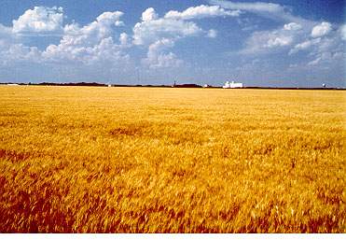
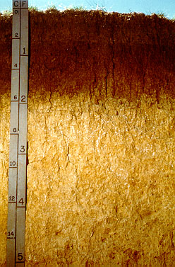
Climate Change and the Midwest: Issues and Impacts
Charles W. Rice
University Distinguished Professor
Department of Agronomy
Lead Author, IPCC AR4 WGIII
K-State Research and Extension

Slide 2
Changes in Climate
Rising CO₂ concentrations in the atmosphere
Warming temperatures over the next 30- 50 years
Variability in both temperature and precipitation

Slide 3
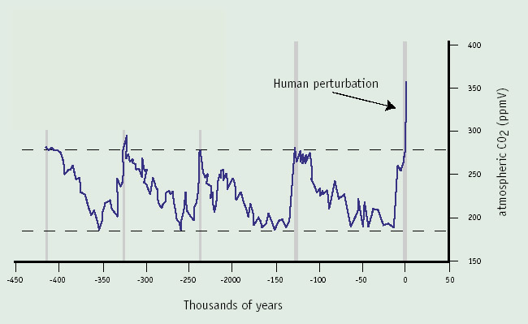
400
Human perturbation
350
300
Atmospheric CO₂ (ppmv)
250
200
150
-450
-400
-350
-300
-250
-200
-150
-100
-50
0
50
Thousands of years
Source: Petit et al. 1999

Slide 6
Impact On Climate

Slide 7
IPCC Fourth Assessment Report, Working Group III, 2007

Slide 9
United States
Already affecting U.S. water resources, agriculture, land resources, and biodiversity, and will continue to do so
Warming is very likely to continue in the United States during the next 25 to 50 years, regardless of reductions in greenhouse gas emissions, due to emissions that have already occurred

Slide 10
Projected Changes for the Climate of the Midwest Temperature
Longer frost-free period (high)
Higher average winter temperatures (high)
Fewer extreme cold temperatures in winter (high)
Fewer extreme high temperatures in summer in short term but more in long term (medium)
Higher nighttime temperatures both summer and winter (high)
More freeze-thaw cycles (high)
Increased temperature variability (high)
*Estimated from IPCC reports

Slide 11
Projected Changes* for the Climate of the Midwest Precipitation
More (~10%) precipitation annually (medium)
Change in “seasonality”: Most of the increase will come in the first half of the year (wetter springs, drier summers) (high)
More variability of summer precipitation (high)
More intense rain events and hence more runoff (high)
Higher episodic streamflow (medium)
Longer periods without rain (medium)
Stronger storm systems (medium)
More winter soil moisture recharge (medium)
Snowfall increases (late winter) in short term but decreases in the long run (medium)
*Estimated from IPCC reports

Slide 12
Impact on Ecosystems and Human Health and Well Being

Slide 13
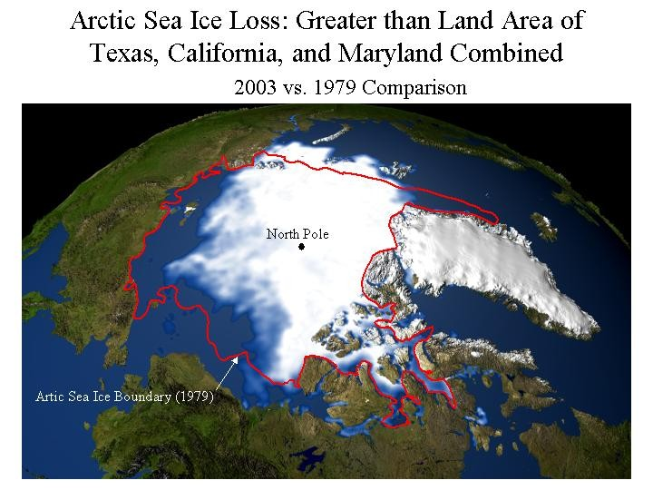

Slide 14
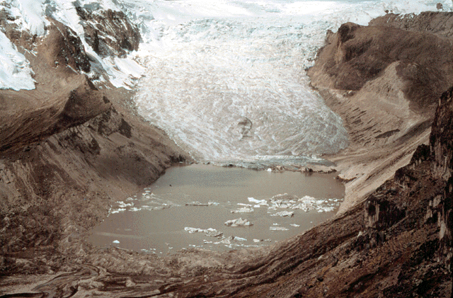
Qori Kalis, Peruvian Andes
1978…
…And Today
In 1978, the Qori Kalis Glacier looked like this, flowing out from the Quelccaya Ice Cap in the Peruvian Andes Mountains.
Glaciers are shrinking nearly worldwide
Source: L. Thompson

Slide 15
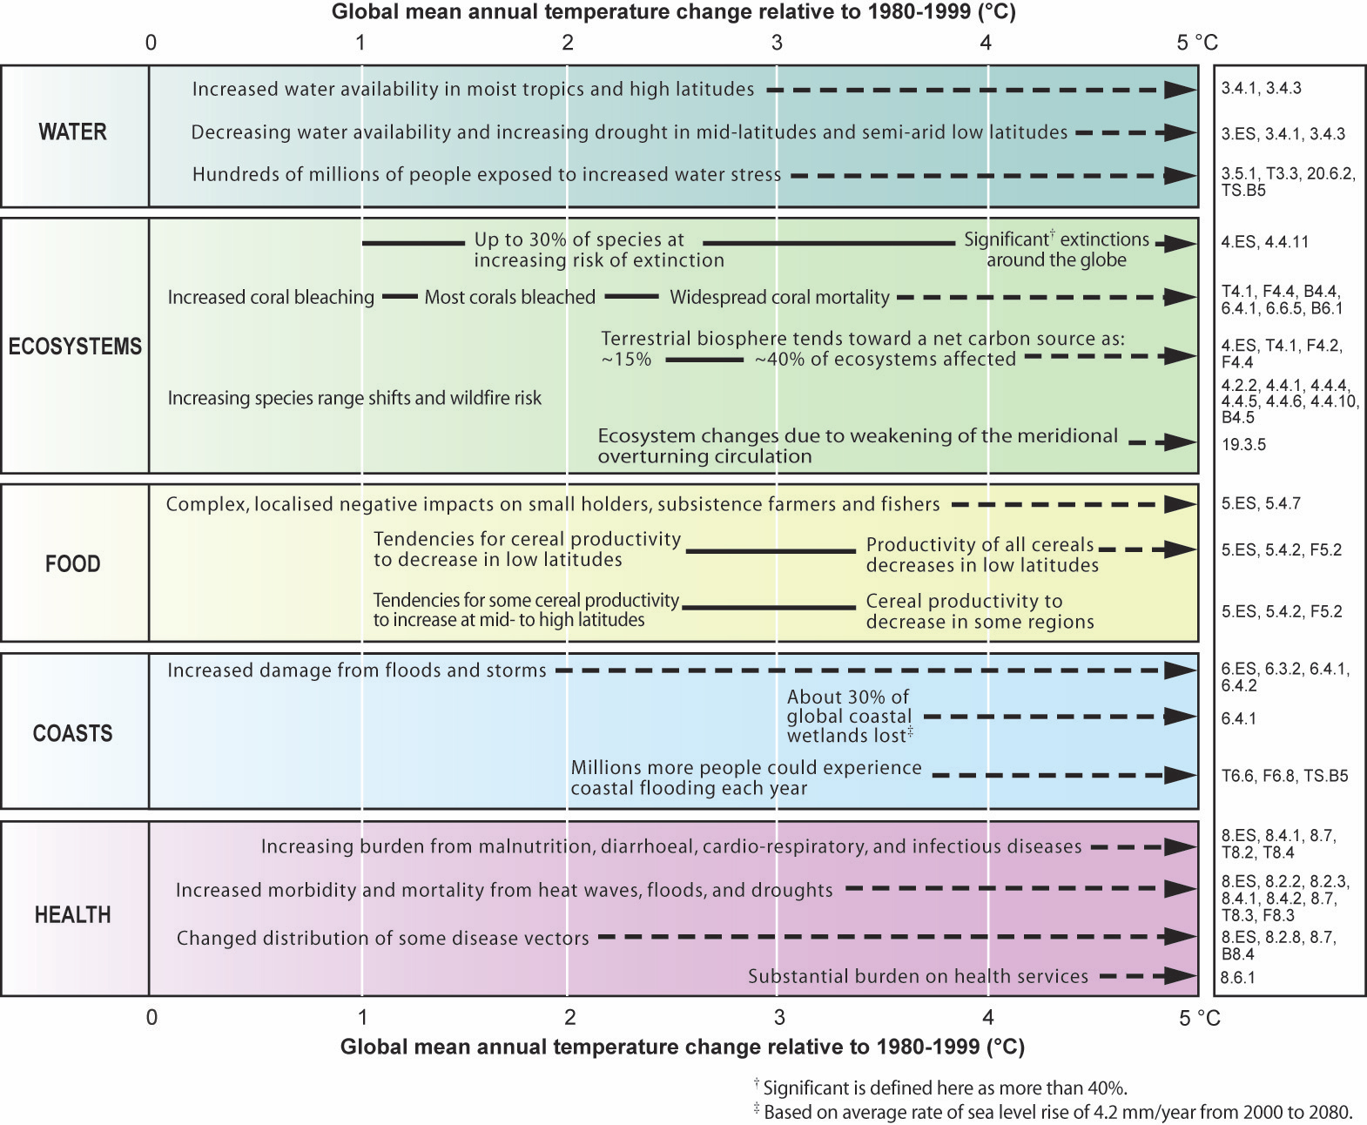

Slide 16
IPCC Fourth Assessment Report, 2007

Slide 17
IPCC Fourth Assessment Report, Working Group III, 2007

Slide 18
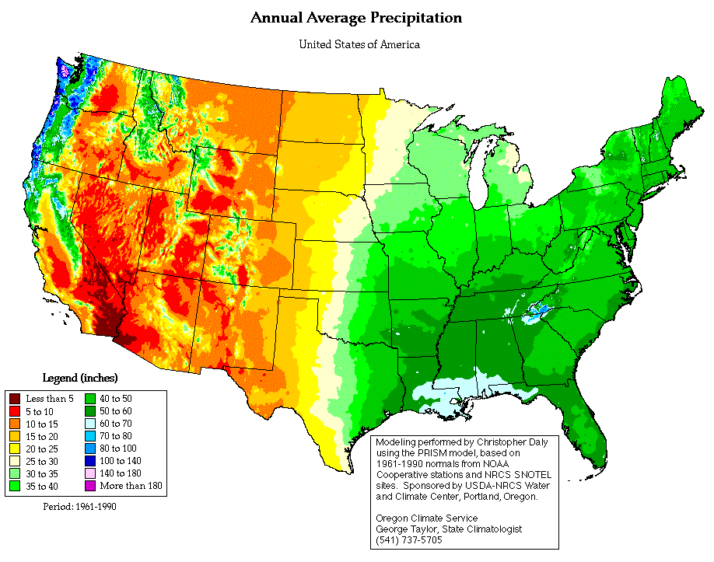

Slide 19
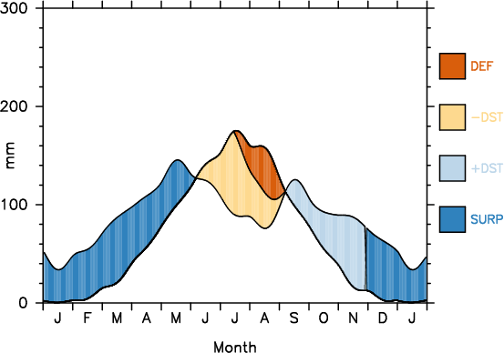
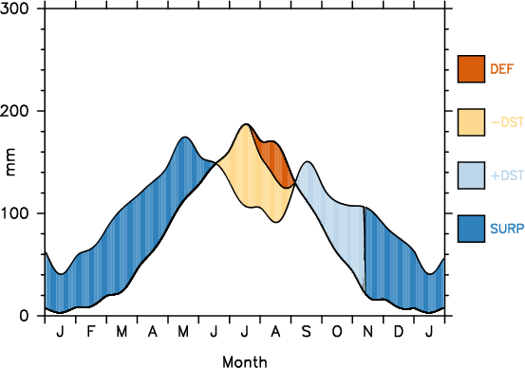
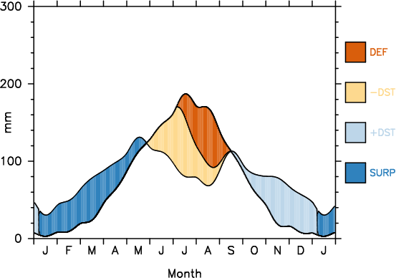
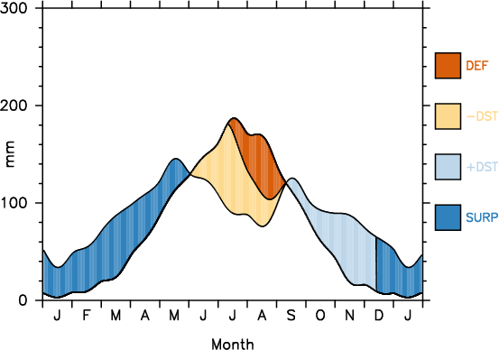
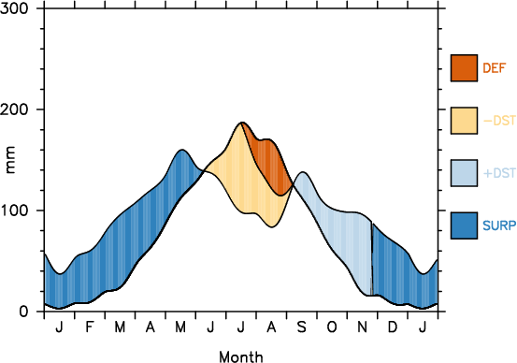
Climate projections
Feddema,2008
D = Annual Deficit (mm)
S = Annual Surplus (mm)
Eastern Kansas (37N, 95W)
+20% Precipitation
D = 30
S = 418
Present Day Normal
D = 47
S = 304
All temperature scenarios
+1 C Summer
+2 C Spring and Fall
+3 C Winter
0.59 Inches wetter!
- 10% precipitation
D = 98
S = 161
No Change
in Precipitation
D = 69
S = 242
+10% Precipitation
D = 46
S = 325
0.04 Inches wetter
2.00 Inches drier
0.87 Inches drier
-0.83 inches surplus water
Notes:
Eastern Kansas climate change is uncertain.
Water is the big issue
affects agriculture, domestic supplies, and industrial.

Slide 20
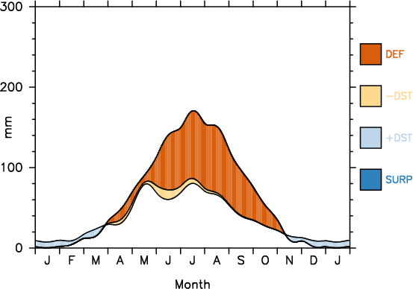
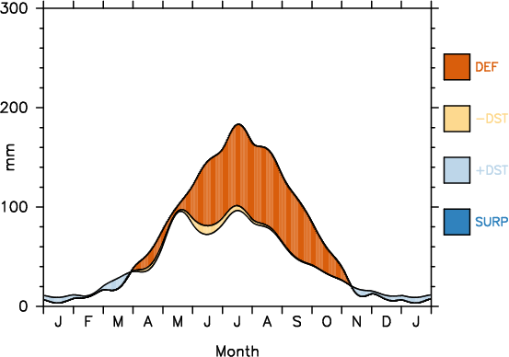
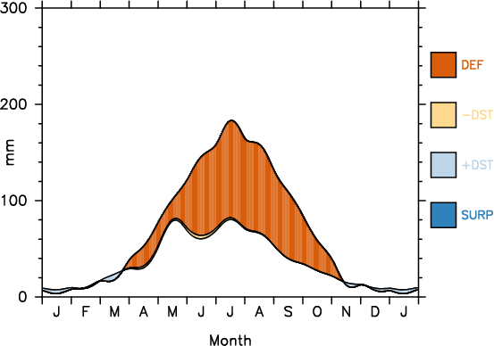
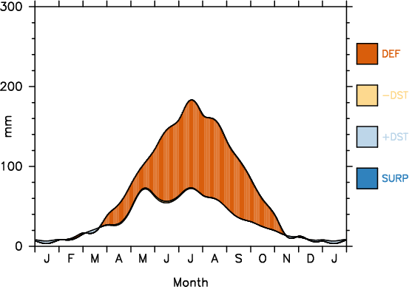
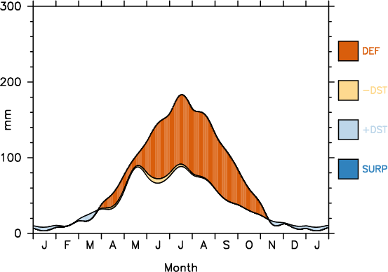
Climate projections
Feddema,2008
D = Annual Deficit (mm)
S = Annual Surplus (mm)
Western Kansas (37N, 102W)
Present Day Normal
D = 330
S = 0
+20% Precipitation
D = 322
S = 0
All temperature scenarios
+1 C Summer
+2 C Spring and Fall
+3 C Winter
0.31 Inches wetter
No Change
in Precipitation
D = 412
S = 0
- 10% precipitation
D = 455
S = 0
+10% Precipitation
D = 366
S = 0
4.92 Inches drier
3.23 Inches drier
1.41 Inches drier
Notes:
In Western KS most cases suggest that water will be much drier which will greatly affect the economy of the state!!!!

Slide 21
Temperature
Crop | Optimum Temp (C) |  | Temp Range (C) |  | Failure Temp (C)
 | Veg | Reprod | Veg | Reprod
Maize | 34 |  | 18-32 | 18-22 | 35
Soybean | 30 | 26 | 25-37 | 22-24 | 39
Wheat | 26 | 26 | 20-30 | 15 | 34
Rice | 36 | 33 | 33 | 23-26 | 35-36
Cotton | 37 | 30 | 34 | 25-26 | 35
Tomato | 22 | 22 |  | 22-25 | 30
Hatfield et al., 2008

Slide 22
Climate Impacts
Crop | Yield Change
Maize | -4.0%
Soybean-Midwest | +2.5%
Soybean-South | -3.5%
Wheat | -6.7%
Rice | -12.0%
Sorghum | -9.4%
Cotton | -5.7%
Peanut | -5.4%
Bean | -8.6%
Hatfield et al., 2008

Slide 23
Impacts on Grasslands
Variability of precipitation will impact growth of pastures and rangeland
Increasing CO₂ will impact forage quality and species composition in rangelands
Interactions of grazing management, climate change, and species composition will impact the long-term use and sustainability
Hatfield et al., 2008

Slide 24
Projected Impacts for the Midwest
Phenological stages are shortened (high)
Weeds grow more rapidly under elevated atmospheric CO2 (high)
Weeds migrate northward and are less sensitive to herbicides (high)
Plants have increased water used efficiency (high)
*Estimated from IPCC and CCSP reports

Slide 25
North America: Key messages
A wide range of impacts of climate change are now clearly documented
Risks from future impacts concentrated on extreme events
Vulnerable people and activities (including ag) in almost every region
Increase number, intensity, and duration of heat waves
Changes in precipitation patterns
Water resources will constrain potential crop yield increases and increase competition for water resources
Warmer nights and winters may increase
Pest and disease in agriculture
Invasive weeds
IPCC Fourth Assessment Report, 2007
Notes:
25

Slide 26
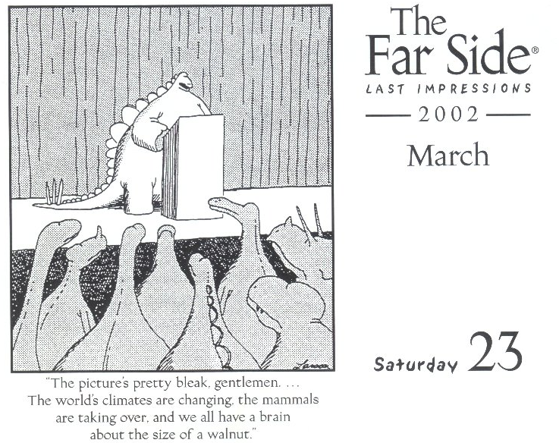

Slide 27
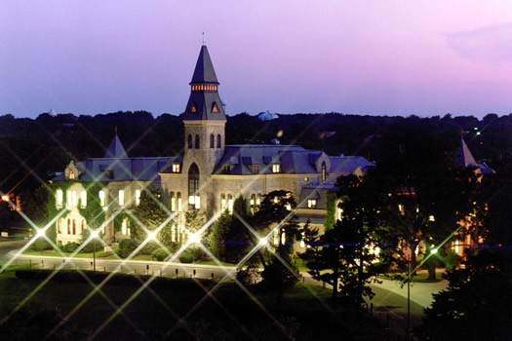
Chuck Rice
Phone: 785-532-7217
Cell: 785-587-7215 cwrice@ksu.edu
Websites
www.soilcarboncenter.k-state.edu/
K-State Research and Extension

