Slide 1
Reducing Carbon Emissions: Current World Progress
KSU Winter Intersession 2010
Michael E. Moore
VP CCS Business Development and External Affairs
Blue Source, LLC
Executive Director
North American Carbon Capture Storage Association
January 6, 2010

Slide 2
Session 1b – Reducing Carbon Emissions: Current World Progress
Start 9:15-10:00am Wednesday
30 min 15 QA then break

Slide 3
Global CO₂ Reductions
Fuel switching
Energy efficiency
Reforestation/forest sequestration
Terrestrial sequestration
Geologic sequestration
Alternative energy
Planned/managed urban development

Slide 4
Carbon-Energy-People

Slide 5
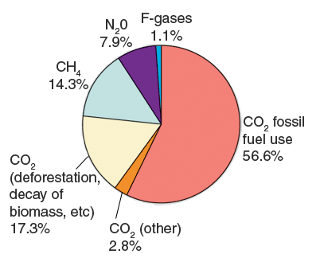
Distribution of GHG Sources 2004 http://www.epa.gov/climatechange/emissions/globalghg.html IPCC 4th Assessment Report: Climate Change 2007: Synthesis Report

Slide 6
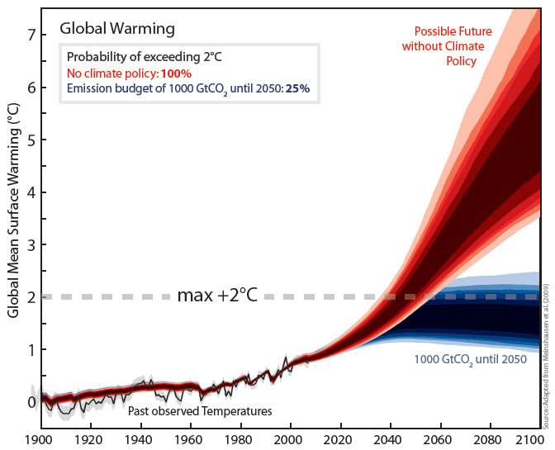
The “Trillionth Ton” http://www.nature.com/news/2009/090429/full/4581091a.html
If no climate policies are implemented (red) global warming will cross 2°C by the middle of the century. Making sure we don't emit more than 1 trillion (1000 gigatons) of CO₂ in total (blue) would limit the risk of exceeding 2°C to 25% (Image: M. Meinshausen)

Slide 7
Distribution of Cumulative CO₂ Emissions http://www.nature.com/news/2009/090429/full/4581091a/box/2.html

Slide 8
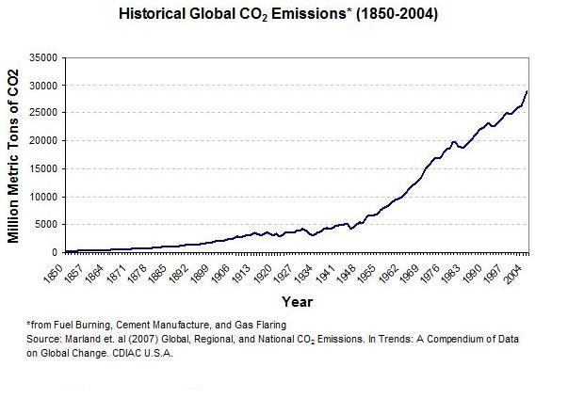
Historical Global CO₂ Emissions
Greenhouse gas emissions, largely CO₂ from the combustion of fossil fuels, have risen dramatically since the start of the industrial revolution. Globally, energy-related CO₂ emissions have risen approximately 145-fold since 1850 - from 200 million tons to 29 billion tons a year.

Slide 9
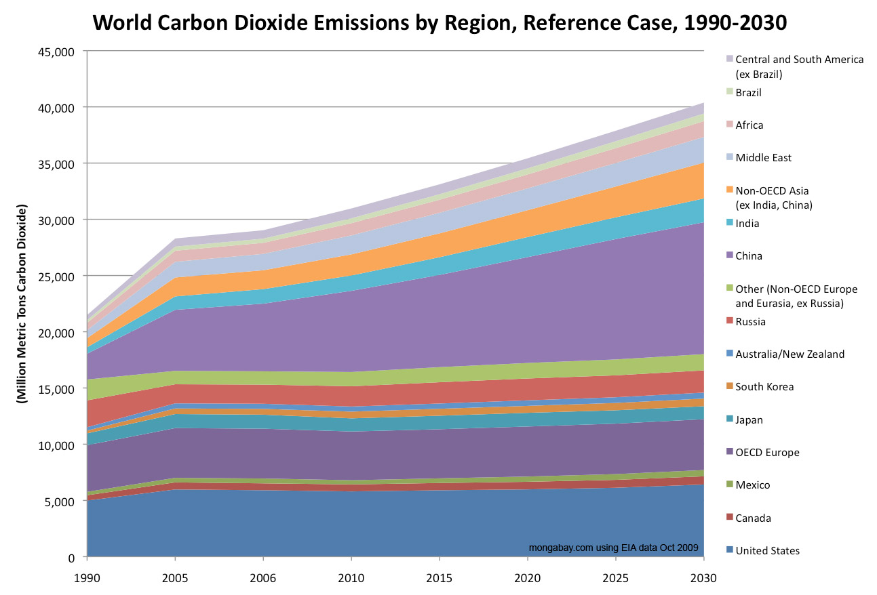
Projected Global CO₂ Emissions http://rainforests.mongabay.com/09-carbon_emissions.htm

Slide 10
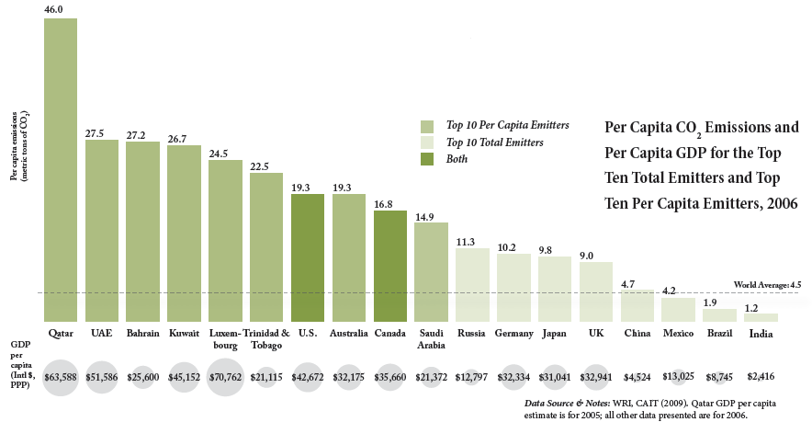
CO₂ Emissions Per Capita http://cait.wri.org/downloads/CAIT_7.0_COP15.pdf

Slide 11
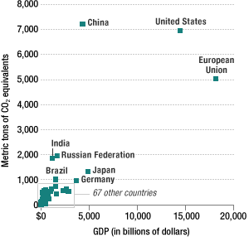
CO₂ Emissions Compared With GDP World Resources Institute's Climate Analysis Indicators Tool, 2009; CIA World Factbook http://www.npr.org/templates/story/story.php?storyId=121240453

Slide 12
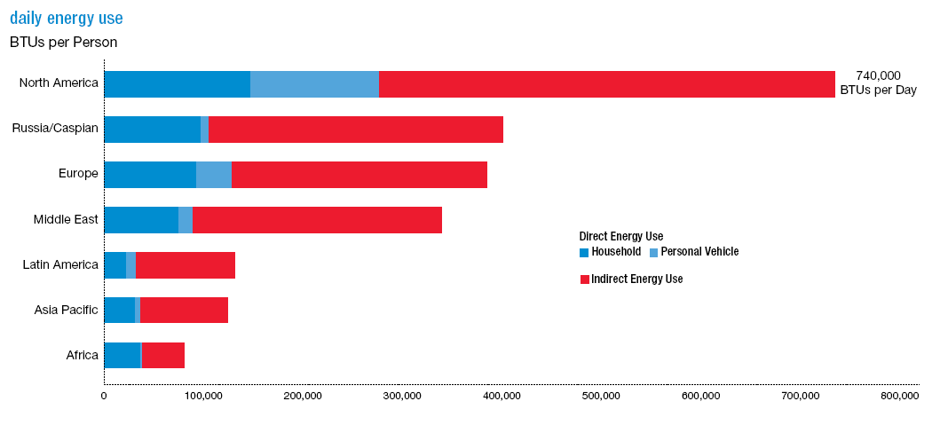
Personal Energy Consumption http://www.exxonmobil.com/Corporate/Files/news_pub_eo_2009.pdf

Slide 13
China vs US
1.37 billion vs 310 million people
38 vehicles per 1000 vs 985 per 1000
9.6 million square miles vs 3.5 million square miles

Slide 14
Transportation-US
~230 million operable cars and trucks
Primarily gasoline/diesel (~24 mln/bls/day)
Push towards electric
Expand urban/regional/national rail systems
Electrify rail systems
But where will the required electricity come from?

Slide 15
Reductions by Energy Efficiency
While the Danish economy has grown approximately 75 per cent over the past 25 years, domestic energy consumption has remained constant and CO₂ emissions have decreased. This has made Denmark one of the world’s most energy efficient economies. Denmark has not only improved its use of renewable energy, but has also reduced waste and greenhouse gases.

Slide 16
Renewables-US
Wind
Solar
Geothermal
Biomass
Hydro
Oceans-wave energy/temperature differential/salinity differential
Problems-production does not match demand
Problems-source does not regionally match demand
Competing interests on resources
Expected land and resource uses do not match urban, state or federal rules and regulations
Distribution infrastructure needs to be reconfigured

Slide 17
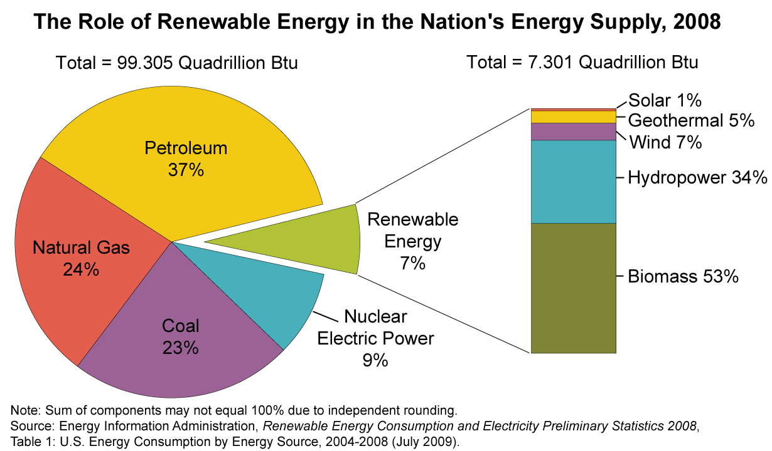
US Energy Mix http://tonto.eia.doe.gov/kids/energy.cfm?page=renewable_home-basics http://www.eia.doe.gov/cneaf/solar.renewables/page/rea_data/rea_sum.html

Slide 18
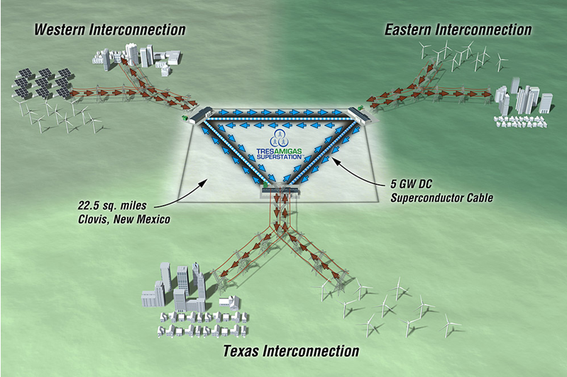
Addressing Renewable Electricity Supply/Demand Dislocations “Tres Amigas Superstation” http://ksjtracker.mit.edu/2009/12/23/climate-wire-an-electric-superstation-game-changer-is-at-ferc/

Slide 19
Major Land Uses - US http://cta.ornl.gov/bedb/introduction/Major_Uses_of_Land_in_the_United_States.xls
The United States has a total land area in all 50 states of 2.263 billion acres. Based on the 2002 land use inventory, 20% of that land was categorized as cropland and 29% as forest-use land, thus about 49% of U.S. land is a potential source of biomass residuals or biomass crops for bioenergy. Grassland pasture and range land is, for the most part, too dry to provide much biomass resources. Miscellaneous, special use land and urban land may be a source of post-consumer biomass residuals, but are not areas where biomass crops could be produced on a large scale.

Slide 20
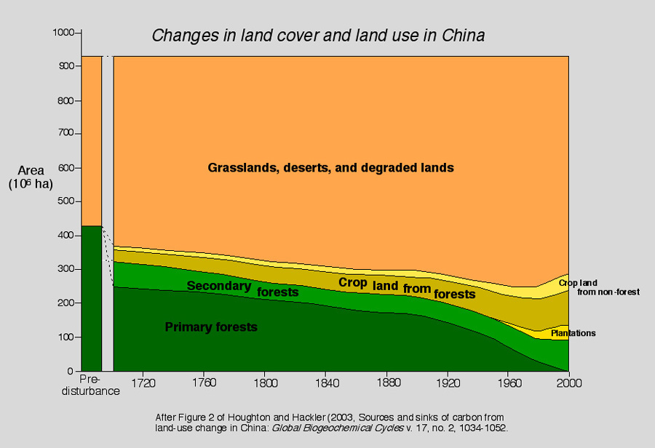
Major Land Use – China http://www.gly.uga.edu/railsback/CTW/ChinaLandUseThruTime.jpeg

Slide 21
Geologic Sequestration

Slide 22
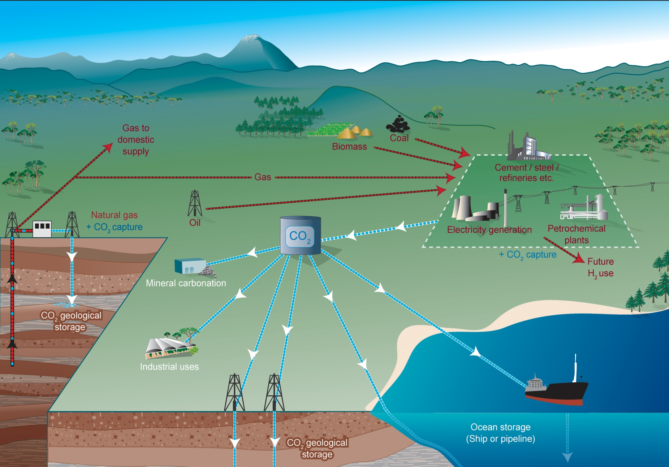
Geologic Sequestration http://www.co2crc.com.au/images/imagelibrary/gen_diag/spm1_media.jpg http://www.netl.doe.gov/technologies/carbon_seq/core_rd/storage.html

Slide 23
NETL Seven Regional Partnerships http://www.netl.doe.gov/technologies/carbon_seq/partnerships/links.html

Slide 24
Houston-CCS Capital of North America

Slide 25
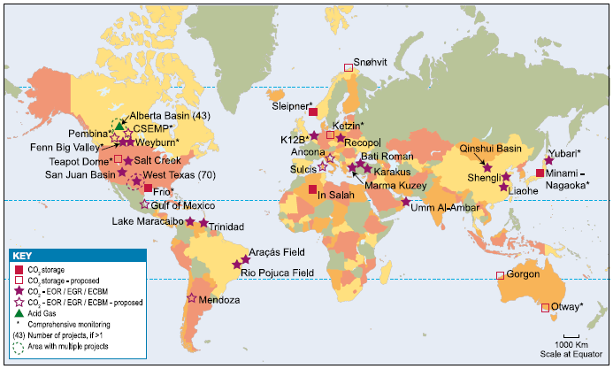
Global Geologic Sequestration Special Report on Carbon Dioxide Capture and Storage pge 198 fig. 5.1 http://www.ipcc.ch/activity/srccs/SRCCS_Chapter5.pdf
192 proposed and active CCS projects worldwide. The projects are located in 20 countries across five continents. The 192 projects globally include 38 capture, 46 storage, and 108 for capture and storage.

Slide 26
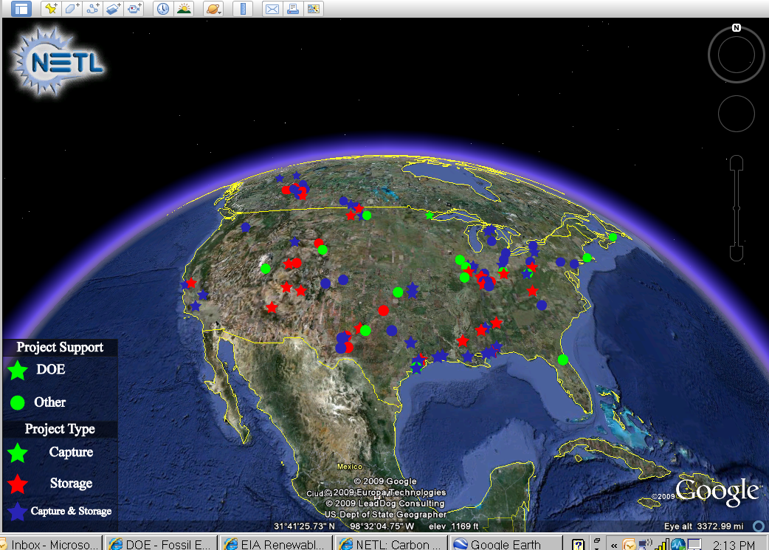
Geologic Sequestration http://www.netl.doe.gov/technologies/carbon_seq/database/index.html

Slide 27
Issues
Liability
Land rights issues: storage space, mineral rights, surface rights and access
Regulatory-Federal and State
Environmental
Water use and access
Infrastructure
Funding
Human Resources
Geographic
Geologic
Public Acceptance
Energy

Slide 28
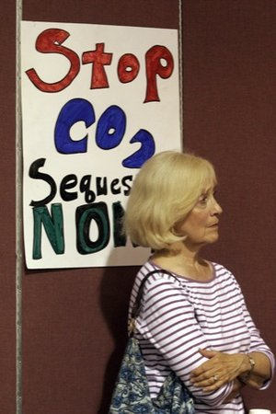
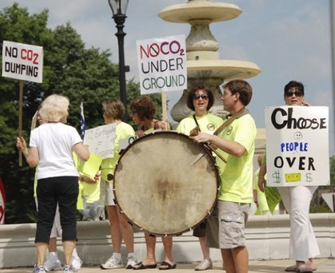
Public Acceptance is Crucial http://sites.google.com/site/noco2wasteindarke/

Slide 29
Public Acceptance is Crucial
Shell's CO2 stocking plans under fire Posted: 03 January 2010 1056 hrs
http://www.channelnewsasia.com/stories/afp_world_business/view/1028244/1/.html
BARENDRECHT, Netherlands: A plan by oil giant Shell to store 300,000 tonnes of carbon dioxide a year in a depleted gas reservoir beneath a Dutch city has drawn the ire of residents and local officials who have vowed to thwart it. "We are going to do everything to oppose this project," declared Barendrecht deputy mayor Simon Zuurbier, who voiced fears for the safety of the city's 50,000 inhabitants. "We are taking legal action to get it cancelled and we'll approve none of the required permits." ……

Slide 30
Getting there and Issues

Slide 31
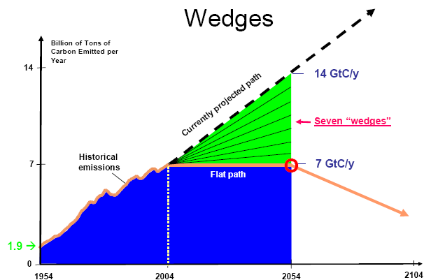
“Wedges” for CO₂ Reductions http://www.stabilisation2005.com/day3/Socolow.pdf

Slide 32
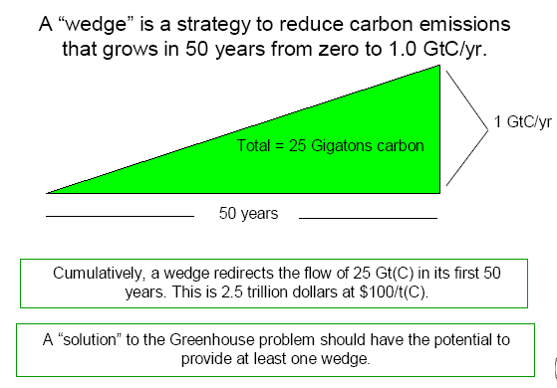
What is a “Wedge”? http://www.stabilisation2005.com/day3/Socolow.pdf

Slide 33
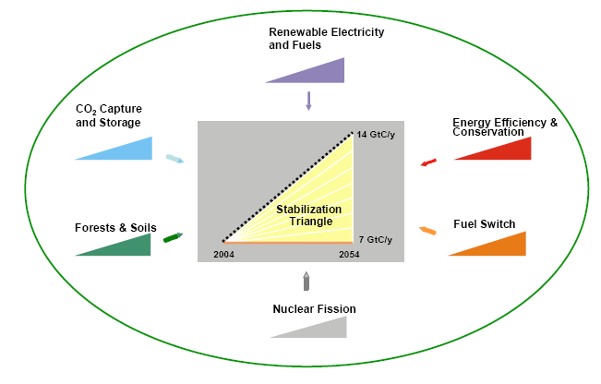
"We have to look everywhere in the economy” Robert Sokolow The Seven Wedges http://www.stabilisation2005.com/day3/Socolow.pdf

Slide 34
Carbon Disclosure Project https://www.cdproject.net/en-US/Pages/HomePage.aspx
The “Carbon Disclosure Project” is having a profound effect on the global carbon market development. CDP provides a coordinating secretariat for 475 institutional investors with a combined (today) $55 trillion of assets under management. On their behalf it seeks information on the business risks and opportunities presented by climate change and greenhouse gas emissions data from the world's largest companies: 3,000 in 2008. “Ignorance is no longer bliss”

Slide 35
Globally vs US
Most countries have powerful federal systems or centrally planned governments-hence government can press its intentions to the people
Not so easy in the US-democratic process requires many inputs
States have strong regional inputs
Public vs private interests also need to intersect
Many legal challenges in the US system not necessarily found elsewhere

Slide 36
What is Needed
A global price on carbon
Actions engaged:
Kyoto now need post Kyoto after 2012
EU-ETS functional and operating
US Cap and Trade or carbon tax-now not expected legislatively until late or after 2010
Other national programs

Slide 37
Issues
Who pays or not?
To whom?
By what mechanism?
And how?
Beginning when?

Slide 38
Issues
Some governments now view carbon as a revenue tool
Large impacted industries deeply engaged
Lesser developed countries want the right to catch up to the developed ones on emissions/capita, emissions/GDP
When should China be considered a developed nation?
Mitigation programs not always globally accepted
Competing regional and national interests at play
Who will enforce a global program?
National sovereignty issues huge

Slide 39
Contact Information
Michael E. Moore
VP External Affairs and Business Development CCS
Blue Source LLC
Executive Director
North American Carbon Capture Storage Association
WWW.NACCSA.Org
VP and Founding member Board of Directors
Texas Carbon Capture Storage Association
WWW.TXCCSA.Org
mmoore@bluesource.com
Tel: 281-668-8475
www.bluesource.com

