Slide 1
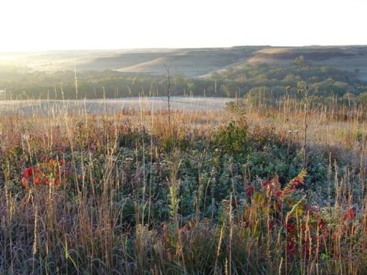
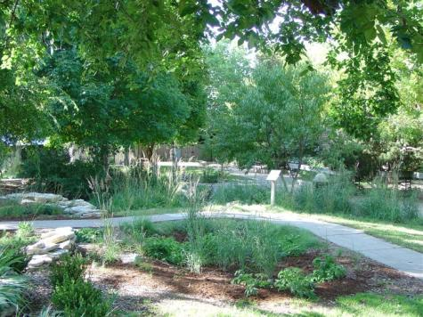
Infiltrating Stormwater & Sequestering Carbon
Lessons Learned from the Kansas State University
Stormwater Management Project
Lee R. Skabelund, Kansas State University
Landscape Architecture / Regional & Community Planning project manager
Konza Prairie near Manhattan, KS
Flint Hills Ecoregion
Sunset Zoo Rain-Gardens
Manhattan, KS

Slide 2
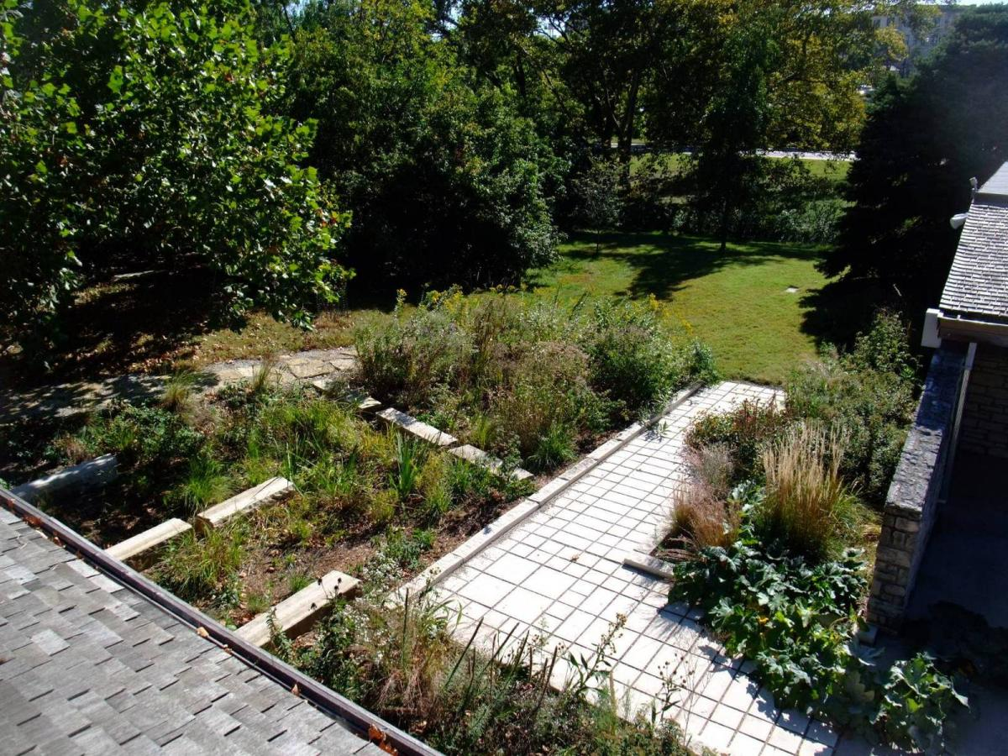
Interweaving Art and Science
K-State’s International Student Center Rain-Garden
10/3/08

Slide 3
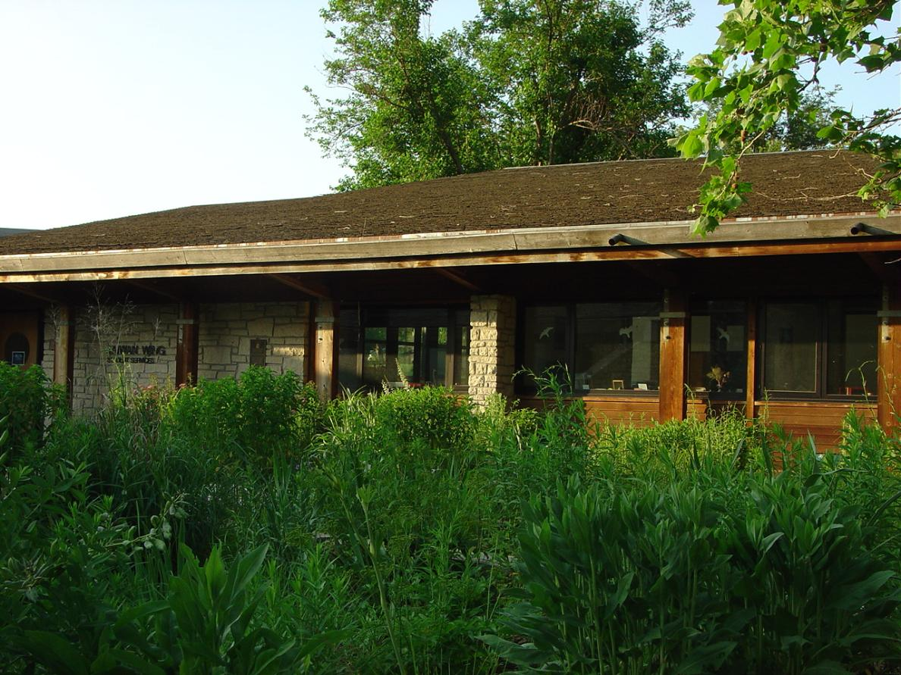
Interweaving Art and Science
K-State’s International Student Center Rain-Garden
6/4/09

Slide 4
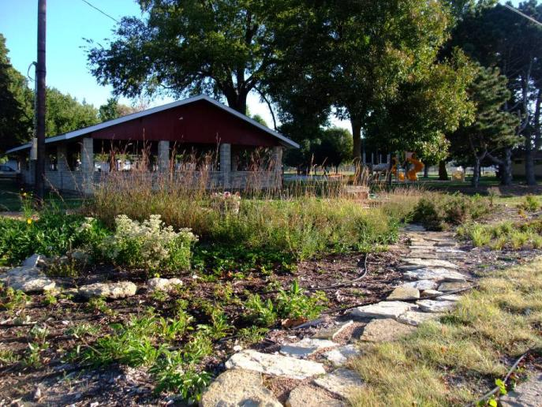
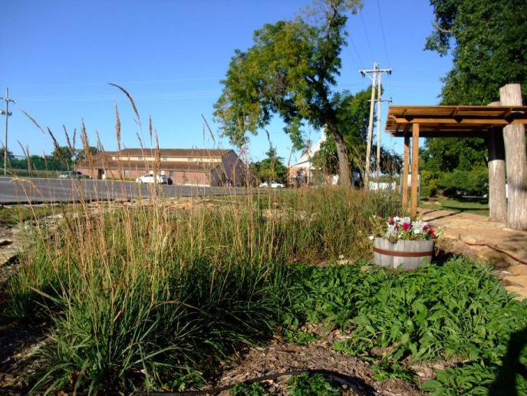
Rossville, Kansas Rain-Garden
Working with Prof. Skabelund, Brett Tagtmeyer & Aarthi Padmanabahn (LAR) designed and helped residents lay out the Rossville Rain-Garden in Spring 2008.
Implementation & maintenance by volunteers from the local community.
10/2/08

Slide 5
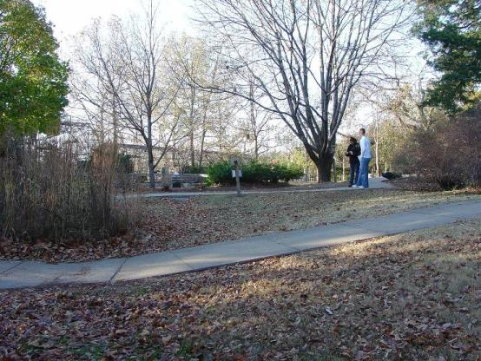
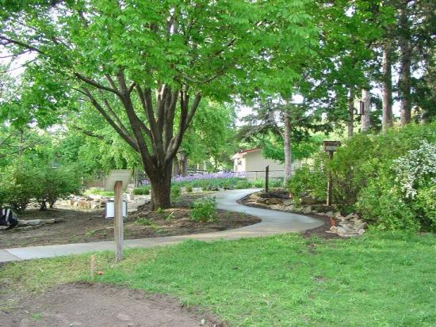
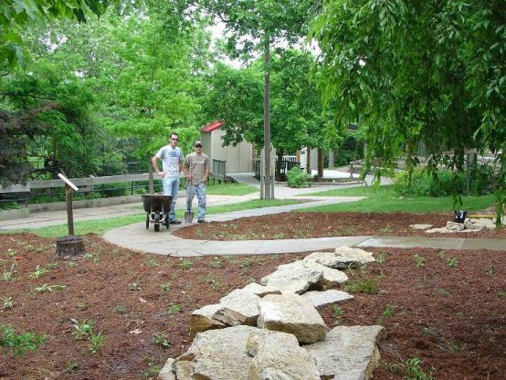
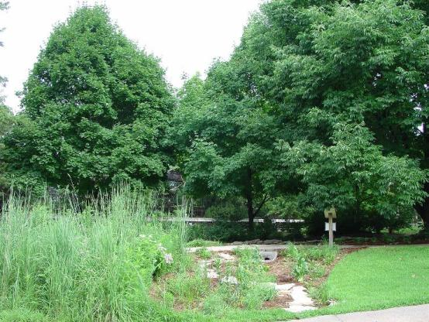
Sunset Zoo Rain-Gardens – Manhattan, KS
11/12/08
5/13/09
5/25/09
7/15/09
Within one good growing season small, live native species can take hold – on the ground, and on a roof...

Slide 6
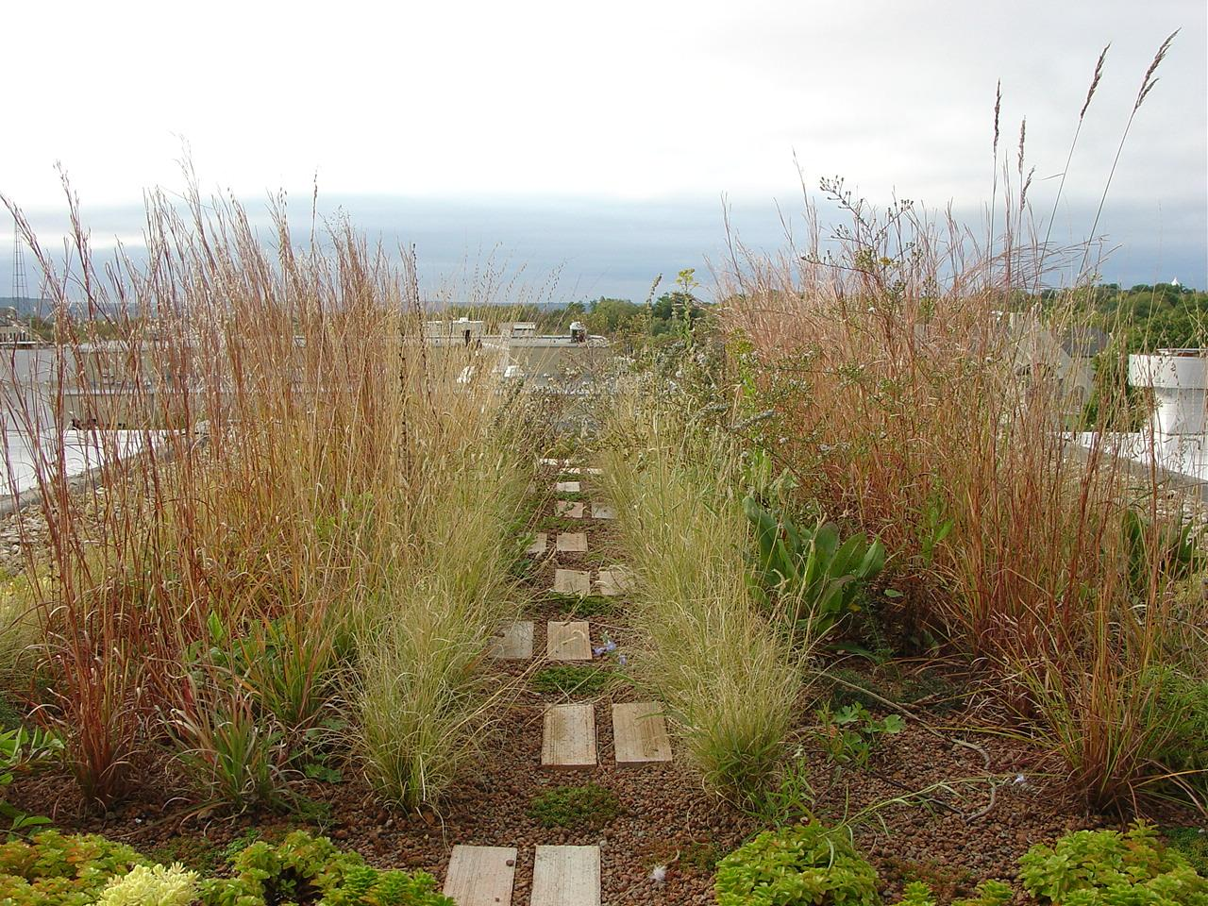
Seaton Hall Green Roof– Manhattan, KS
10/10/09

Slide 8
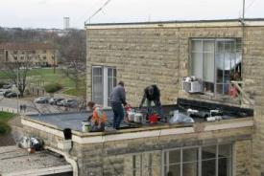
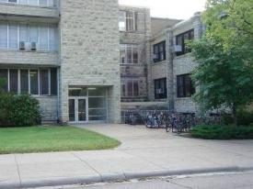
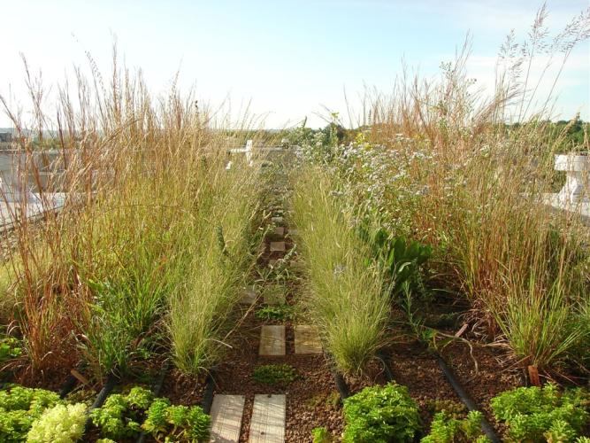
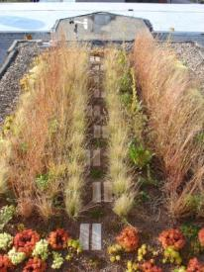
KSU Seaton Hall Green Roof
Seaton Green Roof - exposed upper rooftop
Structural calculations by Jessica Wiles & Dr. Sutton Stephens (Arch. Engineering). Details by Michael Knapp & Mark Neibling, with guidance from professors Todd Gabbard, Lee Skabelund, KSU Facilities, Greg Pfau (BNIM), and others. Monitoring support from Stacy Hutchinson (BAE), Mary Knapp & Carol Blocksome (Agronomy), and Rhonda Janke (Hort). Materials and labor donated by KSU-Facilities, Derbigum, Danker Roofing & American Hydrotech.
Seaton Hall
Upper breezeway roof – 300 sq ft; can hold ~64 lbs/sq ft
9/24/09

Slide 9
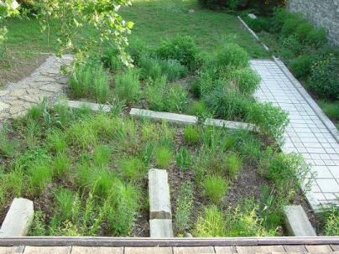
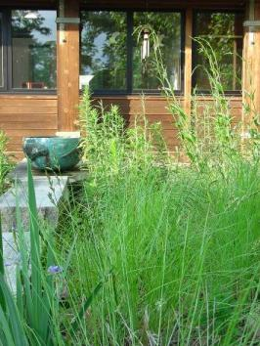
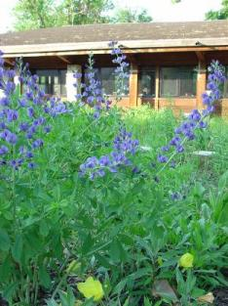
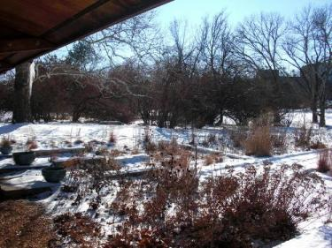
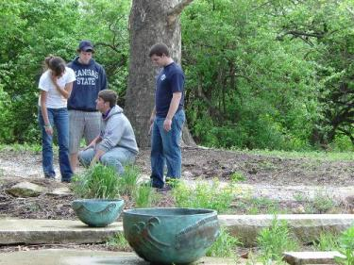
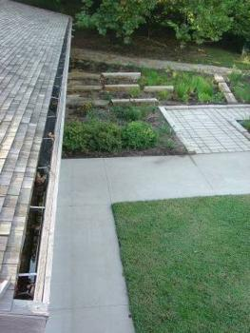
KSU ISC Rain-Garden
6/4/09
Results: participants and visitors clearly recognize the role of water in sustaining ecosystems—and hopefully consider ways they can harness rainwater for irrigation & ecological renewal where they live... They also recognize that ongoing maintenance (as with any landscape) is essential and takes time & thought.
Primary Maintenance Issues:
Who maintains (weeds & clips) this living, dynamic system?
How much time does it take; how often?
Is irrigation needed? How often is mulch applied?
What invasive or nuisance species pose challenges?
Will soils, rain-bowls & permeable paving clog?
How do design, maintenance & aesthetics interrelate?
How do costs compare to other kinds of landscape maintenance?
6/4/09
12/24/08
5/1/09
5/21/09
Note the water still in the rain-gutter, well after water soaked into heavy clay rain-garden soils
9/17/07

