Slide 1
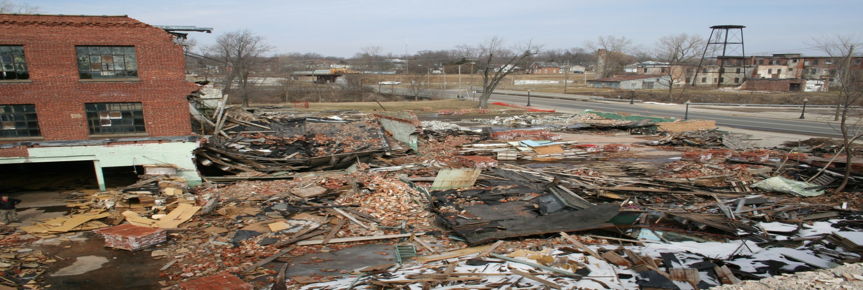
Hot Topics
Deborah Orr
Ball State Workshop
September 2010
Essex Wire Ligonier IN

Slide 2
Auto Sector Closures
AREA WIDE PLANNING IS AN ELIGIBLE
UNDER THE ASSESSMENT GRANT
Reuse planning could be an eligible cost.
Area wide planning could be an option.
Car dealerships not on the list.

Slide 3
Green Remediation
All 10 Regions have an interim Greener Cleanup Policy, Region 5’s policy can be found at :
http://www.epa.gov/reg5rcra/wptdiv/cars/remediation
Policy identifies 12 greener cleanup practices that we encourage
ASTM Standard being discussed

Slide 4
Green Jobs Linkage between job training and job creation is a priority. There is an opportunity to expand the current job training program across all OSWER programs.
Creating jobs support our goals:
Cleaning up our communities
Expanding the conversation on environmentalism and working for environmental justice
Integrated Cleanup Initiative
One EPA

Slide 5
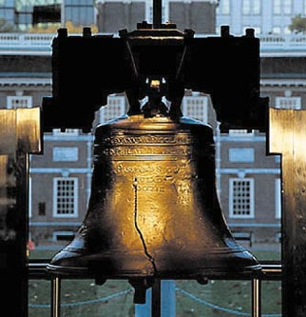
Register October 4th for The National Brownfields 2011 Conference
WHEN: April 3-5, 2011
WHERE: PA Convention Center
Philadelphia, PA
WHY ATTEND?
Largest networking event of its kind
The best of past conferences combined
Where green decision-makers convene
Unique property transaction opportunities
Market your services & properties
Mobile workshops & walking tours
Registration is free. Brownfields2011.org

Slide 6
USEPA Region 5 Brownfields Contacts
Deborah Orr
Phone: 312.886.7576
E-mail: orr.deborah@epa.gov
Webpage: www.epa.gov/R5Brownfields
The FY2011 grant application guidelines are available at www.epa.gov/brownfields

