Slide 1
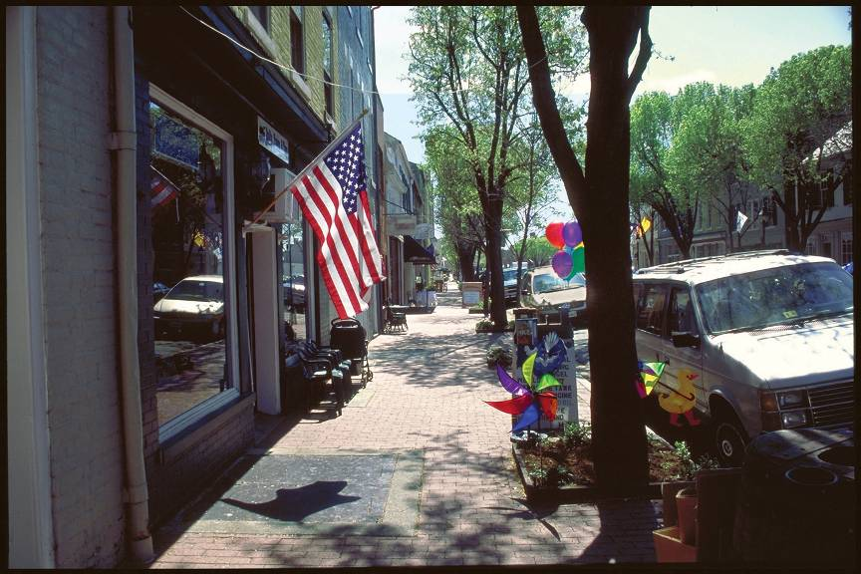
USDA Rural Development

Slide 2
Rural Development
We are a lending arm of the United States Department of Agriculture.
We work to improve the quality of life and increase the economic opportunities in rural America.

Slide 3
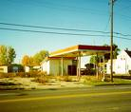
Does Your Community Have Any of These?

Slide 4
Rural Development Financing
These program may help!
Business Programs
Community Facilities
Water and Waste Systems

Slide 5
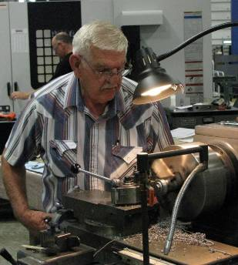
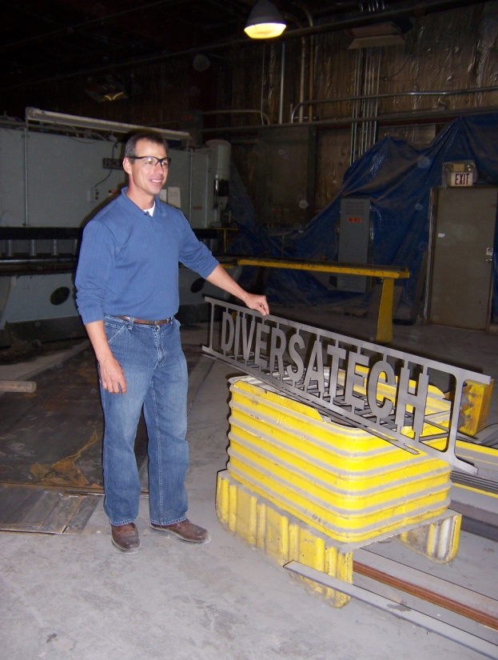
Business Programs
Diversatech, Gridley, IL
Bale Band-It, Pittsfield, IL

Slide 6
Guaranteed Business & Industry Loan Program (B&I)
Purpose:
Spur Business activity and growth
Financial backing for businesses in rural areas
To create jobs and stimulate economic development
Build viable and sustainable rural communities with Guaranteed Loans

Slide 7
B&I Purpose is achieved by…
…bolstering the existing private credit structure by
guaranteeing quality loans which will provide lasting community benefits.

Slide 8
B&I Eligibility
Project
Must be located in a rural area
Population less than 50,000
http://eligibility.sc.egov.usda.gov/eligibility/
Lender
Federal or state chartered banks
Farm Credit System institutions with direct lending authority
Savings & loan associations

Slide 9
B&I Eligibility
Borrower
Sole proprietorship
Corporations
Cooperatives
Partnerships
Other legal entities, public & private, that are organized and operated on a profit or nonprofit basis
Must be at lest 51% U.S. citizen/permanent resident alien owned

Slide 10
B&I Loan Purposes
Loans up to $25 million for:
Business acquisitions
Business conversion, enlargement, repair, modernization or development
Purchase & development of land, easements, right-of-way, buildings or facilities
Machinery & equipment
Startup costs & working capital

Slide 11
Example of use:
Community has site that is available to be developed and a business wishes to locate there or wishes to develop the site.
Guaranteed B&I Loan Program could be used to loan funds to business to purchase site and clean it up. There must be adequate security for the proposed loan.

Slide 12
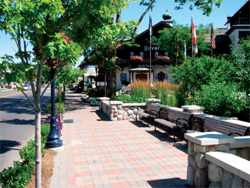
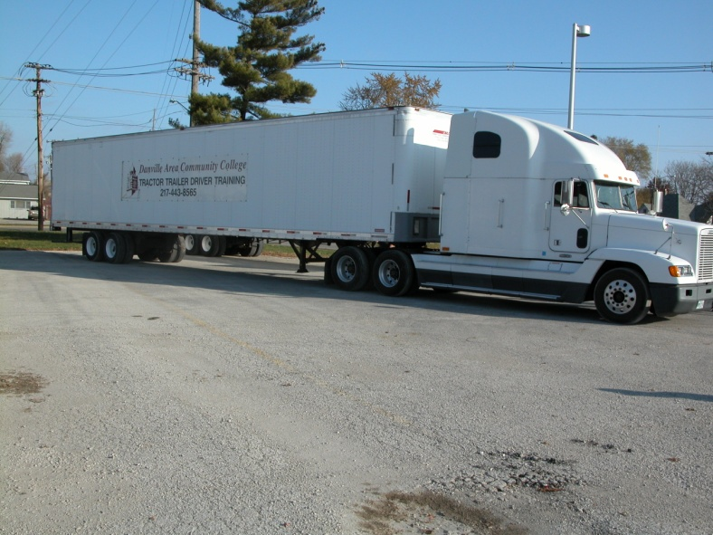
Rural Business Enterprise Grant
(RBEG)

Slide 13
RBEG
Purpose:
Finance and facilitate development of private business enterprises.
Help small businesses create/retain jobs.
Small business = employ 50 or fewer new employees and has less than $1 million in projected gross revenue
(Manufacturing and merchandising businesses may deduct cost of goods sold to determine “gross revenue” )

Slide 14
RBEG
Eligibility Requirements:
Not For Profit/Public Bodies: Eligible entities receive the grant to assist businesses; the grant does not go directly to a business.
Grant funds may not be passed through directly to a small business.
Communities with less than 50,000 pop.

Slide 15
RBEG
Uses:
Technical assistance for proposed grantee projects
Purchase or develop land, easements and rights-of-way
Construct or renovate buildings, machinery or equipment, access streets and roads, parking areas, utilities
reasonable fees and charges for professional services necessary for the planning and development of the project
providing financial assistance to small businesses through a revolving loan fund

Slide 16
RBEG
Example of use:
Community or not for profit wishes to clean up a brownfield in order to facilitate economic development of their community. They have a small business that is interested in renting the site. The community could apply for a Rural Business Enterprise Grant to do the actual clean up and then rent to the business.
Notes:
The entity who receives the RBEG must own the site/facility. Jobs must be involved.

Slide 17
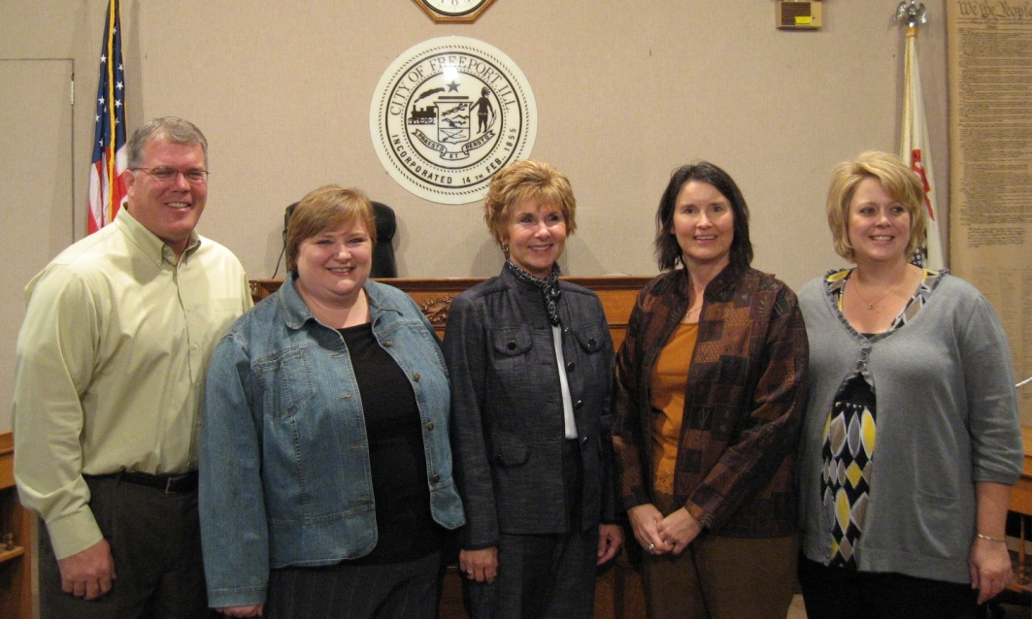
Rural Business Opportunity Grant
(RBOG)
City of Freeport and U of I Extension are working on a plan to help farmers & other entrepreneurs add value to their produce and market it.

Slide 18
RBOG
Purpose:
Finance technical assistance for business development.
Conduct economic development planning in rural areas.

Slide 19
RBOG
Eligibility Requirements:
Not For Profit/Public Bodies, and coops with primarily rural members.
Grant funds may not be passed through directly to a small business.
Communities with less than 50,000 pop.

Slide 20
RBOG
Uses:
Technical assistance, training, new business support centers, economic development plans.

Slide 21
RBOG
Example of Use:
Community or not for profit wishes to clean up a brownfield in order to facilitate economic development in their community. They could apply for a Rural Business Opportunity Grant to: do a study of how to clean it up and to create a plan for the clean up if there will be a benefit to local businesses.
Notes:
Jobs, jobs, jobs

Slide 22
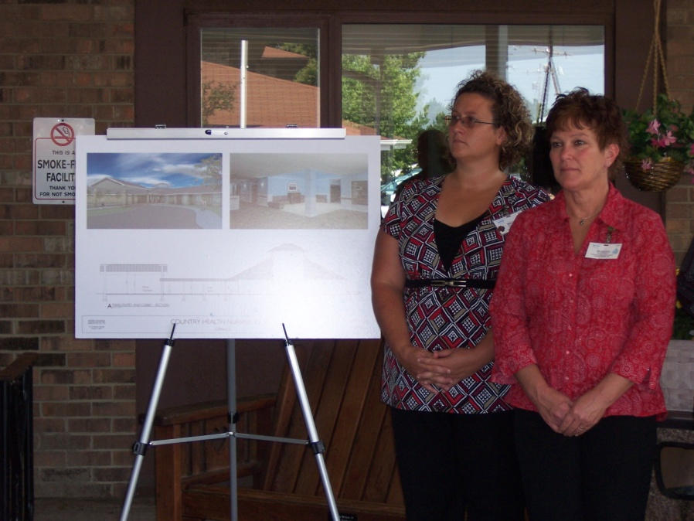
Rural Economic Development Loans and Grants
(REDLG)
Country Health, Inc. in Gifford received funds from Eastern Illini Electric Coop for an expansion of their nursing home facilities. EIEC used REDLG funds for this project.

Slide 23
REDLG
Purpose:
Finance economic development and job creation through local utility companies.

Slide 24
REDLG
Eligibility Requirements:
Electric & telephone utilities who are eligible for financing from the Rural Utilities Service may receive a REDLG to benefit communities with less than 50,000 population.

Slide 25
REDLG
Uses:
Establish revolving loan funds or lend funds to local non-profit and for profit businesses or public bodies that will create or retain jobs. Maximum grant to electric cooperative is $300,000 and maximum loan is $740,000.

Slide 26
REDLG
Example of Use:
Community has a brownfield they would like to clean up for business development. The electric coop could apply for a Rural Economic Development Loan/Grant. They then lend the money to the community at 0% interest for 10 years to do the clean up if local businesses would benefit.

Slide 27
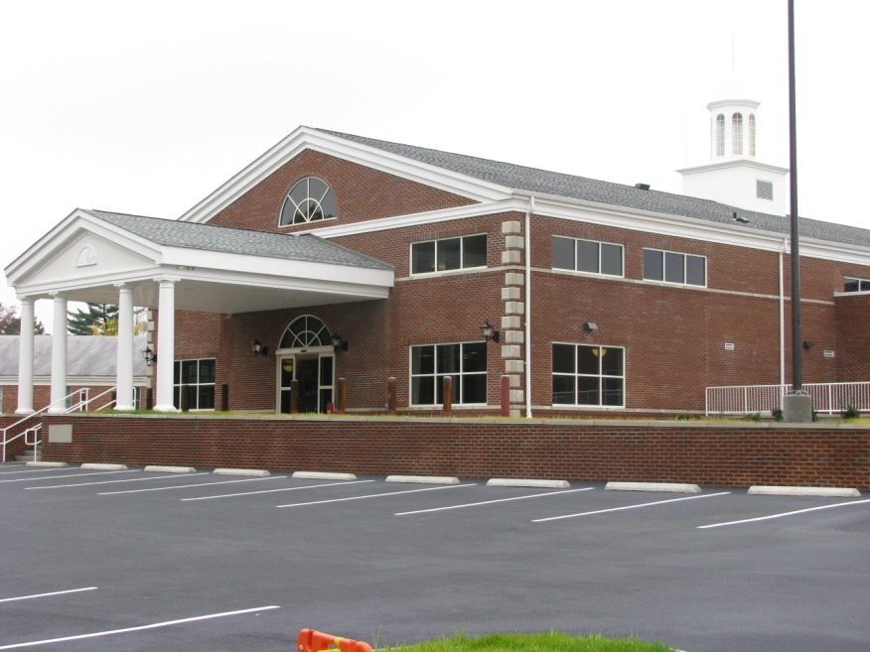
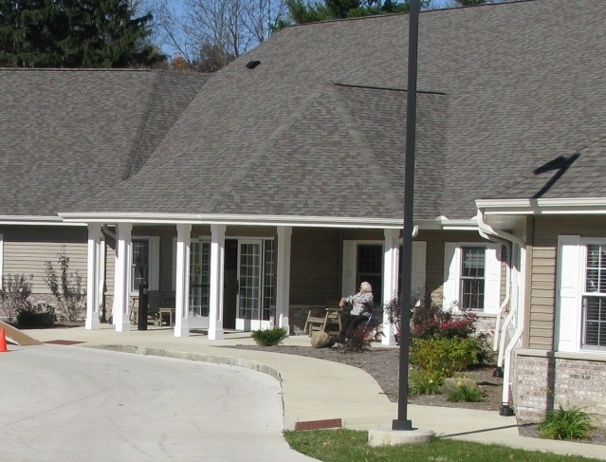
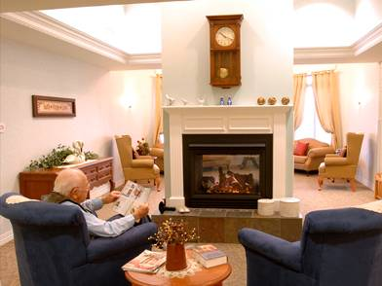
Community Programs
Salem Township Hospital Salem, IL
Eberhardt Village Arthur, IL
Piatt County Supported Living Facility
Notes:
Salem Hospital – $6 million direct community facility
Eberhardt Village in Arthur (assisted living facility plus an area for early stage dementia) – multi-million dollar guaranteed community facility loan
Piatt County Supported Living – direct loan to build new facility

Slide 28
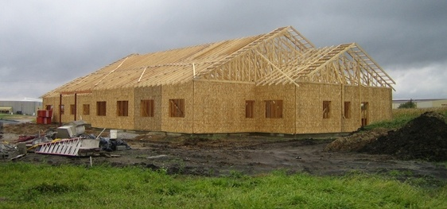
Community Programs
Flanagan-Graymont Fire Protection District
Dewitt Piatt Bi County Health Department,
Clinton, IL
Notes:
Dewitt Piatt Bi County Health Dept. Almost complete.
Flanagan-Graymont FPD

Slide 29
Community Facilities
Purpose:
Provide essential public services
Create jobs
Stimulate local economies
Notes:
Purpose: provide essential public services, create jobs and stimulate the local economies
-The Recovery Act is making more than $1.1 billion available for direct loans and $61 million in grants: $1,197,000 in all
-As you can see, only a small portion of the funding was allocated for grants.
We’ve already used Recovery Act funding these projects:
A Carroll County Fairgrounds building
Street Renovations in Nora (JoDaviess Co.)
Ambulance Upgrade for Gibson Area Hospital
Mental Health Clinic and Dental Clinic in Marion
Building equipment for Indian Creek Township
Maintenance building for North City (Franklin Co)
Downtown renovations in Jacksonville (Morgan Co)

Slide 30
Community Facilities
USES:
Buy and/or renovate facilities
Purchase and equip facilities
Access to health care
Support for first responders
Construction and repair of community facilities
Notes:
Purpose: provide essential public services, create jobs and stimulate the local economies
-The Recovery Act is making more than $1.1 billion available for direct loans and $61 million in grants: $1,197,000 in all
-As you can see, only a small portion of the funding was allocated for grants.
We’ve already used Recovery Act funding these projects:
A Carroll County Fairgrounds building
Street Renovations in Nora (JoDaviess Co.)
Ambulance Upgrade for Gibson Area Hospital
Mental Health Clinic and Dental Clinic in Marion
Building equipment for Indian Creek Township
Maintenance building for North City (Franklin Co)
Downtown renovations in Jacksonville (Morgan Co)

Slide 31
Community Facilities
ELIGIBILTY:
Local Governments
Not for Profits
Indian tribes
Rural areas and towns of 20,000 or less

Slide 32
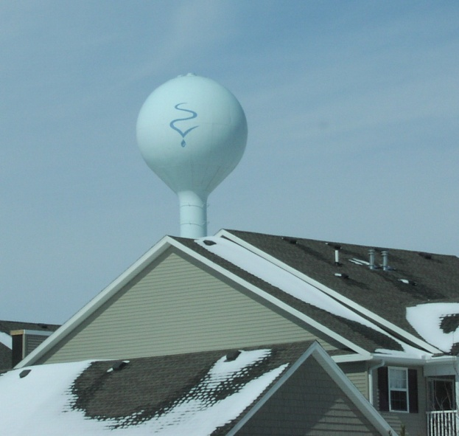
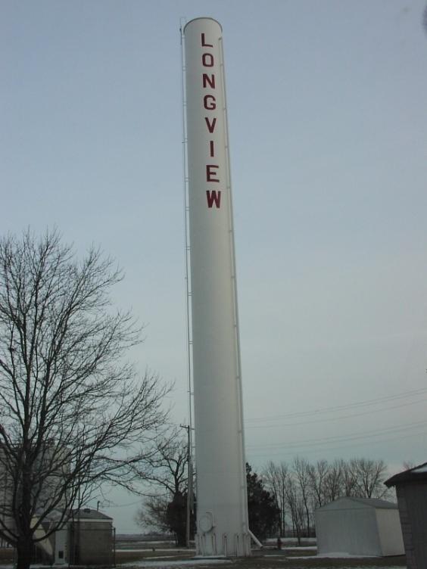
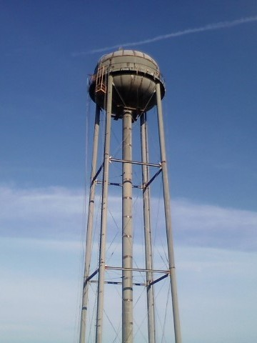
Water & Waste Programs
West Prairie Water District Arcola, IL
Village of Longview, IL
Sangamon Valley Public Water District
Mahomet, IL
Loans & Grants
Notes:
Longview 53,000 gallon
West Prairie Water 100,000 gallon

Slide 33
Water & Waste Programs
Purpose:
Provide water and waste financing to provide safe, reliable drinking water, improve wastewater treatment systems, protect the environment
USES:
Drinking water systems
Sanitary sewer
Storm drainage
Notes:
Provide water and waste financing to the most financially needy applicants to keep user fees reasonable
Provide safe, reliable drinking water, improve wastewater treatment systems, protect the environment
Recovery Act is making $2.7 billion in loans and $939 million in grants
(25% of funds are available in grants);
$3,673,000 in all

Slide 34
Water & Waste Eligibility
Public Entities
Not for Profit Corporations
Rural areas and towns of 10,000 or less
Notes:
We’ve already used Recovery Act funding water projects in the following counties:
Crawford Co (Eaton Water Dist.),
Clay Co (Village of Clay City and Clay County Water)
Marion (Sandoval)
Pike (Barry)
Scott (Scott Co Rural Water Co-op
Sewer projects funded already with Recovery Act funds are in
Johnson (Vienna)
Madison (Tri-City Regional Port Dist.)

Slide 35
CF and Water & Waste
Example of use:
Community may use these programs to fund a water treatment plant on a brownfield site or a build a water tower on the site.
Notes:
We’ve already used Recovery Act funding water projects in the following counties:
Crawford Co (Eaton Water Dist.),
Clay Co (Village of Clay City and Clay County Water)
Marion (Sandoval)
Pike (Barry)
Scott (Scott Co Rural Water Co-op
Sewer projects funded already with Recovery Act funds are in
Johnson (Vienna)
Madison (Tri-City Regional Port Dist.)

Slide 36
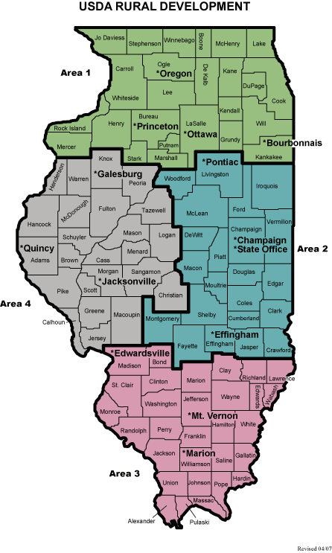
Rural Development Offices

Slide 37
Susan L. Petrea
Susan.petrea@il.usda.gov
217 403-6236

