Slide 1
The TAB Program Technical Assistance to Brownfields
Sabine E. Martin, Ph.D., P.G.
Center for Hazardous Substance Research
Kansas State University
April 2010

Slide 2
Technical Assistance to Brownfield (TAB) Communities
A national program
Funded by EPA headquarters via grants to 4 different entities
Free to communities
K-State assists communities in EPA Regions 5 and 7

Slide 3
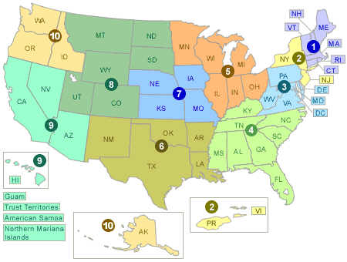
EPA Regions

Slide 4
TAB Assistance to Communities
Tailored to specific community needs
Typically coordinated through the city, tribal or non-profit brownfields project manager
May include:
Help identifying funding sources for revitalization projects
Review of EPA and other grant applications
Help finding a consulting firm
Review of project plans, technical reports
Assistance with community outreach/involvement
visioning
Other assistance, as needed and agreed upon
Communities accepted on a ‘first come’ basis
Depends on staff/funding availability

Slide 5
The Application Process
Contact us
We’ll set up a meeting to discuss assistance needs
Review needs and TAB capability
Agree on a course of action
Get started

Slide 6
Workshops/Training Sessions
Tailored to the information needs of the community
Relaxed atmosphere
Time for networking
Variety of presenters
Hands-on segments
Very effective !

Slide 7
Community Outreach
Redevelopment Planning

Slide 8
Visioning

Slide 9
Visioning

Slide 10
Visioning

Slide 11
Visioning

Slide 12
Visioning

Slide 13
Technical Presentations
Community Meetings

Slide 14
Community Involvement
Who is the Community?
Why do it?
Successful Involvement Techniques

Slide 15
Community Involvement Tools
Fact Sheets, Citizen Briefs
clear
concise
in layman’s terms
basic information
provide contact info and additional resources
Note: NOT a stand-alone tool

Slide 16
Community Involvement Tools
Community Outreach
Community Day/Fair
Bus Tours
Walking Tours
Workshops/Seminars
Public Meetings

Slide 17
If you feed them, they will come

Slide 18
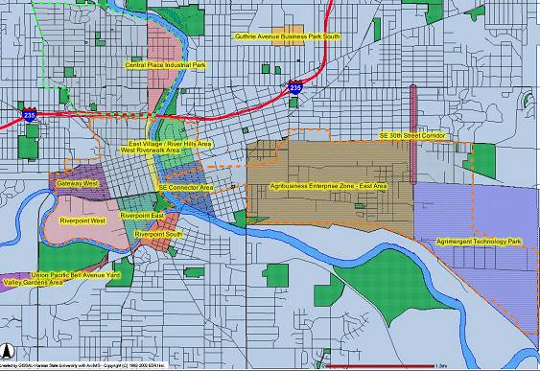
Special Projects
Des Moines, IA GIS-based redevelopment properties web site

Slide 19
Special Projects Web - based software: TAB-BIT www.tab-bit.org

Slide 20
TAB-BIT Brownfields Inventory Tool
Released January 29, 2010
Free, web-based and desk-top version
Desk-top version to be released later this year

Slide 21
Background
Prototype developed by EPA Region 8
Intended to help Response Grant, and other brownfields grant recipients with survey & inventory, public record, oversight & enforcement, assessment and cleanup, and administrative reporting requirements
Tool became obsolete due to MSWindows upgrades

Slide 22
BIT Features
Password protected
Multiple users possible, if permission is granted, or “read only” feature
Database
Import/export function
Search function

Slide 23
What can TAB-BIT do?
Data Management:
Brownfields related data
Other environmental data
Track funding
Upload documents or enter data directly
Site information
Redevelopment data

Slide 24
What can TAB-BIT do? Cont.
Data Management:
Program admin. data
Enforcement documentation
Complaints

Slide 25
What can TAB-BIT do? Cont.
Report Generation:
Property Profile Form (e-submit to ACRES)
Quarterly report form (outline)
Forms for enforcement, complaints, ICs, inspection/oversight, public record reports, etc.
Customized reports
Maps

Slide 26
Special Projects Web - based software: TAB EZ www.tabez.org

Slide 27
WHY TAB EZ?
Levels playing field for small/ rural communities, disadvantaged cities and towns and not-for-profits
Tool is time and place independent: flexibility critical to community resources that are stretched to capacity

Slide 28
Features and Benefits to Users
User friendly and can be accessed anytime at the user’s own pace
Integrates Brownfield education with online support: definitions, regulatory citations and pertinent federal/state web links
Helpful Hints for every criteria to be addressed

Slide 29
What TAB EZ CAN and Can NOT do
TAB EZ can:
provide a framework for the community’s proposal
provides strategies and links to reduce time in writing the proposal
TAB EZ cannot:
write a specific and compelling proposal for you
It’s your proposal!

Slide 30
TAB EZ is NOT a substitute
for reading the grant
guidelines!!!

Slide 31
TAB Contacts
Dr. Sabine Martin (Program Coordinator)
1-800-798-7796 785-532-6519 smartin1@k-state.edu
Dr. Frank Beck
309-438-7090 fdbeck@ilstu.edu
Web site: http://www.engg.ksu.edu/chsr/outreach

