Slide 1
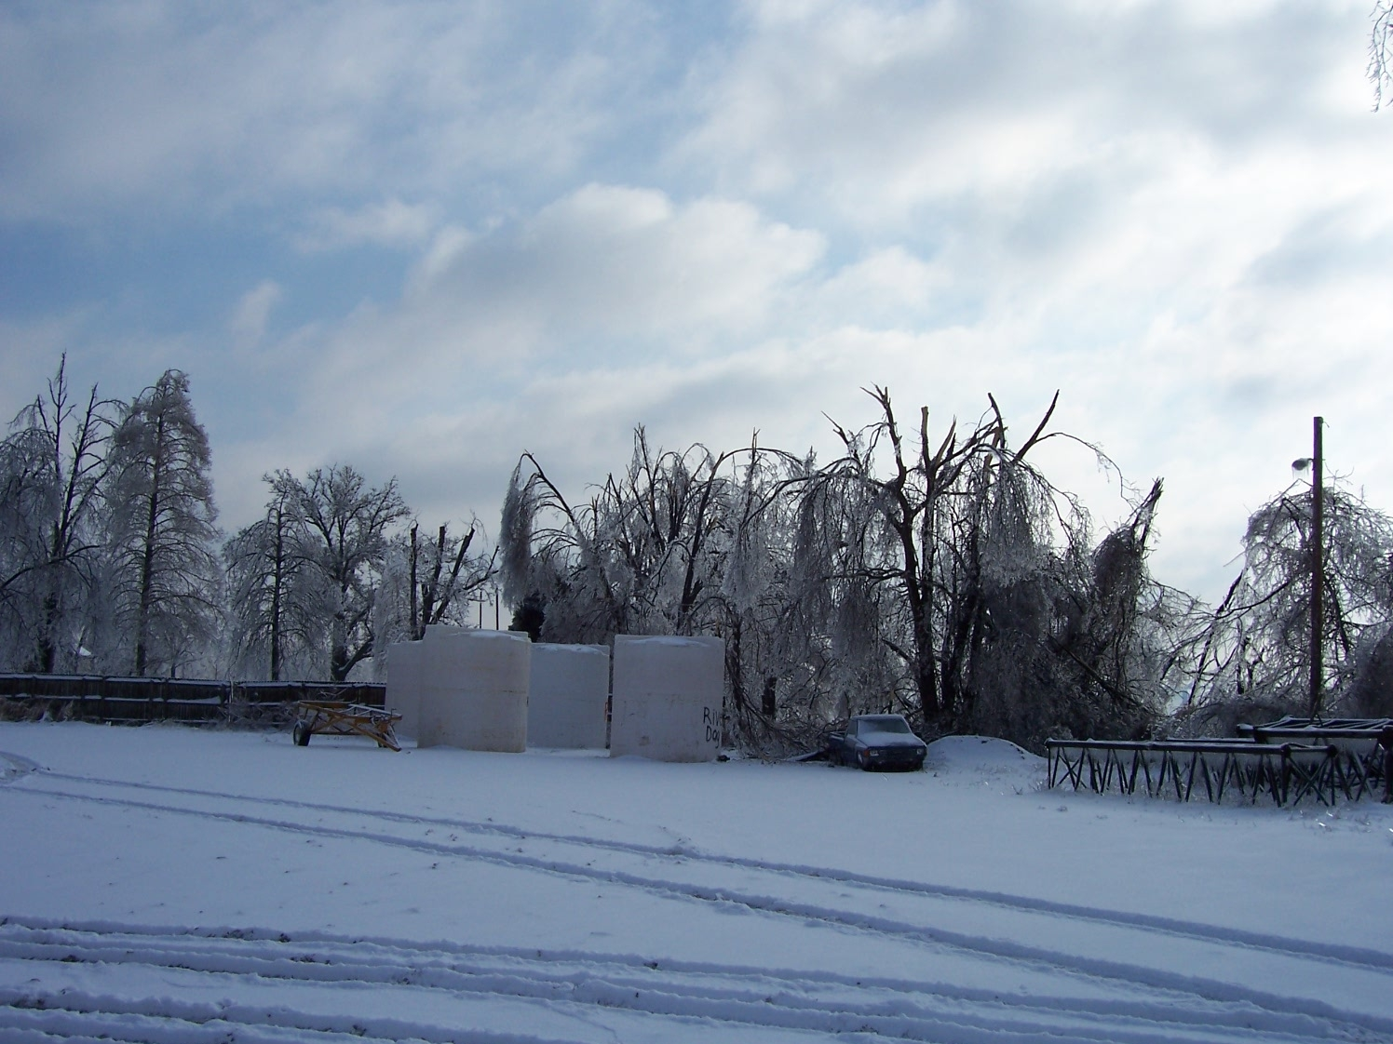
P.L. 107.118. Small Business Liability Relief and Brownfields Revitalization Act of January 11, 2002 U. S EPA, Region 5
Deborah Orr
May 2010
Laidlaw, IL

Slide 2
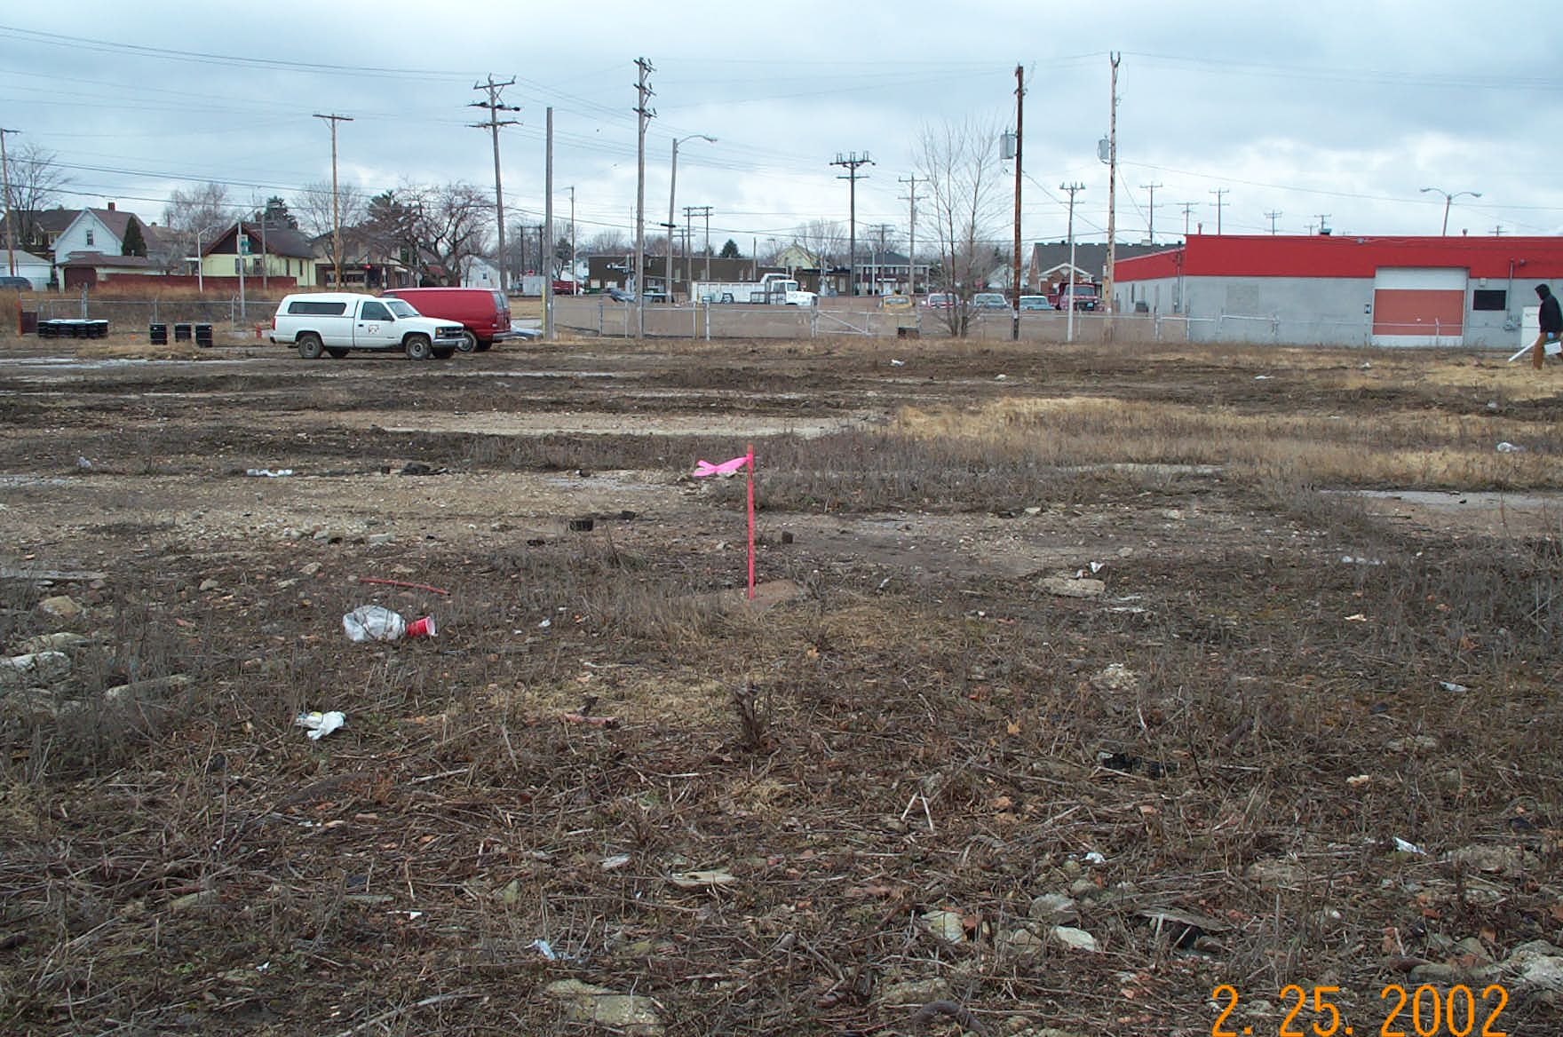
Brownfields Definition
“…..real property, the expansion, redevelopment, or reuse of which may be complicated by the presence or potential presence of a hazardous substance, pollutant or contaminant.”

Slide 3
Subtitle A. Brownfields Revitalization Funding provides $200 million a year
Authorizes grants of up to $350K per site for assessment.
Authorizes grants of up to $200K per site for eligible entities, including not-for-profits, to clean up brownfields*.
Authorizes grants of up to $200K for job training to eligible entitles.
Authorizes grants for up to $1M for revolving loan fund (RLF) program*.
Authorizes targeted brownfields assessements.
*20% cost share

Slide 4
Subtitle B. Brownfields Liability Clarifications
Contiguous Property Owner. Superfund liability relief for innocent persons who own property that is contaminated solely due to a release from a neighboring property, so long as the person did not cause or contribute to the release.
Innocent Landowners. Provides Superfund Liability relief for landowners who had no reason to know of contamination at the time of purchase.
Prospective Purchasers and Windfall Liens. Provides Superfund liability relief for future buyers of facilities who are not responsible for contamination.

Slide 5
All Appropriate Inquiries
BF law requires EPA to establish the AAI rule.
AAI effective date is November 1, 2006
Property buyers who want CERCLA liability protection and eligible entities that use EPA BF funds are affected by AAI.
More information on AAI can be found at:
www.epa.gov.brownfields

Slide 6
Subtitle C. State and Tribal Response Programs
Bars Federal enforcement action for sites in State/Tribal cleanup programs in some circumstances.
Federal re-openers to ensure safety net (State/Tribal requests, endangerment, new information).
States/Tribes maintains list of sites in response program.
Provides suggested elements of State/Tribal response programs.
Can provide NPL deferral of site in State/Tribal Programs.
States/Tribes are provided up to $50 million a year to support brownfields programs.

Slide 7
FY 2009 Appropriations budget: Competitive funding is $241.5 million. EPA anticipates award of approximately 289 cooperative agreements nationally.
Successful proposals in Region 5 totaled 87
State
IL - 12
IN - 7
MI - 29
MN - 7
OH - 21
WI – 11
Tribal – 12
State/Tribal - 18
Grant Type
Assessment - 50
Cleanup - 15
RLF - 15
Job training - 7

Slide 8
Number Of R5 BF Proposal By State 2007 - 2009

Slide 9
Who can apply*?
General Purpose Unit of Local Government.
Land Clearance Authority or other quasi-governmental entity.
Government Entity Created by State Legislature.
Regional Council or group of General Purpose Units of Local.
Redevelopment Agency established by the state.
States and Tribes.
*coalitions

Slide 10
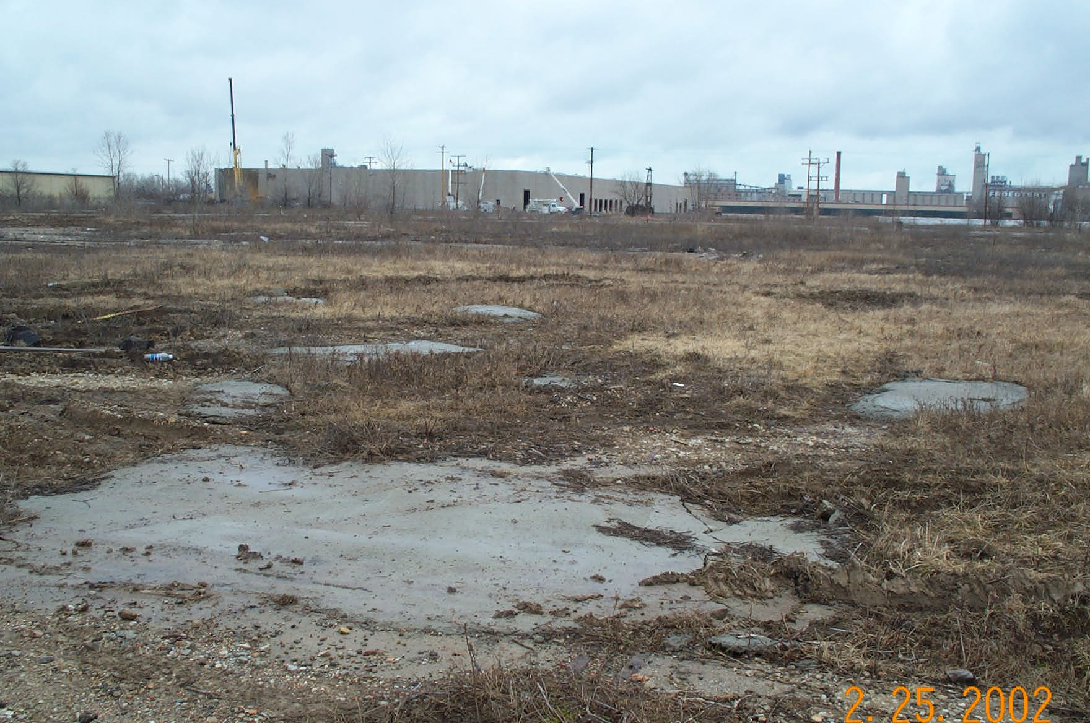
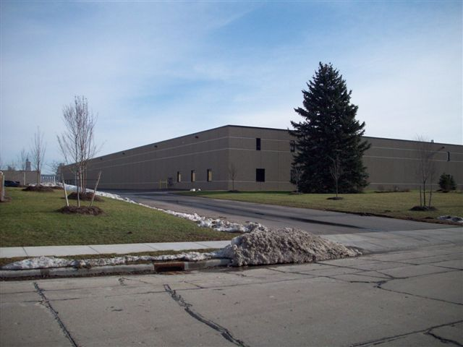
Assessment Success Story: West Allis, WI Wehr Steel – 2009
Before
After

Slide 11
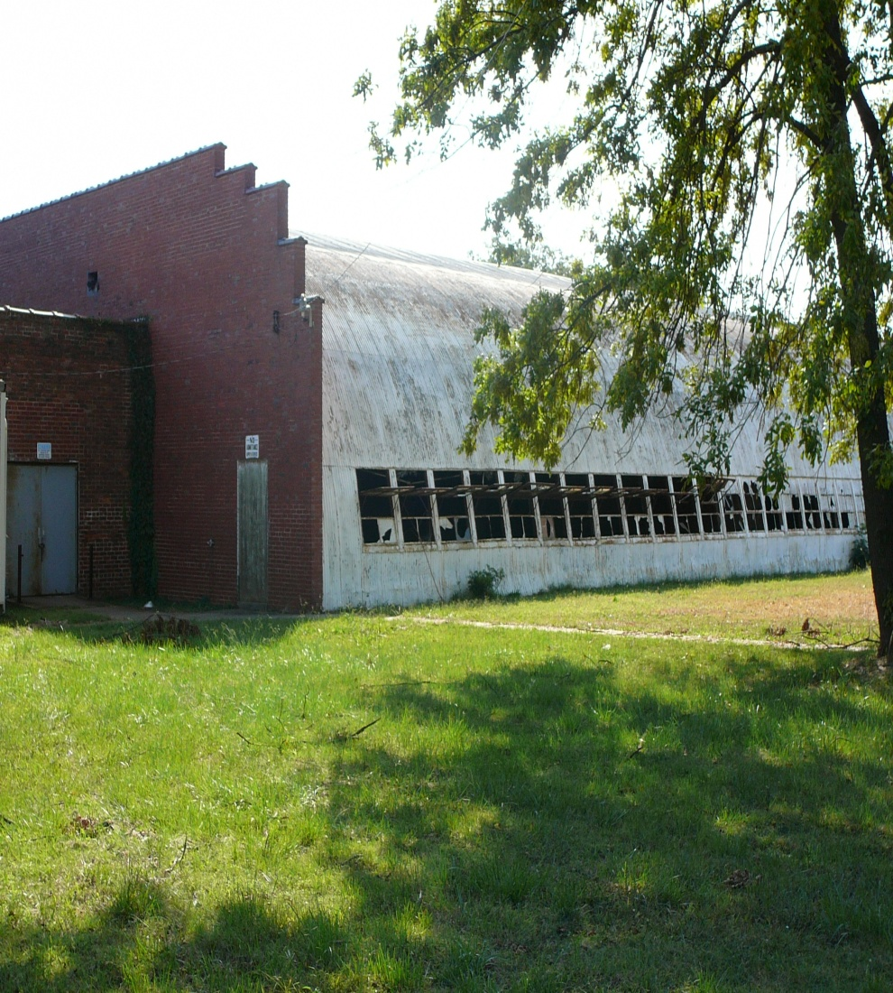
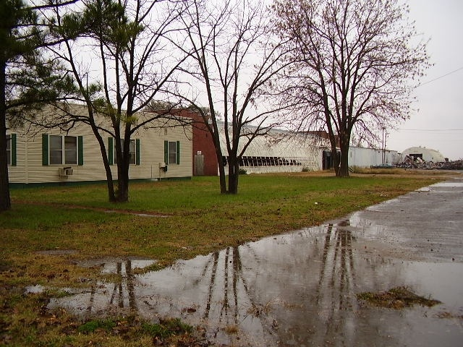
Cleanup Success Story: Metropolis, IL Former Laidlaw Facility - 2009
Before
After

Slide 12
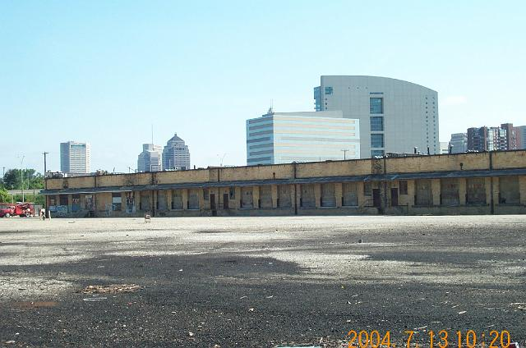
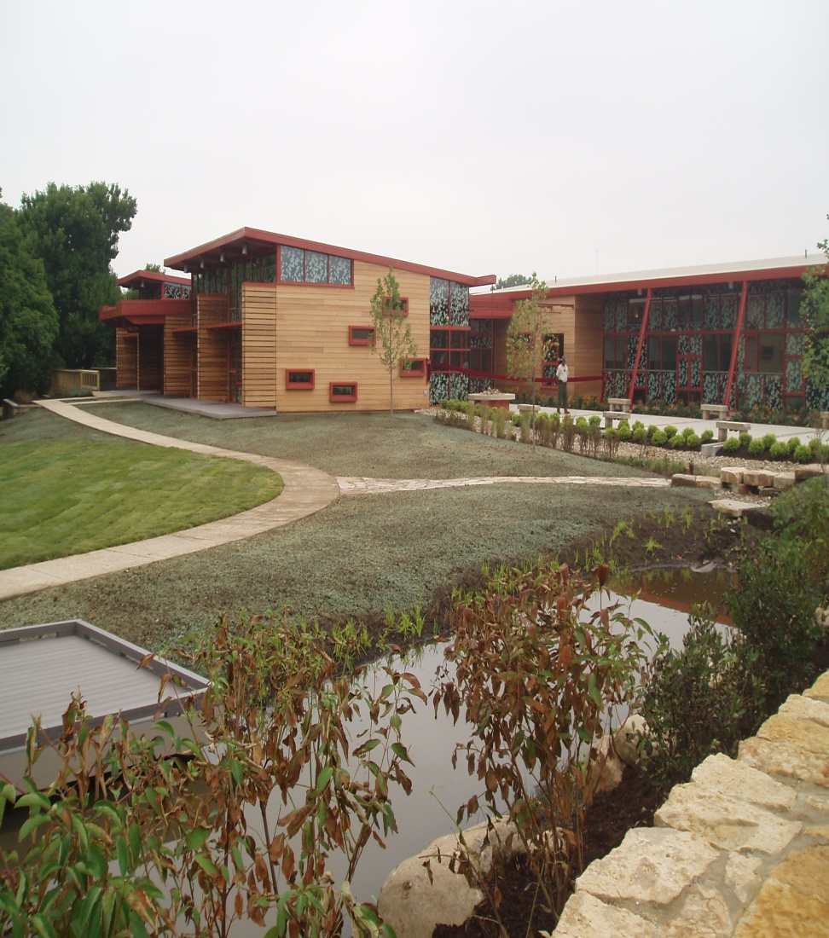
RLF Success Story: Columbus, Ohio Whittier Property - 2009
After
Before

Slide 13
RLF Success Story: Lansing, MI Former Ottawa Street - 2009
Before
After

Slide 14
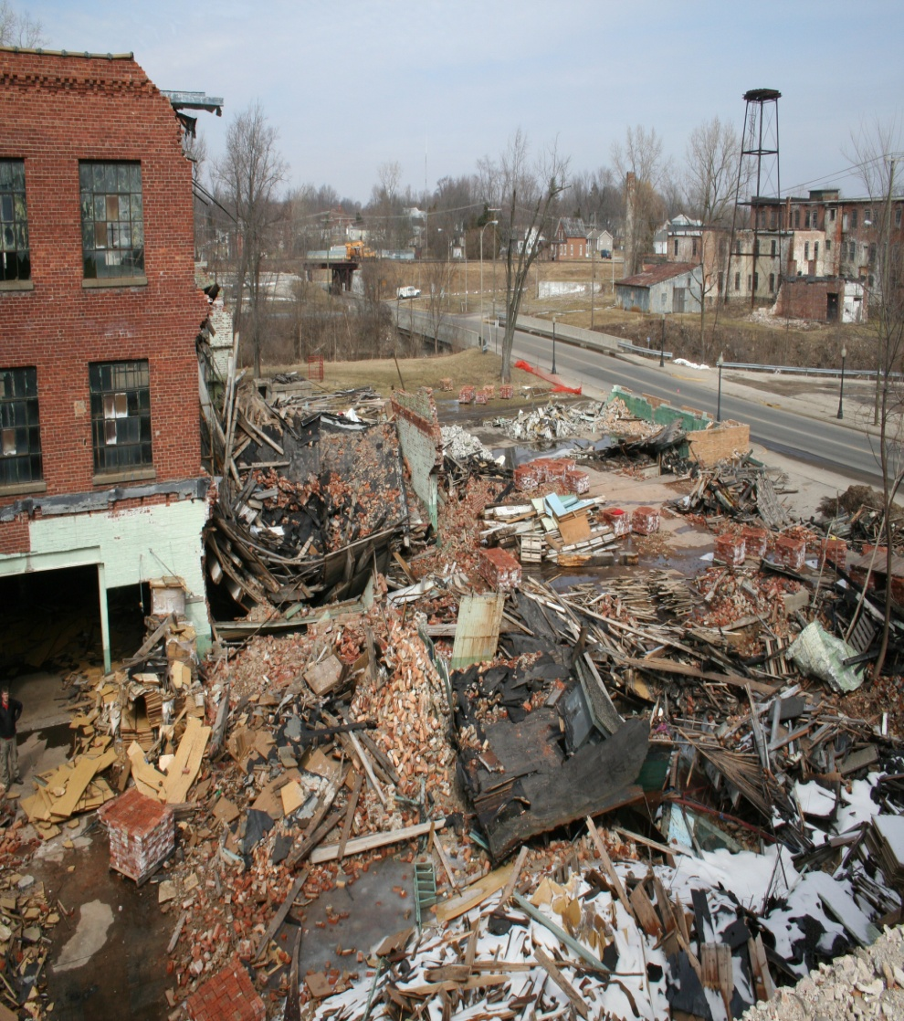
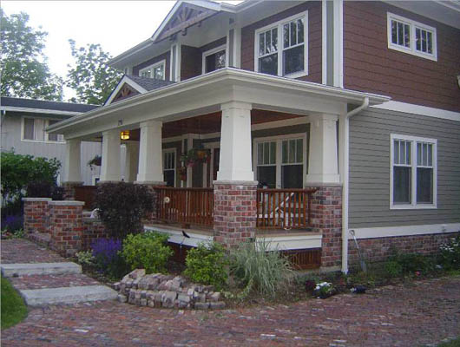
TBA Success Story: Ligonier, IN Essex Wire - 2009
Before
After

Slide 15
Job Training Success Story

Slide 16
ATSDR’s Public Health work and Brownfields Projects
Land Reuse Screening Tool
Baseline Agency Capacity to Work on Land Reuse/Brownfields
Community Guidance/Training Programs
- Nuts and Bolts of PPH and Brownfields
- Best Practice Sites

Slide 17
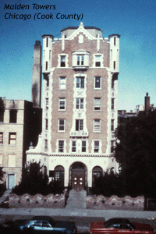
Federal Historic Preservation Tax Credit Program
Encourages protection of landmark
Increases the value of the property, returns underutilized structures to the tax rolls
Upgrades neighborhoods
Contact Illinois Historic Preservation Agency.

Slide 18
Brownfields Tax Incentive
Allows environmental cleanup costs to be deducted in the year incurred
Incentive allows for deduction for petroleum contamination
Previously filed tax returns can be amended
Expired December 31, 2009
Check IRS guidance or consult qualified tax professional

Slide 19
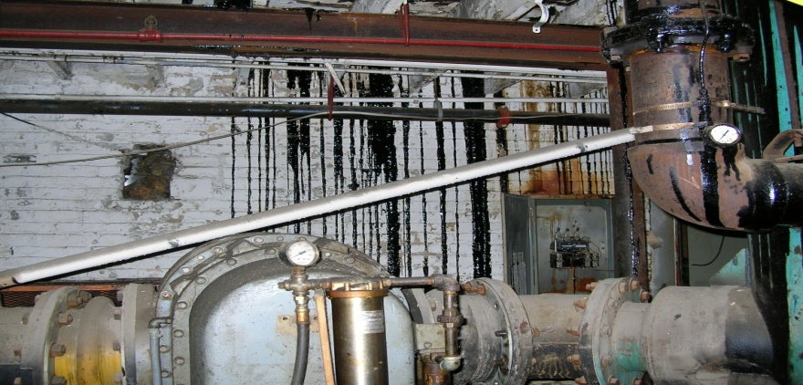
Environmental Justice and Brownfields
Message from Mathy Stanislaus, OSWER Director, to EPA staff on September 2009:
“Look for opportunities to use cleaned up land for urban gardens and urban agriculture. Disadvantaged communities may be particularly interested in opportunities to become more economically independent.”

Slide 20
Application Schedule for FY2011 (draft)
Request for Proposal -- August
Job Training Grant proposals due mid October
Assessment, Revolving Loan, Cleanup Fund (ARC) proposals -- mid October
Spring 2012 – Award Announcements
Fund available before October 1
Notes:
* ARC = Assessment, Revolving Loan, and Cleanup

Slide 21
Training Opportunities
FY2011 Brownfields Competitive Proposal Guideline Training, TBD
FY2011 Brownfields Grants Administration Training, TBD
2011 National Brownfields Conference, April 3 -5, 2011, Philadelphia PA.

Slide 22
USEPA Region 5 Brownfields Contacts
Deborah Orr
Phone: 312.886.7576
E-mail: deborahorr@epa.gov
Webpage: www.epa.gov/R5Brownfields
The FY2011 grant application guidelines will be available at www.epa.gov/brownfields
hopefully by early August.

