Slide 1
Community Programs
Welcome

Slide 2
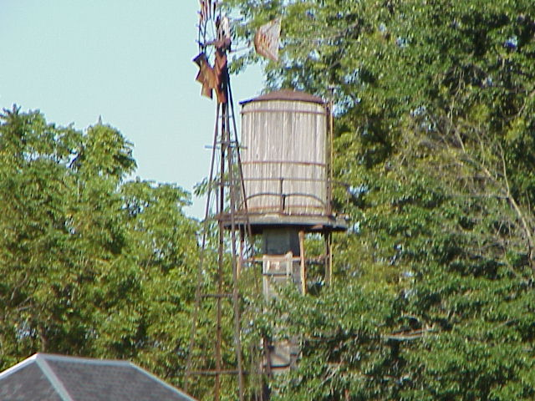
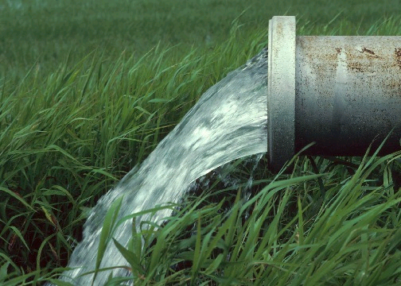
Indiana
Rural Development
United States
Department of Agriculture
Gregg Delp
Director of Community Programs

Slide 3
Rural Development
-- Improving the quality of life of all rural Americans
-- Increasing economic opportunity in rural America

Slide 4
Community Programs
Community Facilities
Water and Environmental Programs
Electric and Telecommunication Programs
Faith-Based

Slide 5
Community Facilities
Program Objective
Provide funding to public bodies, federally recognized Indian tribes and non-profit organizations using three funding sources
Guaranteed Loans
Direct Loans
Grants

Slide 6
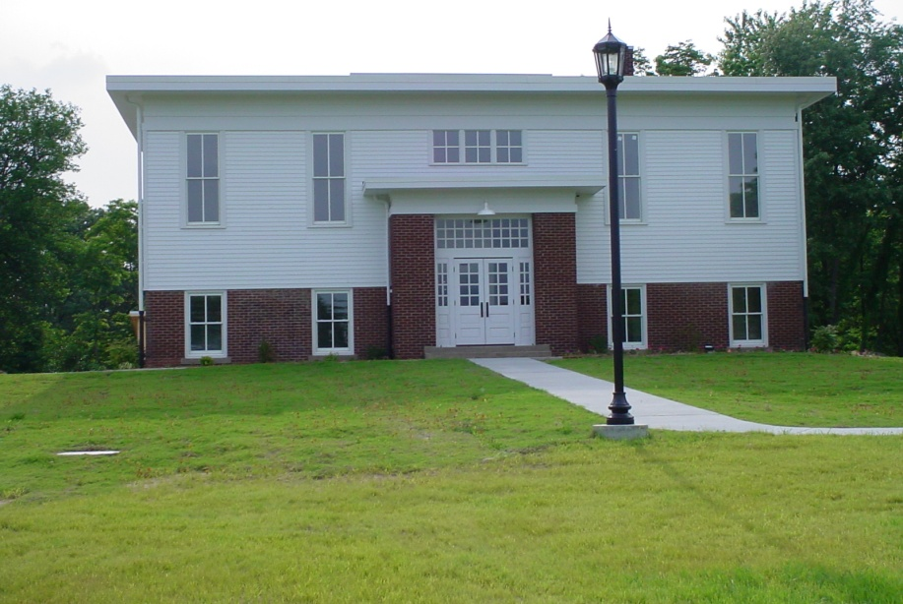
Community Facilities
Purpose
Construct, enlarge, extend or otherwise improve essential community facilities providing essential services in rural areas

Slide 7
Community Facilities
Eligible Areas
Areas with a population of 20,000 or less which includes:
Cities
Towns
Unincorporated Areas

Slide 8
Community Facilities
CF Guaranteed Loans
Rates
Negotiated between lender and borrower
Fixed or variable
Terms
40 years maximum

Slide 9
Community Facilities
CF Direct Loan
Rates
4.00 %
Terms
40 year maximum or life of the facility
Notes:
RD staff will help you with developing an application
RD will originate, underwrite, close and service the loan

Slide 10
Community Facilities
CF Grants
Only to projects without financial capacity
Average grant is less than $30,000 (nationally)
Larger grants to smaller communities with lower median household income
% of Total
Project Cost Population Median Household Income (MHI)
75% Less than 5,000 60% or below the statewide MHI
55% Less than 12,000 70% or below the statewide MHI
35% Less than 20,000 80% or below the statewide MHI
15% Less than 20,000 90% or below the statewide MHI
SNMHI $44,459

Slide 11
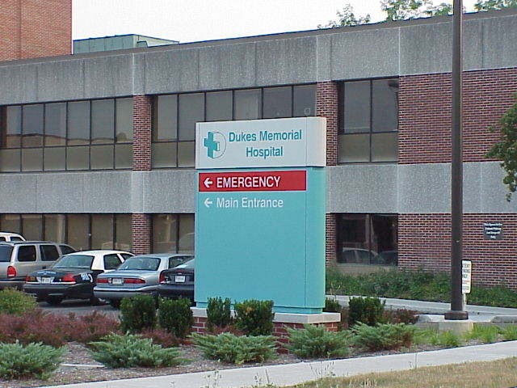
Examples of Community Facilities Community Health Care
Hospital
Critical Access Hospital
Dental Clinic
Nursing Home
Assisted Living Facility
Physicians Clinic
Rehabilitation Center
Psychiatric Hospital
Outpatient Clinic

Slide 12
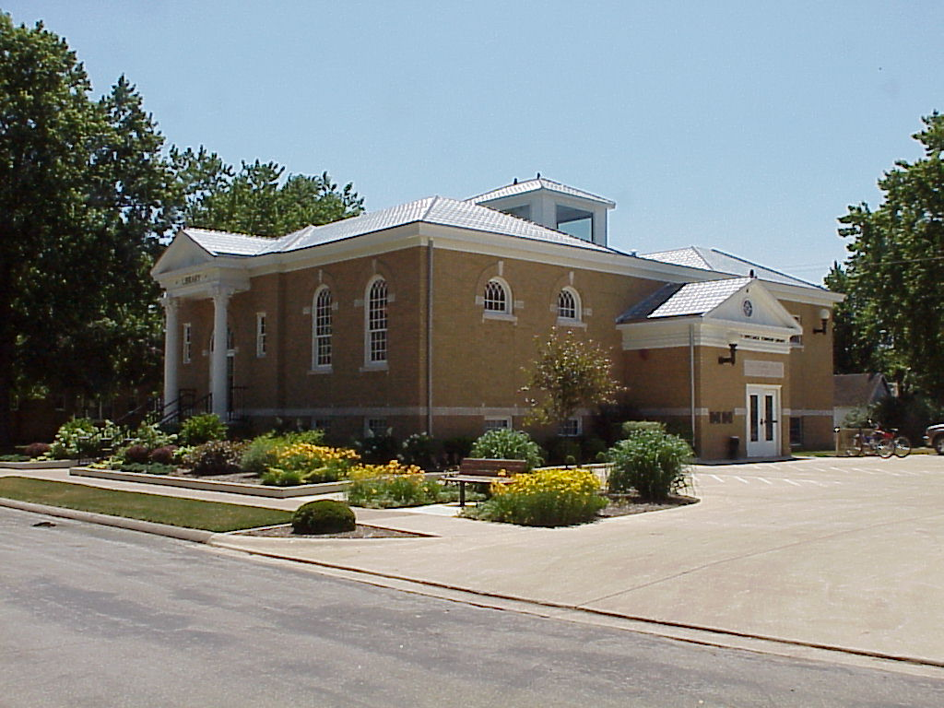
Cultural & Educational
All Purpose Buildings
Colleges
Educational Camp for Physically & Mentally Impaired
Library
Museum
Outdoor Theatre
Public School
School Maintenance & Equipment Service Center
Vocational School

Slide 13
Energy Transmission & Distribution
Electric Equipment
Maintenance Bldg.
Low Head Hydro
Electric Facility
Natural Gas Distribution

Slide 14
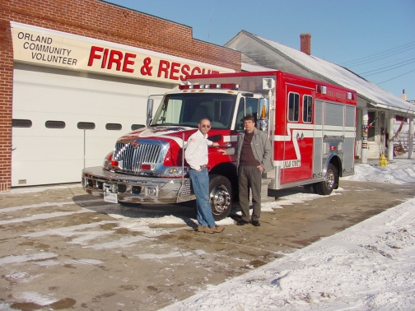
First Responders Fire, Rescue, & Public Safety
Civil Defense Building
Communications Center
Fire Department Building
Fire Trucks
Jail
Turn Out Gear
Mobile Communications Center
Multi-Service Fire/Rescue Building
Equipment Building
Jaws of Life

Slide 15
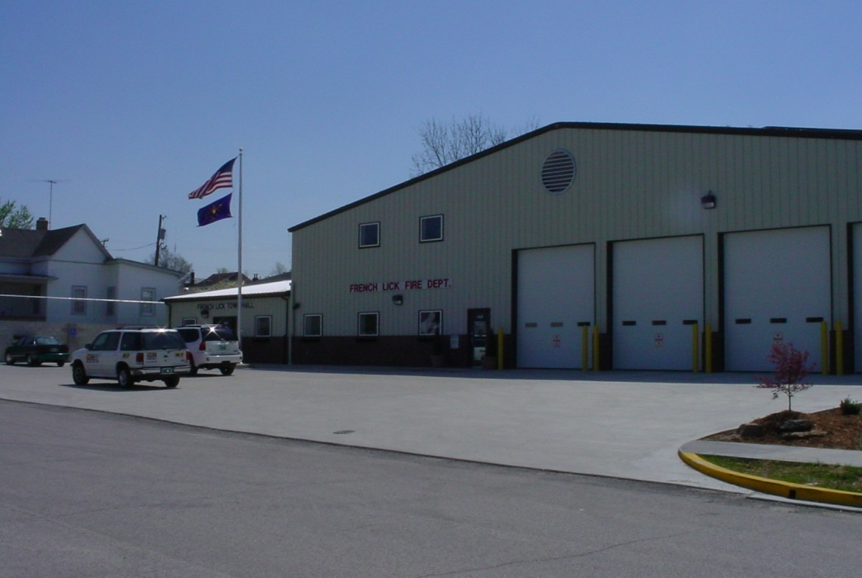
Community Support Buildings & Improvements
Adult Dare Care Center
Child Day Care Center
City Hall
Community Health Department
County Office Building
Community Center
County Courthouse/Annex
Data Processing Center
Food Preparation Center
Food Storage and Distribution Center
Home for Troubled Youth
Public Maintenance Building

Slide 16
Transportation
Airport Hanger
Airport
Bridge
Municipal & County Garage
Offstreet Parking
Sidewalks
Street Improvements
Rural Transportation
Infrastructure for Industrial Park
Railroad
Town Bus
Service/Equipment
Marina
Municipal Dock
Special Transportation Equipment

Slide 17
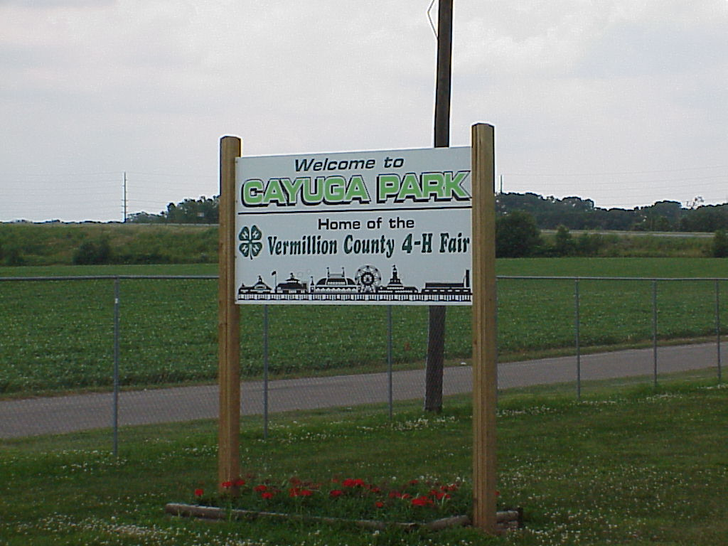
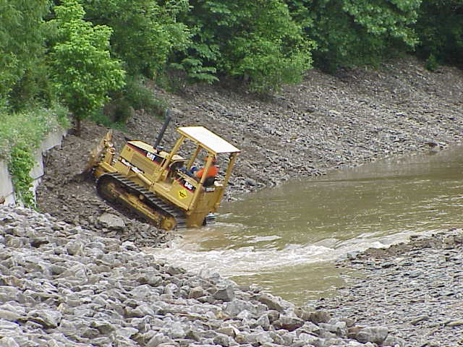
Other
Fairgrounds
Animal Shelter
Levee/dike
Oceanfront Protection
Special Services Building
Sprinkler System
Telemedicine / Distance Learning

Slide 18
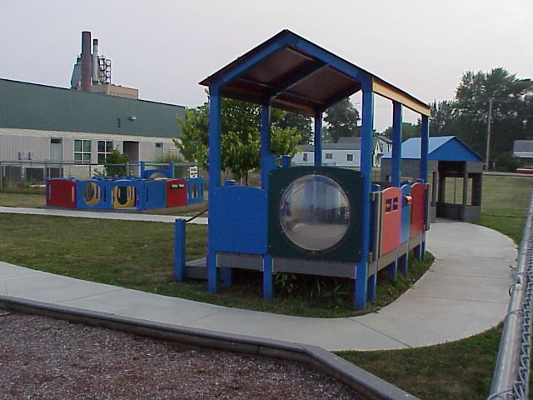
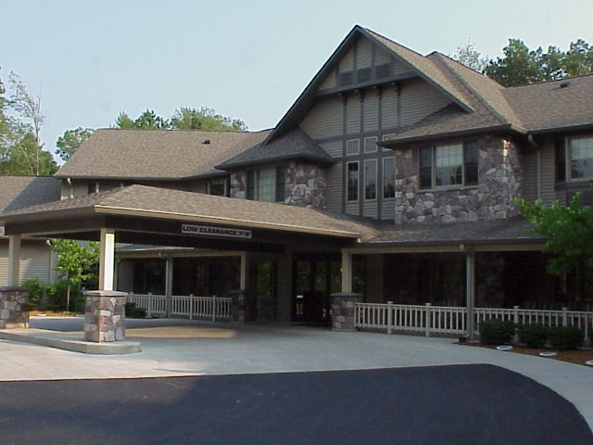
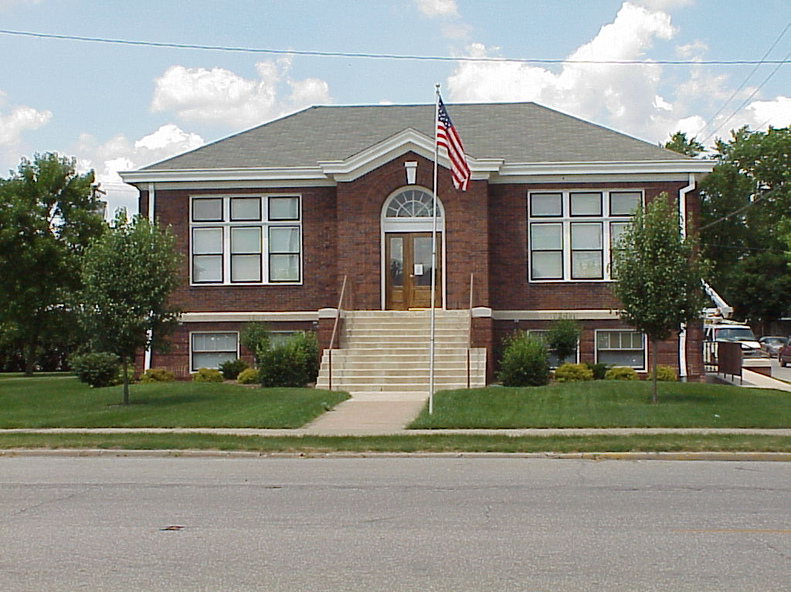
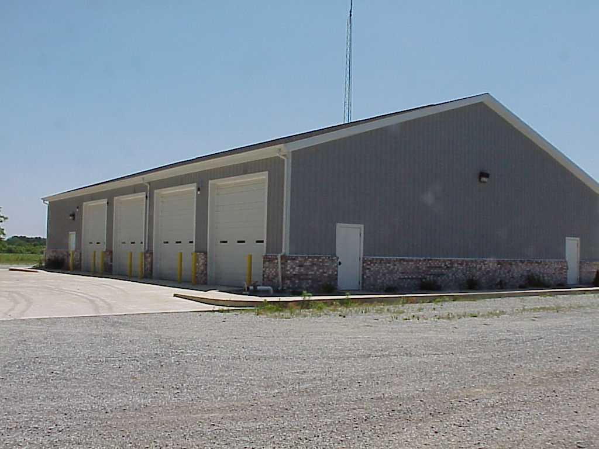

Slide 19
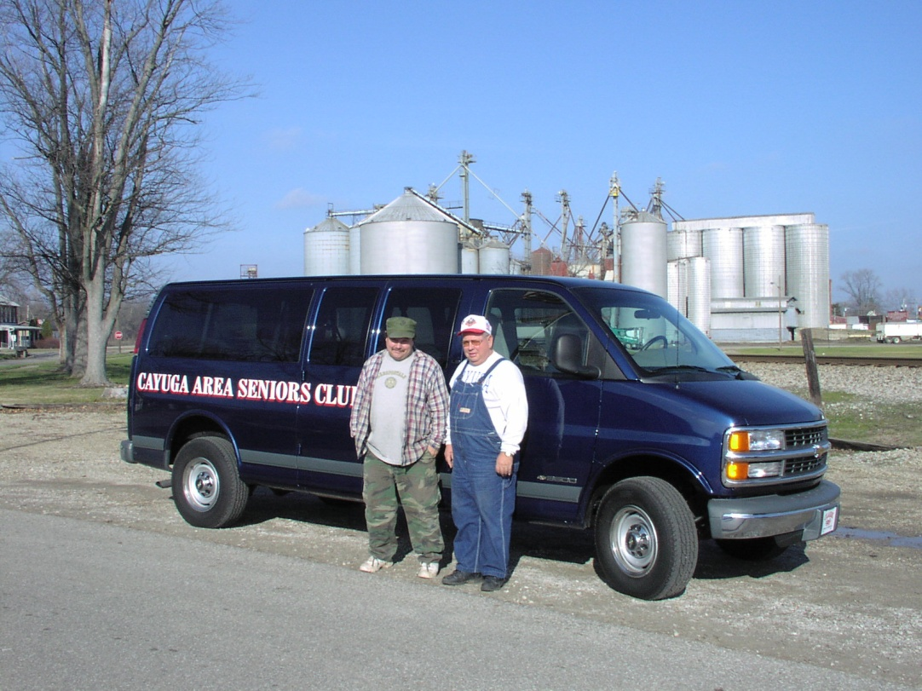
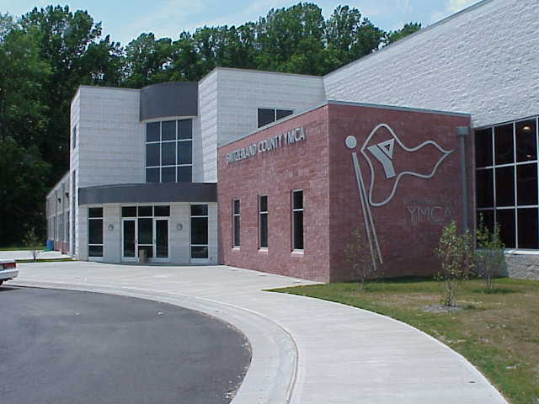
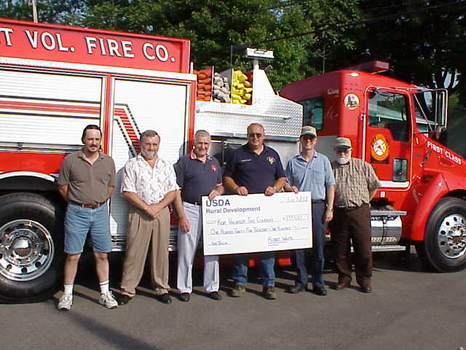

Slide 20
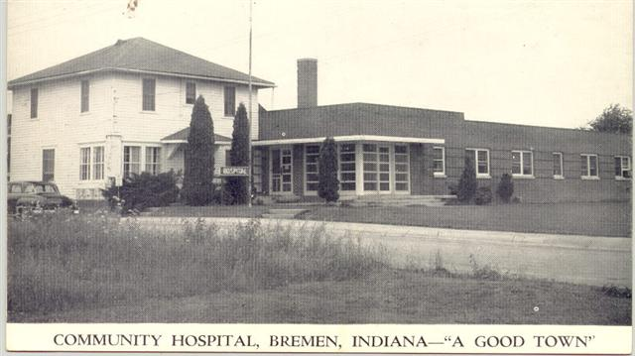
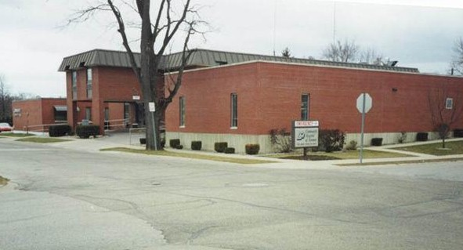
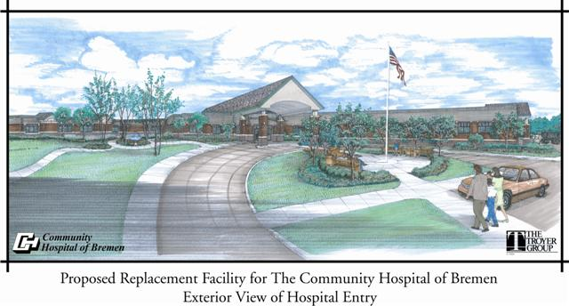

Slide 21
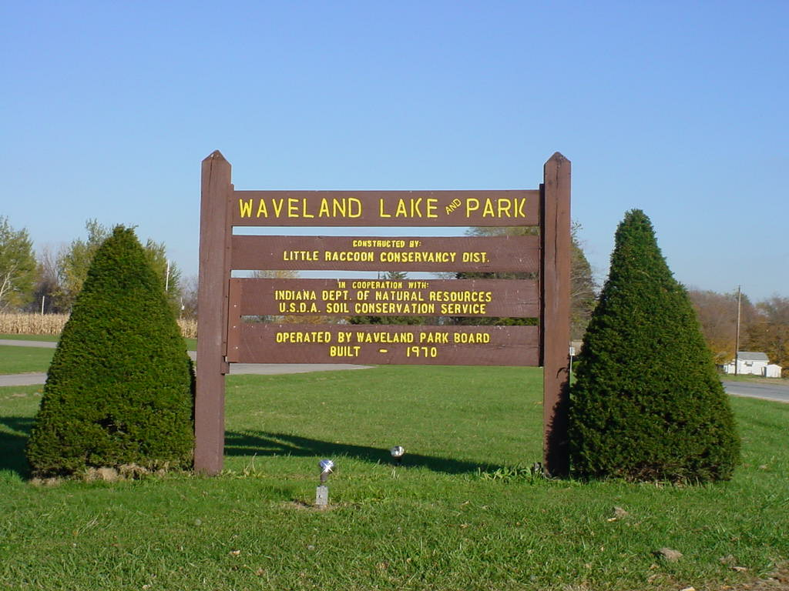
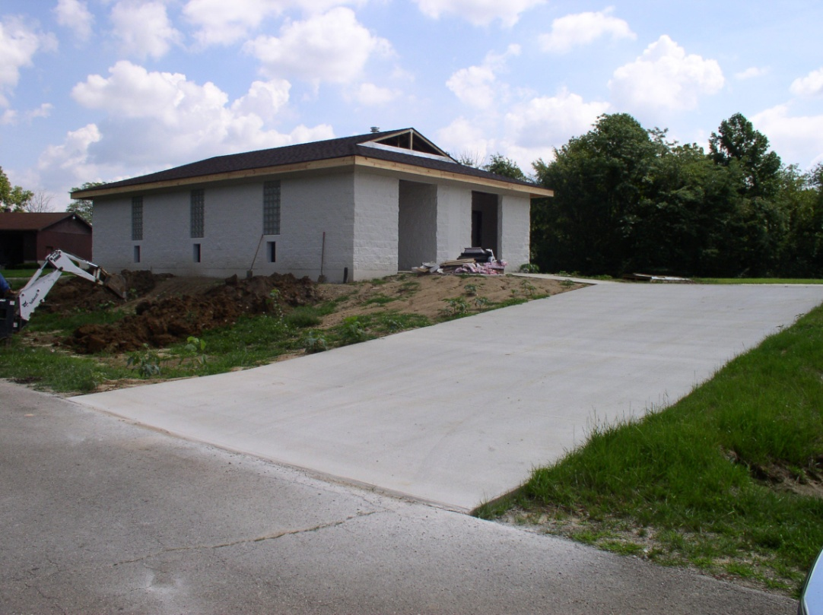
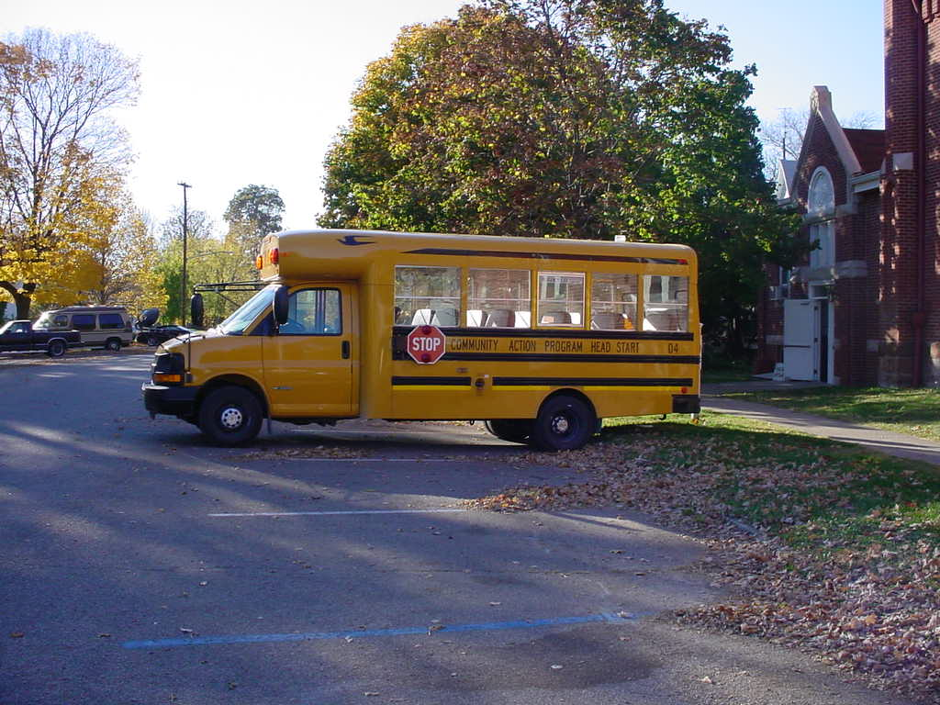
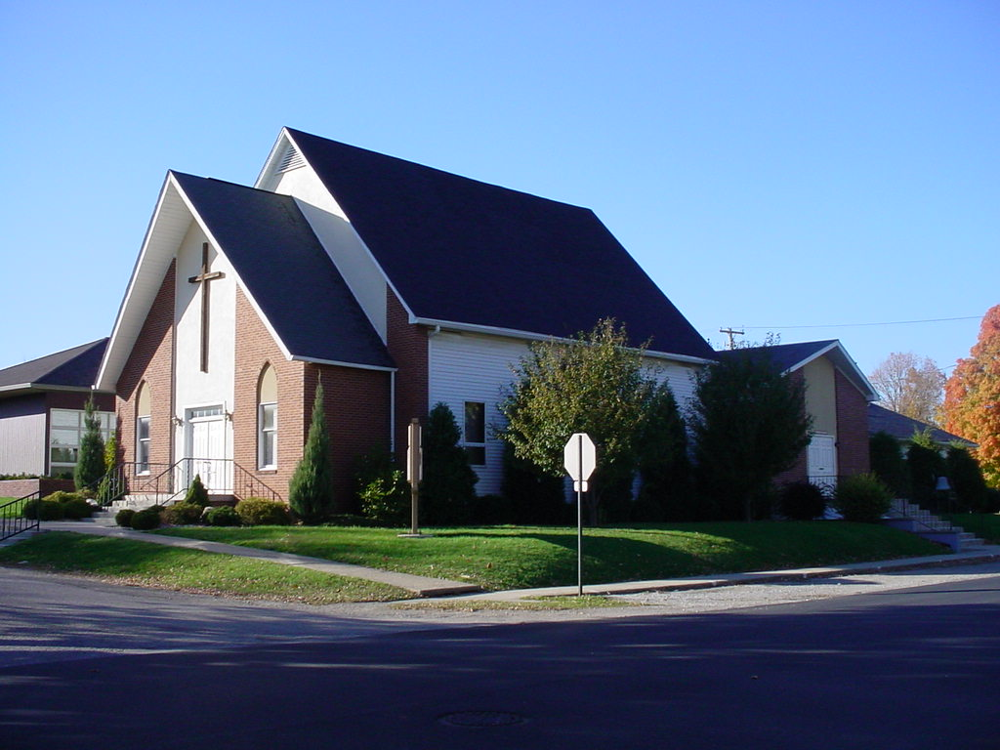

Slide 22
Water and Environmental Programs
Program Objective
Provide funding to public bodies, federally recognized Indiana tribes and non-profit organizations
Guaranteed Loans
Direct Loans
Grants – only in combination with
loans to lower user rates comparable
with similar systems

Slide 23
Water and Environmental Programs
Purpose
Construct, enlarge, extend or otherwise improve utility service in rural areas
Water
Wastewater
Solid waste
Storm water
Solid Waste Management Grants

Slide 24
Water and Environmental Programs
Eligible Areas
Areas with a population of 10,000 or less which include:
Cities
Towns
Unincorporated Areas
Counties
Regional sewer/water districts
Conservancy districts
and water authorities

Slide 25
Water and Environmental Programs
WEP Direct Loan
Rates
2.375 to 4.00 %
Terms
40 years maximum

Slide 26
Electric and Telecommunication Programs
Distance Learning and Telemedicine
Rural Broadband Access
Electric
Telecommunication
www.usda.gov/rus/

Slide 27
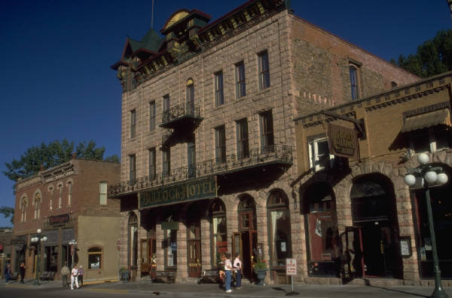
USDA Rural Development
Business Programs
F. Dean Edwards
Program Director
317-290-3100 Extension 427 dean.edwards@in.usda.gov

Slide 28
USDA Rural Development
Business Programs
Additionally, the program provides assistance to agricultural producers. This assistance aids in the development of alternative uses of agricultural products, including energy development, as well as research and support for agricultural cooperatives.
The creation and improvement of viable businesses and cooperatives in rural America is a top priority for USDA Rural Development.
The program works through partnerships with public and private community-based organizations and financial organizations to provide financial assistance, business planning, and technical assistance to rural businesses.

Slide 29
USDA Rural Development
Business Programs
Business & Industry (B&I) Guaranteed Loans
Rural Business Enterprise Grants (RBEG)
Rural Business Opportunity Grants (RBOG)
Rural Economic Development Loans/Grants (REDLG)
Rural Intermediary Relending Program (IRP)

Slide 30
USDA Rural Development
Business Programs
Business & Industry (B&I) Guaranteed Loans
Lender Makes Loan
Comes To Rural Development For Guarantee
Most Banks Are Eligible - State or Federal Chartered
Most Types Of Businesses Are Eligible

Slide 31
USDA Rural Development
Business Programs
Rural Business Enterprise Grants (RBEG)
Designed for non-profit organizations and public bodies
Grant funds used to set up Revolving Loan Funds (RLFs)
To purchase machinery and equipment
For technical assistance (i.e. feasibility studies and/or
market research)

Slide 32
USDA Rural Development
Business Programs
Rural Business Opportunity Grants (RBOG)
Designed for non-profits, public bodies or co-ops
To pay costs of providing rural economic planning
Technical assistance for rural businesses
Training for rural entrepreneurs or economic
development officials

Slide 33
USDA Rural Development
Business Programs
Rural Economic Development Loans/Grants (REDLG)
Grants to Current RUS Electric Borrower
Creates Revolving Loan Funds
Applicants compete Nationwide

Slide 34
USDA Rural Development
Business Programs
Rural Intermediary Relending Program (IRP)
Designed for non-profit organizations and public bodies
Maximum loan amount: $750,000
Terms: 1%, 30 years
Reloan to ultimate recipients (UR)
Intermediary establishes rates/terms to UR

Slide 35
Resources
Rural Development
Lafayette 765-474-9992 ext 4
Business and Industry - John Anthrop extension 116
Community Programs - John Magee extension 117
LaPorte 219-324-6303 extension 4
Community Programs - Steve Ballard extension 113
Plymouth 574-936-2024
Business and Industry - Melissa Christiansen Extension 111
USDA Rural Development http://www.rurdev.usda.gov/
USDA Faith-Based and Community Initiatives http://www.rurdev.usda.gov/rd/fbci/
White House Office of Faith-Based and Community Initiatives http://www.whitehouse.gov/government/fbci/

