Slide 1
What are Brownfields? and…. Do I have One????
Sabine E. Martin, Ph.D., P.G.
Center for Hazardous Substance Research
Kansas State University
April 2010

Slide 2
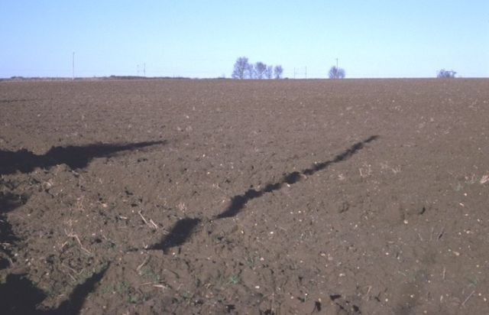

Slide 3
What is a Brownfield?
Real property of which the expansion, redevelopment, or reuse may be complicated by the presence or potential presence of a hazardous substance, pollutant, or contaminant. (Public Law 107-118 (H.R. 2869) - "Small Business Liability Relief and Brownfields Revitalization Act" signed into law January 11, 2002)

Slide 4
Brownfields in the U.S.
Estimated 450,000 to 1 Million sites
5 million acres of abandoned industrial sites in U.S. cities – roughly the same amount of land occupied by 60 of the largest U.S. cities
U.S. Department of Housing and Urban Development

Slide 5
Brownfield Examples
Abandoned gas stations
Abandoned grain elevators
Former manufacturing facilities
Abandoned properties next to rail lines
Former school buildings
Abandoned residential properties next to industrial facilities
Vacant residential lots

Slide 6
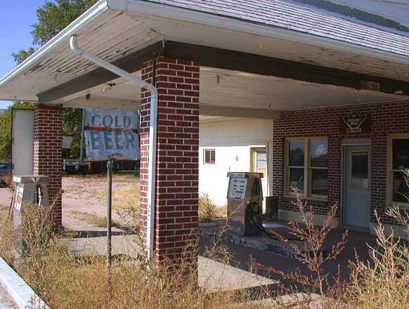
Typical Brownfield
Abandoned Service Station

Slide 7
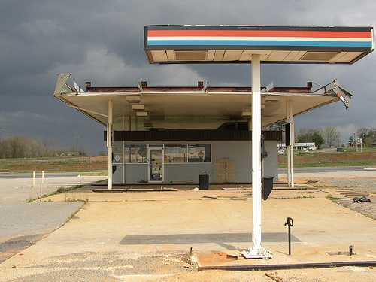
Typical Brownfield
Abandoned Service Station

Slide 8
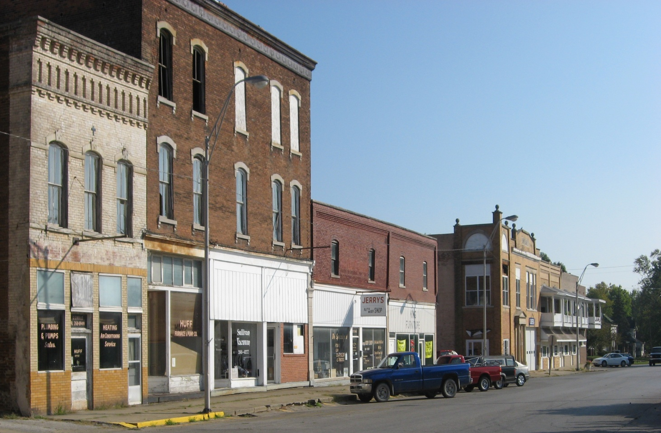
Brownfields on Main Street?

Slide 9
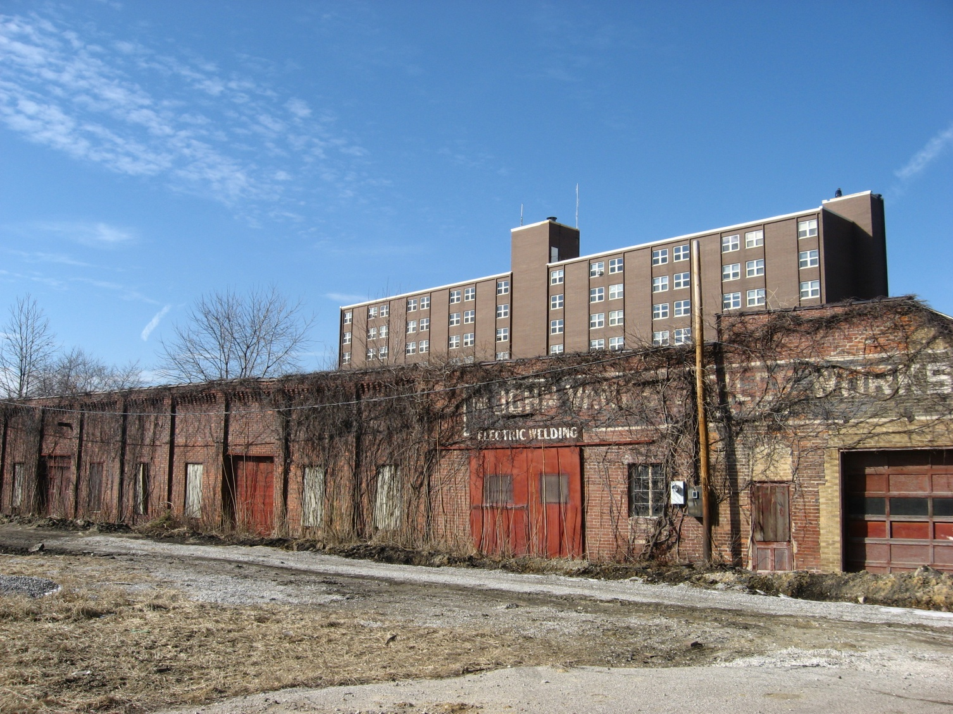
Brownfield?

Slide 10
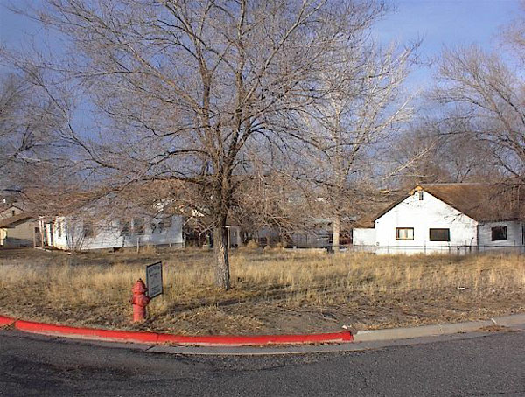
Brownfield?
Abandoned Residential Lot

Slide 11
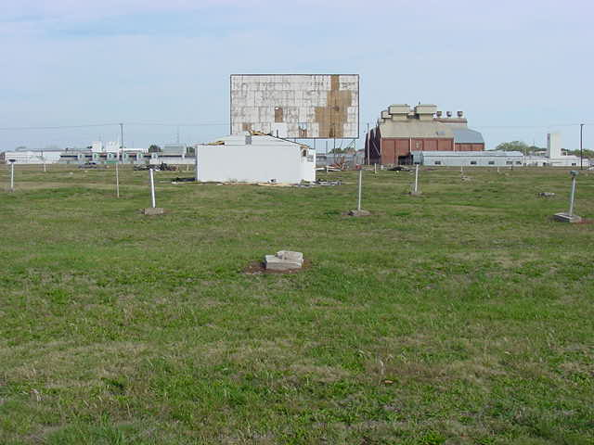
Typical Brownfield
Former Drive-In

Slide 12
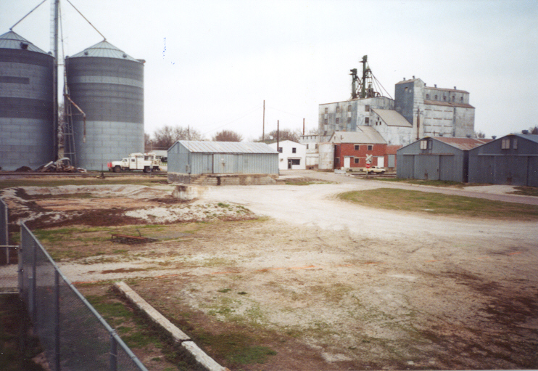
Typical Brownfield
Grain Storage Facilities/Coops found throughout rural areas

Slide 13
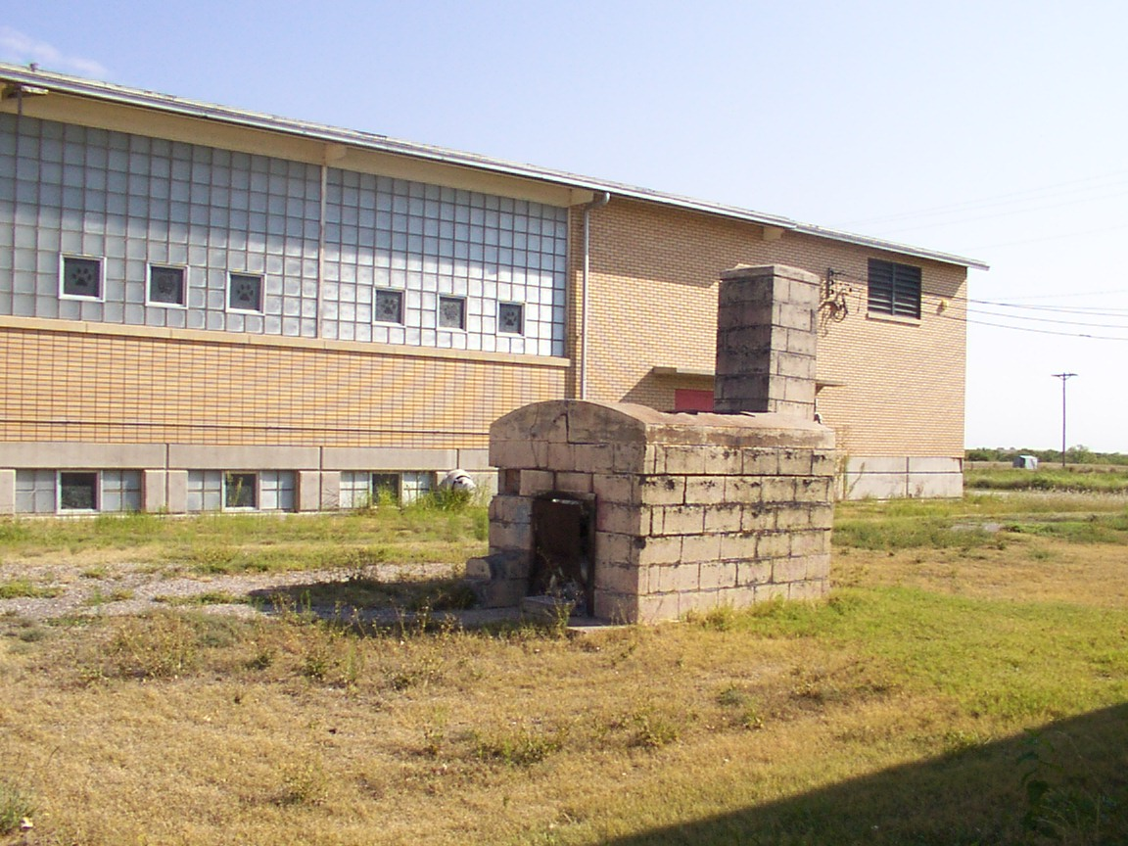
Brownfield?
Abandoned School Building

Slide 14
Why Redevelop Brownfields?
Desirable locations
Increases local tax base
Improves community image
Mitigates blight
Mitigates public health and safety concerns
Reduce the need to develop greenfields
Uses existing infrastructure (cost savings)

Slide 15
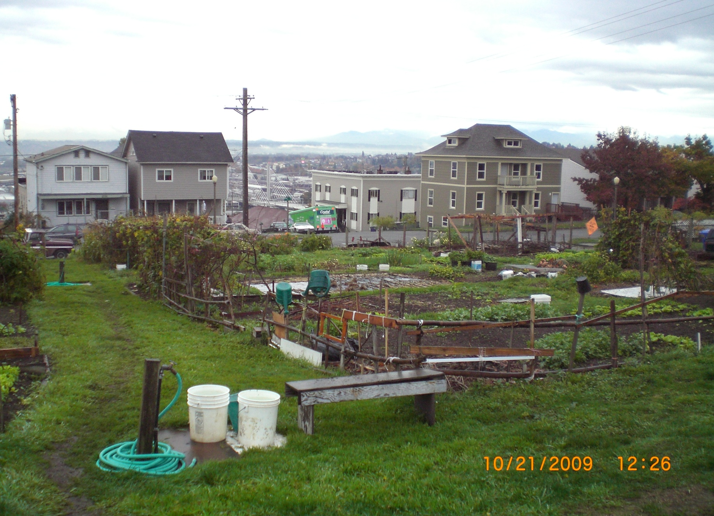

Slide 16
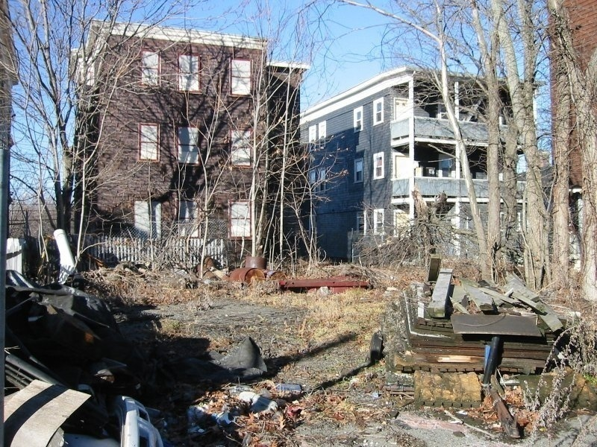

Slide 17
Often it is the PERCEPTION of contamination that keeps properties from being redeveloped, not the actual presence of contamination.
Once the “stigma” is gone, properties can be returned to productive use.

Slide 18
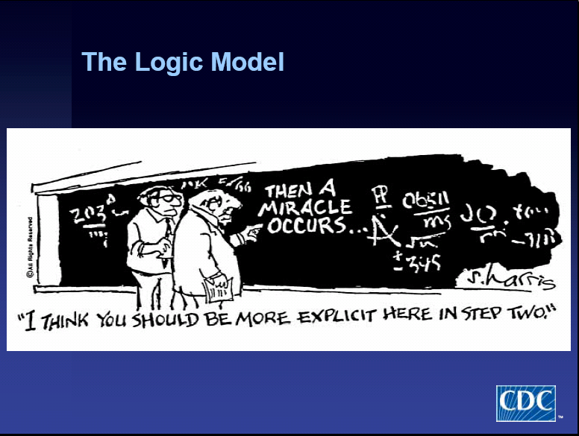

Slide 19
BF Process
Identify the Brownfield
Investigate – Phase I/II site assessments
Clean-up, if necessary
Redevelop

Slide 20


Slide 21


Slide 23
TAB Contacts
Dr. Sabine Martin (Program Coordinator)
1-800-798-7796
785-532-6519
smartin1@k-state.edu
Dr. Frank Beck
309-438-7090
fdbeck@ilstu.edu
Web site: http://www.engg.ksu.edu/chsr/outreach

