Slide 1
Indiana Brownfields Program
Financial and Legal Assistance
Community Resources for Brownfields Redevelopment
May 6 & 7, 2010 Workshops
Michele Oertel

Slide 2
Presentation Overview
What’s the bad news? – obstacles (I mean challenges)
What’s the good news? – incentives (for opportunities)
Who needs financial and legal assistance?
How can the Indiana Brownfields Program help?
What do you really need to remember?

Slide 3
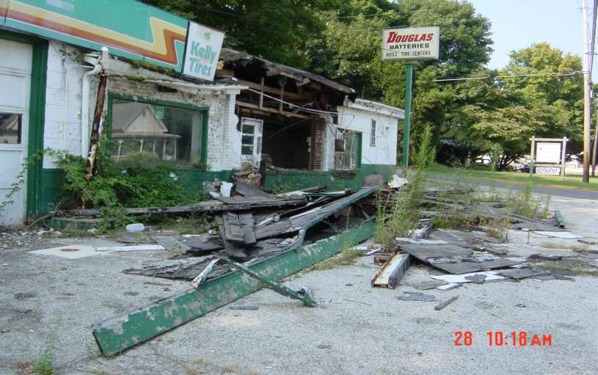
Help?! Is the glass half empty or half full?

Slide 4

Issues with Brownfields
Science
● Environmental contamination factor
● Private environmental consultant & IDEM opinions on
technical aspects
Law
● Liability fears
Real Estate
● Property reuse & transfers
● Brownfields vs. Greenfields
Politics
● Competing priorities of local governments
Socio-economics
● Tax base in blighted areas
● Jobs
Art
● Understanding & coordination of multi-disciplines
● Creativity

Slide 5
What are Obstacles to
Brownfield Redevelopment?
Real or potential environmental contamination
Assessment / Cleanup costs
Liability issues for the lender, prospective purchaser, and third parties
Socio-economic issues
Economic development climate
Viability of re-use plans for the site

Slide 6
More Potential Obstacles to
Redevelopment?
Unknowns – risks, ownership, access
Lack of awareness
Lack of planning
Lack of partnerships (among local gov’t,
developers, community groups, etc.)
Lack of community support

Slide 7
Who Can Help?
YOU…can help redevelop brownfields!
● Provide input for proposed brownfield redevelopment
projects.
● Promote brownfield sites when planning new parks;
recreation, youth, and senior citizen centers;
businesses; municipal buildings; and schools.
● Support businesses that have redeveloped
brownfields or plan to occupy brownfields.
● Identify potential partners to help you….

Slide 8
Stakeholders/Partners
Local Government – Public
State and Federal Government
Agencies – Public
Local/State Interest Groups - Private &
Public
Local Business Organizations - Private
& Public

Slide 9
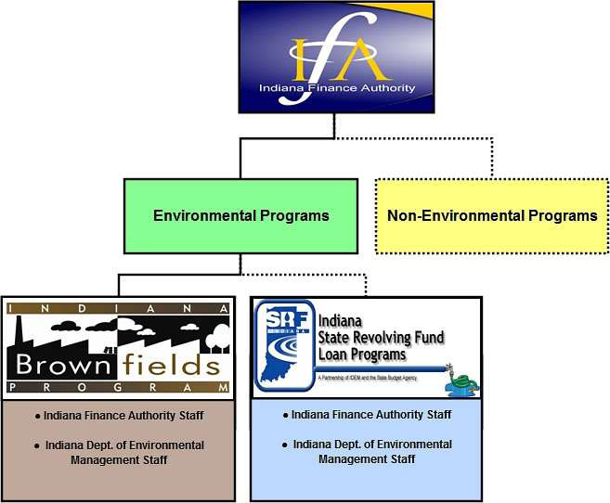
Indiana Brownfields Program
Lends a Hand
Helps communities by
providing:
  Educational Assistance
  Financial Assistance
  Legal Assistance
  Technical Assistance
Serves as a liaison with U.S.
EPA for financial assistance
Coordinates with IDEM’s
Voluntary Remediation
Program
  Certificates of Completion
  Covenants Not to Sue
Coordinates with other related
IDEM programs

Slide 10
When to Call for $…
Indiana Brownfields Program - loan funding
throughout the year
  Stipulated Assessment & Remediation Grants - suspended
  Federal Matching Grants - suspended
  Supplemental Environmental Projects
  Low-interest Loans - suspended
  Revolving Loan Fund (RLF) Incentive (federally funded)
  Trails and Parks Initiative (federally funded) – petroleum
  Auto Sector Initiative
  State Revolving Loan Fund coordination

Slide 11
When to Call for legal help…
Indiana Brownfields Program – letters
throughout the year
  Environmental liability interpretation
letters, including BFPP language –
- Comfort Letters
- Site Status Letters
  Oversight

Slide 12
Liability Interpretation Letters
Comfort Letter:
  Issued to a party that qualifies for an applicable
exemption to liability found in Indiana law or IDEM policy, but is not a legal release from liability
  Explains the applicable liability exemption or
IDEM’s exercise of enforcement discretion under
an applicable IDEM policy

Slide 13
Liability Interpretation Letters
Site Status Letter:
  Issued to a party that can demonstrate that current levels
of contaminants of concern substantially meet current
cleanup criteria as established by IDEM under the Risk
Integrated System of Closure
  Does not address the potential liability of the party
requesting the letter
  States that based on a technical analysis of information
submitted to IDEM pertaining to site conditions, IDEM
concludes that current site conditions do not present a
threat to human health or the environment and that IDEM
does not plan to take or require a response action at the
brownfield site

Slide 14
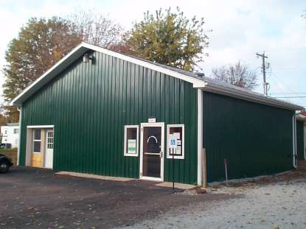
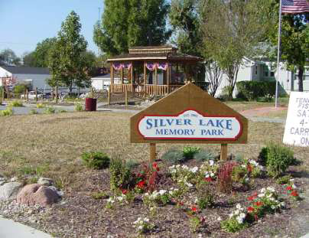
Teamwork leads to Success!

Slide 15
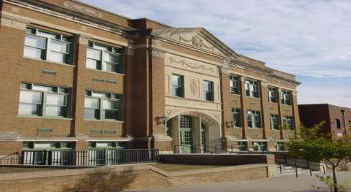
Teamwork leads to Success!

Slide 16
Important Points to Remember
Brownfields are not just challenges – they’re opportunities!
Brownfield redevelopment balances economic development with
environmental protection.
Brownfield projects are driven by local champions.
Success breeds success – talk to other stakeholders – don’t reinvent the wheel.
3 Ps: planning (long-term), public participation, and partnerships are keys to
success!!
Brownfield projects may warrant state and/or federal assistance.
Indiana Brownfields Program offers tools to address environmental issues to facilitate brownfield redevelopment.

Slide 17
Contact Information
Jim McGoff, Director of Env. Programs, IFA (317) 234-2916
jmcgoff@ifa.in.gov
Meredith Gramelspacher, Asst. Dir. & General Counsel (317) 233-1430
mgramels@ifa.in.gov
Sue Overstreet, Administrative Assistant, General Questions (317) 234-4293
soverstreet@ifa.in.gov
Michele Oertel, Federal Funding & Community Relations (317) 234-0235
moertel@ifa.in.gov
Sara Westrick Corbin, Financial Incentives (317) 234-1688
swestrick@ifa.in.gov
Kevin Davis, Technical Matters (317) 233-2415
kdavis@ifa.in.gov
Check out the Indiana Brownfields Program web site at
www.brownfields.in.gov
Environmental Stewardship. Economic Development.

